Slide 1
Cerebrovascular Diseases 1

Slide 2
Pathophysiological Facts :
For maintained normal brain function :
  Continuous blood flow-15% of cardiac output
  High oxygen requirement- 20% of total body O2 consumption
  Maintenance of glucose
↓ BP ≤ 50 mm.Hg is critical →
Hypoxia & ischemia
↑BP ≥ 200 mmHg critical! →
↑risk of Hemorrhage

Slide 3
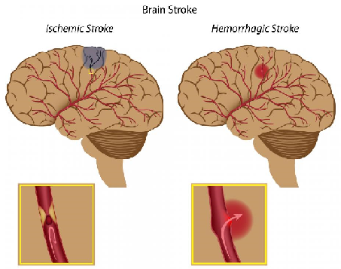
STROKE :
The clinical term of acute neurological dysfunction occurring as a result of hemorrhagic or obstructive vascular lesions, causing irreversible damage or death .

Slide 4
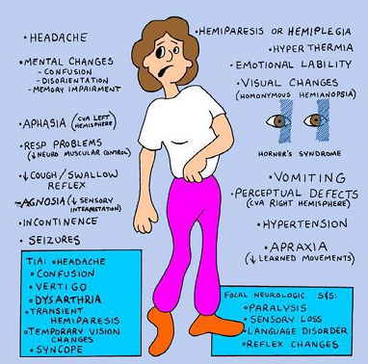

Slide 5
Types of Cerebrovascular Disease :
A- Impairment of blood supply & oxygenation
of CNS tissue :
  Global Cerebral Ischemia due to generalized ↓ cerebral blood flow
  Localized vascular obstruction due to thrombosis or embolism (Infarction)

Slide 6
B- Rupture of CNS blood vessel :
  Intracerebral hemorrhage
  Subarachnoid hemorrhage
  Subdural hemorrhage
  Epidural hemorrhage

Slide 7
GLOBAL Cerebral Ischemia
Hypotenstion, Hypoperfusion, and low flow states

Slide 8
Definition :
Generalized reduction of cerebral perfusion
Symptoms vary from transient mild confusion to irreversible damage

Slide 9
Causes include :
  Sever Hypotension
  Cardiac arrest
  Shock

Slide 10
Features of global ischemia :
Cells: neurons > glia, but all if severe and prolonged
Selective Vulnerability of neurons in certain locations :
  Pyramidal cells of hippocampus
  Purkinje cells of the cerebellum
  Cortical pyramidal neurons

Slide 11
MORPHOLOGY :
  Brain swelling
  Wide gyri and narrow sulci
  Poor demarcation between grey & white matter

Slide 12
Microscopic changes :
- Acute : 12-24 hrs
- RED NEURONS
- Infiltration by neutrophils
- Subacute changes: 24 hrs – 2 weeks
- tissue necrosis, influx of macrophages, vascular proliferation & gliosis
- Repair: after 2 weeks
- Removal of necrotic tissue
- Gliosis

Slide 13
Watershed (Borderzone ) infarcts (Regions of brain at the most distal reaches of arterial blood supply, border zones between arterial territories)
include :
- Boundary between anterior & middle cerebral arteries (Cerebral Convexities)

Slide 14
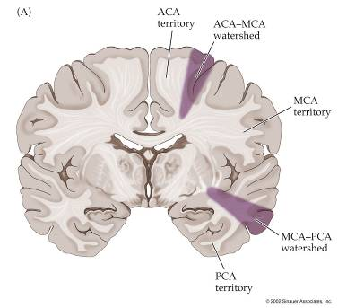
Watershed Vascular Territories

Slide 15
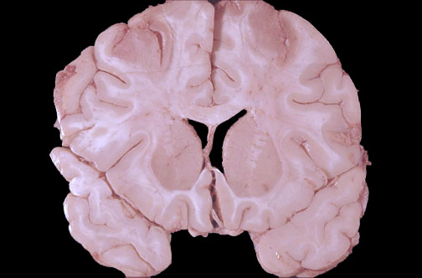
Watershed Infarcts

Slide 16
Outcome :
Depends on:
  Duration of ischemia
  Magnitude and rapidity of reduction of flow
Result varies from persistent neurological deficit to brain death.

Slide 17
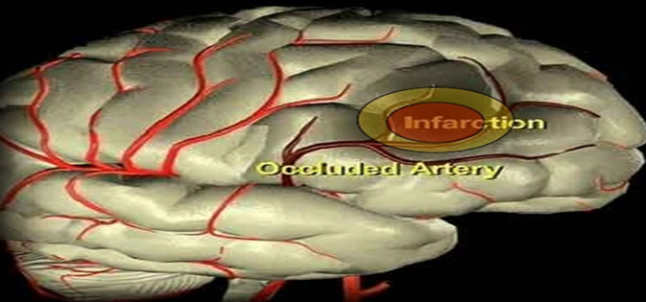
Focal Cerebral Ischemia
Focal brain ………… necrosis due to complete and prolonged ischemia
Notes:
17

Slide 18
Mechanisms leading to infarction :
Embolic occlusion : hemorrhagic/ red
- Source: heart or atherosclerosis in carotid
- Middle Cerebral artery most affected
Thrombotic occlusion, mainly due to Atherosclerosis : Ischemic/ pale
Carotid bifurcation
Origin of middle cerebral artery
Basilar artery at either end

Slide 19
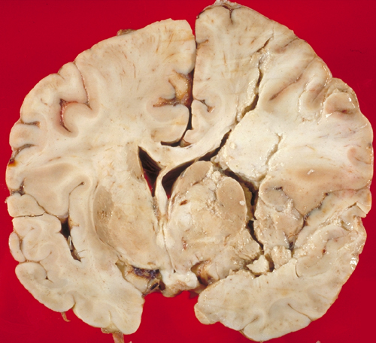
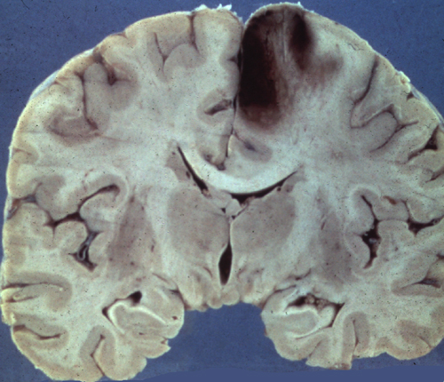
Types of infarction
Acute white infarct in the distribution of the
right middle cerebral artery.
Acute red infarct in the distribution of the
right anterior cerebral artery.
Notes:
19

Slide 20
Macroscopic appearance :
- No gross change before 48 hrs
- Soft swollen pale or hemorrhagic WEDGE SHAPED infarct involving grey & white matter.
Red infarcts: surrounding hemorrhage due to reperfusion of damaged vessels and tissue
After 10 days-3 weeks : liquefaction
- Cavity within 1- 6 months

Slide 21
Microscopic appearance :
  Very similar to global ischemia but more regional.

Slide 22
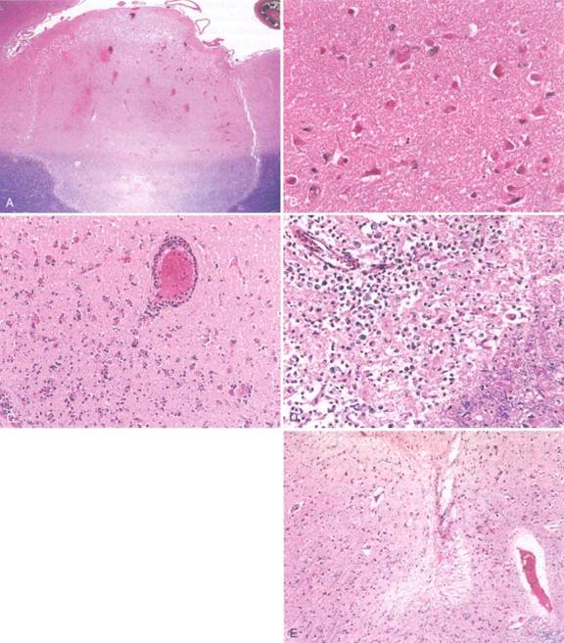
EDEMA
“RED” NEURONS
NEUTROPHILS
MACROPHAGES
GLIOSIS
Histopathologic progression of CNS infarcts
Notes:
22

Slide 23
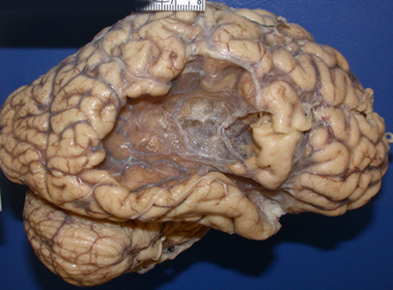
Old infarction

Slide 24
REMEMBER THE GENERAL RULES FOR DATING INFARCTS :
RED Neurons 12-18 hours
Neutrophils 24-48 hours
Macrophages peak at 48 hours – 3 weeks, may persist for months to years
Reactive astrocytes can be seen at week 1 & remain for several months

Slide 25
Clinical picture : linked to site of infarction
  - Contralateral hemiparesis
  - Loss of sensation
  - Visual field abnormalities
  - Aphasia …… etc

Slide 26


Slide 27
INTRACRANIAL HEMORRHAGE
According to location, divided into :
  Intracerebral (intraparenchymal)
  Subarachnoid
  Epidural
  Subdural

Slide 28
I- Primary Intracerebral Hemorrhage:
Causes :
Commonest cause is hypertension (50%)
- Mostly due to rupture of small intraparenchymal vessel.
15% of death in hypertensive patients.
Other causes :
Cerebral Amyloid angiopathy
Vasculitis
Coagulation disorders
Neoplasms

Slide 29
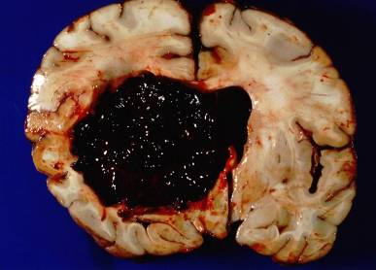
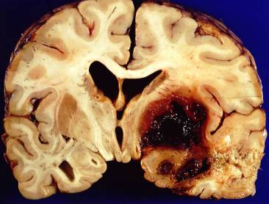
Intracerebral hemorrhage in HT
- Putamen (60%), thalamus, pons, cerebellar hemispheres and others.
- Acute: Extravasation of blood with compression of adjacent parenchyma
- Old: Cavitary destruction of brain with a rim of brown discoloration.

Slide 30
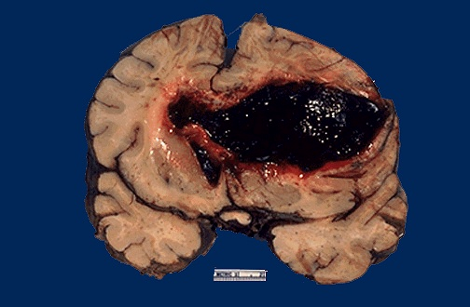
Intracerebral hemorrhage into lateral ventricle

Slide 31
Other Vascular lesions in hypertension include :
Atherosclerosis in larger arteries
Hyaline arteriolosclerosis in smaller vessels →hemorrhage
Arteriolosclerosis in vessels ≤ 150 µm → lacunar
infarcts
Charcot Bouchard Microaneurysms
Microaneurysms in vessels ≤ 300 µm in
basal ganglia → rupture

Slide 32
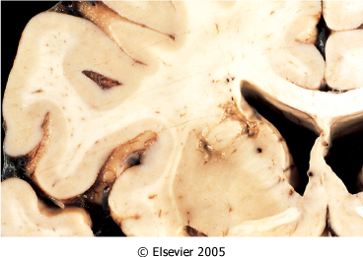
Lacunar Infarcts :
-Tiny cystic infarcts in hemispheric white matter, basal ganglia & brainstem due to hypertensive arteriolosclerosis of deep pentrating artries and arterioles.
- Multiple small cavitary infarcts (Lake-like spaces, less than 15 mm wide).
- Asymptomatic or severe neurologic impairment

Slide 33
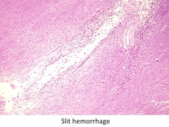
Slit Hemorrhages :
- Rupture of smaller penetrating vessels
- Resorb, leaving behind a slit-like cavity

Slide 34
Acute Hypertensive Encephalopathy :
- Diffuse cerebral dysfunction:
  Headaches, Confusion, Vomiting, and Convulsions
  Coma
Notes:
34

Slide 35
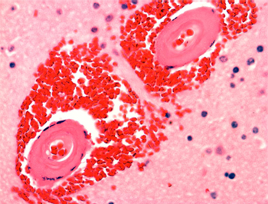
2- Cerebral Amyloid Angiopathy :
- Amyloid (Aβ40) is deposited in wall of medium & small meningeal & cortical vessels → Weak wall → hemorrhage.

Slide 36


Slide 37


