Slide 1
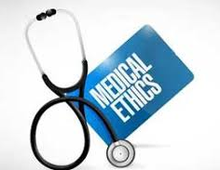
Medical Ethics
INTRODUCTION &
ETHICAL THEORIES
Lec#1
Dr. Reema Karasneh

Slide 2
What is Medical Ethics?
Medical ethics are the guidelines and behaviours that we expect a medical professional with moral integrity to exhibit
It is a practical discipline that provides a structured approach to assist physicians in identifying, analysing and resolving ethical issues in clinical medicine.
The practice of good clinical medicine requires some working knowledge about ethical issues
Examples:
Informed consent
Truth telling
Confidentiality
End-of-life care
Pain relief
Patient rights

Slide 3
Development of medical ethics
Medical ethics are not static, they have changed over the years and will continue to evolve as medicine advances.
Ethical principles were developed by physicians and scholars from all walks of life. They have crafted guidelines to aid providers in their quest to help patients.
Hippocratic oath
Muhammad ibn Zakariya ar-Razi
Thomas Aquinas

Slide 4
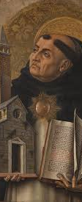
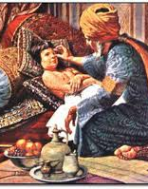

Slide 5
Development of medical ethics
The development of ethical principles is traceable to three different but interrelated events:
A set of unpleasant events (“scandals”) in the history of biomedical research
Advancement in medical technology
The civil rights movement

Slide 6
Moral principles
Specify that some type of action or conduct is either prohibited, required or permitted in certain circumstances

Slide 7
The place of principles in bioethics
Ethical choices, both minor and major, confront us everyday in the provision of health care for persons with diverse values living in a pluralistic and multicultural society.
In the face of such diversity, where can we find moral action guides when there is confusion or conflict about what ought to be done?

Slide 8
Such guidelines would need to be broadly acceptable
among the religious and the nonreligious persons
persons across many different cultures
Due to the many variables that exist in the context of clinical cases as well as the fact that in health care there are several ethical principles that seem to be applicable in many situations
These principles are not considered absolutes
These principles serve as powerful action guides in clinical medicine.

Slide 9
In both clinical medicine and in scientific research it is generally held that these principles can be applied, even in unique circumstances, to provide guidance in discovering our moral duties within that situation.

Slide 10
Why we need ethical theories?
Provide a consistent logical system of thought that can produce practical guidelines
Provide a philosophical approach for making ethical decisions
Provide a value judgement on what a person should do

Slide 11
Ethical Theories
Categories of ethical theory include:
Utilitarianism
Obligation-Based Kants (deontology)
Virtue-Based (Character Ethics)
Principlism
Rights-Based (Liberal Individualism)
Community-Based
Relationship-Based (Ethics of Care)
Case-Based (Casuistry or Reasoning)

Slide 12
Utilitarian Ethics
“Using the available means, act in such a way as to do as much good as possible”
The oldest and most straightforward ethical principle.
States that the best action is the one that maximizes utility (happiness)
the rightness of the act is measured by the consequences
The principle is that a person (physician) aught to act to produce the greatest balance of benefits over harms (the greatest good for the greatest number)
The principle of beneficence

Slide 13
Principles of utilitarian ethics are useful:
In catastrophic situations
When we have to save as many lives as possible in the shortest amount of time with very limited means
War
Earthquakes
Major accidents
In the field of public health and preventive medicine
Offers appropriate advice to activities in the field
Their goals are of statistical nature and not directed towards an identifiable individual.
When choosing among different activities, those with the greatest benefit for the available resources will be chosen.

Slide 14
Focus on Consequences
Advantages
Practical
Challenges
Difficult to evaluate all consequences
Already underlies business thinking
E.g.: Terminally ill and the legalization of euthanasia to reduce the burdens for both the patients’ families and the medical system
Rights of minorities can be sacrificed

Slide 15
Obligation-Based (deontology) Kantian ethics
“An act can be deemed ethical only insofar as it complies with an ethical accord or an a priori agreed-upon ethical norm”
It judges the morality of an action based on rules
E.g. “Do not lie!” is an ethical norm
then lying can never be ethical even if by lying one could prevent severe negative consequences
There are no legitimate exceptions to a perfect duty
Moral rules are absolute
excluded emotions and interpersonal relations from entering ethical reflections

Slide 16
Stands on that the rightness of actions depends on the nature of the act, not on consequences
It considers whether an act is either right or wrong
It leads us to appreciate the individual, one’s free will, and rational responsibility for one’s decisions—the most important is, therefore, the ethical principle of the respect for autonomy.

Slide 17
Focus on deontological theory
Advantages
Rights approach found in public policy debates
Challenges
Determining rule, principle, or right to follow
Golden rule
Deciding which takes precedence
Reconciling deontological and consequentialist approaches when they conflict

Slide 18
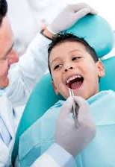
Deontology & Utilitarianism
Example
You are taking a child to the dentist for some work that you know will hurt. On the way to the dentist he/she look up into your eyes and asks will this hurt…?
Do you say YES or NO and why?

Slide 19
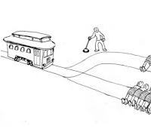
Deontology & Utilitarianism
Train/Trolley example
A runaway train is hurtling down the tracks toward 5 people who will be killed if it proceeds on its present course. You can save these 5 by diverting the trolley onto a different set of tracks, one that has only 1 person on it, but if you do this that person will be killed.

Slide 20
Virtue-Based (Character Ethics)
A right act is the action a virtuous person would do in the same circumstances.
Virtue ethics is person rather than action based
It looks at the virtue or moral character of the person carrying out an action, rather than at ethical duties and rules, or the consequences of particular actions.
Its foundation is the ethical characteristics of a person.

Slide 21
Certain personal characteristics are recognized as virtues and others as vices
Ethical person
Honesty
Vicious person
Deception
Generosity
Compassion
Courage
Justice
Fidelity
Veracity
Selfishness
Cruelty
Infidelity
Disingenuousness

Slide 22
Focus on Integrity (Virtue Ethics)
Advantages
Can rely upon community standards
Challenges
Limited agreement about community standards
Many communities haven’t done this kind of thinking
Community may be wrong

Slide 23
Example: Lying
A consequentialist may argue that lying is wrong because of the negative consequences produced by lying—though a consequentialist may allow that certain foreseeable consequences might make some lying ("white lies") acceptable.
A deontologist might argue that lying is always wrong, regardless of any potential "good" that might come from lying or if by lying one could prevent severe negative consequences.
A virtue ethicist, however, would focus less on lying in any particular instance and instead consider what a decision to tell a lie or not tell a lie said about one's character and moral behaviour. As such, the morality of lying would be determined on a case-by-case basis

Slide 25
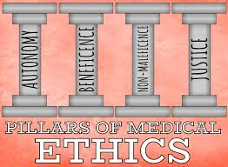
PRINCIPLES OF MEDICAL ETHICS
Autonomy
Beneficence
Non-Maleficence
Justice

Slide 26
Major principles of medical ethics
Four commonly accepted principles of health care ethics, excerpted from Beauchamp and Childress (2008), include the:
Principle of respect for autonomy
Principle of nonmaleficence (to “do no harm)
Principle of beneficence (action that is done for the benefit of others)
Principle of justice
They form the core of modern bioethics discussion
They are now used in modern bioethical decision-making and debate
They form the basis for most decision making in both the research setting and in clinical practice

