Slide 1
CNS-1 MODULE
Bacterial Meningitis
(TWO LECTURES “I and II”)
By
Prof. Dr. Zainalabideen A Abdulla,
MRCPI, DTM&H., Ph.D., FRCPath. (U.K.)

Slide 2
Learning objectives
To describe the morphology, cultural characteristics, pathogenesis, laboratory diagnosis, treatment and prevention of meningitis caused by:
1. Neisseria meningitidis
2. Group-B Streptococci
3. S. pneumoniae
4. Hemophilus influenzae
5. Listeria monocytogenes

Slide 3
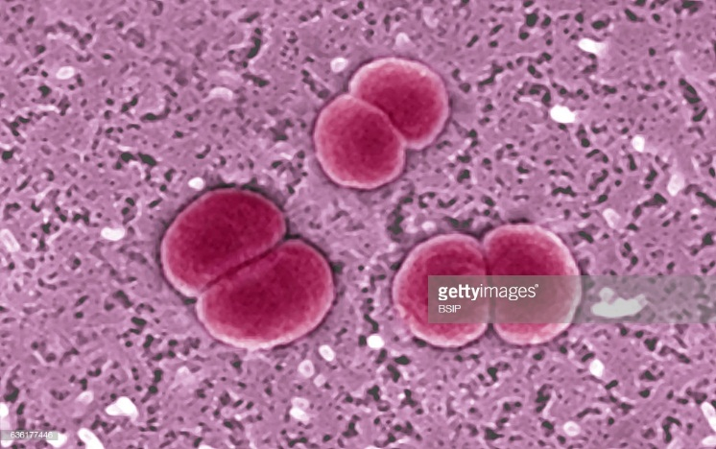
Neisseria meningitidis (Meningococcus)
• Gram negative diplococcic (pairs) with the
opposing sides flattened and
showing a “Kidney-bean”
appearance longitudinally.
• Non-motile, non-spore-forming, non-acid fast
• Has a polysaccharide capsule (for serotyping)
13 serogroups; important A, B, C, W-135 & Y
• Growth: Aerobic + CO2 + enriched medium
• Has pili, outer membrane proteins (OMP),
and lipooligosaccharides (LOS)- See below

Slide 6
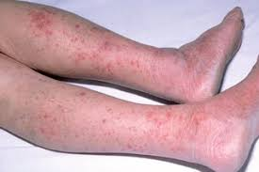
Epidemiology
• Nasopharyngeal carrier rate 10%
• Spread is by respiratory droplets (person -to-
person)
• Group A can cause wide-spread epidemics in
tropical areas.
• One of the feared diseases

Slide 7
Pathogenesis
• Carrier state: With protective antibodies
• Bacteremia, endotoxemia and meningitis
• Pili & OMP attach to non-ciliated nasopharyngeal cells
as microcolonies to microvilli enter cells
as vesicles submucosa bloodstream
• Scavenge iron from transferrin, and resist
phagocytosis and complement by capsule
• LOS + sialic acid interferes with C3 deposition
• LOS & peptidoglycan trigger cytokine release
• Outer membrane blebs (LOS) contain endotoxin

Slide 10
Immunity
• Group specific anticapsular antibody: Protective
• Absence of antibodies = Susceptibility
• Carrier state & infection Antibody production
• Deficiencies of terminal complements: Risk
• Most common age of infection: 6 - 24 months
• Capsular polysaccharide IgG2 response
(relatively deficient in early childhood)
- T-independent response to capsular PS: Poor
• Group B polysaccharide is NOT immunogenic

Slide 12
Clinical Aspects
• Acute purulent Meningitis
• Scattered skin petechiae Ecchymosis
or diffuse petechial rash (sign of DIC and
endotoxic shock/meningococcemia)
Diagnosis
• Gram smear staining: CSF (diagnostic)
• Culture (blood/chocolate agars): CSF, blood,
skin lesion samples
• Speciation: Biochemical, Immunological tests

Slide 14
Treatment
1. Penicillin
If resistant:
2. Cephalosporin /Third generation, e.g.,
Ceftriaxone, Cefotaxime

Slide 15
Prevention
• Rifampin or Ciprofloxacin (NOT penicillin):
prophylaxis for close contacts with a case
• Meningococcal Conjugate Quadravalent
(MCV4):
- A, C, Y, W-135
- Stimulate T cell-dependent response
- Conjugation: Diphtheria Toxoid
- Given from 9 months; 11-16 years
• Group B: Non-immunogenic due to similarity to sialic acid of m.o. to neural cell adhesion mol.

Slide 16
Group B Streptococci (Streptococcus agalactiae); GBS
• Gram positive cocci (short chains/diplococcic)
• Beta-hemolytic on blood agar (Beta-hemolysin)
• Capsular polysaccharides: 10 antigenic types
with sialic acid (type III is most common).
• Pili, and surface protein
• Leading cause of meningitis and sepsis in the
first days of life & late in 1-3 months (mainly
meningitis)
• Found lower GIT & vagina in 10-40% women

Slide 17
Pyrrolidonyl arylamidase (PYR): Red color at the end of the test (+ve)

Slide 19
Pathogenesis/Immunity
• Capsule sialic acid binds factor H, so
C3b deposition on bacteria disrupted
• Trans-placental specific IgG: Protective
• Type-specific anti-capsular Ab: Protective
Diagnosis
• CSF: Gram smear staining
• Culture
• Serotyping (Lancefield grouping)

Slide 20
Treatment
• Penicillin
- No beta-lactamase production
• In early stages (before culture result) an
aminoglycoside is added.
Prevention
• Carrier mother during 35-37 wk pregnancy:
- IV penicillin intra-partum (during labor)
- Vaccine is feasible during pregnancy
(third trimester)

Slide 21
Haemophilus influenzae
• Tiny gram negative coccobacilli
• Require both Hematin (factor X) and NAD
“Nicotinamide-Adenine-Dinucleotide” (factor V)
• Staphylococcus aureus provides NAD
Satellite phenomenon (nearby colonies larger)
• Six serotypes a-f based on capsular poly-
saccharide
• H. influenza type b (Hib) capsule contains
Polyribose-Ribitol- Phosphate (PRP)
• Outer membrane: Proteins (HMW1& 2), LPS, LOS

Slide 22
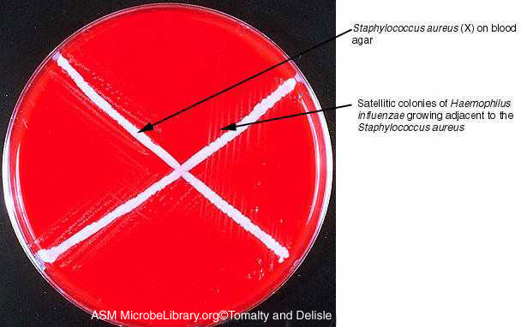

Slide 25
Pathogenesis
• Nasopharyngeal colonization is common
(20% to 80% ; mostly non-capsulated “NTHi”
= nontypeable Haemophilus influenzae)
• Only capsulated m.o. are invasive
• Meningitis: Children < 2 years
• Pili/ adhesins attach to epithelial cells
• Invasion goes between cells
• Capsule prevents phagocytosis

Slide 26
Pathogenesis

Slide 27
Immunity
• Anti-capsular Ab: Bactericidal & Protective
• Hib infections occur at ages (6-18 months)
when antibody is absent
•T-cell- independent response to PRP is poor
at < 18 months of age.
• Conjugation of PRP antigens to protein elicits
T-cell response in infants.

Slide 28
Meningitis
• Hib causes acute purulent bacterial meningitis
• Preceded by URT infection (pharyngitis, otitis
media, or sinusitis)
• Started as vague malaise, lethargy, irritability
and fever
• Mortality 3% to 6% in despite of treatment
• 1/3 of survival: Significant neurologic sequelae

Slide 30
Diagnosis
• Gram staining: CSF
• Culture
• Rapid diagnostic kits for Hib
Treatment
1. Third generation cephalosporin (empirically)
If susceptibility test is available change to:
2. Ampicillin
- 5% to 50% of strains are resistant due to
production of beta-lactamases.

Slide 31
Prevention
• Conjugated Hib vaccine
- Conjugation to Diphtherial Toxoid or
outer membrane protein of N. meningitidis
- Given from 2 months of age
- 99% reduction in incidence
- Reduction in colonization rate
- Stimulate T cell-dependent response
• Rifampin prophylaxis: Unimmunized close
contacts

Slide 32
Streptococcus pneumoniae
• Gram positive, oval, diplococcic (end to end)
• Colonies alpha-hemolytic aerobically
• Capsule has > 90 serotypes
• By Choline-binding proteins attaches to cells
• Pneumolysin forms pores after release by
action of autolysins (present in cell wall)
• Polysaccharide capsule effects:
- Virulent factor
- Non-capsulated: Avirulent
- C3b block of alternative complement

Slide 34
Pneumococcal Meningitis
• Acute purulent meningitis
• Follow: pneumococcal pneumonia/other sites
or without antecedent infection, or trauma
• Sequelae are slightly higher than other
meningeal pathogens (so use appropriate
treatment promptly)

Slide 36
Diagnosis
1. Gram staining: CSF
2. Culture
3. - Optochin sensitivity test (sensitive) &/or
- Bile solubility test (soluble): Differentiate
it from viridans streptococci
- Quellung test capsule “swelling test” :
Conducted with anti-capsular antibody
(usually not done for routine diagnosis)

Slide 38
Treatment
1. Third generation Cephalosporin
(Ceftriaxone, Cefotaxime):
- If MIC > 0.06 µg/mL: High doses +
Vancomycin unless the MIC < 0.05
µg/mL
2. Penicillin
- Resistant strains (10%-40%)
- Due to altered transpeptidation

Slide 39
Prevention
1. 13-valent pneumococcal conjugate vaccine
(PCV):
- Is T-cell dependent vaccine
- Stimulate TH2 response
- Given from 2 months of age and on.
- Immunocompromised < 5 years of age.
2. 23-valent pneumococcal polysaccharide
vaccine (PPV): “Added Protection”
- Is T-cell independent vaccine
- Used for > 2 years of age

Slide 40
Listeria Monocytogenes
• Gram positive rods; resemble Corynebacterium
(diphtheroids)
• Beta-hemolytic colonies
- Catalase positive (D/D S. pyogenes : -ve)
• Grow at temperature below Zero Celsius (due
to RNA Helicase); important in frozen food
- Below 30 Celsius in fluid: Tumbling Motility
(D/D Corynebacteria: non-motile)
• Virulence: Internalin (attachment/ invasion) &
Listeriolysin-O (LLO; pore-forming cytotoxin)

Slide 41
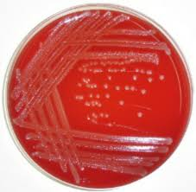
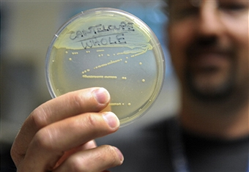
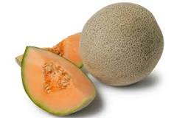
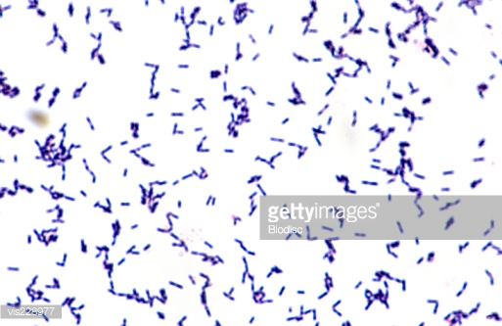
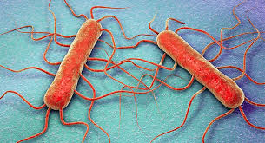
Listeria

Slide 42
Pathogenesis
• Grow in non-immune macrophages
• Invasion: Surface protein and internalin
- Can also cross placental-blood barrier
• Escape from phagosome to cytosol: By
Listeriolysin-O (LLO)
• Actin polymerization (comet tail)
• Common: < 1 month and > 60 Years

Slide 45
Meningitis
• L. monocytogenes has tropism to CNS
including brain parenchyma (encephalitis)
or Meningitis; Bacteremia (occult)
• Not distinguished clinically from other
bacterial meningitis
• Does NOT have high mortality rate

Slide 47
Immunity
• Both innate and adaptive immunity
• Toll-like receptors recognize peptidoglycan
• Specific CD4+, CD8+ cells generation
• Increased in AIDS & immuncompromised

Slide 48
Diagnosis
• CSF: Gram staining
• Culture on blood agar: Beta-hemolytic
G+ Rods
Treatment
• Ampicillin
- Ampicillin + Gentamicin: Fulminating cases
• Cotrimoxazole
- No vaccine is available

Slide 49
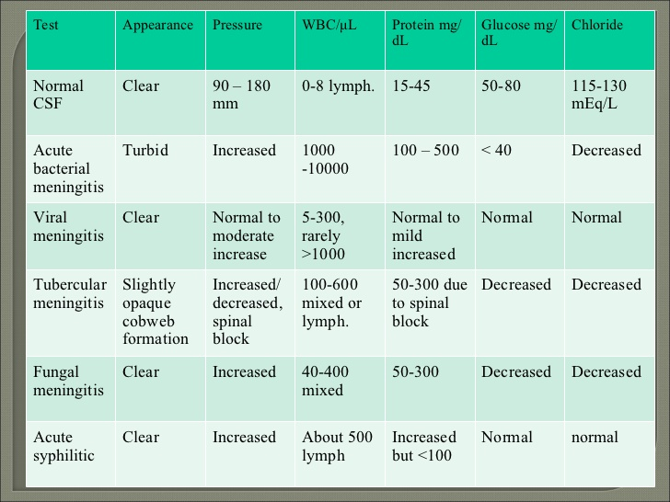

Lym

Slide 50
