Slide 1
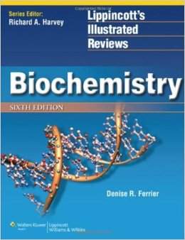
The Biochemical Basis of Selective Neurological Disorders
Dr. Mazhar Al Zoubi| CNS-Biochemistry 2

Slide 2
Outline
1. Discuss the sphingolipids metabolism and their disorders (sphingolipidoses)
2. Understand the biochemical bases of Huntington disease
3. Understand the biochemical bases of Alzheimer disease
4. Understand the role of biochemical mechanisms in brain damage due to stroke

Slide 3
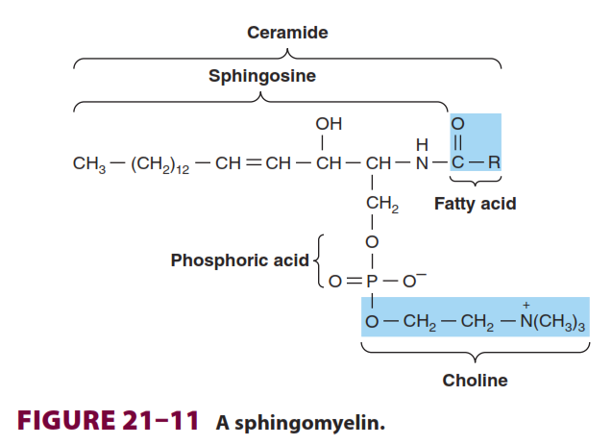
Sphingolipids metabolism and their disorders (Sphingolipidoses)
What is Ceramide ?
combination of Sphingosine and fatty acid

Slide 4
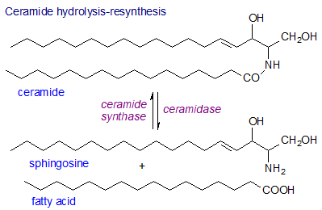

Slide 5
Ceramide
Signaling molecule (second messenger):
Apoptosis.
Cell cycle.
Cell differentiation
Senescence.

Slide 6
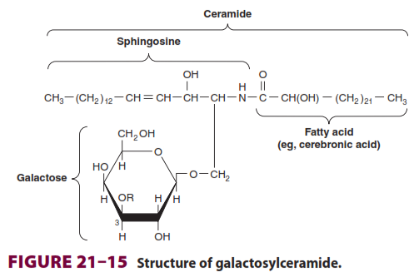
Glycosphingolipids (cerebrosides) : The major glycolipids found in animal tissues.
Galactosylceramide (GalCer ): is a major glycosphingolipid of brain and other nervous tissue.
Golgi apparatus

Slide 7
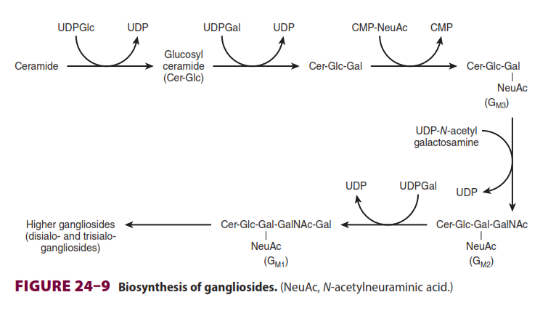
Glycosphinogolipids
GalCer is a major lipid of myelin
GlcCer is the major glycosphingolipid of extraneural tissues and a precursor of most of the more complex glycosphingolipids.
Gangliosides are synthesized from ceramide by the stepwise addition of activated sugars (eg, UDPGlc and UDPGal) and a
Sialic acid, usually N-acetylneuraminic acid

Slide 8
Role of Glycosphinogolipids
Glycosphingolipids are constituents of the outer leaflet of plasma membranes and are important in cell adhesion and cell recognition.
Some are antigens, for example, ABO blood group substances.
Certain gangliosides function as receptors for bacterial toxins (eg, for cholera toxin, which subsequently activates adenylyl cyclase).

Slide 9
CLINICAL ASPECTS
Phospholipids & Sphingolipids are Involved in Multiple Sclerosis and Lipidoses
Classified into two groups:
(1) True demyelinating diseases: multiple sclerosis
(2) Sphingolipidoses: lipid storage diseases
Multiple sclerosis: loss of both phospholipids (particularly ethanolamine
plasmalogen) and of sphingolipids from white matter.
The CSF shows raised phospholipid levels.

Slide 10
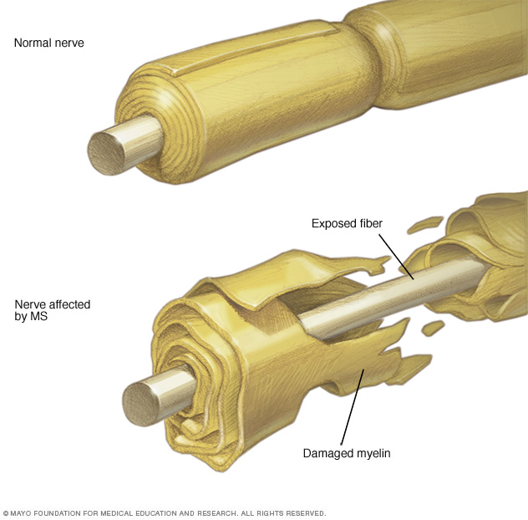

Slide 11
Sphingolipidoses
(lipid storage diseases) are a group of inherited diseases that are caused by a genetic defect in the catabolism of lipids containing sphingosine. (lysosomal disorders)
Features:
Complex lipids containing ceramide accumulate in cells, particularly neurons, causing neurodegeneration and shortening the lifespan.
The rate of synthesis of the stored lipid is normal.
The enzymatic defect is in the lysosomal degradation pathway of sphingolipids.
The extent to which the activity of the affected enzyme is decreased is similar in all tissues.

Slide 12
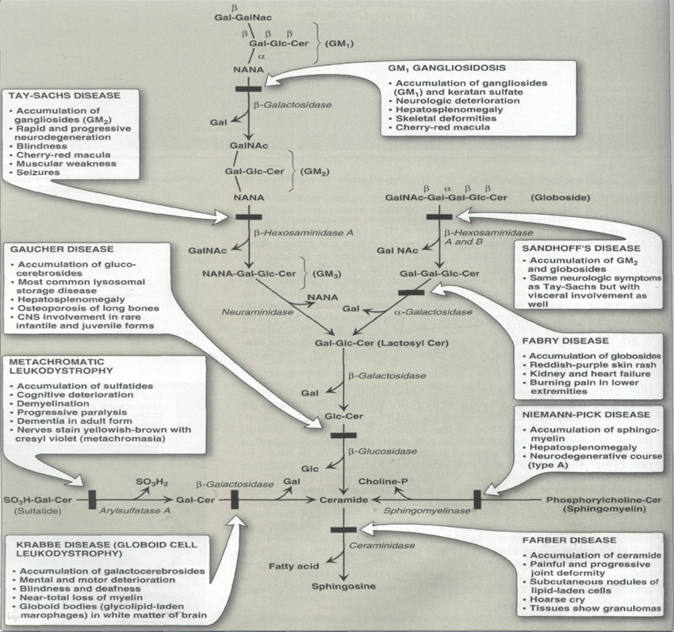

Slide 13
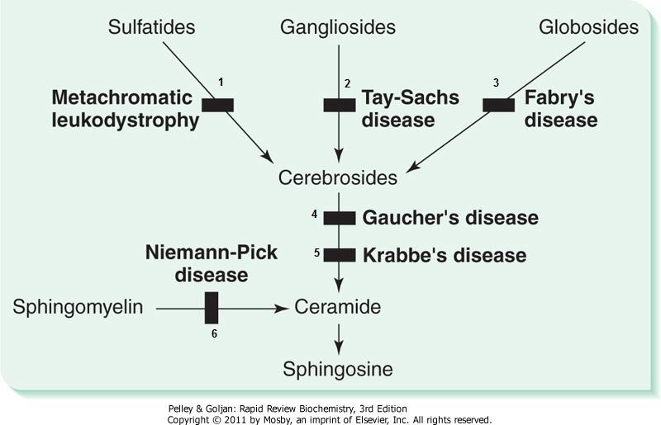

Slide 15
Multiple sulfatase deficiency
Multiple sulfatase deficiency results in accumulation of:
Sulfogalactosylceramide.
Steroid sulfates.
Proteoglycans owing to a combined deficiency of arylsulfatases A, B, and C and steroid sulfatase.

Slide 16
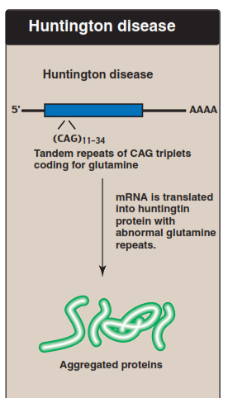
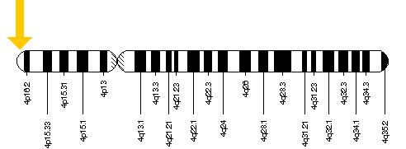
Huntington disease
1983—The gene for Huntington disease is mapped. 4p
Trinucleotide sequences ((CAG)) repeated in abnormal # in HTT gene
Associated with aggregation of amyloids
Adult-onset Huntington disease
Cytogenetic Location: 4p16.3

Slide 17
Huntington disease
Huntington disease affects an estimated 3 to 7 per 100,000 people of European ancestry
Normally, the CAG segment is repeated 10 to 35 times within the gene.
Huntington disease, the CAG segment is repeated 36 to more than 120 times.
This condition is inherited in an autosomal dominant pattern

Slide 18
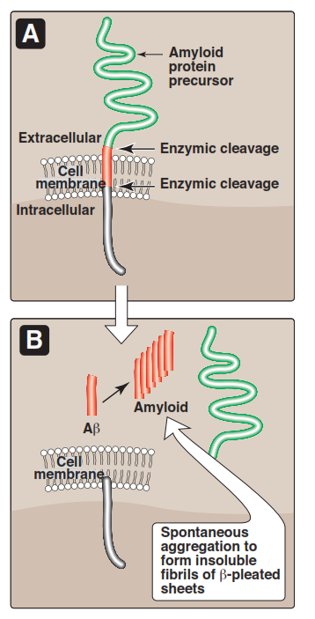
Alzheimer’s Disease
Refolding or misfolding of another protein endogenous to human brain tissue, β-amyloid, is a prominent feature of the Alzheimer’s disease.
A 4.3-kDa polypeptide produced by proteolytic cleavage of a larger protein known as amyloid precursor protein.
Protein undergoes a conformational transformation from a soluble a helix-rich state to a state rich in β sheet and prone to self-aggregation.

Slide 19
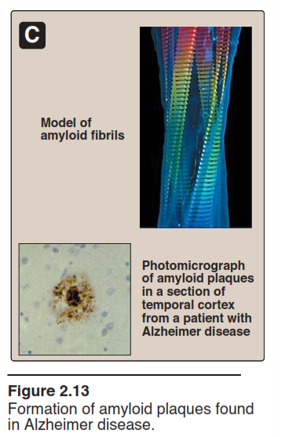
Alzheimer’s Disease
Apolipoprotein E has been implicated as a potential mediator of this conformational transformation.
Researchers have found that this form of the disorder can result from mutations in one of three genes: APP, PSEN1, or PSEN2.
Most cases of Alzheimer disease are not genetically based, although at least 5–10% of cases are familial.

Slide 20
Alzheimer’s Disease and Tau protein
A second biologic factor involved in the development of Alzheimer disease is the accumulation of neurofibrillary tangles inside neurons.
A key component of these tangled fibers is an abnormal form of the tau (τ) protein, which in its healthy version helps in the assembly of the microtubular structure.
The defective τ, however, appears to block the actions of its normal counterpart.

