Slide 1
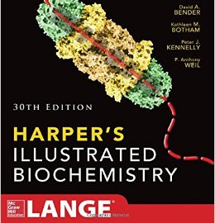
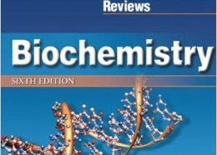
Metabolism of Neurotransmitters
Dr. Mazhar Al Zoubi| CNS-1 Biochem

Slide 2
Outline
Discuss the synthesis and degradation of gamma-amino-butyric acid (GABA)
Discuss the synthesis and degradation of dopamine, epinephrine and nor-epinephrine
Discuss the formation and catabolism of serotonin
Discuss the glutamate metabolism.
Understand the brain peptides as neurotransmitters

Slide 3
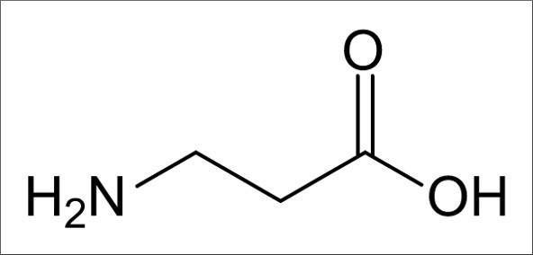
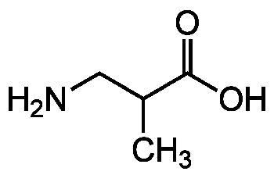
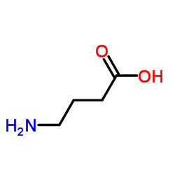
gamma-amino-butyric acid (GABA)
NON-α-AMINO ACIDS:
1. β-alanine
2. β-aminoisobutyrate
3. γ-aminobutyrate (GABA)
Brain inhibitory neurotransmitter altering transmembrane potential differences
Formed by decarboxylation of glutamate by L-glutamate decarboxylase

Slide 4
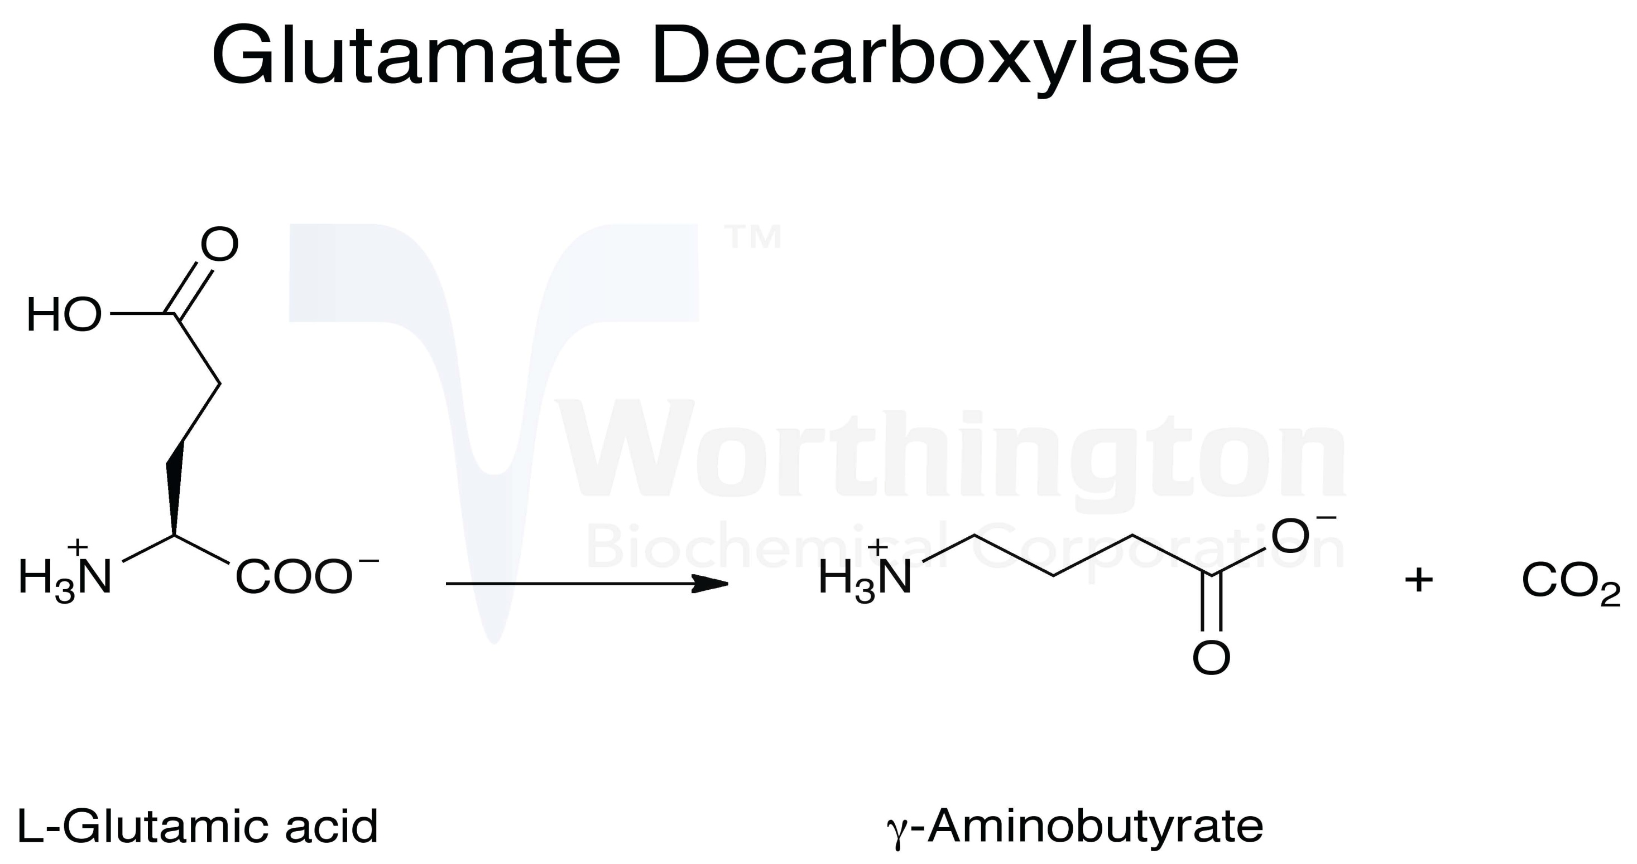

Slide 6
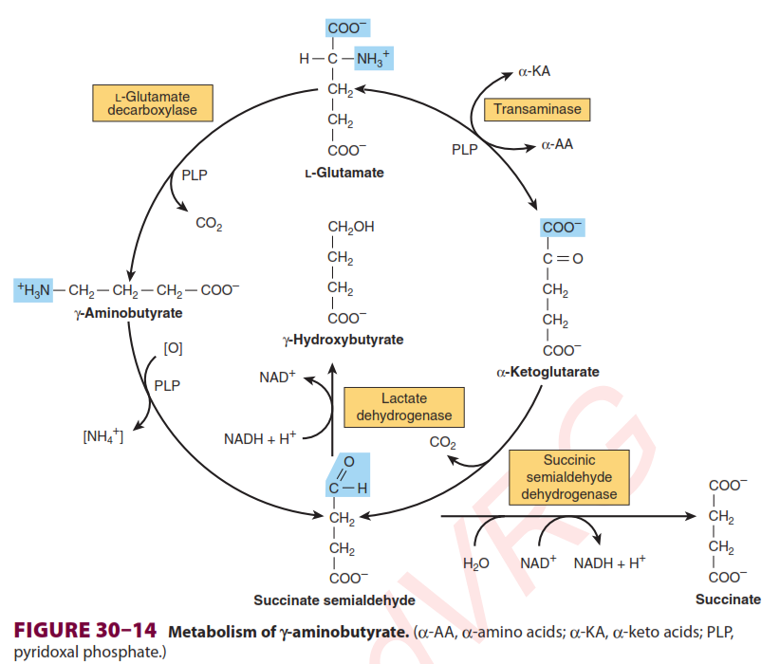
Pyridoxal Phosphate
urine, plasma and CSF
4-hydroxybutyric aciduria
A rare genetic
disorder of GABA metabolism involves a defective GABA
aminotransferase

Slide 7
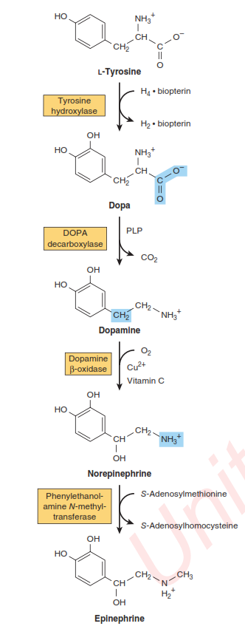
Dopamine, Epinephrine and Nor-Epinephrine
Pyridoxal Phosphate
Neural cells convert tyrosine to epinephrine and norepinephrine.
Dopa is also an intermediate in the formation of melanin, in melanocytes.
Adrenal medulla

Slide 8
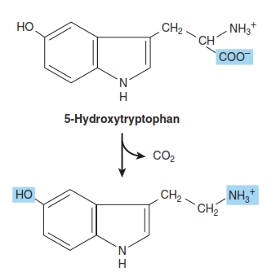
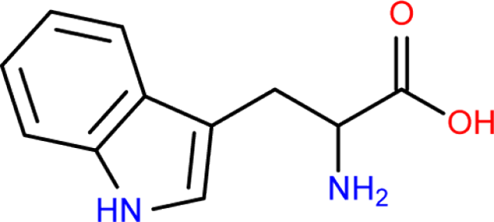
Serotonin (5-OH-tryptamine)
Potent vasoconstrictor and stimulator of smooth muscle contraction
Tryptophan is the precursor
liver tryptophan hydroxylase

Slide 9
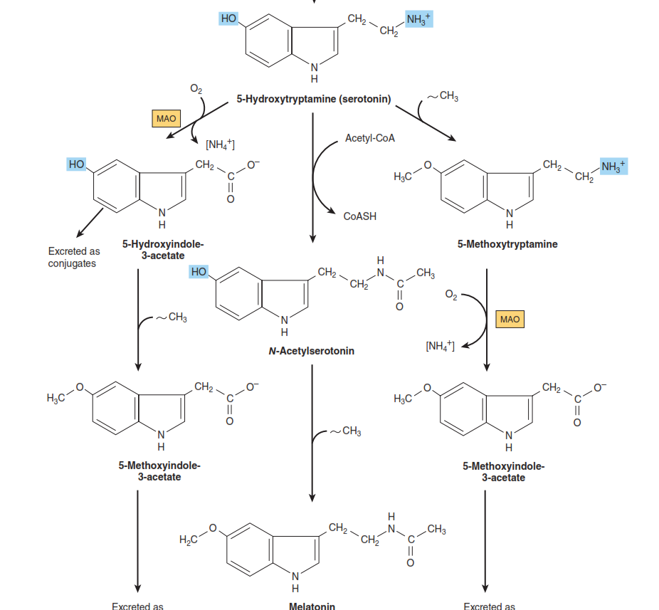
Iproniazid
Pineal body

Slide 10
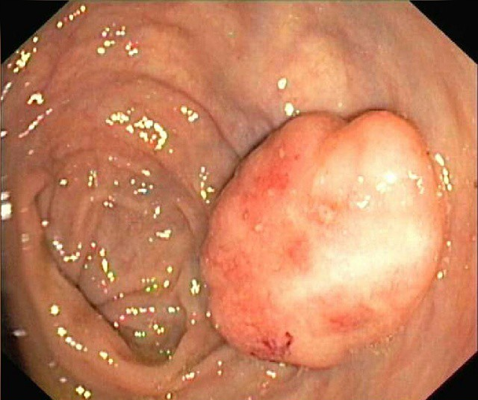
Special secretion of Serotonin
In carcinoid (Argentaffinoma), tumor cells overproduce serotonin.
Circulating melatonin is taken up by all tissues, including brain, but is rapidly metabolized by hydroxylation followed by conjugation with sulfate or with glucuronic acid.

Slide 11
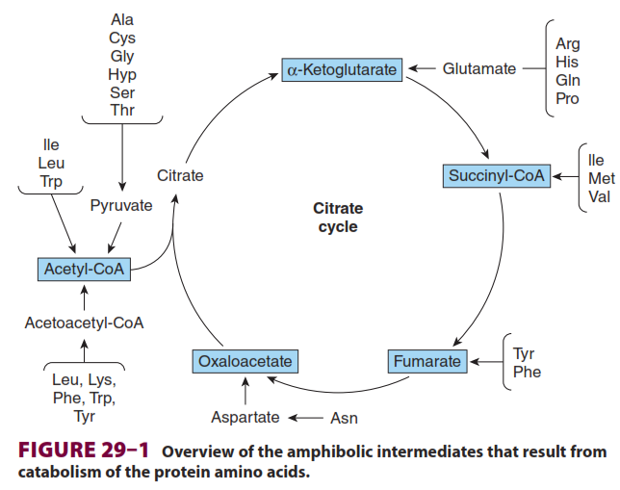
Glutamate metabolism

Slide 12
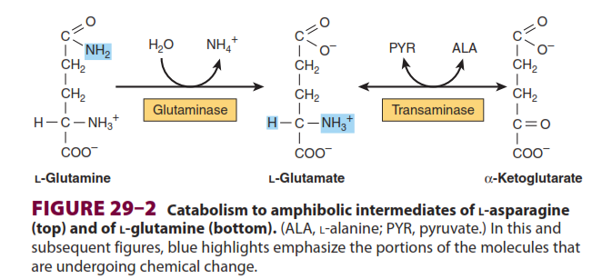

Slide 13
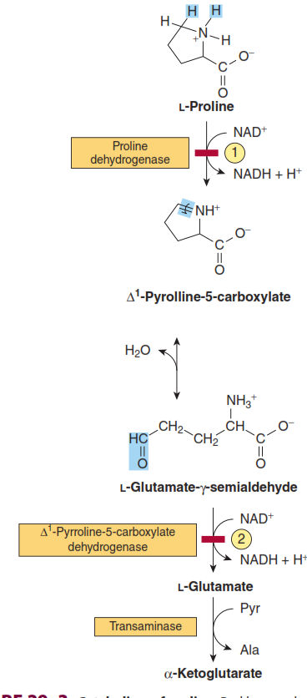
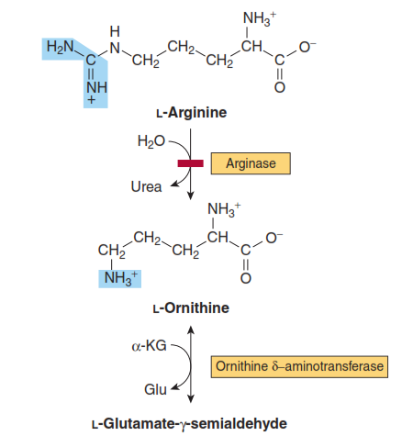

Slide 14
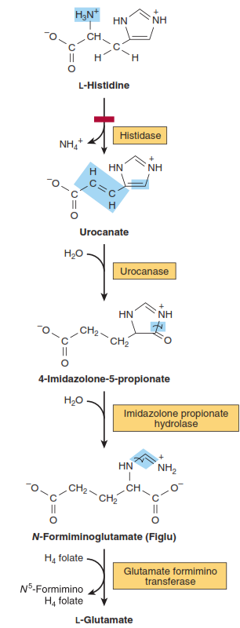

Slide 15
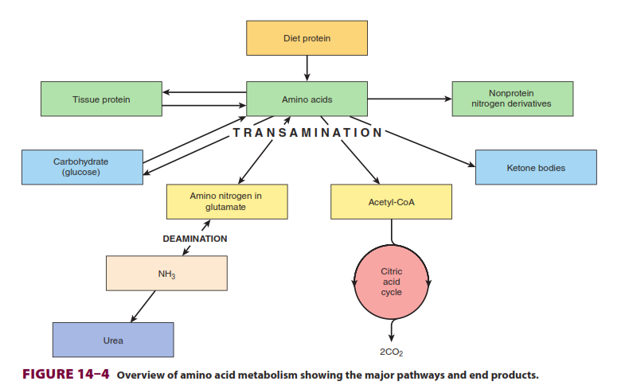
Ammonia disposal

Slide 16
Brain peptides as neurotransmitters
Numerous peptides appear to be neurotransmitter candidates in the brain.
Such as:
Opioid peptide (more than 20 opioid peptides) grouped into three classes:
Endorphins
Enkephalins ( "in the head")
Dynorphins (generally associated with negative emotional states)
These precursors are the product of three distinct genes:
pre-pro-opiomelanocortin, pre-pro-enkephalin A, and pre-pro-dynorphin.
2. Substance P (11-amino acid peptide)
3. Posterior pituitary peptides (vasopressin, oxytocin)
http://science.sciencemag.org/content/209/4460/976.long

Slide 17
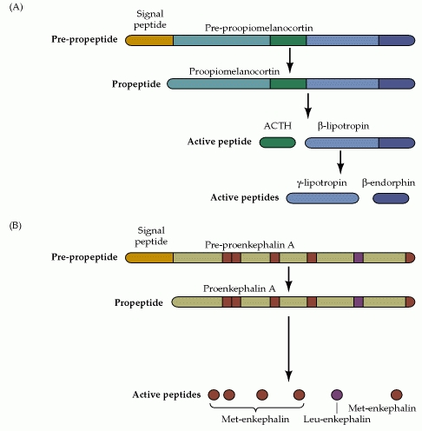
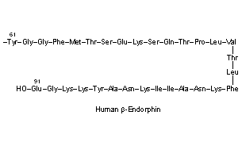
Endorphins
β -endorphin molecules are produced by the body as portions of larger proopiomelanocortin (POMC) molecules, which are coded for by a single gene, synthesized as large molecules, and then cut by enzymes into active subunits.
(POMC)

Slide 18
Enkephalins

Slide 19
Dynorphins

Slide 20
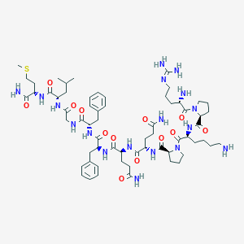
Substance P
Arg-Pro-Lys-Pro-Gln-Gln-Phe- Phe-Gly-Leu-Met-NH2 (RPKPQQFFGLM- NH2)
Associated with inﬂammatory and pain•

Slide 21
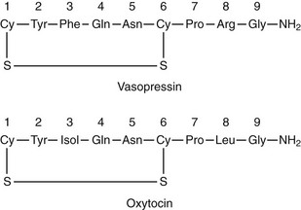
Vasopressin and Oxytocin

