Slide 1
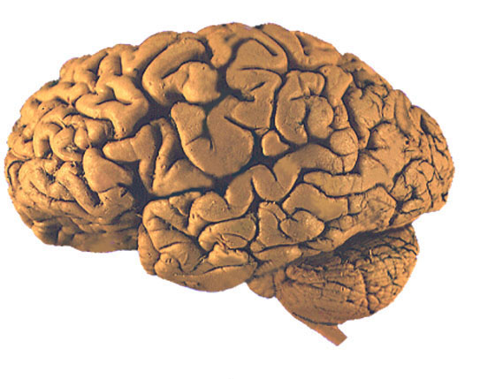
Characteristic features of CNS and Congenital Malformations

Slide 2
Significant features in CNS Pathology
Extremely susceptible to increased I.C.P.
Highly susceptible to ischemia & hypoxia
Site of lesion may be more important than its nature
Selective vulnerability of defined structures to disease processes
No regeneration → gliosis not fibrosis

Slide 3
Component cells of CNS
Neurons
Glial cells:
    Astrocyte
    Oligodendrocyte
    Ependymal cells
    Microglia
Meninges :
    Meningothelial cells
    Connective tissue & BV

Slide 4
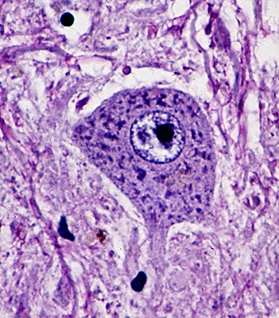
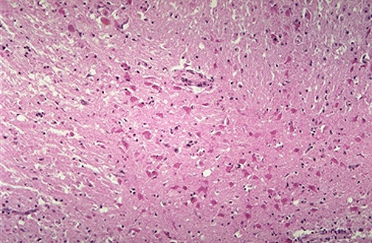
Reactions of components to injury
Neurons :
A- Acute Neuronal injury : RED NEURONS : cell death → 12-24hrs Ischemia/ hypoxia (Shrinkage of cell body, pyknosis of nucleus, loss of nissl substance, intense eosiophilia of cytoplasm)

Slide 5
B - Chronic or subacute injury: Degeneration
  Neuronal loss & replacement by gliosis in progressive diseases.

Slide 6
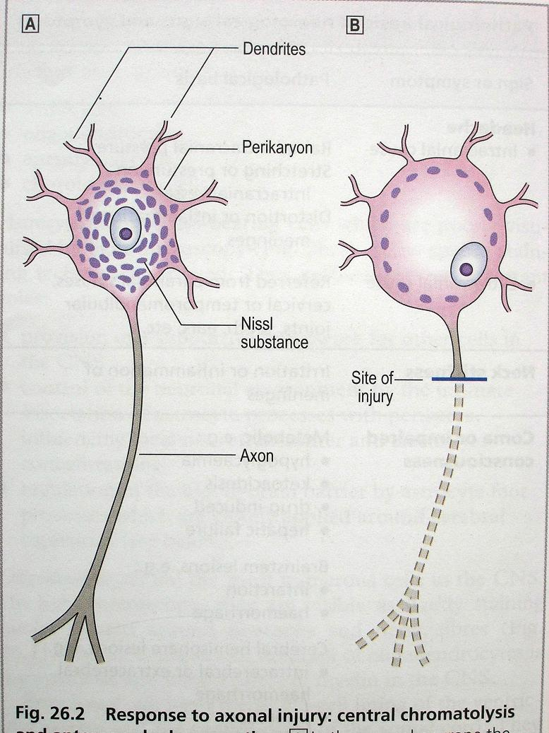
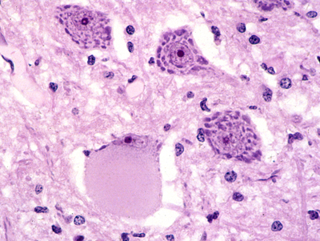
C -Axonal reaction :Central Chromatolysis
(Enlargement of cell body, peripheral displacement of nuc., enlargement of nucleolus, dispersion of Nissl substance from center to periphery)

Slide 7
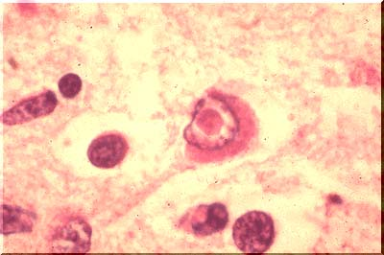
D- Inclusions :
Nuclear or cytoplasmic:
Neurodegenerative diseases
Viral infections

Slide 8
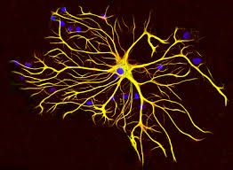
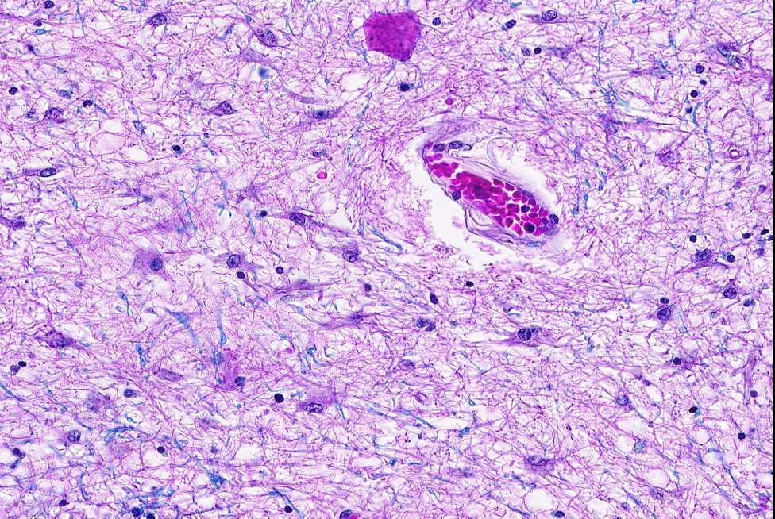
Astrocytes :
- ↑number & size (Gliosis or Astrogliosis)

Slide 9
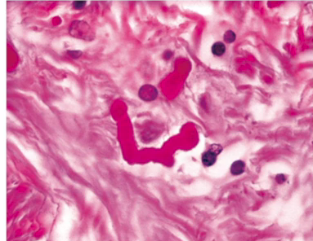
- Rosenthal fibers : Cytoplasmic inclusion bodies
( thick , elongated, eosinophilic) → in old gliosis or some tumors

Slide 10
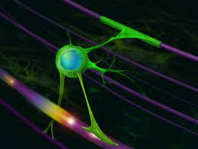
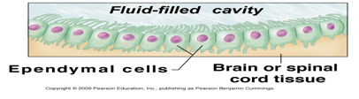
Oligodendrocytes :
- Synthesis & maintenance of myelin
- Injury or apoptosis in demyelinating disorders and leukodystrophies
- Inclusions in specific viral infection
Ependymal cells :
- Injury and inclusions in CMV infection

Slide 11
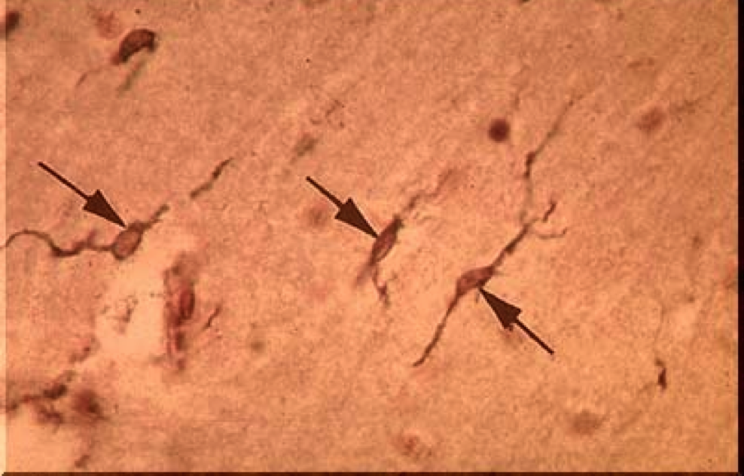
Microglia :
Proliferation
Elongated nuclei in syphilis :( Rod cells)

Slide 12
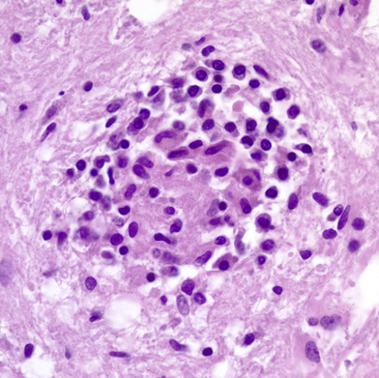
- Forming aggregates around small foci of tissue necrosis : (Microglial nodules)

Slide 13
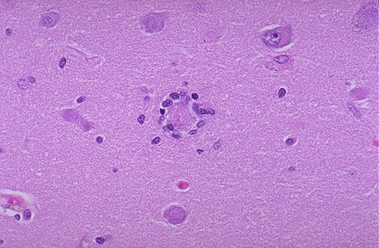
- Aggregate around dead neurons: (Neuronophagia)

Slide 14
Intracranial Pressure
↑ intracranial pressure: if > 15 mm. Hg
- Manifestations :
  Papilledema & visual disturbances
  Nausea & vomiting
  Headache
  Neck stiffness
  Mental status changes
  Others

Slide 15
Causes of Increased ICP
1- Cerebral Edema
  - Vasogenic: due disruption of blood brain barrier and↑ vascular permeability.
    Localized (adjacent to inflammation or neoplasms)
    Generalized
  - Cytotoxic: due to neuronal and glial cell injury
    Generalized hypoxic/ischemic insult or metabolic damage

Slide 16
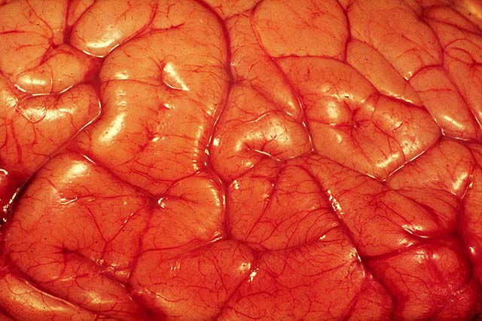
flat gyri, Sulci narrowed
Notes:
16

Slide 17
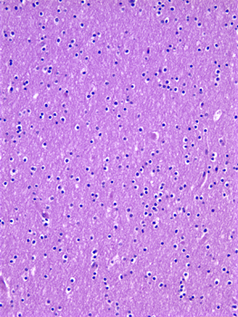
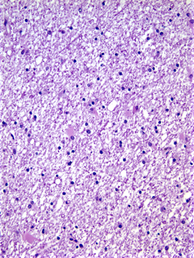
Normal white matter
Edematous white matter

Slide 18
2- Infarction & Hemorrhage
3- Infections - Abscesses & meningitis
4- Tumors - Primary & Secondary
5- Trauma - specially in diffuse brain damage
6- Hydrocephalus

Slide 19
HYDROCEPHALUS
Acummulation of excessive CSF within the ventricular system with enlarged ventricles , caused by:
  I- Impaired flow or resorption of CSF
  ii- Overproduction of CSF in some
  tumors of choroid plexus

Slide 20
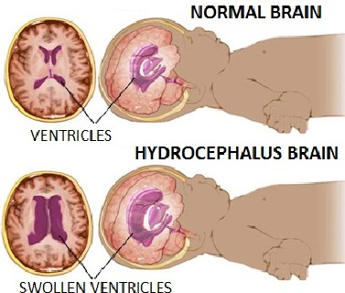

Slide 21
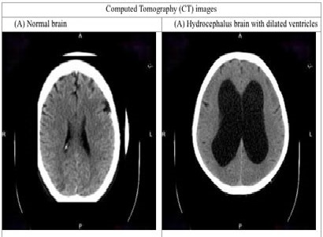

Slide 22
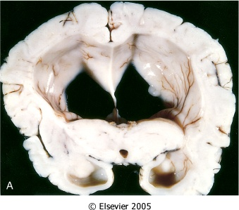
Hydrocephalus: Dilated lateral ventricles seen in a coronal section

Slide 23
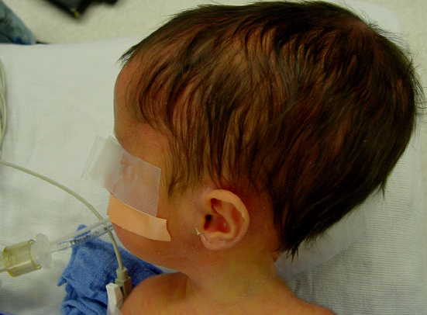
↑ volume of CSF → ↑ICP
If in infancy → Large head , Why??

Slide 24
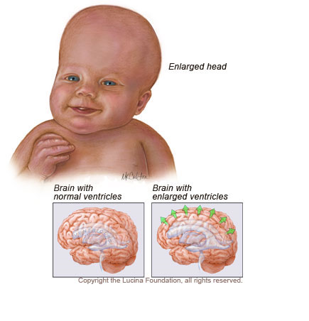

Slide 25
Types of Hydrocephalus :
1- Noncommunicating:
Due to obstruction of CSF flow from
ventricles to the subarachnoid space.
Localized to site of obstruction.

Slide 26
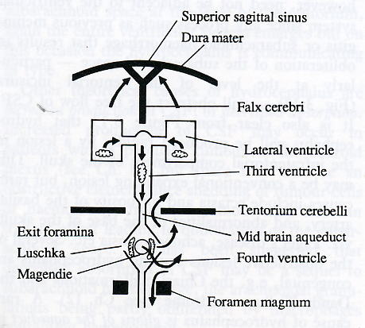

Slide 27
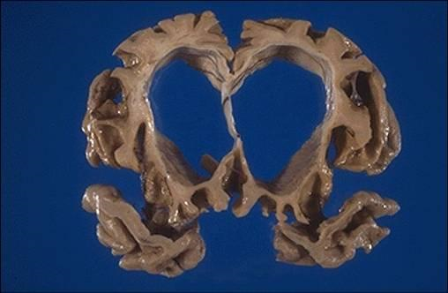
2- Communicating :
- Impaired resorption.
- Generalized to all ventricles.
3- Hydrocephalus ex vacuo:
  - Compensatory dilatation of ventricles due to loss of brain parenchyma

Slide 28
HERNIATIONS
- Displacement of brain tissue from one compartment to another in response to increase I.C.P.

Slide 29
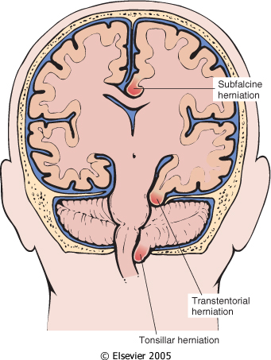
Types of herniation

Slide 30
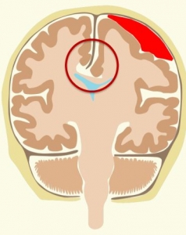
1- Subfalcine (Cingulate) herniation
Herniation of Cingulate gyrus under falx cerebri into the subfalcine space
Compression of branches of Anterior Cerebral Artery →
  Cerebral infarction

Slide 31
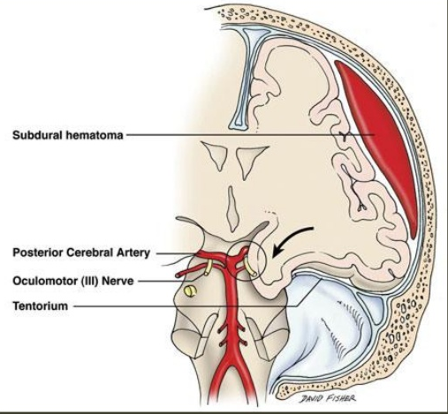
2- Transtentorial (Uncinate, mesial temporal) hernation
Herniation of medial temporal lobe through tentorium.
  - 3rd Cranial Nerve compression → Ipsilateral dilated pupil & impaired eye movement
  - Pressure on Post.CA → Occipital infarction, including visual cortex
  - Cerebral peduncle compression → ipsilateral hemiparesis

Slide 32
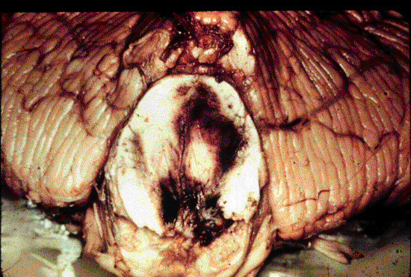
  Progression of transtentorial herniation accompanied by → DURET’S Hemorrhage (Secondary Brain stem hemorrhage)
- Linear hemorrhagic lesions in midbrain and pons
- Cause ? Tearing of penetrating veins
  and arteries supplying upper brain stem

Slide 33
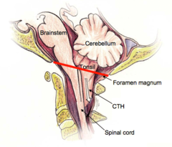
3- Tonsillar herniation
Herniation of cerebellar tonsils through foramen magnum
  - Life threatening, Why??

Slide 34
Congenital Malformations

Slide 35
Neural Tube Defects
The most frequent type of CNS malformation.
Partial failure or reversal of neural tube closure
Genetic factor.
Folate deficiency during the initial weeks of gestation
- Prenatal Folate vitamins can reduce the risk up to 70%.

Slide 36
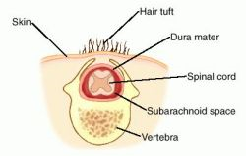
Neural Tube Defects
The most common defects involve the posterior end of the neural tube
Spina bifida occulta: Asymptomatic bony defects .

Slide 37
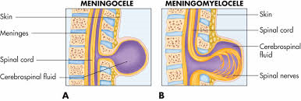
Meningocele
Myelomeningocele: Extension of CNS tissue through a defect in the vertebral column that occurs most commonly in the LS region.
- Motor and sensory deficits in the lower extremities and problems with bowel and bladder control.

Slide 38
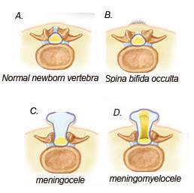

Slide 39
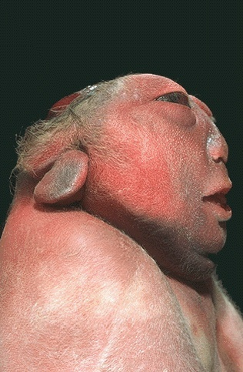
Neural Tube Defects
Malformation of the anterior end of the neural tube
- Anencephaly: Absence of the forebrain and the top of skull.

Slide 40
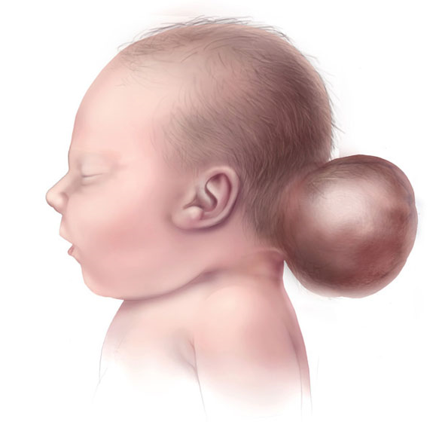
Neural Tube Defects
Encephalocele: diverticulum of malformed CNS tissue extending through a defect in the cranium.
- It most often involves the occipital region or the posterior fossa.

Slide 41
Forebrain Malformations
Megalencephaly : Abnormally large brain
Microencephaly: Small brain, associated with a small head (microcephaly).
- associated with chromosome abnormalities, fetal alcohol syndrome, and (HIV-1) infection acquired in utero.

Slide 42
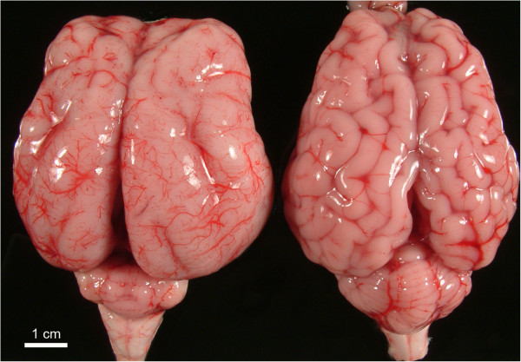
Forebrain Malformations
Disruption of neuronal migration and differentiation during development can lead to abnormalities of gyration
Lissencephaly (agyria) : absent gyration leading to a smooth-surfaced brain.

Slide 43
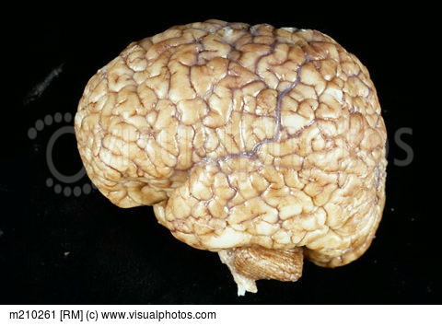
- Polymicrogyria: increased number of irregularly formed gyri.

Slide 44
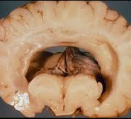
Holoprosencephaly : disruption of the normal midline patterning (incomplete separation of the two hemispheres)

Slide 45
Posterior Fossa Anomalies
The Arnold-Chiari malformation (Chiari type II malformation) :
- Small posterior fossa
- Misshapen midline cerebellum
- Downward extension of the vermis through the foramen magnum
- hydrocephalus and a lumbar myelomeningocele are also present.

Slide 46
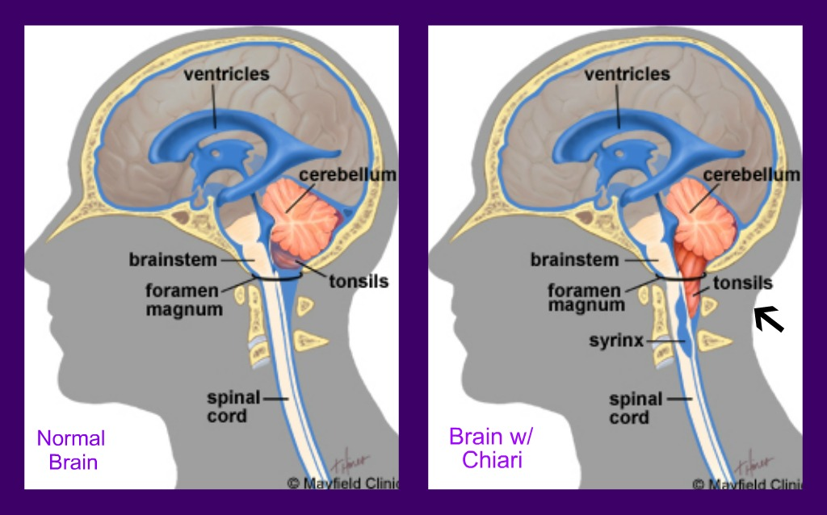
Chiari type I malformation:
- low-lying cerebellar tonsils that extend through the foramen magnum.
Dandy -Walker malformation

Slide 47


