Slide 1
Digestion and Absorption

Slide 2
Digestion of Carbohydrates

Slide 3
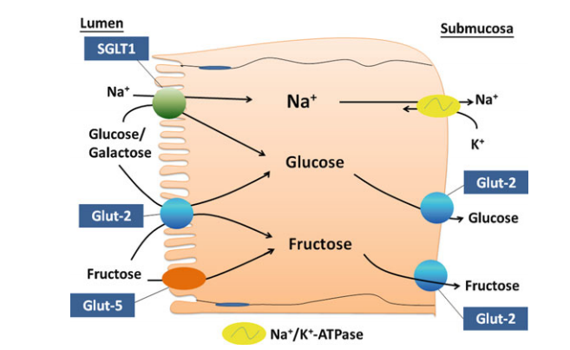
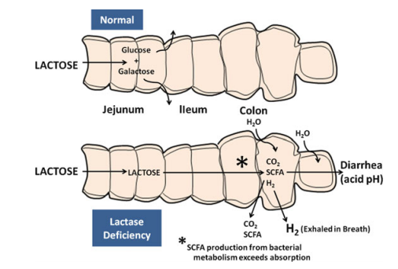
ABSORPTION OF CARBOHYDRATES

Slide 4
DIGESTION OF PROTEINS
Two classes of proteases are endopeptidases and exopeptidases
Brush-border proteases:
aminopolypeptidase (e.g Dipeptidyl aminopeptidase IV (DPP IV)
dipeptidases.

Slide 5
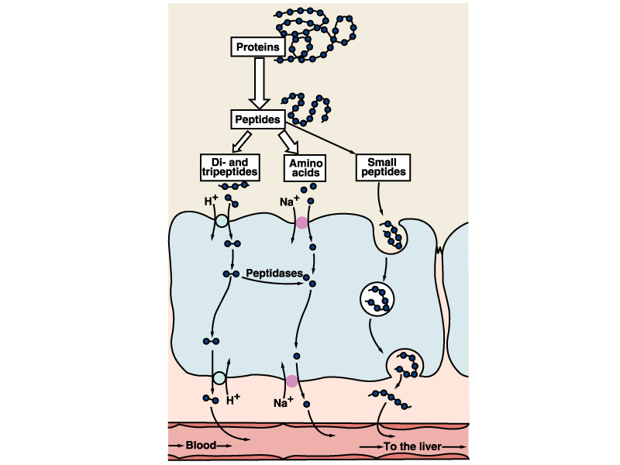
Absorption of Proteins
Lumen
Endocytosis
K⁺
Na⁺
Exocytosis

Slide 6
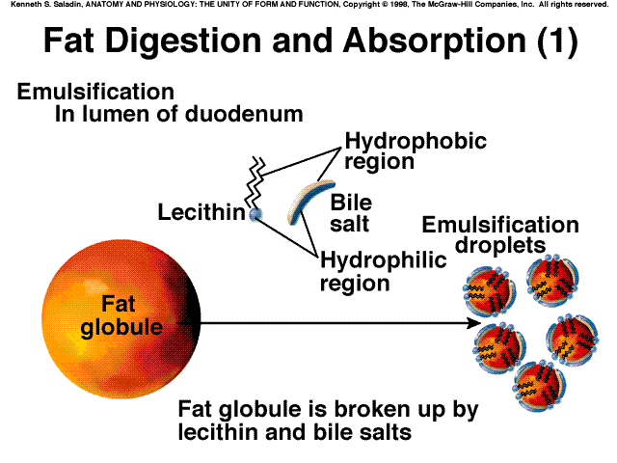
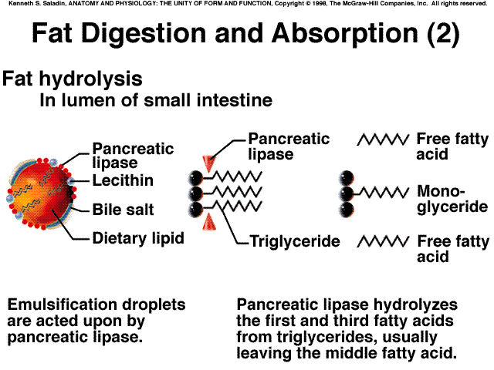
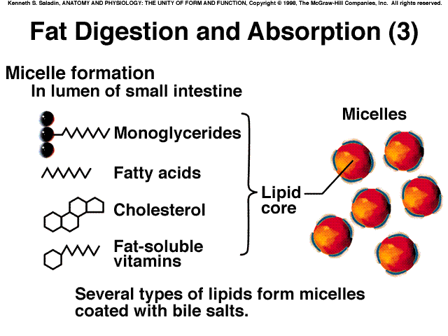
DIGESTION OF FATS

Slide 7
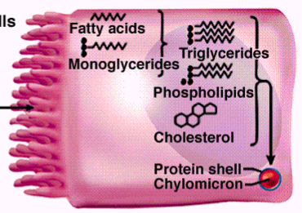
Absorption of fat in the intestine
Resynthesis of triglycerides. Coating with protein, forming droplets called chylomicrons

Slide 8
ABSORPTION OF FATS

Slide 9
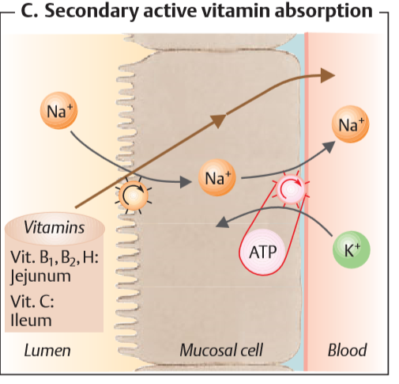
Vitamin Absorption
Water-Soluble Vitamins:
B1, B2, B6, and C; biotin; folic acid
Na+-dependent cotransport mechanism
The exception is the B12
Fat-Soluble Vitamins:
A, D, E, and K
Micelles

Slide 10
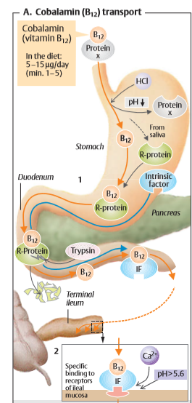
Vitamin B12 Absorption
Gastrectomy
Pernicious anemia

Slide 11
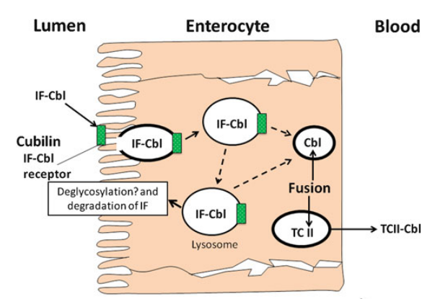
Vitamin B12 Absorption

Slide 12
Summary of water and electrolyte absorption in the gut

