Slide 1
Secretory Functions of the Alimentary Tract
Salivary glands and gastric secretion

Slide 2
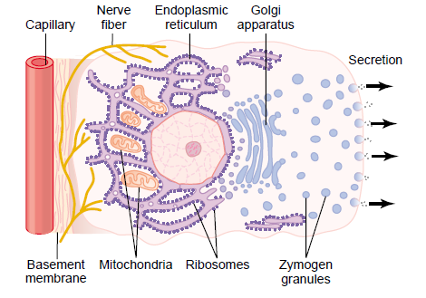
BASIC MECHANISM OF SECRETION BY GLANDULAR CELLS
Types of secretory' glands along the GI tract, include:
Single-cell secretory glands (goblet cells).
Pits ( invaginations of the epithelium in the submucosa)
  in small intestine are known as "Crypts of Lieberklihn"
  in the stomach "Tubular glands".
Complex glands: like Salivary glands, Pancreas and Liver.
GI secretions serves to:
- Digest food.
- Lubricate and protect the mucosa.
The composition of secretion includes:
  Organic materials (e.g Enzymes)
  Mucus
  Water and electrolytes
Secretory cell

Slide 3
Regulation of glandular secretion
ENS regulation
Autonomic regulation
  Sympathetic
  Parasympathetic
Hormonal regulation

Slide 4
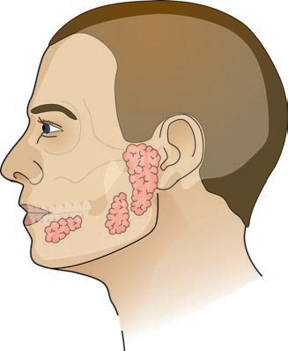
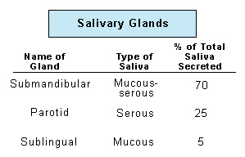
SECRETION OF SALIVA
Serous
Salivary secretion (saliva) is nearly 1L of fluid/day.
It begins the process of digestion and lubricate foods
It is critical for proper oral hygiene
It is composed of two major constituents:
  Serous (digesting)
  Mucinous (lubricating)

Slide 5
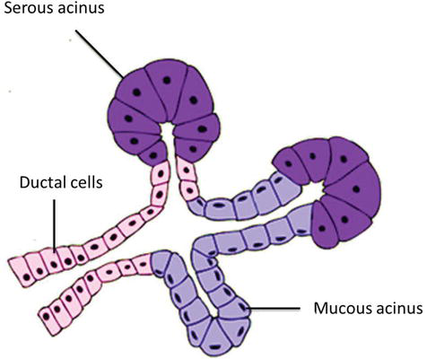

Secretion of saliva
Myoepithelial cells

Slide 6
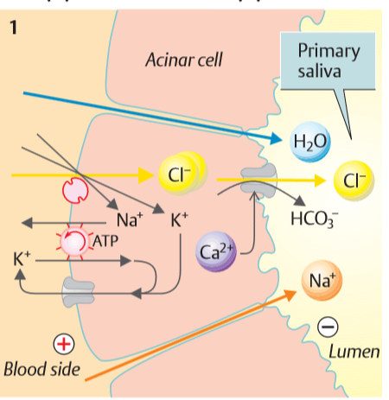
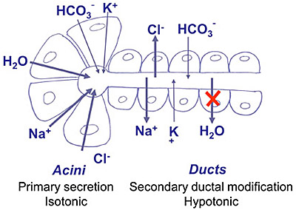
Secretion of saliva
Primary saliva formation by acini
The acinar cells also secrete organic constituents.

Slide 7

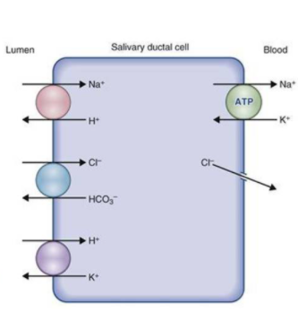

Secretion of saliva
Secondary saliva modifications by ductal cells

Slide 8
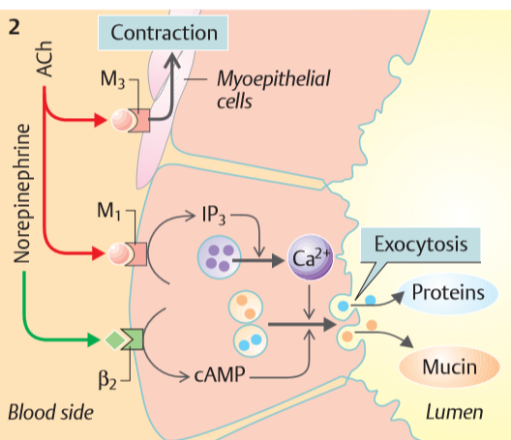
Saliva protein secretion

Slide 9
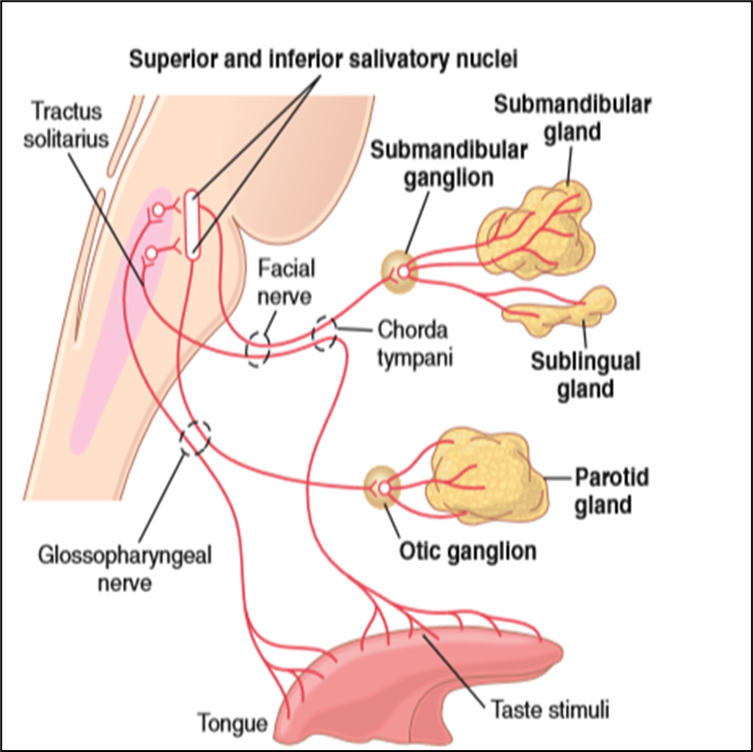
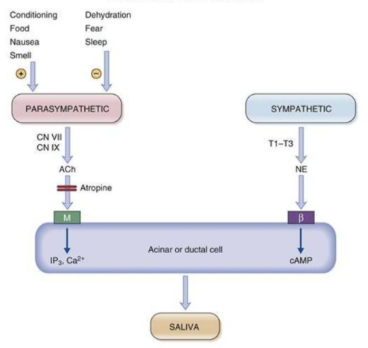
Regulation of salivary secretion
Stimulation of salivary cells results in increased saliva production( increased HCO3^{−,} enzyme secretions), increased blood flow, and contraction of myoepithelial cells.

Slide 10
control of saliva secretion in acinar cells

Slide 11
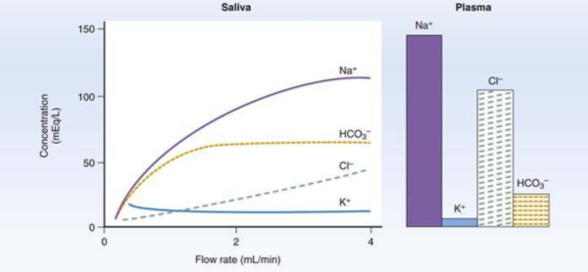
The effect of flow rate on saliva composition
The ionic composition of saliva changes as the salivary flow rate changes

