Slide 1
Intestinal Secretions
the doctor said that it won't be included in the exam but you should know it 😅

Slide 2
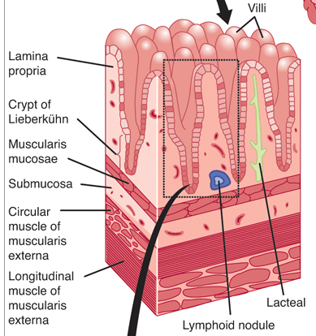
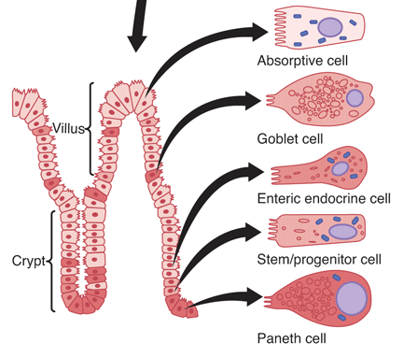
SECRETIONS OF THE SMALL INTESTINE
submucosal mucous glands, termed Brunner glands.

Slide 3
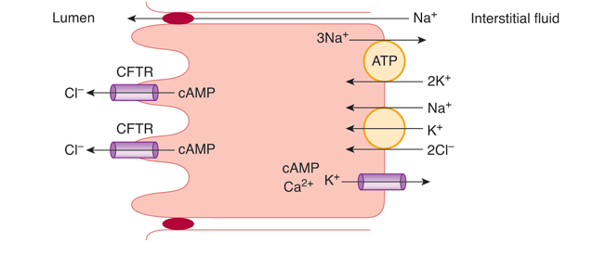
Secretion of intestinal digestive juices by the crypts of lieberkühn
Secretagogues:
Neurotransmitter: VIP, Ach
Paracrine:bradykinin, serotonin, histamine, and prostaglandins
Luminal

Slide 4
Regulation of small intestine secretion
Local enteric nervous reflexes
Neural mechanisms: mediated by Ach and VIP.
Hormonal:
Secretin: increases duodenal secretion.

Slide 5
SECRETION OF MUCUS BY THE LARGE INTESTINE

