Slide 1
Regulation of Glucose Metabolism
Example of hormonal control

Slide 2
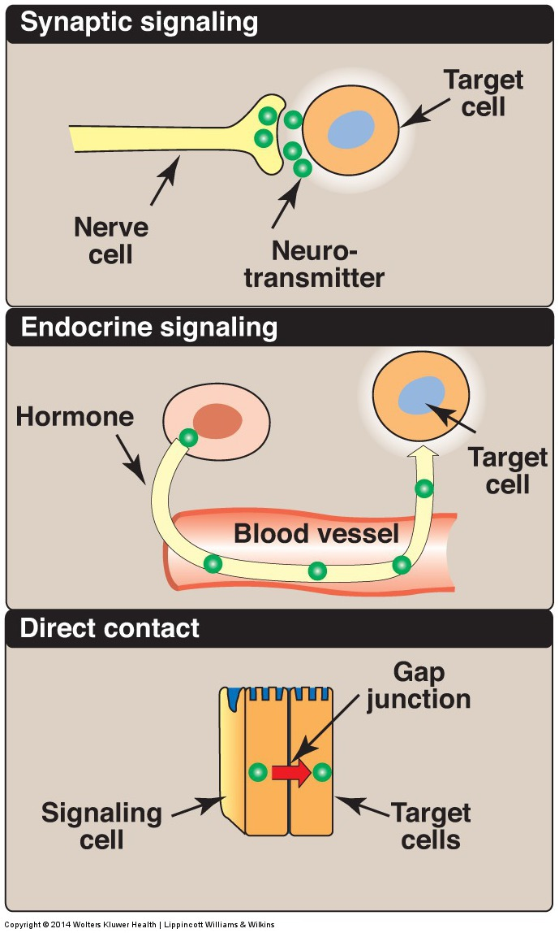
REGULATION OF METABOLISM
Figure 8.5
Notes:
Some commonly used mechanisms for transmission of regulatory signals between cells.

Slide 3
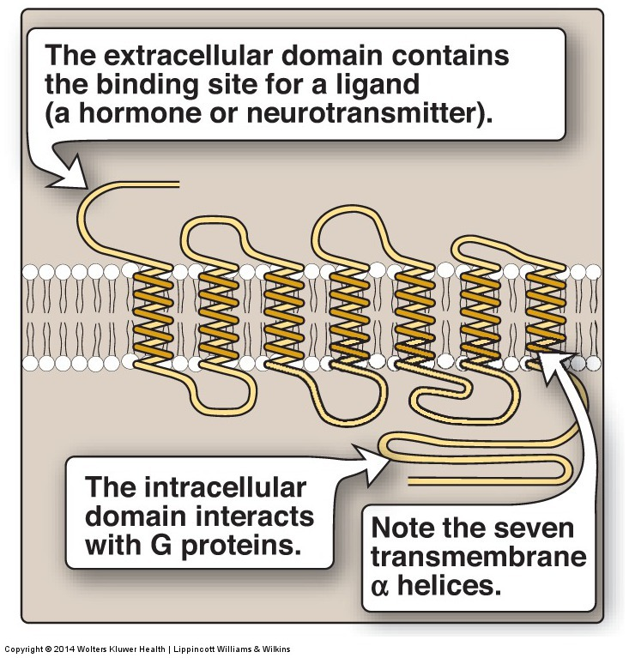
REGULATION OF METABOLISM (continued)
Figure 8.6
Notes:
Structure of a typical G protein–coupled receptor of the plasma membrane.

Slide 4
Figure 8.7
Notes:
The recognition of chemical signals by certain membrane receptors triggers an increase (or, less often, a decrease) in the activity of adenylyl cyclase. GDP = guanosine diphosphate; GTP = guanosine triphosphate; cAMP = cyclic AMP.

Slide 5
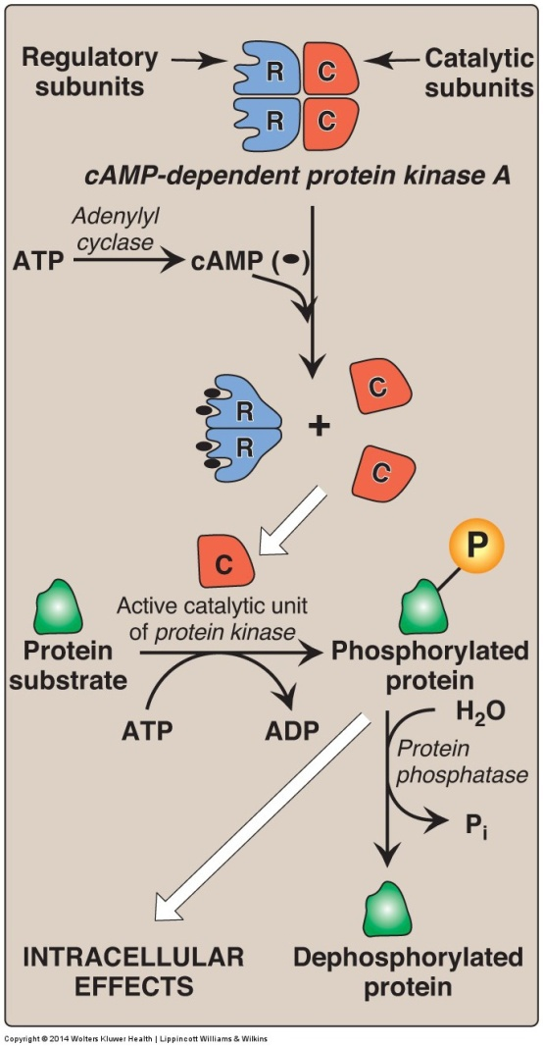
Figure 8.8
Notes:
Actions of cyclic AMP (cAMP). P_{i} = inorganic phosphate.

Slide 6
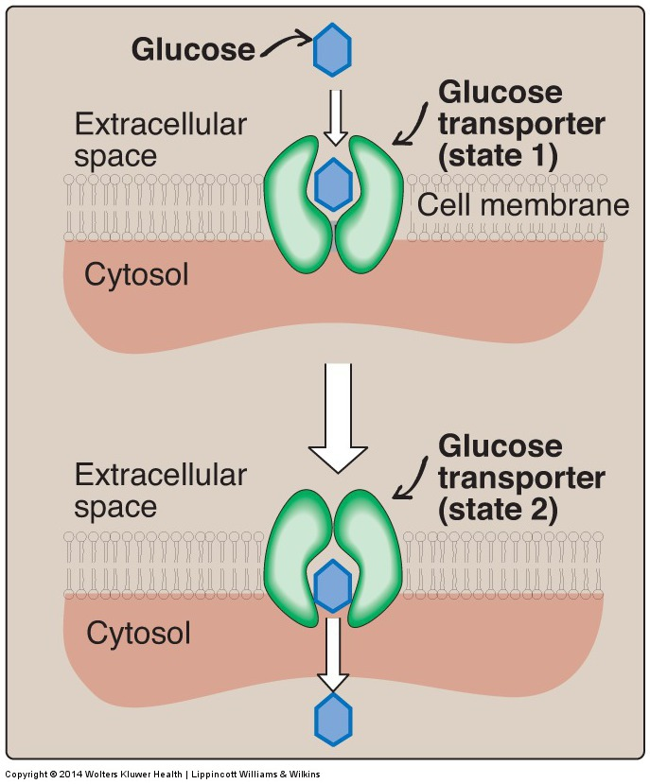
TRANSPORT OF GLUCOSE INTO CELLS (continued)
Figure 8.10
Notes:
Schematic representation of the facilitated transport of glucose through a cell membrane. [Note: Glucose transporter proteins are monomeric and contain 12 transmembrane α helices.]

Slide 7
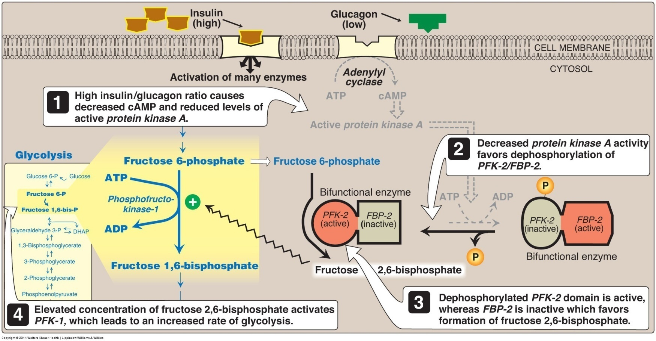
Glycolysis
Notes:
Effect of elevated insulin concentration on the intracellular concentration of fructose 2,6-bisphosphate in liver. PFK-2 = phosphofructokinase-2; FBP-2 = fructose 2,6-bisphosphatase; cAMP = cyclic AMP; P = phosphate.

Slide 8
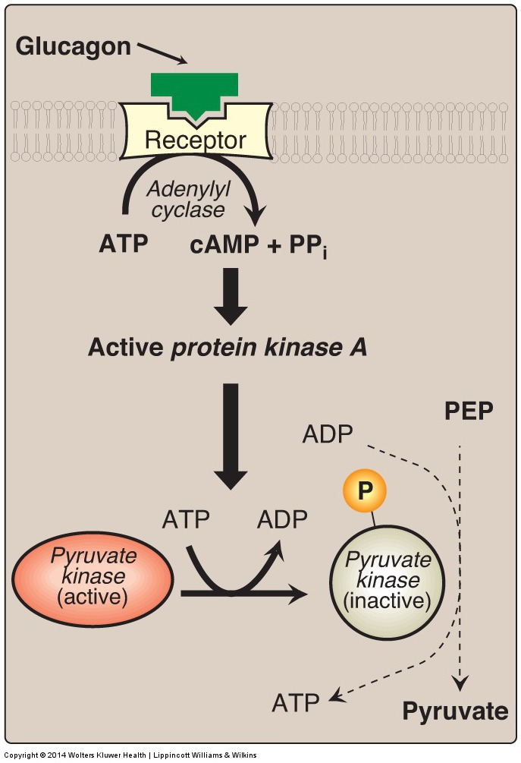
Figure 8.19
Notes:
Covalent modification of hepatic pyruvate kinase results in inactivation of the enzyme. cAMP = cyclic AMP; PEP = phosphoenolpyruvate; P = phosphate; PP_{i} = pyrophosphate.

Slide 9
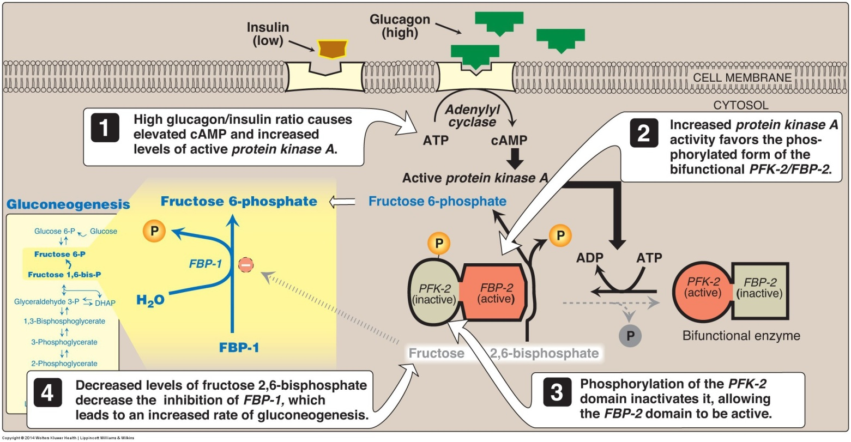
Gluconeogenesis
Notes:
Effect of elevated glucagon on the intracellular concentration of fructose 2,6-bisphosphate in the liver. cAMP = cyclic AMP; PFK-2 = phosphofructokinase-2; FBP-2 = fructose 2,6-bisphosphatase; FBP-1 = fructose 1,6-bisphosphatase; P = phosphate.

Slide 10
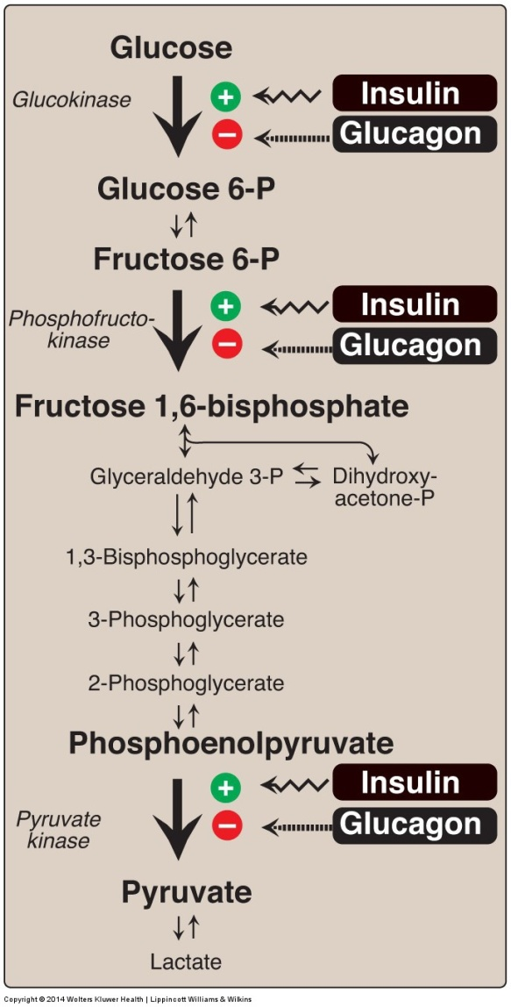
Figure 8.23
Notes:
Effect of insulin and glucagon on the synthesis of key enzymes of glycolysis in liver. P = phosphate.

Slide 11
Hormonal Assay
Radio Immuno Assay(RIA)
Enzyme-Linked Immunosorbent Assay(ELISA)
Fluorescence Polarization Immuno Assay(FPIA)
Chemiluminescence enzyme immunoassay(CLIA)

