Slide 1
Adrenal Gland Part 1

Slide 2
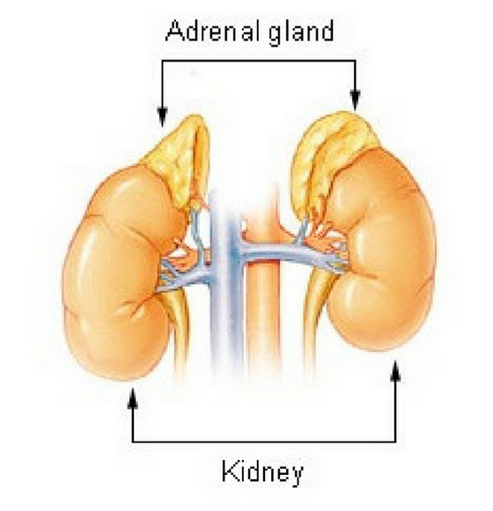
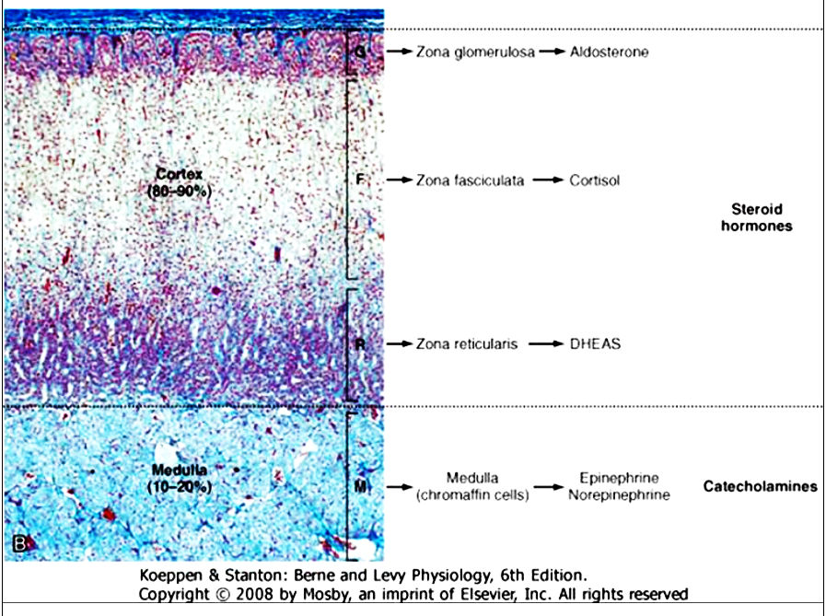
The adrenal glands are bilateral structures located immediately above the kidneys .In humans, they are also referred to as the suprarenal glands . The outer portion of the adrenal gland, called the adrenal cortex is composed of three zones-the zona glomerulosa, the zona fasciculata, and the zona reticularis-that produce mineralocorticoids, glucocorticoids, and adrenal androgens, respectively. The inner portion of the gland is called the Adrenal Medulla, it is composed of chromaffin cells. The chromaffin cells of the adrenal medulla have the potential to develop into postganglionic sympathetic neurons. They are innervated by cholinergic preganglionic sympathetic neurons and can synthesize the catecholamines
dehydroepiandrosterone sulfate (DHEAS)

Slide 3
ADRENAL MEDULLA CATECHOLAMINES
Instead of being secreted near a target organ and acting as neurotransmitters, adrenomedullary catecholamines are secreted into blood and act as hormones.
About 80% of the cells of the adrenal medulla secrete epinephrine as a primary hormone, and the remaining 20% secrete norepinephrine.
Although circulating epinephrine is derived entirely from the adrenal medulla, only about 30% of the circulating norepinephrine comes from the medulla. The remaining 70% is released from postganglionic sympathetic nerve terminals and diffuses into the vascular system. Because the adrenal medulla is not the sole source of catecholamine production, this tissue is not essential for life

Slide 4
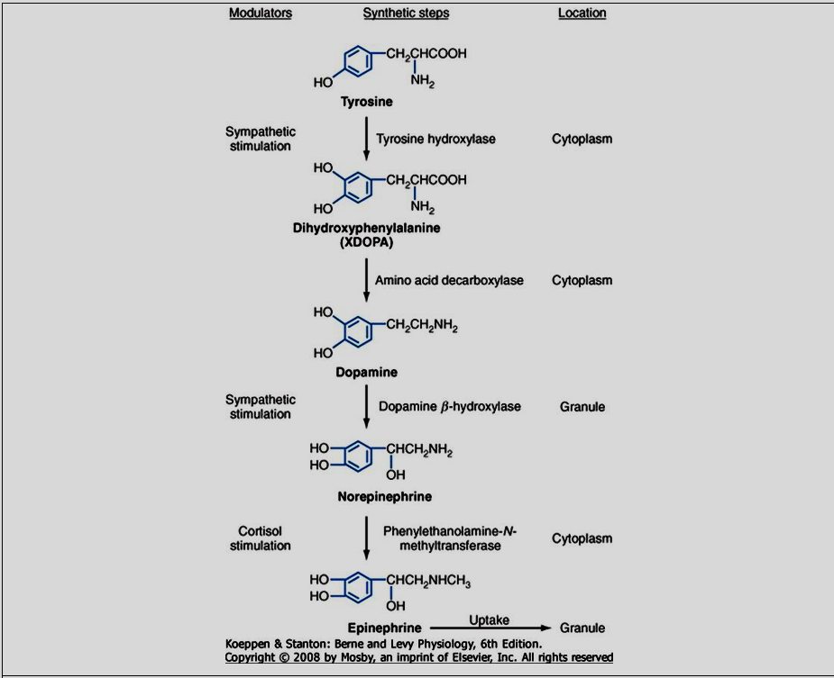
Synthesis of Catecholamines

Slide 5
Secretion of catecholamines
Preganglion fiber releases Ach
Nicotinic receptor activation
Depolarization
Ca2+ entry
exocytosis
Stimuli such as injury, anger, anxiety, pain, cold, exercise, and hypoglycemia generate impulses in these fibers, causing a rapid discharge of the catecholamines into the bloodstream.

Slide 6
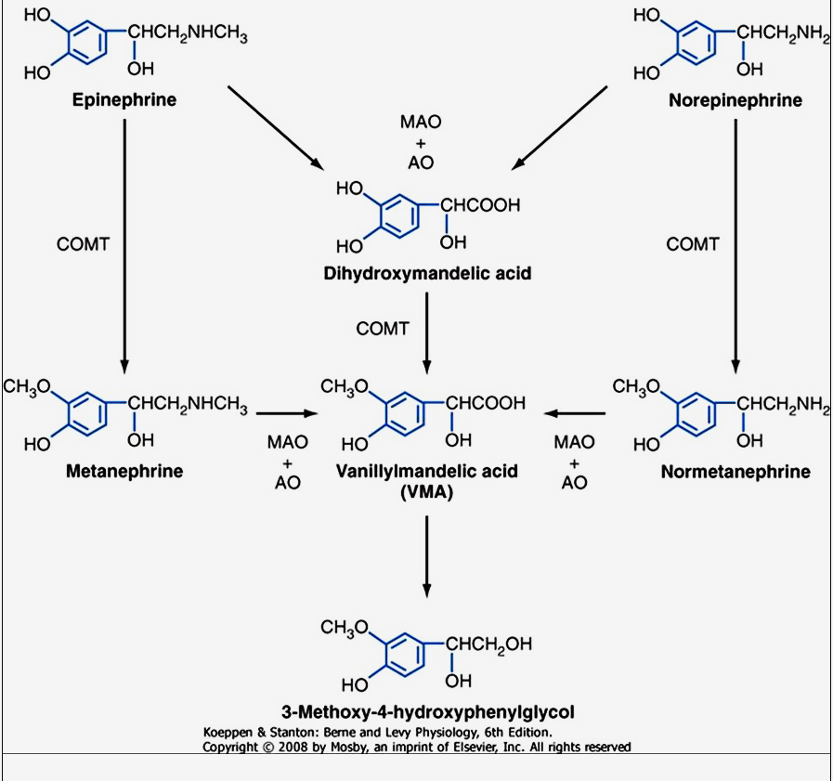
Metabolism of Catecholamines
Two primary enzymes are involved in the degradation of catecholamines: monoamine oxidase (MAO) and catechol-O-methyltransferase (COMT)

Slide 7
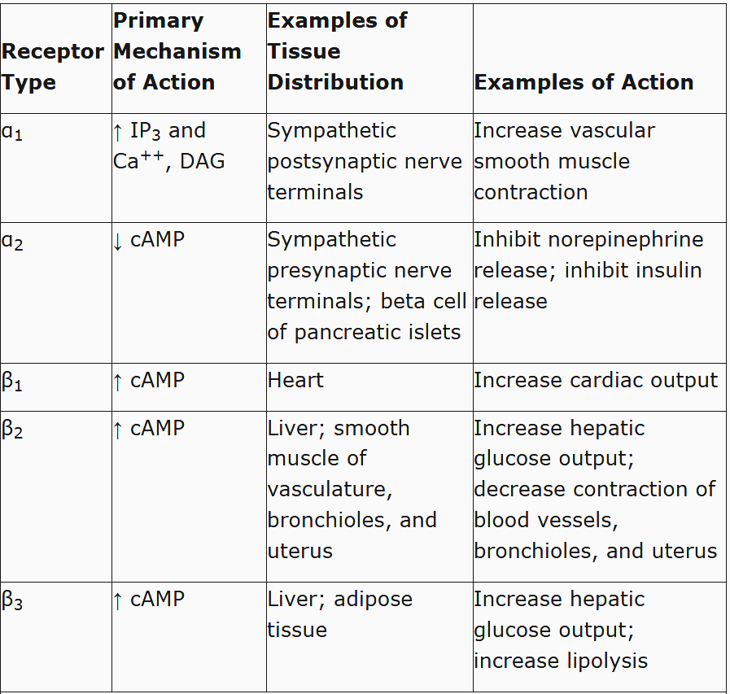
Adrenergic Receptors

Slide 8
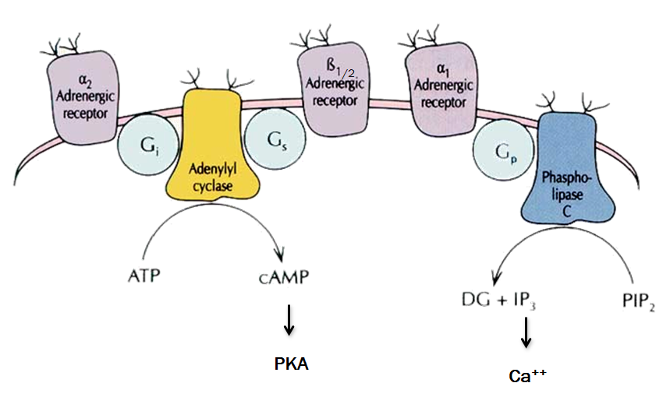

Slide 9
Physiological ACTIONS
Because the adrenal medulla is directly innervated by the autonomic nervous system, adrenomedullary responses are very rapid.
Circulating epinephrine and norepinephrine have similar effect of sympathetic stimulation.
Effects of epinephrine and norepinephrine on various target organs depend upon the type and ratio of receptors present in the cells of the organs.
Epinephrine acts through both alpha and beta receptors equally.
Norepinphrine acts mainly through alpha receptors and occasionally through beta receptors.

Slide 10
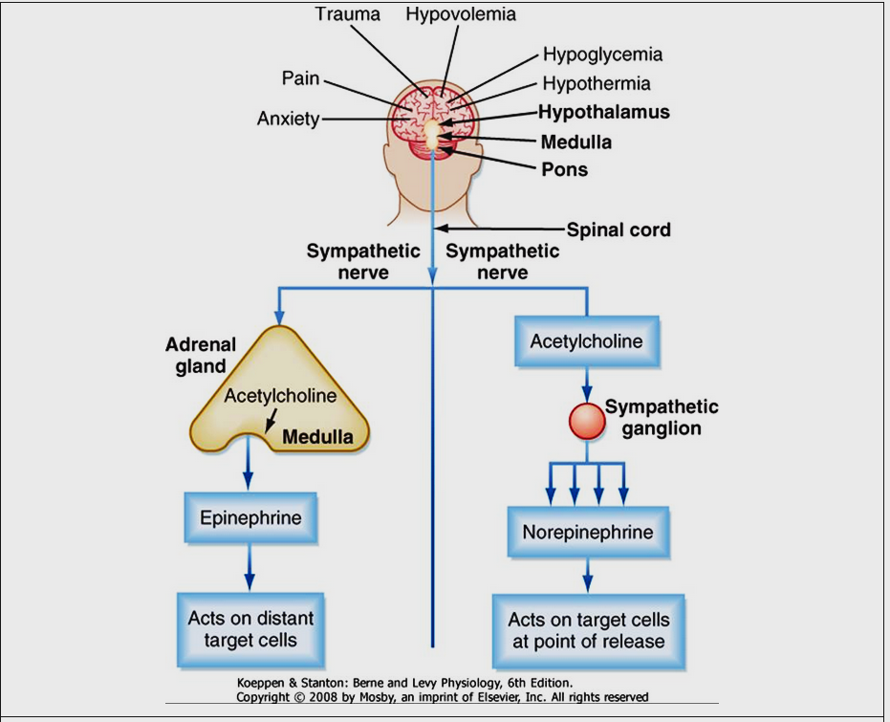

Slide 11
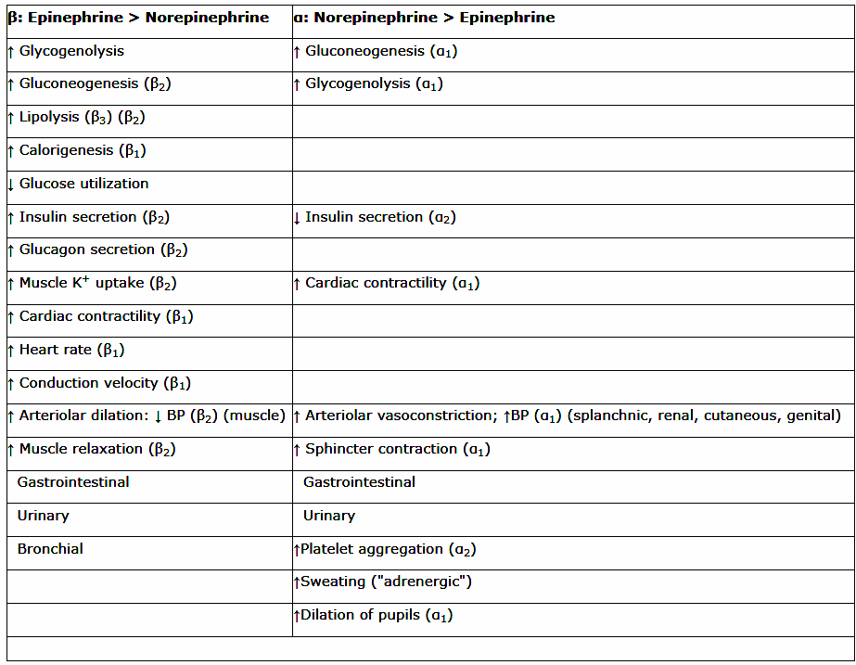
Physiological ACTIONS

Slide 12
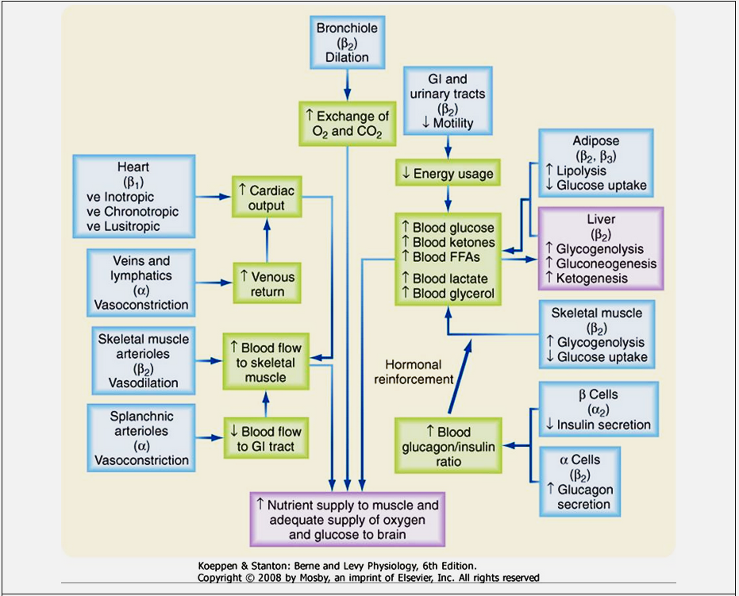
Exercise as an example

Slide 13
The overall goal of the sympathoadrenal system during exercise is to meet the increased energy demands of skeletal and cardiac muscle while maintaining sufficient oxygen and glucose supply to the brain.
The response to exercise includes the following major physiological actions:
1. Increased blood flow to muscles is achieved by the integrated action of norepinephrine and epinephrine on the heart, veins and lymphatics, nonmuscular and muscular arteriolar beds.

Slide 14
Epinephrine promotes glycogenolysis in muscle. Exercising muscle can also utilize free fatty acids (FFAs), and epinephrine and norepinephrine promote lipolysis in adipose tissue.
The actions just described increase circulating levels of lactate and glycerol, which can be used by the liver as gluconeogenic substrates to increase glucose.
Epinephrine increases blood glucose by increasing hepatic glycogenolysis and gluconeogenesis.
The promotion of lipolysis in adipose tissue is also coordinated with an epinephrine-induced increase in hepatic ketogenesis.
The effects of catecholamines on metabolism are reinforced by the fact that they stimulate glucagon secretion (β2 receptors) and inhibit insulin secretion (α2 receptors).
Efficient production of ATP during normal exercise (i.e., a 1-hour workout) also requires efficient exchange of gases with an adequate supply of oxygen to exercising muscle.
Catecholamines promote this by relaxation of bronchiolar smooth muscle
Catecholamines decrease energy demand by visceral smooth muscle. In general, a sympathoadrenal response decreases overall motility of the smooth muscle in the gastrointestinal (GI) and urinary tracts, thereby conserving energy where it is not needed

Slide 15
Epinephrine vs. Norepinephrine
Epinephrine >> norepinephrine – in terms of cardiac stimulation leading to greater cardiac output (β stimulation).
Norepinephrine > epinephrine – in terms of constriction of blood vessels – leading to increased peripheral resistance – increased arterial pressure.
Epinephrine >> norepinephrine –in terms of increasing metabolism

Slide 16
Clinical Insights
Pheochromocytoma is a tumor of chromaffin tissue that produces excessive quantities of catecholamines. These are commonly adrenal medullary tumors, but they can occur in other chromaffin cells of the autonomic nervous system. Although pheochromocytomas are not common tumors, they are the most common cause of hyperfunctioning of the adrenal medullary. The catecholamine most frequently elevated in pheochromocytoma is norepinephrine. For unknown reasons, the symptoms of excessive catecholamine secretion are often sporadic rather than continuous. Symptoms include hypertension, headaches (from hypertension), sweating, anxiety, palpitations, and chest pain. In addition, patients with this disorder may show orthostatic hypotension (despite the tendency for hypertension). This occurs because hypersecretion of catecholamines can decrease the postsynaptic response to norepinephrine as a result of down-regulation of the receptors. Consequently, the baroreceptor response to blood shifts that occurs on standing is blunted

