Slide 1
Endocrine Functions of the Pancreas

Slide 2
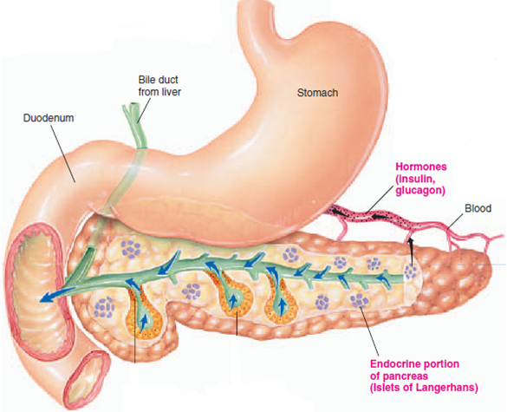
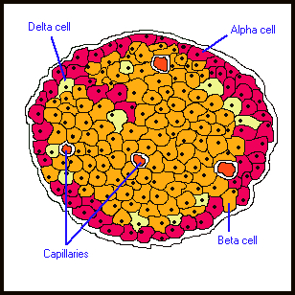
Islets of Langerhans
Somatostatin
Glucagon
Exocrine portion
Insulin

Slide 3
Islets of Langerhans
The islets of Langerhans (1% to 2% of the pancreatic mass):
1. Beta cells: most abundant cell type represented three fourths. They secrete the Insulin
2. Alpha (A) cells: 10% of the cells and they secrete the
glucagon
3. Delta (D) cell: 5% of the cells and they produce the peptide somatostatin
4. F cells : constitute about 80% of the cells in the islets situated within the posterior portion of the head of the pancreas and it secrete the peptide pancreatic polypeptide.

Slide 4
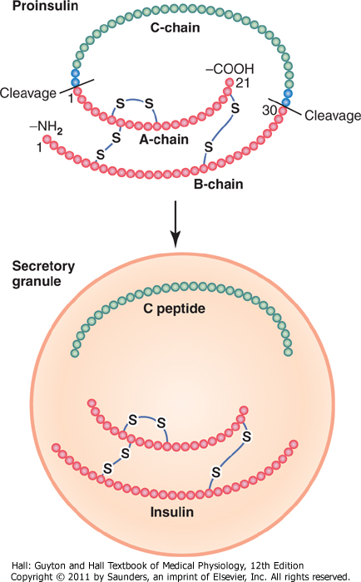
Insulin Chemistry and Synthesis
The insulin gene codes for preproinsulin. The mature messenger RNA initiates synthesis of the N-terminal signal peptide (S) in ribosomes, followed by the B, C, and A chains. The signal is degraded during the course of completion of the proinsulin molecule. The latter is folded into a conformation that permits disulfide linkages to form between the A and B chains. Within the Golgi and secretory granule, converting enzymes cleave off the C chain, known as C peptide, thereby completing the synthesis of insulin.
Insulin has a half-life of 5 to 8 minutes and is cleared rapidly from the circulation. It is degraded by insulinase in the liver, kidney, and other tissues.

Slide 5
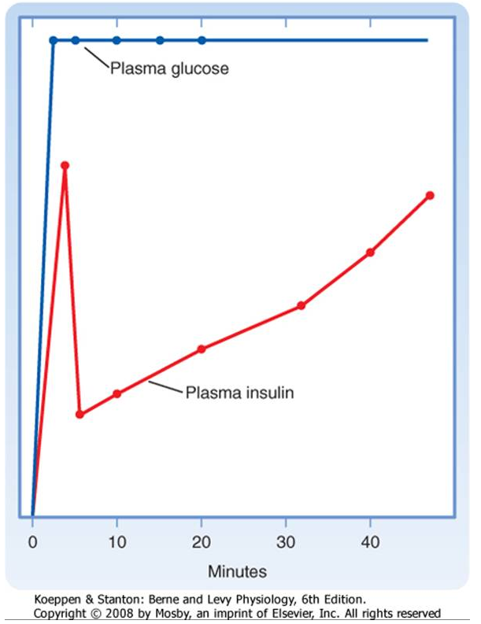
Insulin secretion is stimulated, insulin is released within minutes. If the stimulus is maintained, insulin secretion falls within 10 minutes and then slowly rises over a period of about 1 hour .The latter phase is referred to as the late phase of insulin release. The early phase of insulin release probably involves the release of preformed insulin, whereas the late phase represents the release of newly formed insulin.

Slide 6
Regulation of insulin by Glucose
Glucose is the primary stimulus of insulin secretion. Entry of glucose into beta cells is facilitated by the GLUT2 transporter.
Once glucose enters the beta cell, it is phosphorylated to G6P by the low-affinity hexokinase glucokinase.
Glucokinase is referred to as the "glucose sensor" of the beta cell because the rate of glucose entry is correlated to the rate of glucose phosphorylation, which in turn is directly related to insulin secretion.
Metabolism of G6P by beta cells increases the intracellular ATP/ADP ratio and closes an ATP-sensitive K+ channel .
This results in depolarization of the beta cell membrane, which opens voltage-gated Ca++ channels. Increased intracellular [Ca++] activates microtubule-mediated exocytosis of insulin/proinsulin-containing secretory granules.
The ATP-sensitive K+channel is a protein complex that contains an ATP-binding subunit called SUR. This subunit is also activated by sulfonylurea drugs, which are widely used as oral agents to treat hyperglycemia in patients with partially impaired beta cell function.

Slide 7
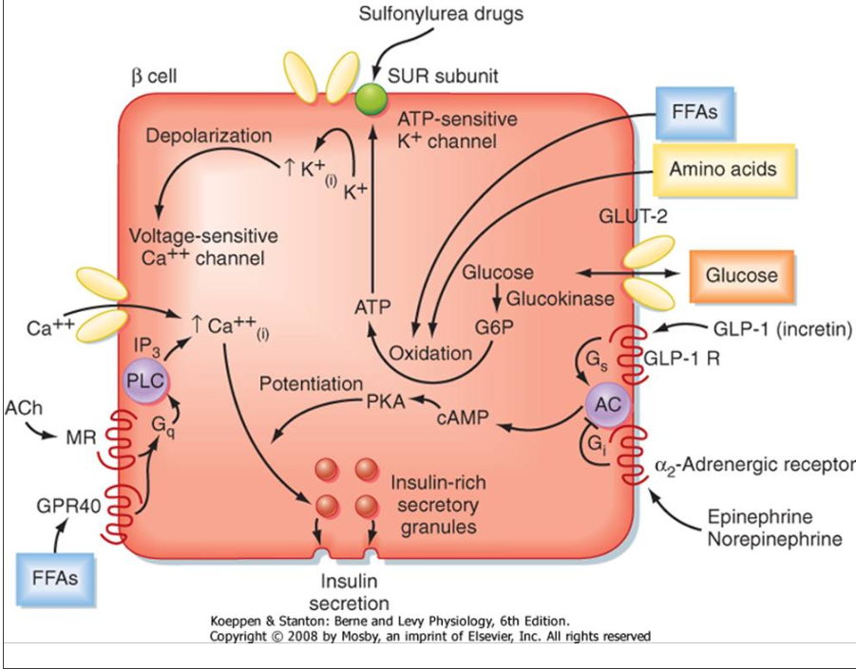

Slide 8
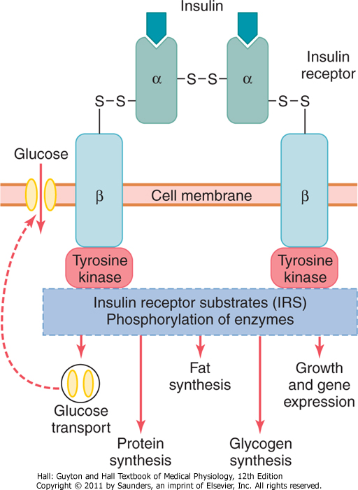
MODE OF ACTION OF INSULIN
Enzyme-linked “tyrosine kinase” receptor
Insulin receptor is a tetramer, formed by four glycoprotein subunits (two α-subunits and two β-subunits).
When insulin binds with α-subunits of the receptor protein, the tyrosine kinase at the β-subunit is activated by means of autophosphorylation.
Activated tyrosine kinase acts on many intracellular enzymes by phosphorylating or dephosphorylating.

Slide 9
ACTIONS OF INSULIN
On Carbohydrate Metabolism:
Insulin reduces the blood glucose level by its following actions on carbohydrate metabolism:
Increases transport and uptake of glucose by the muscle cells:
Energy
Glycogenesis

Slide 10
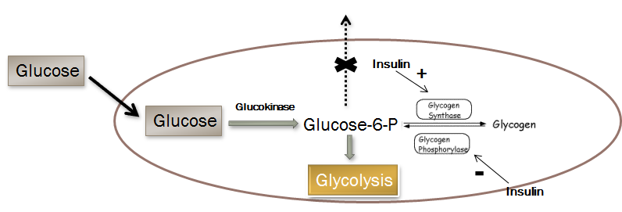
ACTIONS OF INSULIN
ii- Insulin Promotes Liver Uptake, Storage, and Use of Glucose

Slide 11
ACTIONS OF INSULIN
iii- Insulin Promotes Conversion of Excess Glucose into Fatty Acids and Inhibits Gluconeogenesis in the Liver.

Slide 12
ACTIONS OF INSULIN
On Protein Metabolism
Insulin facilitates the synthesis and storage of proteins and inhibits the cellular utilization of proteins by the following actions:
i. Facilitating the transport of amino acids into the cell from blood, by increasing the permeability of cell membrane for amino acids
ii. Accelerating protein synthesis by influencing the transcription of DNA and by increasing the translation of mRNA
iii. Preventing protein catabolism by decreasing the activity of cellular enzymes which act on proteins
iv. Preventing conversion of proteins into glucose. Thus, insulin is responsible for the conservation and storage of proteins in the body.
Insulin Lack Causes Protein Depletion and Increased Plasma Amino Acids.

Slide 13
ACTIONS OF INSULIN
On Fat Metabolism
Actions of insulin on fat metabolism are:
Synthesis of fatty acids and triglycerides :Insulin promotes the transport of excess glucose into cells, particularly the liver cells. This glucose is utilized for the synthesis of fatty acids and triglycerides.
Insulin facilitates the transport of fatty acids into the adipose tissue.
Storage of fat: Insulin promotes the storage of fat in adipose tissue by inhibiting the enzymes which degrade the triglycerides.
Insulin inhibits the action of hormone sensitive lipase; preventing hydrolysis of the triglycerides already stored in the fat cells, so inhibiting back release of fatty acids

Slide 14
Insulin Deficiency Causes Lipolysis of Storage Fat
Insulin Deficiency Increases Use of Fat for Energy
Insulin Deficiency Causes Lipolysis of Stored Fat and Release of Free Fatty Acids
Liver converts of some of the fatty acids into phospholipids and cholesterol → Atherosclerosis
β oxidation of fatty acids in the liver leads to excess generation of acetoacetic acid → it cannot all be metabolized by tissues → Ketosis/acidosis

Slide 15
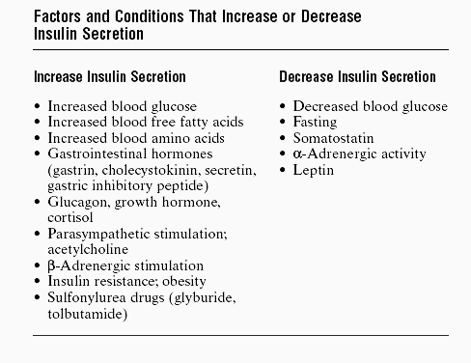
Control of Insulin Secretion

Slide 16
Glucagon
SOURCE OF SECRETION:
Glucagon is secreted from α-cells in the islets of Langerhans of pancreas.
Glucagon circulates in an unbound form and has a short half-life of about 6 minutes.
 SYNTHESIS
Glucagon is synthesized from the preprohormone precursor called preproglucagon in the α-cells of islets.
Preproglucagon is converted into proglucagon, which gives rise to glucagon.
METABOLISM
About 30% of glucagon is degraded in liver and 20% in kidney. The cleaved glucagon fragments are excreted through urine. 50% of the circulating glucagon is degraded in blood itself by enzymes such as serine and cysteine proteases.

Slide 17
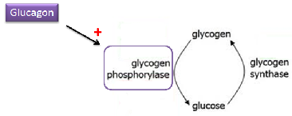
ACTIONS OF GLUCAGON
Actions of glucagon are antagonistic to those of insulin. It increases the blood glucose level, peripheral utilization of lipids and the conversion of proteins into glucose.
On Carbohydrate Metabolism
Glucagon increases the blood glucose level by:
Increasing glycogenolysis in liver and releasing glucose from the liver cells into the blood.

Slide 18
ACTIONS OF GLUCAGON
On Protein Metabolism
Glucagon increases the transport of amino acids into liver cells. The amino acids are utilized for gluconeogenesis.
On Fat Metabolism
Glucagon increases lipolysis by increasing the release of free fatty acids from adipose tissue and making them available for peripheral utilization.
The lipolytic activity of glucagon, in turn promotes ketogenesis (formation of ketone bodies) in liver.

Slide 19
MODE OF ACTION OF GLUCAGON
On the target cells (mostly liver cells), glucagon combines with receptor and activates adenyl cyclase via G protein. Adenyl cyclase causes the formation of cAMP which brings out the actions of glucagon.

Slide 20
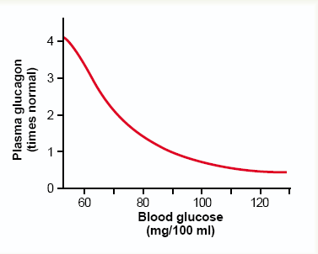
Regulation of Glucagon Secretion
Secretion of glucagon is controlled mainly by glucose and amino acid levels in the blood.
Role of Blood Glucose Level
When blood glucose level decreases below 80 mg/dL of blood, α-cells of islets of Langerhans are stimulated and more glucagon is released.
Glucagon, in turn increases the blood glucose level. On the other hand, when blood glucose level increases, α-cells are inhibited and the secretion of glucagon decreases.
Role of Amino Acid Level
Glucagon promotes rapid conversion of the amino acids to glucose, thus making even more glucose available to the tissues.

Slide 21
Regulation of Glucagon Secretion
Role of Exercise:
In exhaustive exercise, the blood concentration of glucagon often increases fourfold to fivefold.

Slide 22
SOMATOSTATIN
 SOURCE OF SECRETION
Somatostatin is secreted from:
1. Hypothalamus
2. δ-cells in islets of Langerhans of pancreas
3. D cells in stomach and upper part of small
intestine.
ACTIONS OF SOMATOSTATIN
Somatostatin inhibits the secretion of both glucagon and insulin
Somatostatin brings out its actions through cAMP

Slide 23
Diabetes Mellitus
A syndrome of impaired carbohydrate, fat, and protein metabolism caused by either lack of insulin secretion or decreased sensitivity of the tissues to insulin
Blood glucose concentration increases, cell utilization of glucose falls, and utilization of fats and proteins increases

Slide 24
Symptoms of Diabetes Mellitus
Due to High Blood Glucose Concentration
Loss of Glucose in the Urine (glucosuria)
When [blood glucose] is above 180 mg/100 ml (blood "threshold" for the appearance of glucose in the urine)
Osmotic diuresis (polyuria) (excessive urine excretion)
Dehydration and increased thirst (polydepsia)
Depletion of the Body's Proteins; Loss of strength (asthenia)

Slide 25
Type I Diabetes
Characterized by the destruction, almost always by an autoimmune mechanism, of beta cells.
T1DM is also termed "insulin-dependent diabetes mellitus.
5%-10% of DM

Slide 26
Characteristics of T1DM include the following:
1. People with T1DM need exogenous insulin to maintain life and prevent ketosis; virtually no pancreatic insulin is produced.
2. There is pathological damage to the pancreatic beta cells
3. People with T1DM are prone to ketosis.
4. Ninety percent of cases begin in childhood, mostly between 10 and 14 years of age. This common observation led to application of the term "juvenile diabetes" to the disorder. This term is no longer used because T1DM can arise at any time of life, although juvenile onset is the typical pattern.

Slide 27
Type II Diabetes-Resistance to the Metabolic Effects of Insulin
90-95 % of diabetics
After age 30, adult-onset diabetes
The most important risk factor for type II diabetes is obesity
There are multiple causes for the development of T2DM in a given individual that are associated with defects in the ability of target organs to respond to insulin (i.e., insulin resistance), along with some degree of beta cell deficiency.

Slide 28
DM Diagnosis
With normal fasting (i.e., no caloric intake for at least 8 hours), plasma glucose levels should be below 110 mg/dL. A patient is considered to have impaired glucose control if fasting plasma glucose levels are between 110 and 126 mg/dL, and the diagnosis of diabetes is made if fasting plasma glucose exceeds 126 mg/dL on 2 successive days.
Another approach to the diagnosis of diabetes is the oral glucose tolerance test. After overnight fasting, the patient is given a bolus of glucose (usually 75 g) orally, and blood glucose levels are measured at 2 hours. A 2-hour plasma glucose concentration greater than 200 mg/dL on 2 consecutive days is sufficient to make the diagnosis of diabetes.

