Slide 1
Therapeutic uses of corticosteroids
Dr. Fatimah Almahasneh
Department of Basic Medical Sciences
Yarmouk University

Slide 2
Therapeutic uses in nonendocrine diseases

Slide 3
Rheumatic diseases
Glucocorticoids are used widely in the treatment of a variety of rheumatic disorders and are a mainstay in the treatment of the more serious inflammatory rheumatic diseases, such as systemic lupus erythematosus (SLE), and a variety of vasculitic disorders.

Slide 4
Rheumatic diseases
The starting dose of glucocorticoids should be sufficient to suppress the disease rapidly and minimize resultant tissue damage.
Initially, prednisone (1 mg/kg per day in divided doses) often is used, generally followed by consolidation to a single daily dose, with subsequent tapering to a minimal effective dose as determined by the clinical picture.
Corticosteroids are usually used along with other immunosuppressive agents such as cyclophosphamide and methotrexate, which offer better long-term control than steroids alone.

Slide 5
Rheumatic diseases
In rheumatoid arthritis (RA)
glucocorticoids provide relief until other slower acting antirheumatic drugs, such as methotrexate, take effect.
Glucocorticoids are used as stabilizing agents for progressive disease that fails to respond to first-line treatments such as physiotherapy and nonsteroidal anti-inflammatory agents.
because of the serious and debilitating side effects associated with chronic use.

Slide 6
Rheumatic diseases
In rheumatoid arthritis (RA)
Patients with major symptomatology confined to one or a few joints may be treated with intra-articular steroid injections.
Preferred agents:
triamcinolone acetonide
briamcinolone hexacetonide
prednisolone tebutate
hydrocortisone acetate
methylprednisolone acetate.

Slide 7
Rheumatic diseases
In noninflammatory degenerative joint disease (e.g., osteoarthritis) and in a number of regional pain syndromes (e.g., tendinitis, bursitis) glucocorticoids may be administered by local injection for the treatment of episodic disease flare-up.
It is recommended that intra-articular injections be performed with intervals of at least 3 months to minimize complications (e.g., painless joint destruction).

Slide 8
Renal diseases
Glucocorticoids (such as prednisone) are the first-line treatment in both adults and children with nephrotic syndrome secondary to minimal change disease.
Response is seen in 2-3 weeks.
Cessation of steroid therapy frequently is complicated by disease relapse → if that happens repeatedly → steroid-resistance → treated with other immunosuppressants (e.g., azathioprine or cyclophosphamide).
Patients with renal disease secondary to SLE also are given a therapeutic trial of glucocorticoids.

Slide 9
Renal diseases
Other renal diseases, such as membranous and membranoproliferative glomerulonephritis and focal sclerosis → conflicting data on the role of glucocorticoids.
In clinical practice, patients with these disorders often are given a therapeutic trial of glucocorticoids.

Slide 10
Allergic disease
The onset of action of glucocorticoids in allergic diseases is delayed
patients with severe allergic reactions such as anaphylaxis require immediate therapy with epinephrine.
For allergic manifestations of limited duration (hay fever, serum sickness, urticaria, contact dermatitis, mild drug reactions)
Use glucocorticoids + primary therapy.

Slide 11
Allergic disease
For severe cases → IV glucocorticoids (ex.: IV methylprednisolone).
In less severe disease, antihistamines are the drugs of first choice.
In allergic rhinitis, intranasal steroids are now viewed as the drug of choice by many experts.

Slide 12
Bronchial asthma
Corticosteroids are frequently used in bronchial asthma.
role of inflammation in the immunopathogenesis of this disorder.
In severe asthma attacks requiring hospitalization, treatment with high-dose parenteral glucocorticoids is essential.
Less severe acute exacerbations of asthma often are treated with brief courses of oral glucocorticoids (5 days).
In many patients, inhaled steroids can either reduce the need for oral corticosteroids or replace them entirely.

Slide 13
Antenatal glucocorticoids
Used frequently in the setting of premature labor to decrease the incidence of
respiratory distress syndrome
intraventricular hemorrhage
death
in infants delivered prematurely.
Betamethasone (IM, two doses)
or
Dexamethasone (IM, four doses).

Slide 14
Infectious diseases
AIDS patients with Pneumocystis carinii pneumonia and moderate to severe hypoxia
addition of glucocorticoids to the antibiotic regimen increases oxygenation and lowers the incidence of respiratory failure and mortality.
Haemophilus influenzae type b meningitis in infants and children ≥2 months of age
Glucocorticoids decrease the incidence of long-term neurological impairment.

Slide 15
Infectious diseases
A long-standing controversy in medicine is the use of glucocorticoids in septic shock.
Latest guidelines (2020)
Corticosteroids are not recommended in sepsis or severe sepsis if fluid resuscitation and vasopressors are sufficient to restore hemodynamic stability.
Rather, they can be added as adjunctive therapy for patients requiring higher doses of vasopressors.

Slide 16
Skin diseases
Glucocorticoids are remarkably efficacious in the treatment of a wide variety of inflammatory dermatoses.
a large number of different preparations and concentrations of topical glucocorticoids of varying potencies are available.
Glucocorticoids are administered systemically for severe episodes of acute dermatological disorders and for exacerbations of chronic disorders.

Slide 17
Gastrointestinal diseases
Inflammatory bowel disease
Ulcerative colitis and Chron’s disease
Patients who fail to respond to more conservative management (i.e., rest, diet, and sulfasalazine) may benefit from glucocorticoids; steroids are most useful for acute exacerbations.
Mild ulcerative colitis → hydrocortisone can be administered as a retention enema.
More severe acute exacerbations → oral prednisone

Slide 18
Malignancies
Glucocorticoids are used in the chemotherapy of acute lymphocytic leukemia and lymphomas because of their antilymphocytic effects.
Most commonly, glucocorticoids are one component of combination chemotherapy administered under scheduled protocols.
Glucocorticoids once were frequently employed in the setting of hypercalcemia of malignancy, but more effective agents, such as the bisphosphonates, now are the preferred therapy.

Slide 19
Organ transplantation
In organ transplantation, high doses of prednisone are given at the time of transplant surgery, in conjunction with other immunosuppressive agents, and most patients are kept on a maintenance regimen that includes lower doses of glucocorticoids
For some solid organ transplants (e.g., pancreas), protocols that either withdraw corticosteroids early after transplantation or that avoid them completely are becoming more common.

Slide 20
Spinal cord injury
Patients with acute spinal cord injury treated within 8 hours of injury with large doses of methylprednisolone sodium succinate (bolus, followed by IV infusion for 1 or 2 days).
→ Inhibition of free radical–mediated cellular injury.

Slide 21
Adverse effects of corticosteroid therapy

Slide 22
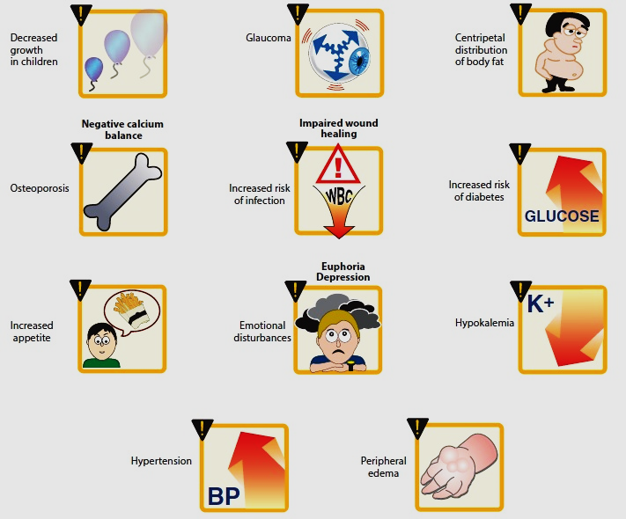
Adverse effects of corticosteroid therapy

