Slide 1
Pharmacology of the adrenal gland
Dr. Fatimah Almahasneh
Department of Basic Medical Sciences
Yarmouk University

Slide 2
Adrenal insufficiency

Slide 3
Treatment of chronic adrenal insufficiency
Goal of treatment:
Manage symptoms
Prevent development of adrenal crisis
Lifelong glucocorticoid replacement therapy may be necessary for patients with adrenal insufficiency.
Mineralocorticoid replacement therapy is usually required for those with Addison disease.

Slide 4
Treatment of chronic adrenal insufficiency
Glucocorticoids with sufficient mineralocorticoid activity are generally required.
However, the addition of a potent mineralocorticoid such as fludrocortisone, along with adequate salt intake, is sometimes needed to prevent sodium loss, hyperkalemia, and intravascular volume depletion.
Mineralocorticoid supplementation typically is not indicated for the treatment of secondary or tertiary adrenal insufficiency because aldosterone production is often unaffected.

Slide 5
Treatment of chronic adrenal insufficiency
Hydrocortisone is often prescribed
it most closely resembles endogenous cortisol (relatively high mineralocorticoid activity and short half-life)
allows the design of regimens that simulate the normal circadian cycle.
Other glucocorticoids, however, can be used.

Slide 6
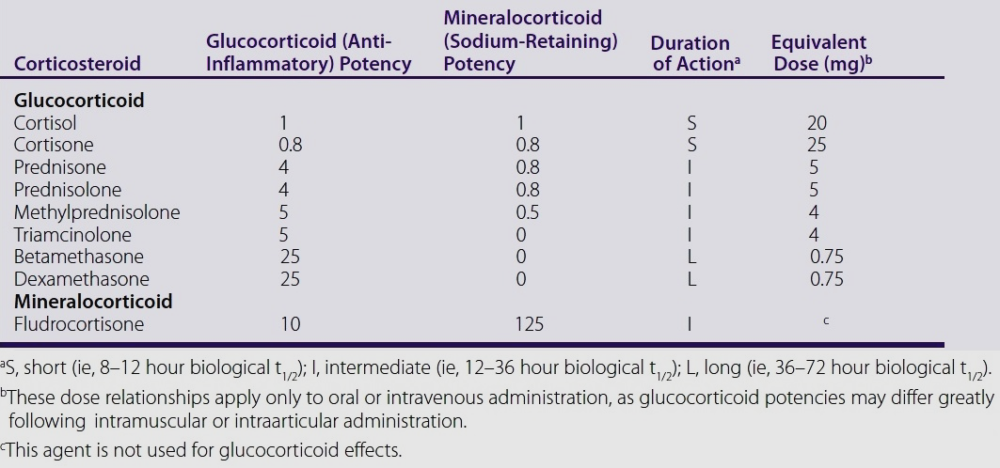
Pharmacologic characteristics of major corticosteroids

Slide 7
Treatment of Addison disease
Hydrocortisone or cortisone acetate in two or three divided oral doses per day (recommended regimen).
the highest dose is given in the morning at awakening to mimic the early morning rise in endogenous cortisol.
2/3 of the total dose is preferably given in the morning.
If there is concern about adherence → consider oral prednisolone administered once or twice daily.
Dexamethasone, a long-acting glucocorticoid is not recommended due to risk of Cushingoid side effects.

Slide 8
Treatment of Addison disease
Many patients will also need oral fludrocortisone in the morning.
All patients should maintain adequate sodium intake.

Slide 9
Treatment of secondary or tertiary adrenal insufficiency
Oral hydrocortisone or another glucocorticoid as for primary adrenal insufficiency.
However, lower doses are needed.
Patients with drug-induced adrenal insufficiency or adrenal insufficiency following treatment for Cushing syndrome will only require glucocorticoid replacement temporarily, which can be discontinued after recovery of the HPA axis.
Fludrocortisone therapy is generally not needed.

Slide 10
Treatment of acute adrenal insufficiency
Correct volume depletion
rapid infusion of 1 L isotonic saline within the first hour or (5% glucose in isotonic saline), followed by continuous IV isotonic saline guided by individual patient needs.
Manage hypoglycemia
Slow IV infusion of D25W
Provide glucocorticoid replacement
hydrocortisone IV bolus, followed by hydrocortisone IV continuous infusion.

Slide 11
Hypercortisolism (Cushing syndrome)

Slide 12
Nonpharmacologic therapy of Cushing syndrome
Transsphenoidal pituitary microsurgery is the treatment of choice for Cushing disease.
HPA axis suppression associated with chronic hypercortisolism → prolonged adrenal insufficiency lasting for months after surgery → exogenous glucocorticoid needed.
The treatment of choice in patients with adrenal adenomas is unilateral laparoscopic adrenalectomy.
Glucocorticoid supplementation during and after surgeryis required → due to atrophy of the contralateral adrenal gland and suppression of the HPA axis. Glucocorticoid therapy is continued until recovery of the remaining adrenal gland is achieved.

Slide 13
Pharmacologic therapy of Cushing syndrome
Pharmacotherapy is indicated if:
the ectopic ACTH-secreting tumor cannot be localized
to control hypercortisolism to prepare for surgery
in patients who
are not surgical
have failed surgery or had a relapse after surgery
have Cushing disease awaiting the onset of effect of pituitary radiation.

Slide 14
Pharmacologic therapy of Cushing syndrome
Inhibitors of adrenal steroidogenesis
Ketoconazole
Metyrapone
Etomidate
Adrenolytic agent
Mitotane
Peripheral glucocorticoid antagonist
Mifepristone
Somatostatin analog
Pasireotide

Slide 15
Ketoconazole
Effective in a majority of causes; rapid clinical improvement seen.
Useful in women with hirsutism and patients with hyperlipidemia.
Adverse effects:
Generally well-tolerated.
Symptoms of adrenal insufficiency, gynecomastia, impotence.
Hepatotoxicity → monitor liver transaminases.

Slide 16
Metyrapone
MOA:
Inhibits 11β-hydroxylase.
Also suppresses aldosterone synthesis.
Used in Cushing disease, ectopic ACTH syndrome, and adrenal carcinoma
Also used as a test to diagnose adrenal insufficiency.
Adverse effects:
Generally well-tolerated.
Hirsutism, acne, adrenal insufficiency.

Slide 17
Etomidate
Is a general anesthetic
Generally reserved for patients with more severe symptoms and in emergency settings.
MOA:
Inhibits 17,20-lyase, 17-hydroxylase, and 11β-hydroxylase.
Adverse effects:
Injection site pain, nausea, vomiting, myoclonus, hypotension.

Slide 18
Mitotane
MOA
Inhibits steroidogenesis at lower doses and is adrenolytic at higher doses. Reduces aldosterone synthesis.
FDA-approved for treatment of inoperable adrenal cortical carcinoma.
Can be used in other types of Cushing syndrome.
Efficacy takes several weeks.
Enables lower doses and therefore lower rate of adverse reactions.

Slide 19
Mitotane
Adverse effects:
GI intolerance (high incidence), fatigue, dizziness, somnolence, gynecomastia.
Hyperlipidemia requiring lipid-lowering treatment.
Adrenal insufficiency → may persist several weeks/months after discontinuation, as drug is stored in fatty tissues.

Slide 20
Mifepristone
MOA
Antagonizes glucocorticoid receptors
Increases cortisol and ACTH levels via antagonism of negative feedback of ACTH secretion.
FDA-approved for control of hyperglycemia secondary to hypercortisolism in adult patients with endogenous Cushing syndrome who have type 2 diabetes mellitus or glucose intolerance and have failed surgery or are not candidates for surgery.

Slide 21
Mifepristone
Adverse effects:
nausea, vomiting
fatigue, headache
hypokalemia
arthralgia
peripheral edema
hypertension

Slide 22
Pasireotide
MOA
Binds to somatostatin receptor subtype 5 over-expressed in corticotroph tumor cells → results in inhibition of ACTH secretion.
FDA-approved for treatment of adult patients with Cushing disease for whom pituitary surgery is not an option or has not been curative.
Adverse effects:
GI pain, nausea, diarrhea, headache, fatigue, QT prolongation.

Slide 23
Pharmacologic therapy of Cushing syndrome
In drug-induced Cushing syndrome, discontinuation of the offending agent is the best management option.
However, abrupt withdrawal of the glucocorticoid can result in adrenal insufficiency or exacerbation of the underlying disease.
Glucocorticoid doses less than 7.5 mg/day of prednisone or its equivalent for less than 3 weeks generally would not be expected to lead to suppression of the HPA axis.

Slide 24
Pharmacologic therapy of Cushing syndrome
In patients receiving pharmacologic doses of glucocorticoids for prolonged periods, gradual tapering to near physiologic levels (5–7.5 mg/day of prednisone or its equivalent) should precede drug discontinuation.
Administration of a short-acting glucocorticoid in the morning and use of alternate-day dosing may reduce the risk of adrenal suppression.

Slide 25
To be continued..

