Slide 1
Metabolic Syndrome & Obesity

Slide 2
Outline
Definition of Metabolic Syndrome & Obesity
Prevalence of Metabolic Syndrome and obesity among adults
Prevalence of Metabolic Syndrome among children and adolescents
Prevention of Metabolic Syndrome

Slide 3
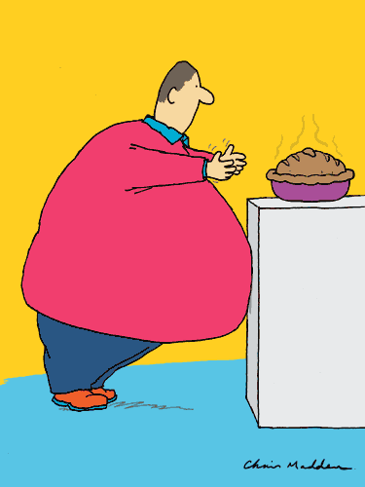
OBESITY

Slide 4
THE ISSUE:
The problem of obesity is a major dilemma that the World must confront.
What is obesity and how does it relate to standards of health?
What are the economic costs and implications associated with obesity?
What are the broader implications of obesity, particularly on the global level?
What are solutions to the problem of obesity?

Slide 5
Defining Obesity
What constitutes obesity?
"a condition characterized by the excessive accumulation and storage of fat in the body”
(Body Mass Index)
BMI is calculated by taking a person’s weight (kg.) and dividing by their height squared (meter).
BMI= Wt (kg)/Ht (m) ²
In Adults: Overweight is defined as a BMI of 25-29

Slide 6
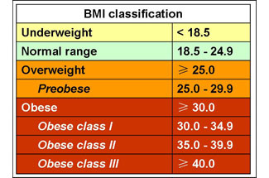

Slide 7
Risks
Raised BMI is a major risk factor for non-communicable diseases such as:
cardiovascular diseases (mainly heart disease and stroke), which were the leading cause of death in 2012;
diabetes;
musculoskeletal disorders (especially osteoarthritis - a highly disabling degenerative disease of the joints);
some cancers (endometrial, breast, and colon).
The risk for these non-communicable diseases increases, with an increase in BMI.

Slide 8
Reasons created an “obesogenic environment” around the Arabic countries
Easy transportation
Sedentary lifestyles
Adopting Western style fast food
Easier life styles

Slide 9
For any given degree of overweight, younger adults generally had greater YLL than did older adults. The maximum YLL for white men aged 20 to 30 years with a severe level of obesity (BMI >45) is 13 and is 8 for white women.
One way to quantify the individual effect is in terms of the expected number of years of life lost (YLL). The YLL is defined as the difference between the number of years a person would be expected to live if he/she was not obese and the number of years expected to live if the person is obese.

Slide 10
10 facts on obesity/WHO
Overweight and obesity are defined as "abnormal or excessive fat accumulation that may impair health“
WHO defines overweight as a BMI equal to or more than 25, and obesity as a BMI equal to or more than 30.

Slide 11
In 2014, more than 1.9 billion adults, 18 years and older, were overweight. Of these over 600 million were obese.
The prevalence of obesity has nearly doubled between 1980 and 2008. Once associated with high-income countries, obesity is now also prevalent in low- and middle-income countries.

Slide 12
Childhood obesity is one of the most serious public health challenges of the 21st century. Overweight children are likely to become obese adults.
They are more likely than non-overweight children to develop diabetes and cardiovascular diseases at a younger age, which in turn are associated with a higher chance of premature death and disability.

Slide 13
Overweight and obesity are linked to more deaths worldwide than underweight

Slide 14
For an individual, obesity is usually the result of an imbalance between calories consumed and calories expended

Slide 15
Supportive environments and communities are fundamental in shaping people’s choices and preventing obesity

Slide 16
Children's choices, diet and physical activity habits are influenced by their surrounding environment.
Social and economic development as well as policies in the areas of agriculture, transport, urban planning, environment, education, food processing, distribution and marketing influence children's dietary habits and preferences as well as their physical activity patterns. Increasingly, these influences are promoting unhealthy weight gain leading to a steady rise in the prevalence of childhood obesity.

Slide 17
Eating a healthy diet can help prevent obesity
People can:
1) maintain a healthy weight 2) limit total fat intake and shift fat consumption away from saturated fats to unsaturated fats 3) increase consumption of fruit, vegetables, pulses, whole grains and nuts 4) limit the intake of sugar.

Slide 18
Regular physical activity helps maintain a healthy body
People should engage in adequate levels of physical activity throughout their lives. At least 30 minutes of regular, moderate-intensity physical activity on most days reduces the risk of cardiovascular disease, diabetes, colon cancer and breast cancer.

Slide 19
Curbing the global obesity epidemic requires a population-based multisectoral, multi-disciplinary, and culturally relevant approach

Slide 20
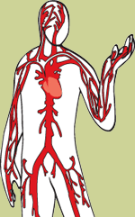
Metabolic Syndrome
Metabolic Syndrome is not a disease, but rather a cluster of disorders of your body’s metabolism, including:
High blood pressure
High insulin levels
Excess body weight
Abnormal cholesterol levels
Each of these disorders is by itself a risk factor for other diseases.
In combination, however, these disorders dramatically boost the chances of developing potentially life-threatening illnesses, such as diabetes, heart disease or stroke.

Slide 21
Metabolic Syndrome
The syndrome is closely related to a generalized metabolic disorder called insulin resistance, in which the body can’t use insulin efficiently.
Metabolic syndrome has been called many names, including:
Syndrome X
The deadly quartet
Insulin Resistance Syndrome

Slide 22
Prevalence
Affects as many as one in four American adults (25%)
For adults over the age of 40 years, more than 40% are affected.
Metabolic syndrome prevalence has increased by 61% over the past decade.
Rates differ among races and genders.

Slide 23
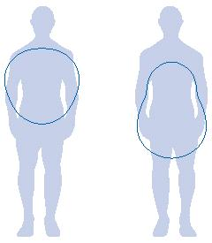
Risk Factors
The following factors increase your risk of developing Metabolic Syndrome:
Apple Pear
Age | The prevalence of metabolic syndrome increases with age, affecting less than 10% of people in their 20s and 40% of people in their 60s.
Race | Metabolic syndrome is generally more common among blacks and Mexican-Americans than among Caucasians.
Obesity | A body mass index (BMI) greater than 25 increases your risk of metabolic syndrome and abdominal obesity increase the risk of MS. Abdominal obesity refers to having an apple shape rather than a pear.
History of diabetes | Having a family history of type 2 diabetes or diabetes during pregnancy (gestational diabetes) increases the risk for developing metabolic syndrome.
Other diseases | A diagnosis of hypertension, cardiovascular disease (CVD) or polycystic ovary syndrome (a hormonal disorder in which a woman’s body produces an excess of male hormones) also increases the risk for metabolic syndrome.

Slide 26
The Metabolic Syndrome (ATP III)
Any 3 OF 5
Risk Factor | Criterion
Abdominal Obesity Men Women | Waist Circumference >102 cm (>40 in) >88 cm (>35 in)
Triglycerides | ≥150 mg/dL
HDL-Cholesterol Men Women | <40 mg/dL <50 mg/dL
Blood Pressure | ≥130/≥85 mm Hg
Fasting Glucose | ≥110 mg/dL

Slide 27
IDF (2005)
Waist circumference : – ethnicity specific*
– for Europids: Male > 94 cm
Female > 80 cm
plus any two of the following
Raised triglycerides
Reduced HDL cholesterol
Raised fasting plasma glucose
Raised blood pressure

Slide 28
Cardiovascular Diseases Mortality increases with the increased number of Metabolic Syndrome components

Slide 29
Prevalence of MeS in the region

Slide 30
Metabolic syndrome in Jordan

Slide 31
Metabolic syndrome and its components among Jordanian children and adolescents

Slide 32
Prevalence of Childhood Obesity in the Region
(9-18 yrs)
Country | % Overweight | % Obesity
Jordan | 17 | 9
Oman | 19 | 10
Syria | 17 | 11
Sudan | 12 | 8

Slide 33
Overweight and obesity
24%
24%
14%
9%

Slide 34
2,131 children aged 6 and 12 year
Overweight 20%
Obesity
6%

Slide 35
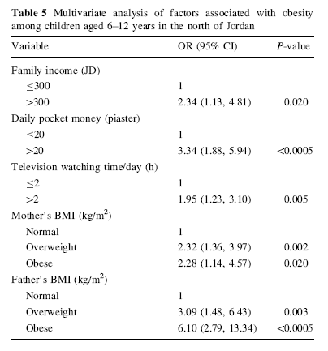
Predictors of obesity among Jordanian children

Slide 36
Individual metabolic abnormalities in children
Notes:
In conclusion, our results indicate that although the prevalence of MeS is low in Jordanian children and adolescents, a large proportion of them had one or two metabolic abnormalities

Slide 37
Individual metabolic abnormalities in adolescents

Slide 38
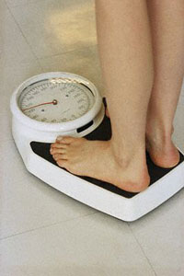
Self-care
Although metabolic syndrome creates a real risk for developing diabetes, stroke or heart disease, these conditions can be prevented. Insulin resistance can be controlled by the following:
Lose weight
Losing as little as 5 to 10% of your body weight can reduce insulin levels and high blood pressure, thus reducing your risk of diabetes.
Exercise
Walking just 30 minutes a day or engaging in other aerobic activities can help prevent the serious diseases associated with MS.
Stop smoking
Smoking cigarettes increases insulin resistance and worsens health consequences associated with MS.
Eat fiber-rich foods
Whole grains, beans, fruits and vegetables are high in dietary fiber. These are important foods to eat since dietary fiber is known to lower insulin levels.

Slide 40
Thank you

