Slide 1


Slide 2
HORMONES TRANSDUCE SIGNALS TO AFFECT HOMEOSTATIC MECHANISMS
The stimulus can be a challenge or a threat to:
Organism.
Organ.
Integrity of a single cell within that organism.

Slide 3
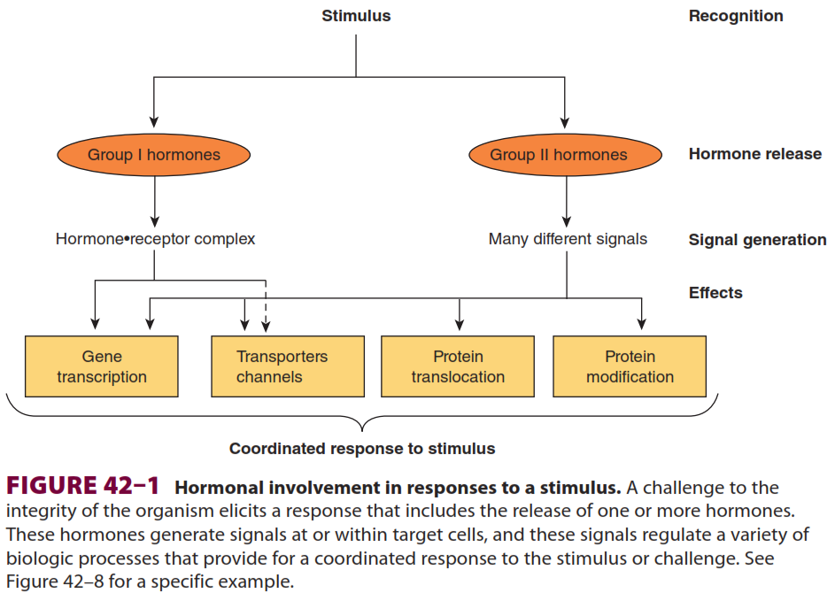
Chapter 42
Hormone Action & Signal Transduction
© The McGraw-Hill Companies, Inc, 2011

Slide 4


Slide 5
The Ligand-receptor Complex Is the
Signal for Group I hormones
Lipophilic group I hormones diffuse through the plasma
membrane of all cells but only encounter their specific, high affinity intracellular receptors in target cells.
A given hormone directly affects <1% of the genes, mRNA, or proteins in a target cell.
microRNAs have been implicated in mediating some of the diverse actions of hormones.

Slide 6
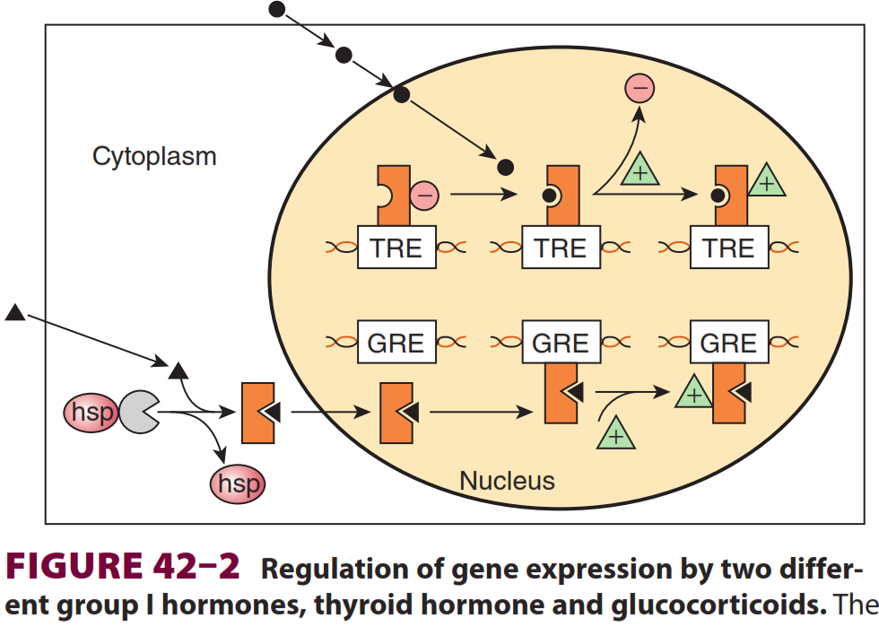

Chapter 42
Hormone Action & Signal Transduction
Thyroid hormones and retinoic acid
Glucocorticoid hormones
© The McGraw-Hill Companies, Inc, 2011

Slide 7
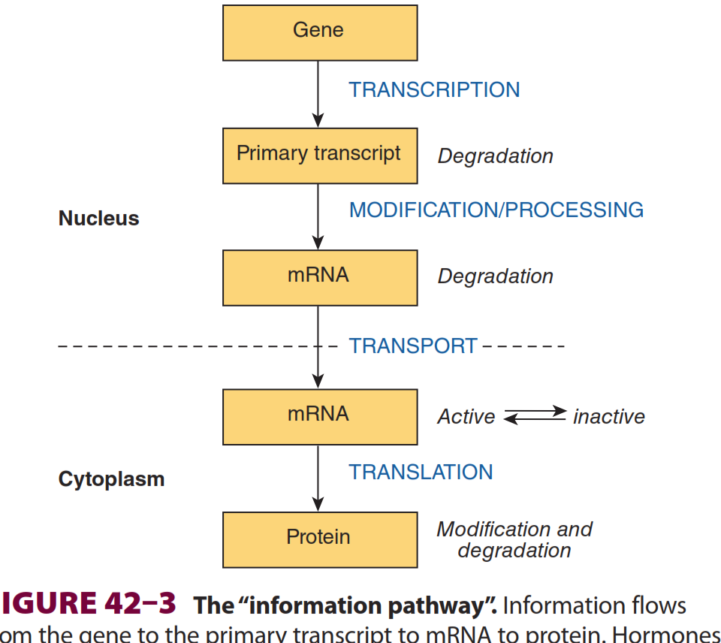
Chapter 42
Hormone Action & Signal Transduction
Hormones
can affect any of the steps involved and can affect the rates of processing,
degradation or modification of the various products.
© The McGraw-Hill Companies, Inc, 2011

Slide 8
GROUP II
(PEPTIDE & CATECHOLAMINE) HORMONES HAVE MEMBRANE RECEPTORS & USE INTRACELLULAR MESSENGERS
have a short plasma half-life

Slide 9
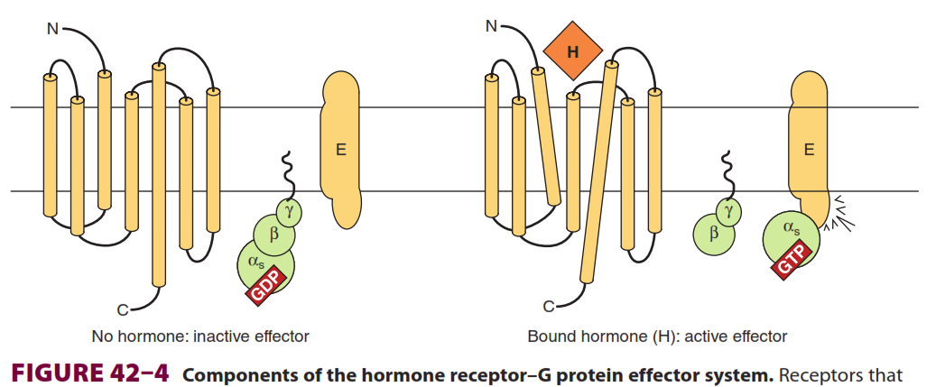
G protein–Coupled receptors
These receptors typically have seven hydrophobic plasma membrane-spanning domains.

Slide 10
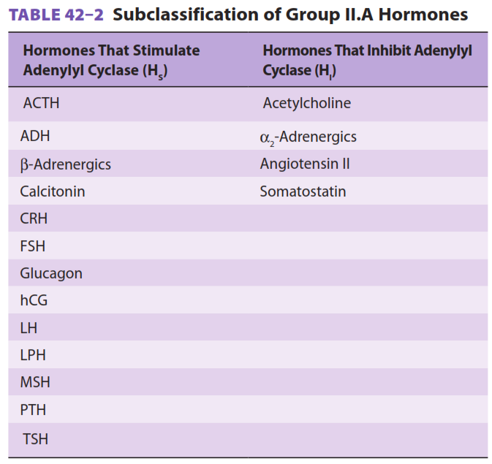
cAMP Is the Intracellular Signal for Many Responses
Adenylyl Cyclase
Protein Kinase
Phosphoproteins
Phosphodiesterases
Phosphoprotein Phosphatases

Slide 11
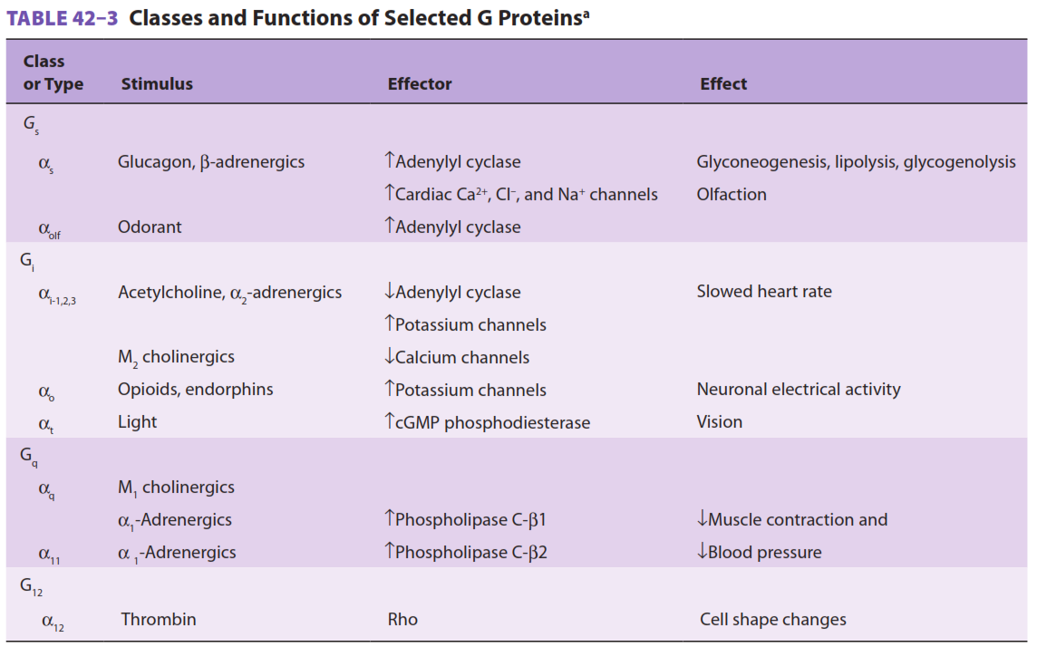

Slide 12
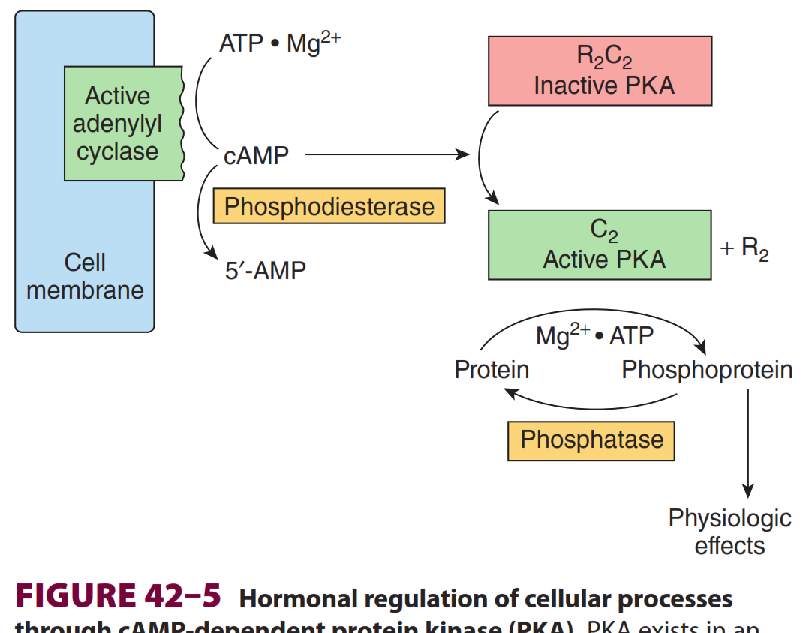

Chapter 42
Hormone Action & Signal Transduction
Bind CRP in prokaryots
© The McGraw-Hill Companies, Inc, 2011

Slide 13
cGMP Is also an Intracellular Signal
Cyclic GMP is made from GTP by the enzyme guanylyl cyclase, which exists in soluble and membrane-bound forms.
Formed by:
The atriopeptins, a family of peptides produced in cardiac atrial tissues, cause natriuresis, diuresis, vasodilation, and inhibition of aldosterone secretion.
Other stimulators: nitroprusside, nitroglycerin, nitric oxide, sodium nitrite, and sodium azide, all cause smooth muscle relaxation and are
potent vasodilators.
Inhibitors: phosphodiesterase (the drug sildenafil [Viagra])

Slide 14
Several hormones act Through Calcium or phosphatidylinositols

Slide 15
Calcium Metabolism
Intracellular = 0.05 to 10 μmol/L.
There are three ways of changing cytosolic Ca²⁺ levels:
(1) Certain hormones by binding to receptors that are themselves Ca²⁺
channels, enhance membrane permeability to Ca²⁺, and thereby increase Ca²⁺ influx.
(2) Hormones also indirectly promote Ca²⁺ influx by modulating the membrane potential at the plasma membrane. Membrane depolarization opens voltage-gated Ca²⁺ channels and allows for Ca²⁺ influx.
(3) Ca²⁺ can be mobilized from the endoplasmic reticulum, and possibly
from mitochondrial pools.

Slide 16
Calmodulin
Is homologous to the muscle protein troponin C in structure and function.
Binding of 4 Ca will lead to activate enzymes and ion channels.
Regulates the activity of many structural elements in cells:
Actin-myosin complex of smooth muscle.
Various microfilament-mediated processes in noncontractile
Cells.
Cell motility, cell conformation changes, mitosis, granule release, and endocytosis.

Slide 17
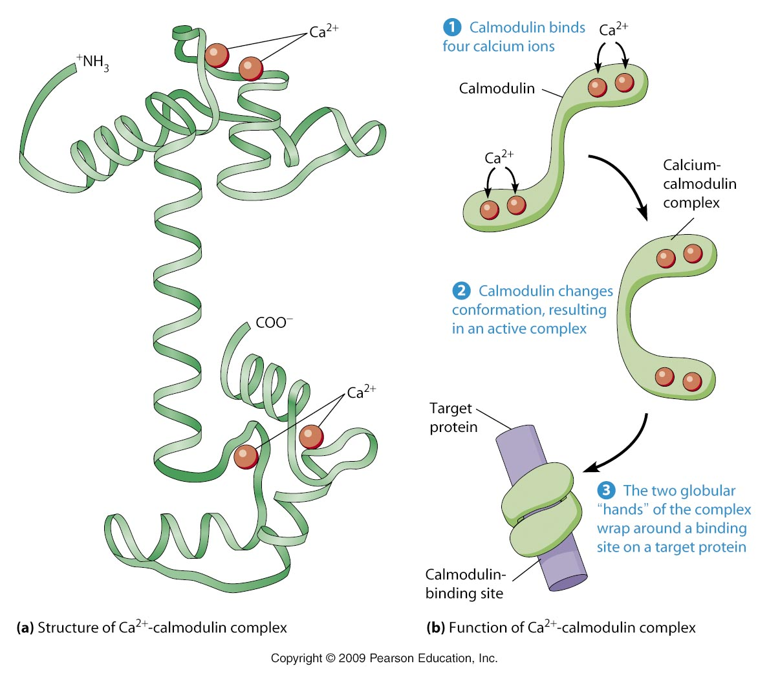

Slide 18
Calcium Is a Mediator of Hormone Action
How they found this:
Blunted by Ca²⁺-free media or when intracellular calcium is depleted.
Can be mimicked by agents that increase cytosolic Ca²⁺
Influences cellular calcium flux.
Number of critical metabolic enzymes are regulated by Ca, phosphorylation, or both.
These include glycogen synthase, pyruvate kinase, pyruvate carboxylase, glycerol3-phosphate dehydrogenase, and pyruvate dehydrogenase.

Slide 19
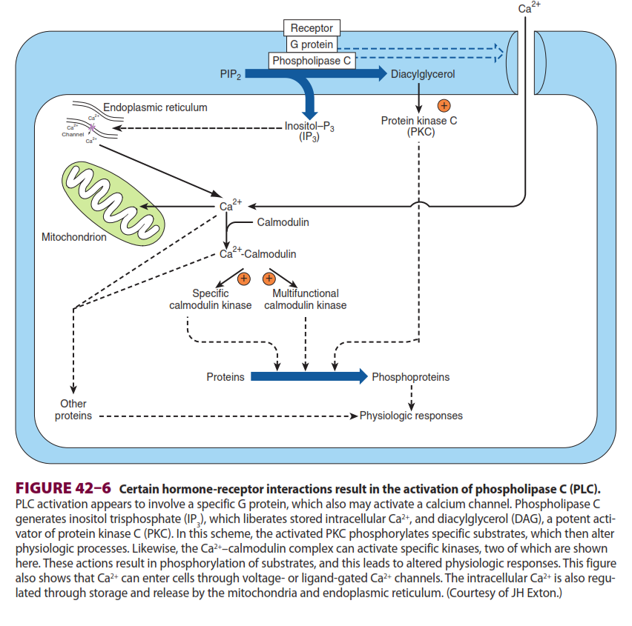
Phosphatidylinositide Metabolism Affects
Ca²⁺-Dependent Hormone Action

Slide 20
Some hormones act Through a protein Kinase Cascade
The discovery that the EGF receptor contains an intrinsic tyrosine kinase activity that is activated by the binding of the ligand EGF was an important breakthrough.
The insulin and IGF-I receptors also contain intrinsic ligand-activated tyrosine kinase activity.

Slide 21
Insulin Transmits Signals by Several Kinase Cascades
The insulin, epidermal growth factor (EGF), and IGF-I receptors have intrinsic protein tyrosine kinase activities located in their cytoplasmic domains.

Slide 22
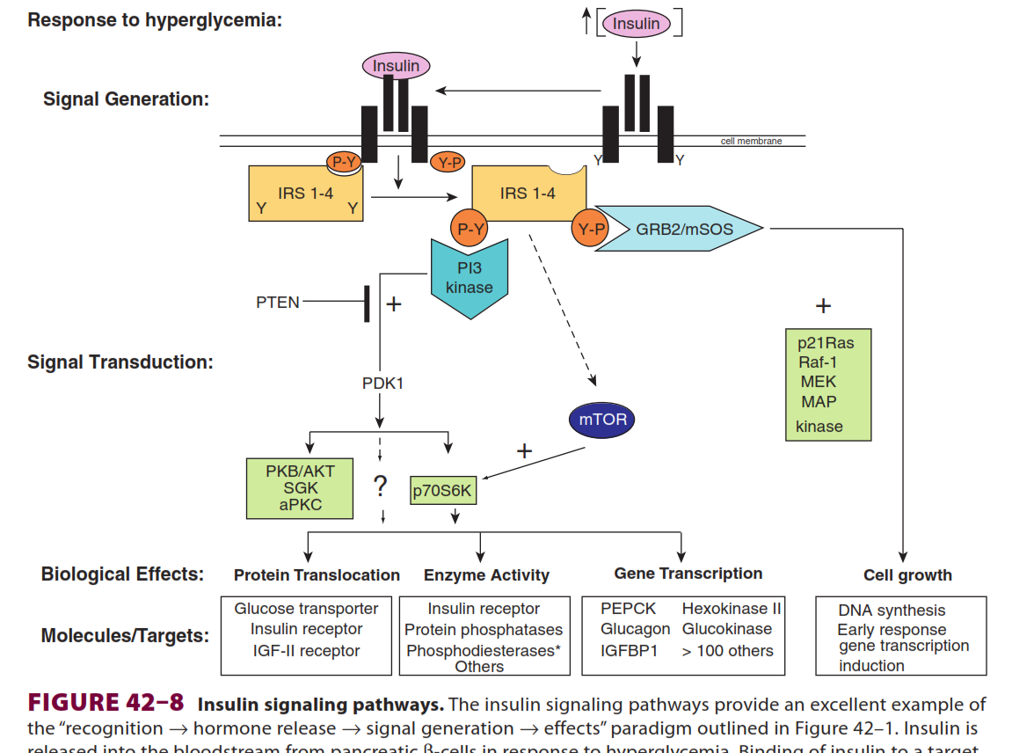
Chapter 42
Hormone Action & Signal Transduction
phosphoinositide-dependent
kinase-1
© The McGraw-Hill Companies, Inc, 2011

Slide 23
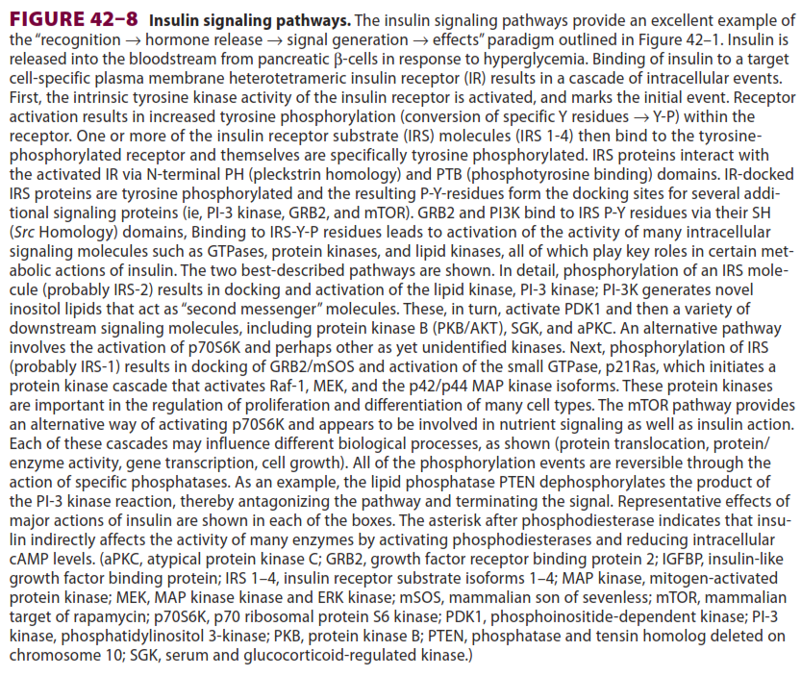

Slide 24
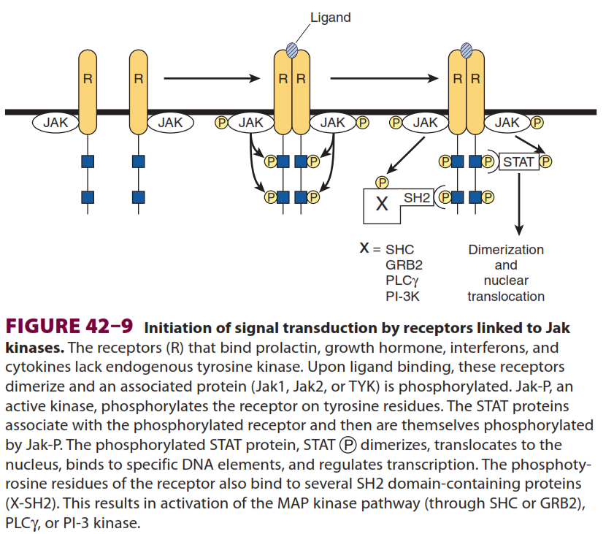
Chapter 42
The Jak/STAT Pathway Is Used by Hormones and Cytokines
GH, PL, IP and CKine
© The McGraw-Hill Companies, Inc, 2011

Slide 25
HORMONES CAN INFLUENCE
SPECIFIC BIOLOGIC EFFECTS BY MODULATING TRANSCRIPTION

Slide 26
How hormones affect transcription
Actively transcribed genes are in regions of “open” chromatin (experimentally defined as relative susceptibility to the enzyme DNase I), which allows for the access of transcription factors to DNA.
Genes have regulatory regions, and transcription factors bind to these to modulate the frequency of transcription initiation.

Slide 27
(3) The hormonereceptor complex can be one of these transcription factors. The DNA sequence to which this binds is called a HRE.
(4) Alternatively, other hormone generated signals can modify the location, amount, or activity of transcription factors and thereby influence binding to the regulatory or response element.

Slide 28
(5) Members of a large superfamily of nuclear receptors act with—or in a manner analogous to—the hormone receptors.
(6) These nuclear receptors interact with another large group of coregulatory molecules to effect changes in the transcription of specific genes.

Slide 29
Several HREs Have Been Defined
They generally are found within a few hundred nucleotides upstream (5′) of the transcription initiation site, but they may be located within the coding region of the gene, in introns.

Slide 30
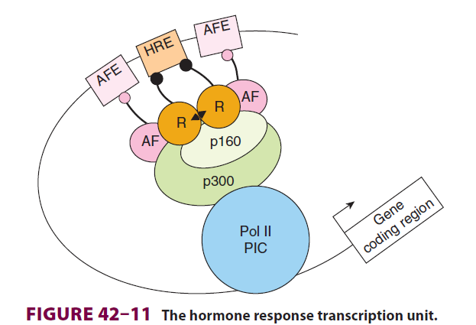
Chapter 42
Hormone Action & Signal Transduction
© The McGraw-Hill Companies, Inc, 2011

Slide 31
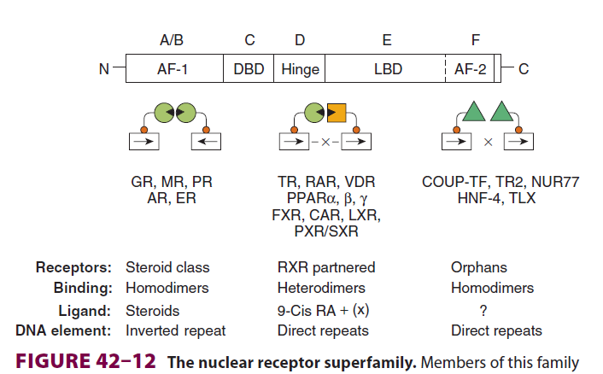
There Is a Large Family of Nuclear Receptor Proteins
Diverse set of transcription factors, >50 members

Slide 32
Chapter 42
A Large Number of Nuclear Receptor Coregulators Also Participate in Regulating Transcription
The first of these to be described was the CREB-binding protein, CBP.
© The McGraw-Hill Companies, Inc, 2011

Slide 33
