Slide 1
Hypothalamic-Pituitary Relationship

Slide 2
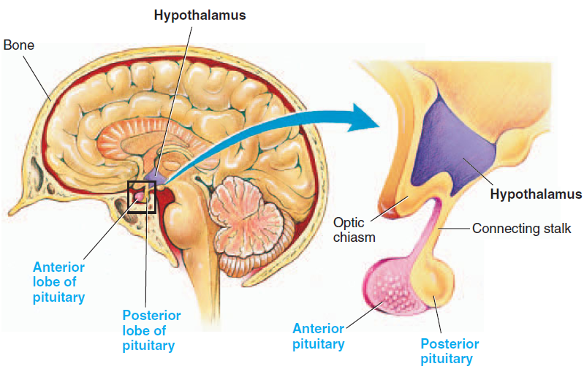
Pituitary Gland and Its Relation to the Hypothalamus
Pituitary Gland (hypophysis):
Two Distinct lobes:
The Anterior lobe : also known as the adenohypophysis
The Posterior lobe : also known as the neurohypophysis
Pituitary is located in bony pocket
(called sella turcica) of the sphenoid bone at the base of the brain, below the hypothalamus.
It hangs from the hypothalamus by the infundibulum or pituitary stalk.

Slide 3
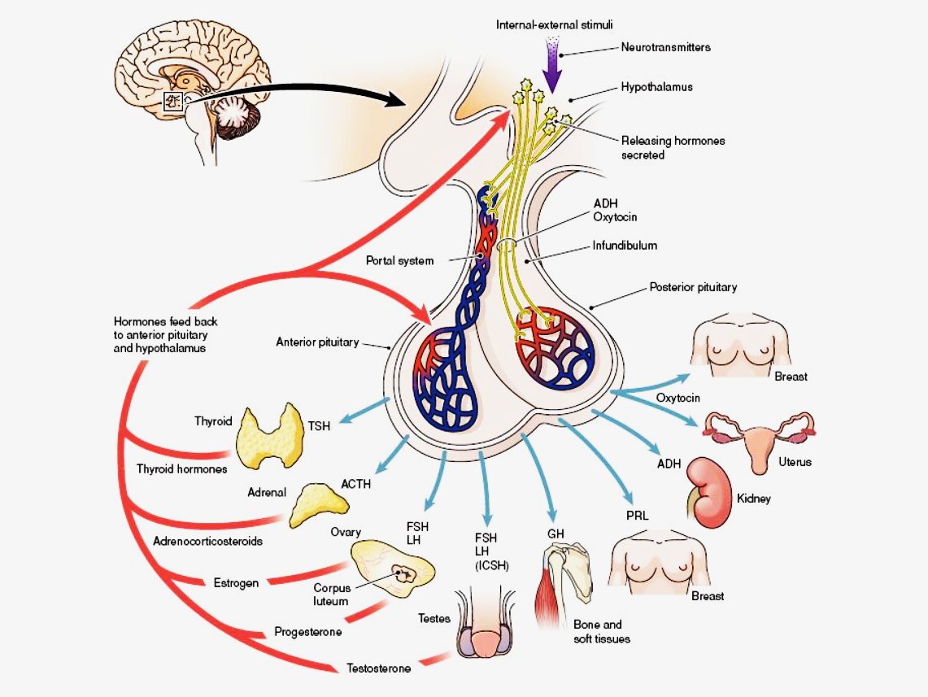
Pituitary Gland Hormones

Slide 4
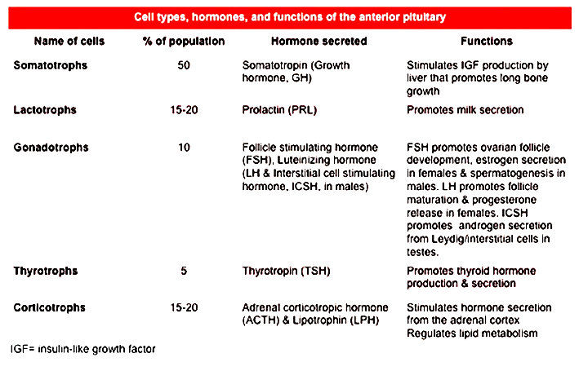
Anterior Pituitary Hormones

Slide 5
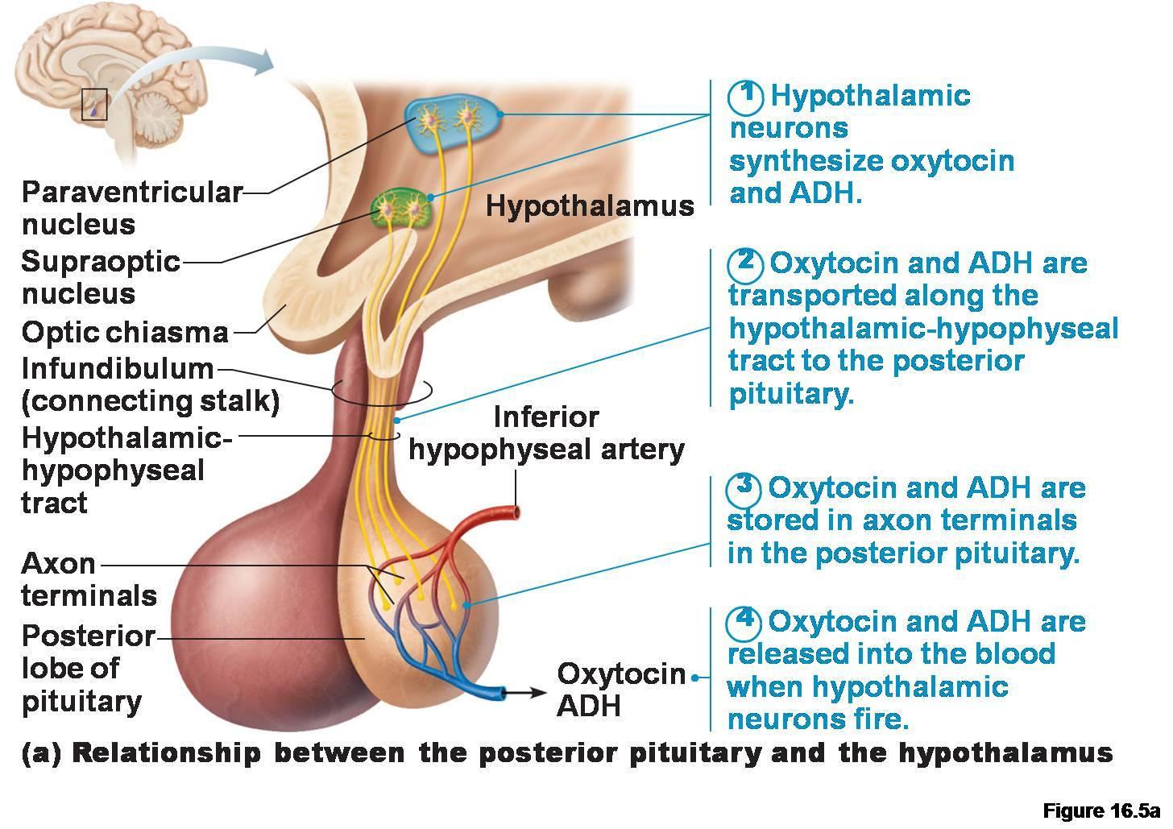
Posterior Pituitary Hormones

Slide 6
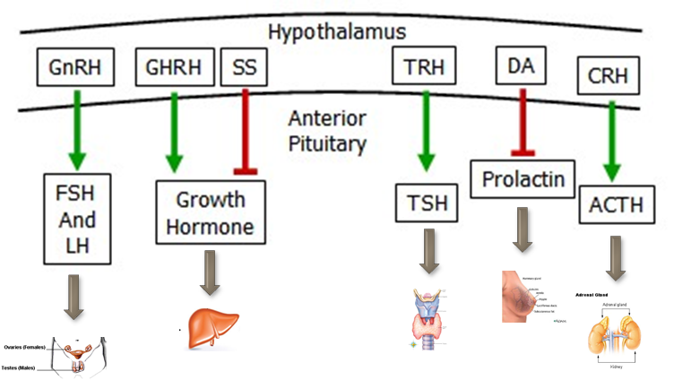
Anterior pituitary gland hormones and the hypothalamus
Hormonal feed back
Neural signals
TRH; Thyrotropin-releasing hormone
DA; Dopamine
GHRH; Growth hormone-releasing hormone
SS; Somatostatin (or growth hormone-inhibiting hormone GHIH)
GnRH; Gonadotropin-releasing hormone
CRH; Corticotropin-releasing hormone
hypophysiotropic hormones

Slide 7
Anterior pituitary gland hormones and the hypothalamus

Slide 8
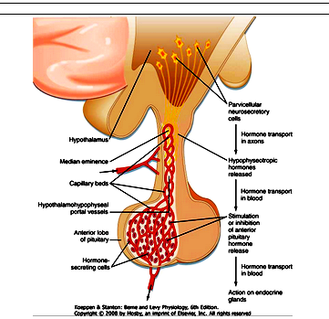
Anterior Pituitary Gland and Its Relation to the Hypothalamus
Secretion by the anterior pituitary is controlled by hormones called hypophysiotropic hormones (hypothalamic releasing/inhibitory hormones ) transported through hypothalamic-hypophysial portal vessels
Hormones are transported to axon endings of median eminence.
Hormones secreted into the hypothalamo-hypophyseal portal system regulate the secretions of the anterior pituitary

Slide 9
Hypothalamus –Pituitary gland
Hypothalamus
Magnocellular neurons
(paraventricular and supraoptic nuclei
Hypothalamus
hypophysiotropic
(Parvicellular neurons)
Axonal transport
Axonal transport
Median Eminence
CRH,GnRH,GHRH,TRH,SS(GHIH), DA
Portal
veins
Posterior Pituitary
(Oxytocin &ADH)
Anterior Pituitary
ACTH,FSH,LH,TSH, PrL,GH
Systemic Circulation

Slide 10
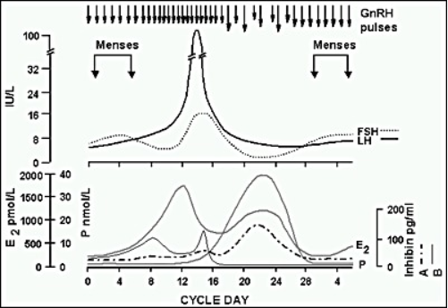
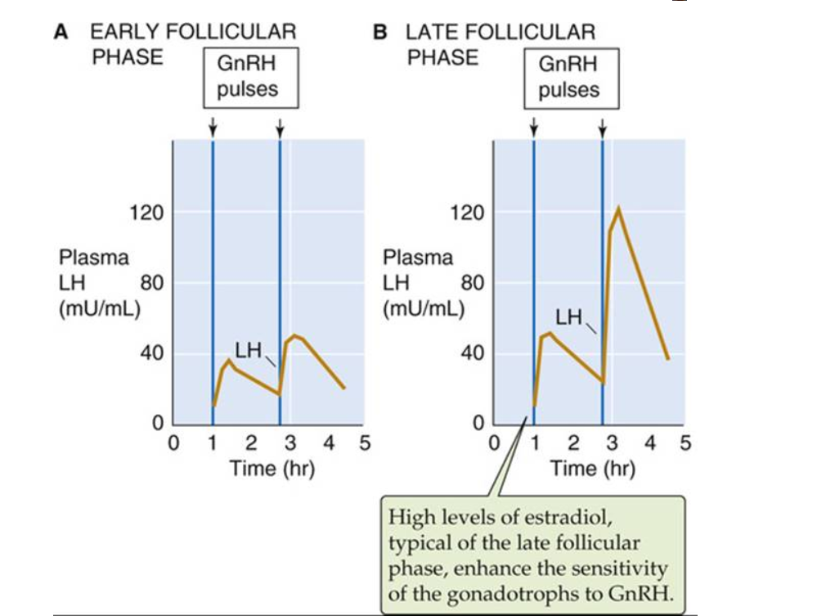
Most hypothalamic releasing hormones undergoes a pulsatile (burst-like or episodic) secretion patterns
Hypothalamic hypophysiotropic neurons are often secreted in a pulsatile manner and are entrained to daily and seasonal rhythms through CNS input.

Slide 11
Hormonal Feedback Control of the Hypothalamus/Anterior Pituitary
-Anterior pituitary & hypothalamic secretions are controlled by negative feedback inhibition
.

