Slide 1
Pharmacology of the thyroid gland
Dr. Fatimah Almahasneh
Department of Basic Medical Sciences
Yarmouk University

Slide 2
Hypothyroidism and thyroid hormone preparations

Slide 3
Therapeutic uses of thyroid hormone
The major indications for the therapeutic use of thyroid hormone are for:
hormone replacement therapy in patients with hypothyroidism.
TSH suppression therapy in patients with thyroid cancer.

Slide 4
Thyroid hormone preparations
Levothyroxine (L-T₄)
Available in tablets and for injection.
Different brands may not be bioequivalent.
Absorption is not complete (∽80%) → increased if taken on empty stomach.
T_{1/2} = 7 days
Follow-up blood tests typically are done ~6 weeks after any dosage change.

Slide 5
Thyroid hormone preparations
Liothyronine (L-T₃)
Available in tablets and for injection.
Nearly 100% absorption after oral ingestion.
More rapid onset of action than levothyroxine.
T_{1/2}= 0.75 days → more frequent dosing needed
Higher cost
Transient increase in T₃ serum levels
→ not preferred for chronic replacement.

Slide 6
Thyroid hormone preparations
Liotrix
A mixture of thyroxine and triiodothyronine 4:1 by weight.

Slide 7
Thyroid hormone replacement therapy in hypothyroidism
Thyroxine (levothyroxine sodium) is the hormone of choice for thyroid hormone replacement therapy due to its consistent potency and prolonged duration of action.
With this therapy, one relies on the types 1 and 2 deiodinases to convert T₄ to T₃ to maintain a steady serum level of free T₃.

Slide 8
Thyroid hormone replacement therapy in hypothyroidism
The average daily adult replacement dose of levothyroxine sodium is 1.7 μg/kg lean body weight.
The goal of therapy is to normalize the serum TSH (in primary hypothyroidism) or free T₄ (in secondary or tertiary hypothyroidism) and to relieve symptoms of hypothyroidism.
Combination therapy with levothyroxine plus liothyronine provides no better response than T₄ alone.

Slide 9
Hypothyroidism during pregnancy
The dose of levothyroxine in the hypothyroid patient who becomes pregnant usually needs to be increased (by 30-50%).
Overt hypothyroidism during pregnancy is associated with fetal distress and impaired psychoneural development in the progeny.
Subclinical hypothyroidism during pregnancy is associated with mildly impaired psychomotor development in the children and preterm delivery.
Any degree of hypothyroidism should be treated during pregnancy.

Slide 10
Myxedema coma
Myxedema coma is a rare syndrome that represents the extreme expression of severe, longstanding hypothyroidism.
It is a medical emergency associated with high mortality rate.

Slide 11
Treatment of myxedema coma
Supportive care
ventilatory support
rewarming with blankets
correction of hyponatremia
treatment of the precipitating cause.

Slide 12
Treatment of myxedema coma
I.V. steroids are indicated before initiating thyroxine therapy and should be continued until adrenal function has been proven normal
Because there is a 5-10% incidence of coexisting decreased adrenal reserve.
Thyroid hormone therapy
IV administration of thyroid hormone (levothyroxine) is advised due to uncertain absorption through the gut.
A loading dose may be used.

Slide 13
Thyroid nodules
The use of levothyroxine to suppress TSH in euthyroid individuals with thyroid nodules cannot be recommended as a general practice.
However, if the TSH is elevated, it is appropriate to administer levothyroxine to bring the TSH into the lower portion of the reference range.

Slide 14
Thyroid cancer
The mainstays of therapy for well differentiated thyroid cancer (papillary, follicular) are:
surgical thyroidectomy
radioiodine
levothyroxine to suppress TSH.
The rationale for TSH suppression is that TSH is a growth factor for these cancers.

Slide 15
Adverse effects of thyroid hormone
Similar to the consequences of hyperthyroidism.
Generally occur only upon overtreatment.
An excess of thyroid hormone can :
increase the risk of atrial fibrillation, especially in the elderly.
increase the risk of osteoporosis, especially in postmenopausal women.

Slide 16
Hyperthyroidism and thyroid inhibitors

Slide 17
Thyroid inhibitors
Anti-thyroid drugs, which interfere directly with the synthesis of thyroid hormones.
Ionic inhibitors, which block the iodide transport mechanism.
High concentrations of iodine, which decrease release of thyroid hormones from the gland and also may decrease hormone synthesis.
Radioactive iodine, which damages the thyroid gland with ionizing radiation.

Slide 18
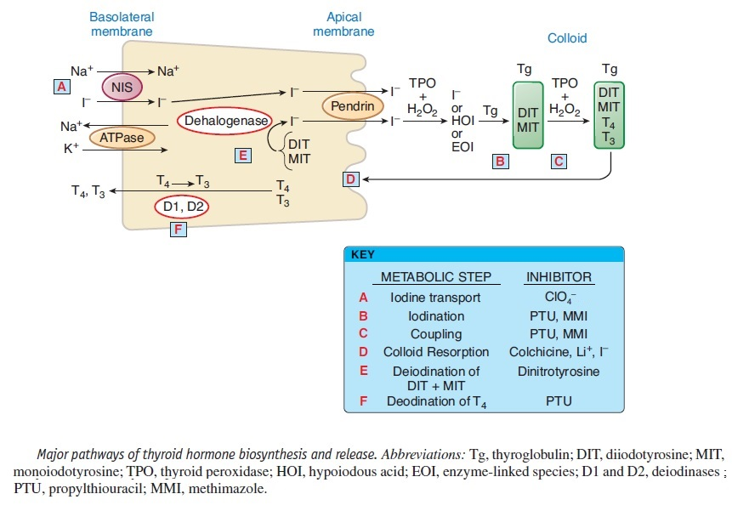
Thyroid inhibitors

Slide 19
Anti-thyroid drugs
Belong to the family of thionamides.
Propylthiouracil is considered the prototype.
Other agents include: methimazole and carbimazole.

Slide 20
Anti-thyroid drugs - MOA
Inhibit the formation of thyroid hormones by interfering with the incorporation of iodine into tyrosyl residues of thyroglobulin; they also inhibit the coupling of these iodotyrosyl residues to form iodothyronines.
These drugs are thought to inhibit the peroxidase enzyme, thereby preventing oxidation of iodide or iodotyrosyl groups to the required active state.
Propylthiouracil also partially inhibits the peripheral deiodination of T4 to T3, while methimazole does not have this effect.

Slide 21
Anti-thyroid drugs
Adverse effects:
(Relatively low incidence)
Skin rash
Pain and stiffness of the joints
Headache ● Nausea
Loss of hair
Agranulocytosis (reversible upon d/c of the drug)
Vasculitis
Hepatic failure (with propylthiouracil)

Slide 22
Antithyroid drugs – Therapeutic uses
As definitive treatment, to control the disorder in anticipation of a spontaneous remission in Graves’ disease.
In conjunction with radioactive iodine, to hasten recovery while awaiting the effects of radiation.
To control the disorder in preparation for surgical treatment.

Slide 23
Antithyroid drugs – Therapeutic uses
Methimazole is the drug of choice for Graves’ disease
it is effective when given as a single daily dose
has improved adherence
is less toxic than propylthiouracil.
Euthyroidism is usually achieved in 12 weeks → dose can be reduced, but not stopped → an exacerbation of Grave’s disease may occur.

Slide 24
Antithyroid drugs – Therapeutic uses
Response to treatment
The thyrotoxic state usually improves within 3-6 weeks after the initiation of anti-thyroid drugs.
The clinical response is related to:
the dose of anti-thyroid drug
the size of the goiter
pretreatment serum T₃ concentrations
Overtreatment may lead to hypothyroidism

Slide 25
Antithyroid drugs – Therapeutic uses
Response to treatment
After treatment is initiated, patients should be examined and thyroid function tests (serum FT4 and total or freeT₃ concentrations) measured every 2-4 months.
Serum TSH will often remain suppressed for several months after a patient has been hyperthyroid → so the circulating T4 and T3 concentrations are the most reliable assessment of thyroid status.
Once euthyroidism is established, follow-up every 4-6 months is reasonable.

Slide 26
Antithyroid drugs – Therapeutic choice
Small goiters or mild hyperthyroidism | prolonged drug therapy of Graves’ disease in anticipation of a remission
Large goiters or severe disease | definitive therapy with either surgery or radioactive iodine (¹³¹I) Radioactive iodine is the treatment of choice of many endocrinologists in the U.S. Coexisting ophthalmopathy is considered a relative contraindication for radioactive iodine therapy.
Older patients | depleting the thyroid gland of preformed hormone by treatment with anti-thyroid drugs is advisable before therapy with radioactive iodine
Toxic nodular goiter | definitive therapy with radioactive iodine or surgery

Slide 27
Thyrotoxicosis in pregnancy
Thyrotoxicosis occurs in ~0.2% of pregnancies and is caused most frequently by Graves’ disease.
Anti-thyroid drugs are the treatment of choice
Radioactive iodine is clearly contraindicated.
Propylthiouracil, carbimazole and methimazole may be used safely in pregnancy.
Methimazole is preferred over propylthiouracil because of the risk of propylthiouracil-associated liver failure in pregnancy.

Slide 28
Adjuvant therapy of thyrotoxicosis
β Adrenergic receptor antagonists
are effective in antagonizing the sympathetic/adrenergic effects of thyrotoxicosis, thereby reducing the tachycardia, tremor, and stare, and relieving palpitations, anxiety, and tension.
Either propranolol or atenolol is usually given initially.
Propranolol or esmolol can be given intravenously if needed.

Slide 29
Adjuvant therapy of thyrotoxicosis
Calcium channel blockers (e.g., diltiazem)
Can be used to control tachycardia and decrease the incidence of supraventricular tachyarrhythmias.
β Adrenergic receptor antagonists or Ca²⁺ channel blockers should always be used as adjuncts to anti-thyroid drugs and only for short-term (2-6 weeks).

Slide 30
Adjuvant therapy of thyrotoxicosis
Drugs that inhibit the peripheral conversion of
T₄ to T₃
Dexamethasone
Cholestyramine
Immunotherapy (for Grave’s hyperthyroidism and ophthalmopathy)

Slide 31
Preoperative preparation
Before subtotal thyroidectomy, patients should be rendered euthyroid (normal T₃ and T₄ – not necessarily TSH).
to reduce operative morbidity and mortality.
Anti-thyroid drugs
Iodide (for 7-10 days)
To decrease the vascularity of the gland → makes it less friable and decreases difficulty for the surgeon.

Slide 32
Thyroid storm
Is an uncommon but life threatening complication of thyrotoxicosis, in which a severe form of the disease is usually precipitated by an intercurrent medical problem.

Slide 33
Thyroid storm - Treatment
Supportive measures, such as
IV fluids
Antipyretics
cooling blankets
sedation.
Anti-thyroid drugs given in large doses.
(Propylthiouracil is preferred over methimazole because it also impairs peripheral conversion of T₄→T₃₎.

Slide 34
Thyroid storm - Treatment
Oral iodides (after the first dose of an anti-thyroid drug).
Adjuvant therapies of thyrotoxicosis
Hydrocortisone
Treatment of the underlying precipitating illness.

Slide 35
Ionic inhibitors
Ionic inhibitors are substances that interfere with the concentration of iodide by the thyroid gland.
Include:
thiocyanate
perchlorate
fluoroborate
Are all monovalent hydrated anions of a size similar to that of iodide.

Slide 36
Ionic inhibitors
Perchlorate (ClO₄–) is 10 times as active as thiocyanate.
The various NIS (sodium/iodide symporter) inhibitors, perchlorate, thiocyanate, and nitrate, are additive in inhibiting iodine uptake.
Perchlorate blocks the entrance of iodide into the thyroid by competitively inhibiting the NIS.
Lithium principal effect is decreased secretion of thyroxine and triiodothyronine, which can cause overt hypothyroidism in some patients taking Li⁺ for the treatment of mania.

Slide 37
Iodide
Iodide is the oldest remedy for disorders of the thyroid gland. Before the anti-thyroid drugs were used, it was the only substance available for control of the signs and symptoms of hyperthyroidism.

Slide 38
Iodide - MOA
High concentrations of iodide appear to influence almost all important aspects of iodine metabolism by the thyroid gland. These include:
Acute inhibition of the synthesis of iodotyrosines and iodothyronines (for 2 days).
Inhibition of the release of thyroid hormone (rapid and efficient).

Slide 39
Iodide
The response to iodides in patients with hyperthyroidism is often striking and rapid (24 hours).
The maximal effect is attained after 10-15 days.
Iodide therapy usually does not completely control the manifestations of hyperthyroidism, and after a variable period of time, the beneficial effect disappears.

Slide 40
Iodide – Therapeutic uses
The uses of iodide in the treatment of hyperthyroidism are:
in the preoperative period in preparation for thyroidectomy
in conjunction with antithyroid drugs and propranolol, in the treatment of thyrotoxic crisis.

Slide 41
Iodide – Adverse effects
Marked sensitivity
Angioedema Cutaneous hemorrhage
Serum-sickness type of hypersensitivity.
Chronic intoxication with iodide (iodism) may occur and the severity of symptoms is related to the dose.
Unpleasant brassy taste and burning in the mouth and throat
head cold ● productive cough
Skin lesions ● gastric irritation ● fever
Symptoms disappear within a few days of d/c of iodide.

Slide 42
Radioactive iodine
Radioactive isotopes of iodine (mainly ¹²³I and ¹³¹I).
Used therapeutically for thyroid destruction of an overactive or enlarged thyroid and in thyroid cancer for thyroid ablation and treatment of metastatic disease.

Slide 43
Radioactive iodine - MOA
¹³¹I is rapidly and efficiently trapped by the thyroid, incorporated into the iodoaminoacids and deposited in the colloid of the follicles.
The destructive β particles originate within the follicle and act almost exclusively on the parenchymal cells of the thyroid (pyknosis and necrosis), with little or no damage to surrounding tissue.

Slide 44
Radioactive iodine – Therapeutic uses
Treatment of hyperthyroidism and in the diagnosis of disorders of thyroid function.
For hyperthyroidism:
Initial treatment with thyroid ablative doses of ¹³¹I, with subsequent treatment for hypothyroidism is recommended.
Antithyroid medications should be discontinued 1 week before the therapeutic dose of ¹³¹I therapy and only resumed 3 days after ¹³¹I.

Slide 45
Radioactive iodine – Therapeutic uses
Therapy with radioactive iodine has advantages and disadvantages.
Mostly indicated in:
older patients and in those with heart disease.
when Graves’ disease has persisted or recurred after subtotal thyroidectomy and when prolonged treatment with anti-thyroid drugs has not led to remission.
patients with toxic nodular goiter (because the disease does not go into spontaneous remission).

Slide 46
Thyroid carcinoma
Because most well-differentiated thyroid carcinomas accumulate very little iodine, stimulation of iodine uptake with TSH is required to treat metastases effectively.
by withdrawal of thyroid hormone replacement therapy in patients previously treated with near-total thyroidectomy.
TSH-suppressive therapy with levothyroxine is indicated in all patients after treatment for thyroid cancer.

