Slide 2
PATHOLOGY OF ENDOCRINE SYSTEM
Dr. Nesreen Bataineh MD, FRCPath

Slide 4
What is the endocrine signaling?
In endocrine signaling, the secreted molecules, which frequently are called hormones, act on target cells distant from their site of synthesis.
An endocrine hormone typically is carried by the blood from its site of release to its target.
Increased activity of the target tissue often down regulates the activity of the gland that secretes the stimulating hormone, a process known as feedback inhibition.

Slide 5
The Endocrine system is divided into :
Endocrine organs dedicated to production of hormones e.g. pituitary, thyroid….etc
Endocrine components in clusters in organs having mixed functions e.g. pancreas, ovary, testes.
Diffuse endocrine system comprising scattered cells within organs acting locally on adjacent cells without entry into blood stream

Slide 6
Classification of Hormones
A- Hormones that trigger biochemical signals upon interacting with cell receptors.
Leads to an increase in intracellular molecules, termed second messenger (cAMP) , production of mediators from membrane phospholipid which increases the intracellular calcium, leads to increase in proliferation, differentiation, survival, functional activity of the cells:
1- Peptide hormones: Growth hormones, and insulin.
2- Small molecules: epinephrine.

Slide 7
B- Hormones that diffuse across the plasma membrane and interact with intracellular receptors:
Lipid -soluble hormones include: steroids ( estrogens, progesterone, glucocorticoids), retinoids, thyroxin.

Slide 8
Disease divided into :
1- Diseases of overproduction of secretion
( Hyperfunction )
2- Diseases of underproduction
( Hypofunction )
3- Mass effects ( Tumors )
N.B. Correlation of clinical picture , hormonal assays , biochemical findings , together with pathological picture are of extreme importance in most conditions.

Slide 9
PITUITARY GLAND

Slide 10
PITUITARY GLAND
Pituitary in sella turcica,& weighs about 0.5gm.
Connected to the HYPOTHALAMUS with stalk.
Composed of :
A-ADENOHYPOPHYSIS- (80%)
Blood supply is through portal venous plexus
Hypothalamic-Hypophyseal feed back control
B- NEUROHYPOPHYSIS
From floor of third ventricle
Modified glial cells & axons hypothalamus.
Has its own blood supply.

Slide 11
Histology of the Adenohypophysis
Composed of winding cords of epithelial cells flanked by vascular sinusoids. In sections stained with hematoxylin and eosin, three distinct cell types are seen among epithelial cells:
Acidophils have cytoplasm that stains red or orange
Basophils have cytoplasm that stains a bluish color
Chromophobes have cytoplasm that stains very poorly

Slide 12
Normal architecture of the anterior pituitary. The gland is populated by several distinct cell types containing a variety of stimulating (trophic) hormones. Each of the hormones has different staining characteristics, resulting in a mixture of cell types in routine histologic preparations.

Slide 14
CELLS & SECRETIONS :
A- Anterior pituitary ( Adenohypophysis )
1- Somatotrophs from acidophilic cells → Growth H.
2- Lactotrophs from acidophilic cells → Prolactin
3- Corticotrophs from basophilic cells → ACTH.
4- Thyrotrophs from pale basophilic cells → TSH
5- Gonadotrophs from basophilic cells → FSH, LH
B- Posterior pituitary ( Neurohypophysis )
1- Oxytocin
2- ADH
Notes:
POMC: pro-opiomelanocortin

Slide 15
HYPERPITUITARISM & PITUITARY ADENOMA
In most cases, excess is due to ADENOMA
arising in the anterior lobe.
Less common causes include :
* Hyperplasia
* Carcinoma
* Ectopic hormone production
* Some hypothalamic disorders

Slide 16
Incidence of pituitary adenomas:
10% of all intracranial neoplasms
25% are incidental
3% occur with MEN syndrome
Most occur between 30-50 years of age

Slide 17
Pathogenesis of pituitary adenomas :
1-Mutations in G-proteins ( α subunit) &in the GNAS1 gene on chromosome 20q13
G-proteins are involved in signal transduction :
GDP GTP cAMP
Mutations in α subunit interfere with GTPase function
GNAS1 mutation present in 40% of GH secreting adenomas & less in ACTH
Also seen in parathyroid , thyroid & some MEN tumors
G proteins
GTPase

Slide 18
Pathogenesis continued :
2- Mutations in RAS
3- Over expression in C- MYC
4- NM23 inactivation
(All above may be found in aggressive tumors )
5- In familial MEN syndrome :
MEN-1 gene, CDKNIB.
Notes:
CDKNIB: the product gene is cell cycle checkpoint regulator p27. patients have MEN-like syndrome but lack MEN abnormalities.

Slide 19
Behavior of pituitary adenomas :
Primary pituitary adenomas usually benign
May or may not be functional
If functional, the clinical effects are secondary to the hormone produced.
More than one hormone may be produced by same cell
Although most are localized, invasive adenomas erode sella turcica & extend into cavernous & sphenoid sinus

Slide 20
CLINICAL FEATURES of PITUITARY ADENOMA:
1- Symptoms of hormone produced
2- Local mass effects :
i- Radiological changes
ii-Visual field abnormalities
iii-Elevated intracranial pressure
3- Hypopituitarism
4- Pituitary apoplexy

Slide 21
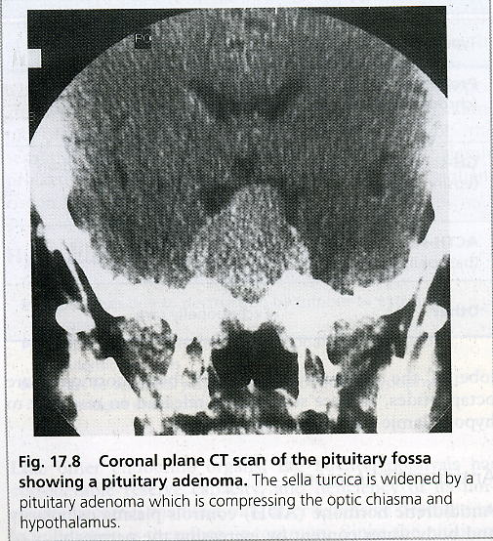

Slide 22
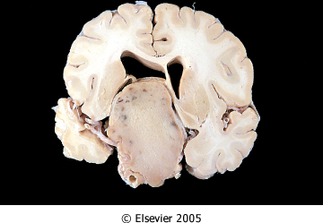
Mass effect of pituitary adenoma
Downloaded from: Robbins & Cotran Pathologic Basis of Disease (on 4 December 2005 01:50 PM)

Slide 23
Morphology of pituitary adenomas :
Well circumscribed, invasive in up to 30%
Size 1cm or more, specially in nonfunctioning
tumor
Hemorrhage & necrosis seen in large tumors
Microscopic picture :
Uniform cells, one cell type (monomorphism)
Absent reticulin network
Rare or absent mitosis

Slide 24
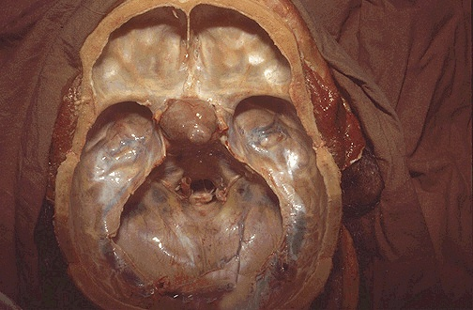
Sella turcica with pituitary adenoma

Slide 25
Normal pituitary gland

Slide 26
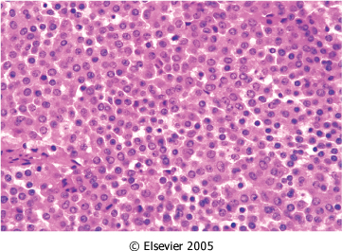
Uniform cells of pituitary adenoma
Downloaded from: Robbins & Cotran Pathologic Basis of Disease (on 4 December 2005 01:50 PM)

Slide 27
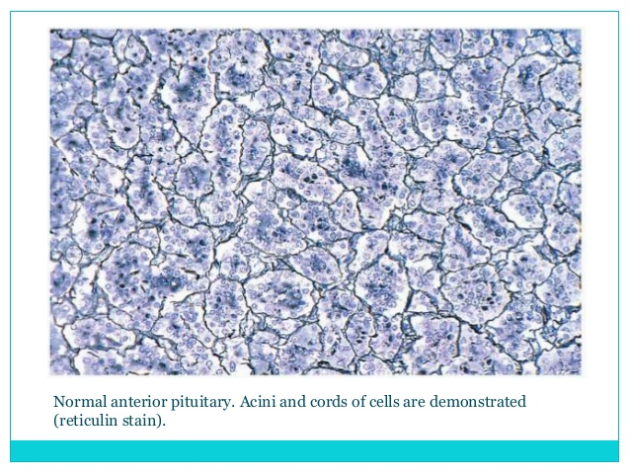

Slide 28
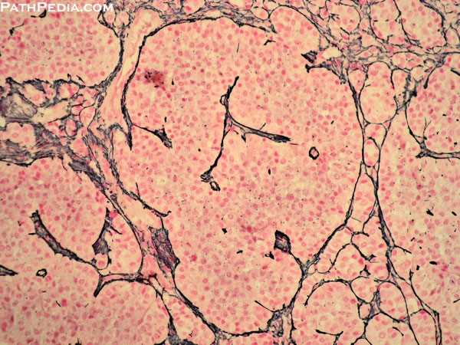
Absent reticulin fibers in pituitary adenoma

Slide 29
Types of Pituitary Adenomas
Previously classified according to histological
picture e.g : Acidophilic Adenoma
Now according to immunohistochemical
findings & clinical picture ….. e.g.
Growth hormone secreting adenoma

Slide 31
1- PROLACTINOMA :
30% of all adenomas, chromophobe or w. acidophilic
Functional even if microadenoma , but amount of secretion is related to size
Mild elevation of prolactin does NOT always indicate prolactin secreting adenoma !
Other causes of ↑ prolactin include :
estrogen therapy
pregnancy
certain drugs, e.g reserpine ,
hypothyroidism
mass in suprasellar region

Slide 32
Symptoms :
Galactorrhea
Amenorrhea
Decrease libido
Infertility

Slide 33
( STALK EFFECT )
Any mass in the suprasellar region may interfere with normal prolactin inhibition → ↑ Prolactin
Notes:
It has been postulated that these suprasellar tumors induce hyperprolactinemia by compressing the pituitary stalk, resulting in impaired dopamine delivery to the pituitary and, consequently, disinhibition of the lactotropes. An alternative hypothesis proposed is that suprasellar tumors secrete a specific pars tuberalis factor that stimulates prolactin secretion

Slide 34
2- Growth hormone secreting adenoma :
40% Associated with GNAS 1 gene mutation
Persistent secretion of GH stimulates the hepatic secretion of insulin-like growth factor I (IGF-I) → many of clinical effects
Initial investigation : measurement of GF & IGF-I which is increased.
Confirm by failure to suppress GH production in response to an oral load of glucose.

Slide 35
Structure :
Composed of granular ACIDOPHILIC cells
May be mixed with prolactin secretion.
Symptoms :
May be delayed so adenomas are usually
large
Produce GIGANTISM (children) or ACROMEGALLY (adults).
Diabetes, arthritis, large jaw & hands,
osteoporosis, ↑BP, HF…..etc

Slide 36
3- Corticotroph cell adenoma
Usually microadenomas
Higher chance of becoming malignant
Chromophobe or basophilic cells
Functionless or Cushing ‘s Disease ( ↑ ACTH )
Bilateral adrenalectomy or destruction may
result in aggressive adenoma:
Nelson’s Syndrome
Corticotroph microadenoma → Macroadenoma
↑ ICP

Slide 37
4- Non functioning adenoma 20% silent or null cell ,nonfunctioning & produce mass effect only
5- Gonadotroph producing LH &FSH- ( 10-15%)- Function silent or is minimal , late presentation mainly mass effect.
Produce gonadotrophin α subunit, β- FSH & β-LH
6- TSH producing ,(1%) rare cause of hyperthyroidism
7- Pituitary carcinoma - Extremely rare, diagnosed only by metastases.

Slide 38
HYPOPITUITARISM :
Loss of > 75% of ant. Pituitary → Symptoms
Congenital or acquired, intrinsic or extrinsic
Acquired causes include :
1- Non-secretory pituitary adenoma
2- SHEEHAN’S SYNDROME
3- Ischemic necrosis e.g. sickle cell anemia, DIC…
4- Pituitary apoplexy…
5- Iatrogenic by radiation or surgery
6- Autoimmune ( lymphocytic) hypophysitis
7- Hypothalamic mass
8- Inflammatory e.g sarcoidosis or TB …..
9- Craniopharyngioma

Slide 39
Symptoms of hypopituitarism:
Dwarfism (Pituitary Dwarf) in children.
Effect of individual hormone deficiencies.
Amenorrhea & no lactation
Loss of MSH → Decreased pigmentation

Slide 40
Craniopharyngioma
1-5 % of intracranial neoplasms
Derived from remnants of Rathke’s Pouch
Suprasellar or intrasellar ,often cystic with
calcification
Children or adolescents most affected
Symptoms may be delayed ≥ 20yrs( 50%)
Symptoms of hypofunction of pituitary and /or visual disturbances.
Benign & slow growing

Slide 41
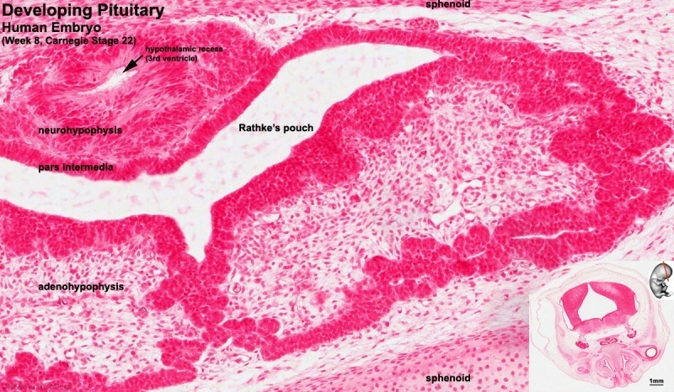
During development, the boundary epitheilal ectoderm in the roof of the pharynx forms a pocket (Rathke's pouch) that comes into contact with the ectoderm of developing brain. Rathke's pouch is named after German embryologist and anatomist Martin Heinrich Rathke (1793 -1860).

Slide 42
composed of histologically appearing squamoid and columnar epithelium lining cystic spaces filled with oily fluid.

Slide 43
POSTERIOR PITUITARY SYNDROMES:
A- ADH deficiency : Diabetes Insipidus
Polyuria, polydipsia, hypernatremia &
dehydration.
Urine is dilute, due to inability to reabsorb
water from the collecting tubules.
Causes :-
Head trauma, tumors & inflammations in
pituitary or hypothalamus…etc.

Slide 44
B- Syndrome of inappropriate ADH secretion (SIADH)
Part of paraneoplastic Syndrome :
Small Cell CA of Lung
Causes excessive resorption of water→
hyponatremia, cerebral edema.

Slide 45
Abnormal oxytocin secretion :
Abnormalitis of synthesis & release have not been associated with any significant abnormality.

Slide 46
وَما نَيلُ المَطالِبِ بِالتَمَنّي
وَلَكِن تُؤخَذُ الدُنيا غِلابا
وَما اِستَعصى عَلى قَومٍ مَنالٌ
إِذا الإِقدامُ كانَ لَهُم رِكابا

Slide 47
Thank you

