Slide 1
Epidemiology of Diabetes Mellitus (D.M)
Dr. Moawiah Khatatbeh

Slide 2
Objectives
To discuss diabetes prevalence estimates at world and local level.
To discuss diabetes complications and prevalence estimates.

Slide 3
The burden of diabetes is increasing globally due to rapid increases in:
overweight
obesity
physical inactivity.

Slide 4
Key facts
In 2014 the global prevalence of diabetes * was estimated to be 9% among adults aged 18+ years (1).
WHO projects that diabetes will be the 7th leading cause of death in 2030 (3).
Healthy diet, regular physical activity, maintaining a normal body weight and avoiding tobacco use can prevent or delay the onset of type 2 diabetes (4).

Slide 5
Facts on diabetes (WHO)
About 425 million people worldwide have diabetes (2017).
2. Diabetes is predicted to become the 7th leading cause of death in the world by the year 2030
Total deaths from diabetes are projected to rise by more than 50% in the next 10 years.

Slide 6
3. There are two major forms of diabetes
Type 1 diabetes is characterized by a lack of insulin production and type 2 diabetes results from the body's ineffective use of insulin.
4. A third type of diabetes is gestational diabetes
5. Type 2 diabetes is much more common than type 1 diabetes

Slide 7
6. Cardiovascular disease is responsible for between 50% and 80% of deaths in people with diabetes
Diabetes has become one of the major causes of premature illness and death in most countries, mainly through the increased risk of cardiovascular disease (CVD).
7. 80% of diabetes deaths occur in low- and middle-income countries

Slide 8
10 million more adults with diabetes than 2015
34 million more adults are at risk of developing diabetes than 2015
8 million more adults above 65 years old with diabetes than 2015
Over a million children and adolescents have type 1 diabetes
19 million more adults with diabetes are undiagnosed than 2015
1 in 6 live births is affected by hyperglycaemia in pregnancy
USD 54 billion more is spent on diabetes than 2015
Highlights:

Slide 9
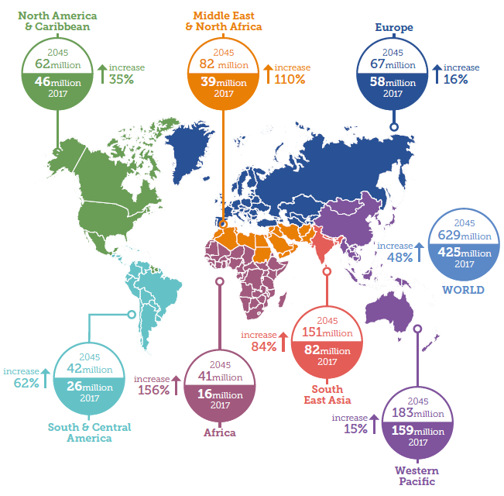
Diabetes: A global emergency
Number of people with diabetes worldwide and per region in 2017 and 2045 (20-79 years)

Slide 10
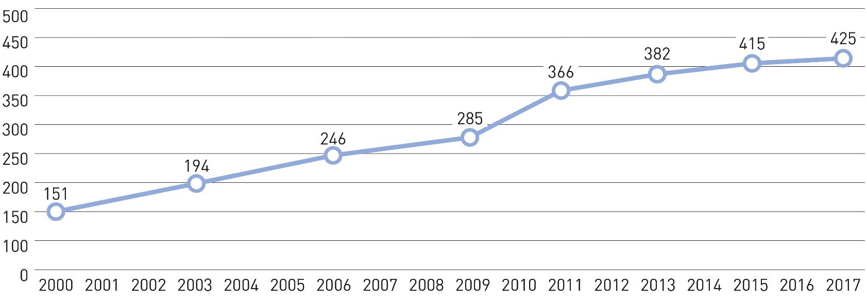
Diabetes around the world
Total number of adults with diabetes (20-79 years)

Slide 11
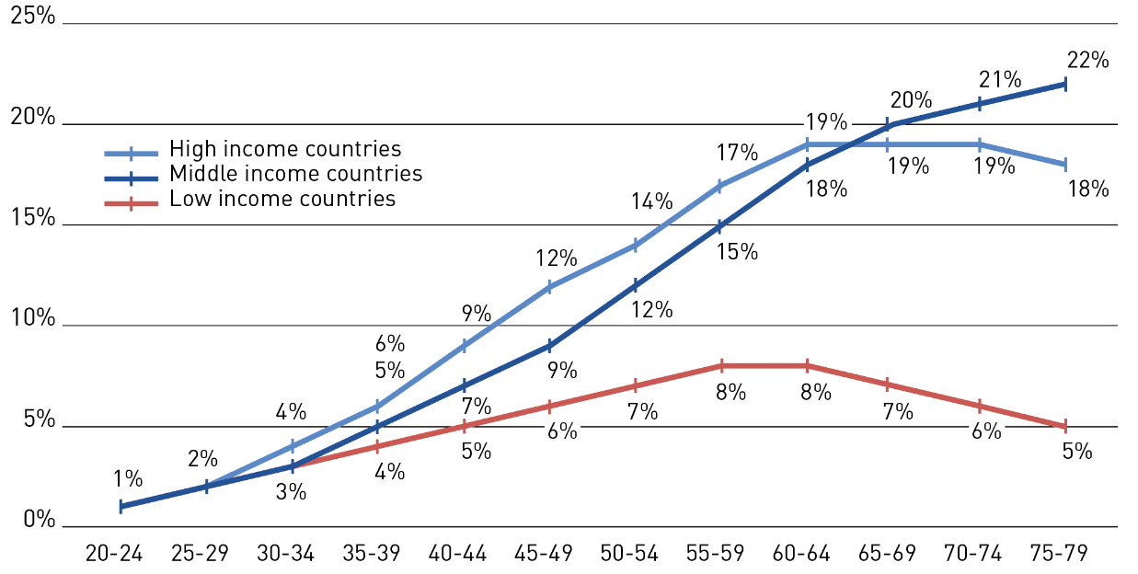
“4 out of 5 people with diabetes live in low- and middle-income countries”
Diabetes around the world
Prevalence (%) estimates of diabetes (20-79 years) by income group and age

Slide 12
Diabetes around the world

Slide 13
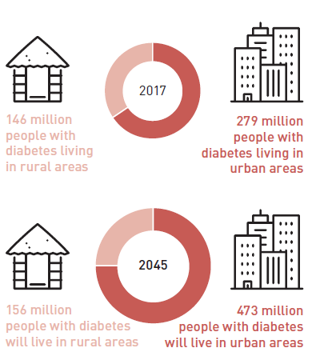
“Two-thirds of people with diabetes live in
urban areas
and number will increase to
three fourths by 2045”
Diabetes around the world
Rural-urban division among people with diabetes

Slide 14
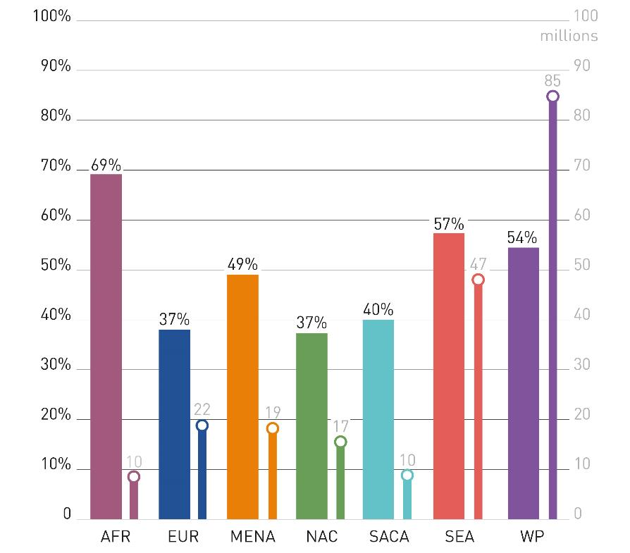
“One in two adults with diabetes are undiagnosed
(over 212 million people)”
Undiagnosed Diabetes
Undiagnosed percentage and undiagnosed cases of diabetes (20-79 years) per region

Slide 15
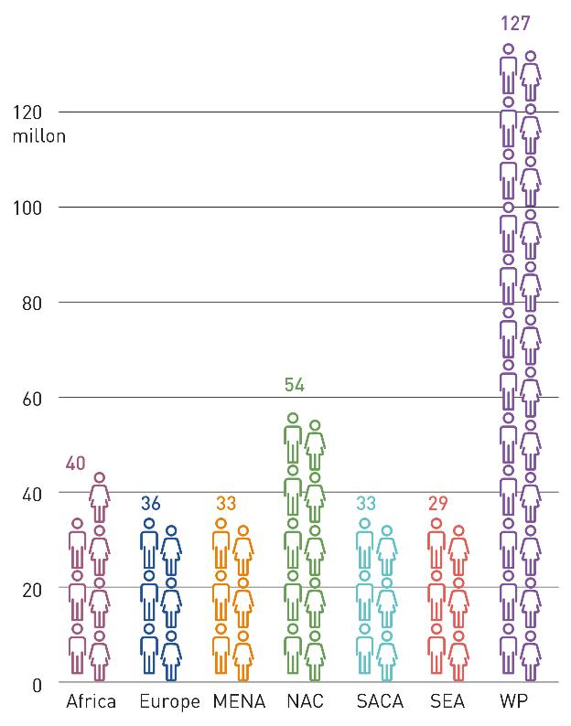
“One in 14 adults
(20-79 years) has
impaired glucose tolerance
(352 million people)”
Impaired Glucose Tolerance
Number of adults (20-79 years) with IGT per IDF region, 2017

Slide 16
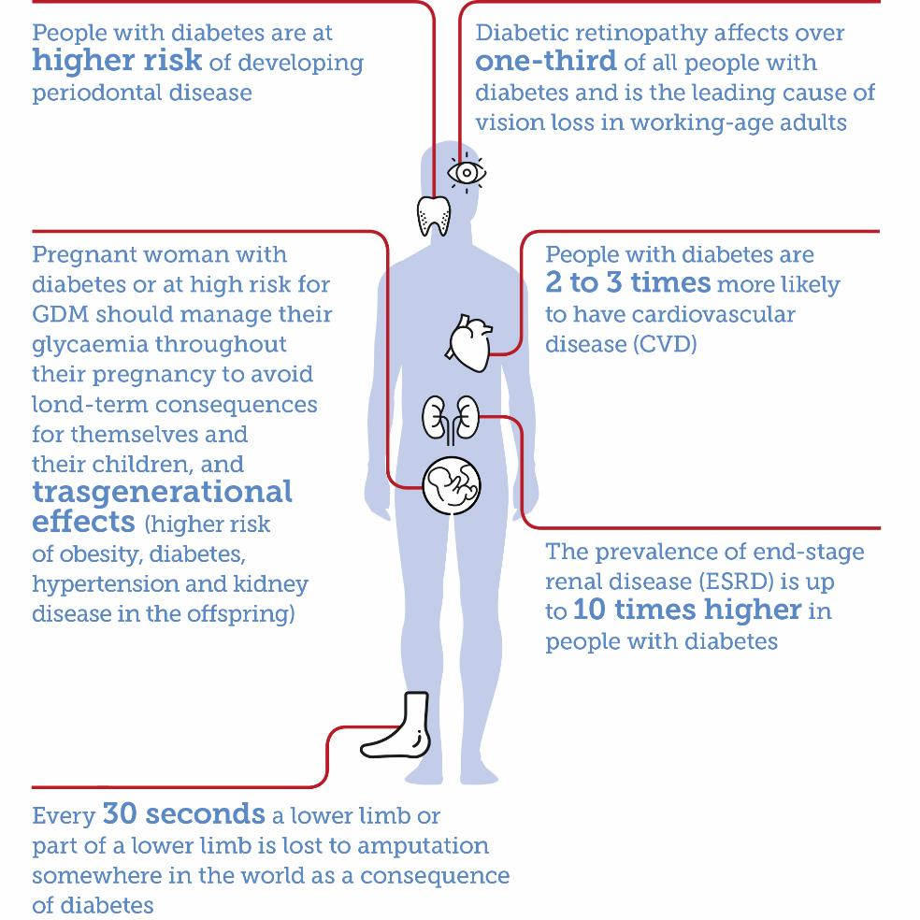
Diabetes Complications

Slide 17
Diabetes Complications
Diabetes is among the leading causes of kidney failure (4).
The overall risk of dying among people with diabetes is at least double the risk of their peers without diabetes (8).

Slide 18
Diabetes Complications
Over time, diabetes can damage the heart, blood vessels, eyes, kidneys, and nerves.
Diabetes increases the risk of heart disease and stroke. In a multinational study, 50% of people with diabetes die of cardiovascular disease (primarily heart disease and stroke) (6).
Combined with reduced blood flow, neuropathy (nerve damage) in the feet increases the chance of foot ulcers, infection and eventual need for limb amputation.

Slide 19
Promote high-quality research on diabetes
epidemiology.
Implement National Plans and Strategies to
reduce diabetes burden.
Prioritization of diabetes care and control.
Recommendations
Extend health promotion to reduce diabetes
and its complications.

Slide 20
Diabetes in Jordan
According to WHO statistics about Jordan, the probability of dying between ages 30 and 70 years from the 4 main NCDs is 20%.
Cancers
Diabetes
Cardiovascular Diseases
Chronic Respiratory Diseases

Slide 21
Diabetes in Jordan
Jordan has one of the top 10 most overweight populations in the world.
With 34 per cent of Jordanians aged above 25 years living with diabetes (2014).
The prevalence of type 2 diabetes and IFG is high in Jordan and is increasing. More than half of the patients with diabetes have unsatisfactory control.

Slide 22
Risk Factors
Type 1 DM
Genetic predisposition
In an individual with a genetic predisposition, an event such as virus or toxin triggers autoimmune destruction of β-cells probably over a period of several years.

Slide 23
Risk Factors
Type 2 DM
Family History
Obesity
Habitual physical inactivity
Previously identified impaired glucose tolerance
(IGT) or impaired fasting glucose (IFG)
Hypertension
Hyperlipidemia
Notes:
IFG: > or = 110 and <126
IGT: > or = 140 and <200

Slide 24
How can the burden of diabetes be reduced? - Prevention - Diagnosis - Treatment

Slide 25
Prevention
Simple lifestyle measures have been shown to be effective in preventing or delaying the onset of type 2 diabetes.
To help prevent type 2 diabetes and its complications, people should:
- achieve and maintain healthy body weight;
- be physically active – at least 30 minutes of regular, moderate-intensity activity on most days. More activity is required for weight control;
- eat a healthy diet of between 3 and 5 servings of fruit and vegetables a day and reduce sugar and saturated fats intake;

Slide 27
Diagnosis
Early diagnosis can be accomplished through relatively inexpensive blood testing.

Slide 28
Treatment
Desired outcome
Relieve symptoms
Reduce mortality
Improve quality of life
Reduce the risk of microvascular and macrovascular disease complications

Slide 29
How to achieve the goals ?
Treatment
Near normal glycemic control reduce the risk of developing microvascular disease complications
Control of the traditional CV risk factors such as smoking, management of dyslipidemia, intensive BP control and antiplatelet therapy.

Slide 30
Treatment General approaches
Medications
Dietary and exercise modification
Regular complication monitoring
Self monitoring of blood glucose
Control of BP and lipid level

Slide 31
Treatment Pharmacological therapy

Slide 32
Treatment Nonpharmacological therapy
Diet
For type 1 the goal is to regulate insulin administration with a balanced diet
In most cases, high carbohydrate, low fat, and low cholesterol diet is appropriate
Type 2 DM patients need caloric restriction

Slide 33
Treatment Nonpharmacological therapy
Diet (Cont’d)
Artificial sweeteners:
e.g. Aspartame, saccharin, sucralose, and acesulfame
Safe for use by all people with diabetes
Nutritive sweeteners:
e.g. fructose and sorbitol
Their use is increasing except for acute diarrhea in
some patients
Notes:
Excessive intake of sorbitol: can induce an osmotic diarrhea.
Excessive fructose can increase total and LDL cholesterol.

Slide 34
Treatment Nonpharmacological therapy
Activity
Exercise improves insulin resistance and achieving glycemic control.
Exercise should start slowly for patients with limited activity.
Patients with CV diseases should be evaluated before starting any exercise

Slide 35
Treatment Complication monitoring
Annual eye examination
Annual microalbuminuria
Feet examination
BP monitoring
Lipid profile

Slide 36
Treatment Self-monitoring of blood glucose
Frequent self monitoring of blood glucose to achieve near normal level
More intense insulin regimen require more frequent monitoring
Notes:
SMBG needs to be 4 or more times daily in patients on multiple insulin injections per day.

Slide 37
Potential Barriers to Effective Clinical-System Based Lifestyle Intervention Programs
Clinical health systems lack structure and expertise to change lifestyle.
Too expensive and not “scalable”.
Previous models of clinical based / lifestyle change have not achieved sustainable reimbursement.
Waiting until people have elevated glucose is too late.
Diabetes is a common-source epidemic rooted in culture and society.

Slide 38
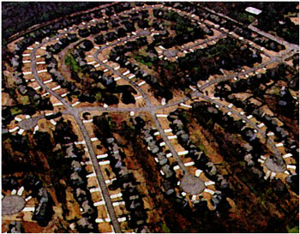
Macro-Level Determinants Obesity and Diabetes:
Physical environment
Food
environment
Social environment
Economy and poverty

Slide 39
Policy Options to Influence Diabetes Risk
Taxation
Food and Menu labeling
Engage Private Industry
Crop subsidy policies
Incentives/promotion for community availability and affordability of foods.
Incentives/promotion for community support for physical activity.
Regulation of foods in public areas.
School food and physical education policies.

Slide 40
References
(1) Global status report on noncommunicable diseases 2014. Geneva, World Health Organization, 2012. (2) World Health Organization. Global Health Estimates: Deaths by Cause, Age, Sex and Country, 2000-2012. Geneva, WHO, 2014. (3) Mathers CD, Loncar D. Projections of global mortality and burden of disease from 2002 to 2030. PLoS Med, 2006, 3(11):e442. (4) Global status report on noncommunicable diseases 2010. Geneva, World Health Organization, 2011. (5) Definition, diagnosis and classification of diabetes mellitus and its complications. Part 1: Diagnosis and classification of diabetes mellitus. Geneva, World Health Organization, 1999 (WHO/NCD/NCS/99.2). (6) Morrish NJ, Wang SL, Stevens LK, Fuller JH, Keen H. Mortality and causes of death in the WHO Multinational Study of Vascular Disease in Diabetes. Diabetologia 2001, 44 Suppl 2:S14–S21. (7) Global data on visual impairments 2010. Geneva, World Health Organization, 2012.

