Slide 1
CATECHOLAMINES & THYROID HORMONES ARE MADE FROM TYROSINE

Slide 2
Catecholamines Are Synthesized in Final Form & Stored in Secretion Granules
All synthesized from Tyrosine.
Dopamine - synthesized in the brain
Norepinephrine -methylated epinephrine- synthesized in the brain and adrenal medulla- chromaffin cells
Epinephrine-80% of the catecholamines in the medulla-it is not made in extramedullary tissue- chromaffin cells

Slide 3
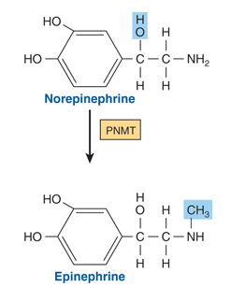

Slide 4
The conversion of tyrosine to epinephrine requires four sequential steps:
ring hydroxylation;
decarboxylation;
side-chain hydroxylation to form norepinephrine;
N -methylation to form epinephrine.

Slide 5
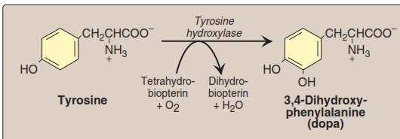
catecholamines
RATE-LIMITING

Slide 6
Methyldopa is effective in treating some kinds of hypertension
PRESENT IN ALL TISSUES

Slide 7
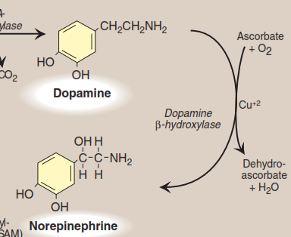

Slide 11
T3 & T4 Illustrate the Diversity in Hormone Synthesis
triiodothyronine (T3 )
tetraiodothyronine (thyroxine; T4 )
Synthesized as part of a very large precursor molecule (thyroglobulin)
Stored in (colloid)
Peripheral conversion of T4 to T3 , active hormone.

Slide 12
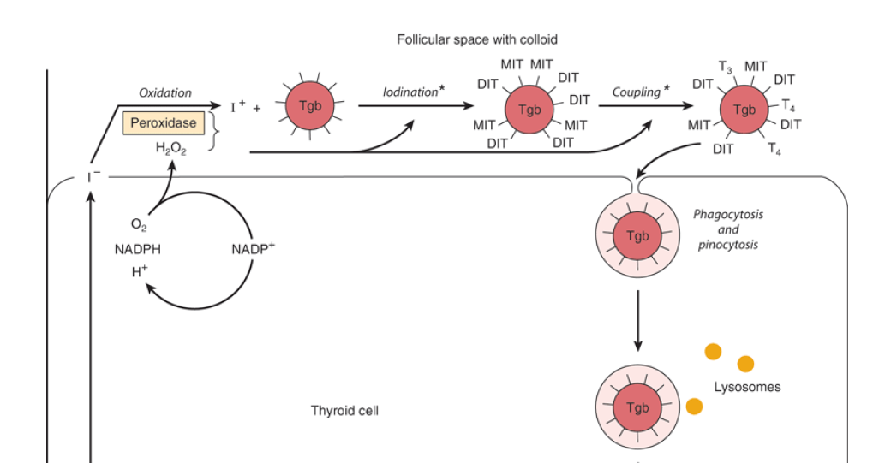

Slide 13
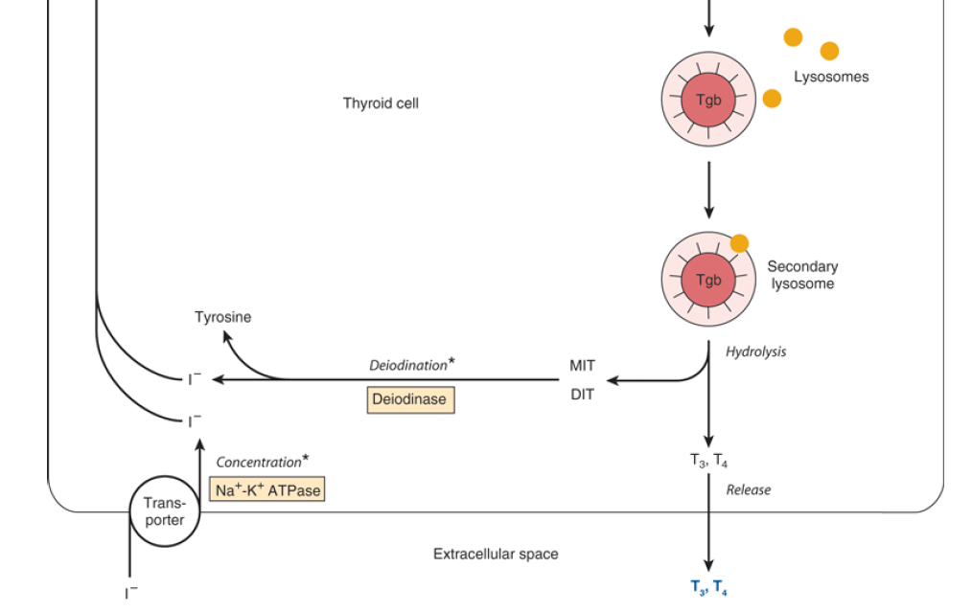
70 %
30 %

Slide 14
Thyroglobulin (large prohormone)
It is a large iodinated, glycosylated protein.
Carbohydrate 8–10.
Iodide 0.2–1%.
Composed of two large subunits.
Contains 115 tyrosine residues (potential site of iodination.
T4 :T3 ratio is about 7:1

Slide 15
Iodide Metabolism
The thyroid is able to concentrate I– against a strong electrochemical gradient.
Na+ -K+ ATPase-dependent thyroidal I– transporter.
The T:S ratio in humans on a normal iodine diet is about 25:1 stimulated by TSH
Thyroperoxidase, a tetrameric protein requires hydrogen peroxide as an oxidizing agent. (thiourea drugs are inhibitors)
The coupling of two DIT molecules to form T4 —or of an MIT and DIT to form T3 —occurs within the thyroglobulin molecule.

Slide 16
A deiodinase removes I– from the inactive mono and diiodothyronine molecules in the thyroid.
A peripheral deiodinase in target tissues such as pituitary, kidney, and liver selectively removes I– from the 5' position of T4 to make T3

Slide 17
Several Hormones Are Made from Larger Peptide Precursors

Slide 18
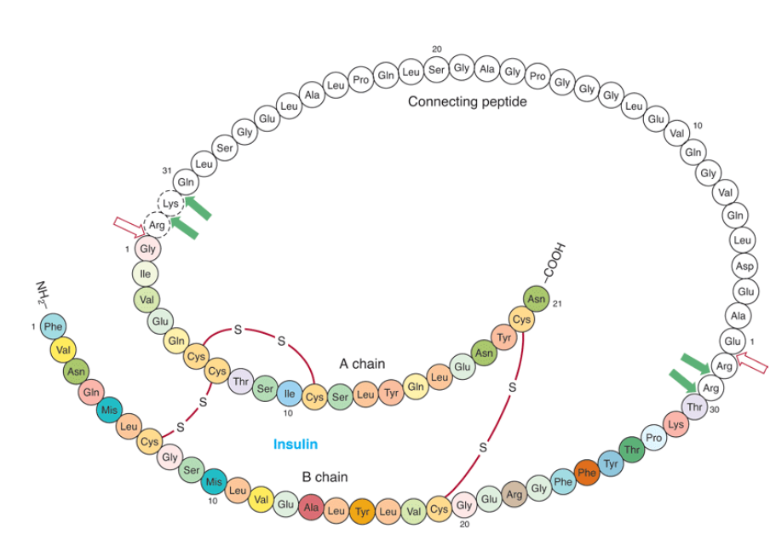
Insulin Is Synthesized as a Preprohormone & Modified Within the Beta Cell
Insulin has an AB heterodimeric structure with one intrachain (A6–A11) and two interchain disulfide bridges (A7–B7
and A20–B19)
trypsin-like enzyme
carboxypeptidase-like enzyme

Slide 19
Parathyroid Hormone (PTH) Is Secreted as an 84-Amino-Acid Peptide
The immediate precursor of PTH is proPTH: highly basic hexapeptide amino terminal extension.
The immediate precursor for proPTH is the 115-amino-acid preproPTH (having an additional hydrophobic 25-amino-acid amino terminal extension)
PTH1–34 has full biologic activity, and the region 25–34 is primarily responsible for receptor binding

Slide 20
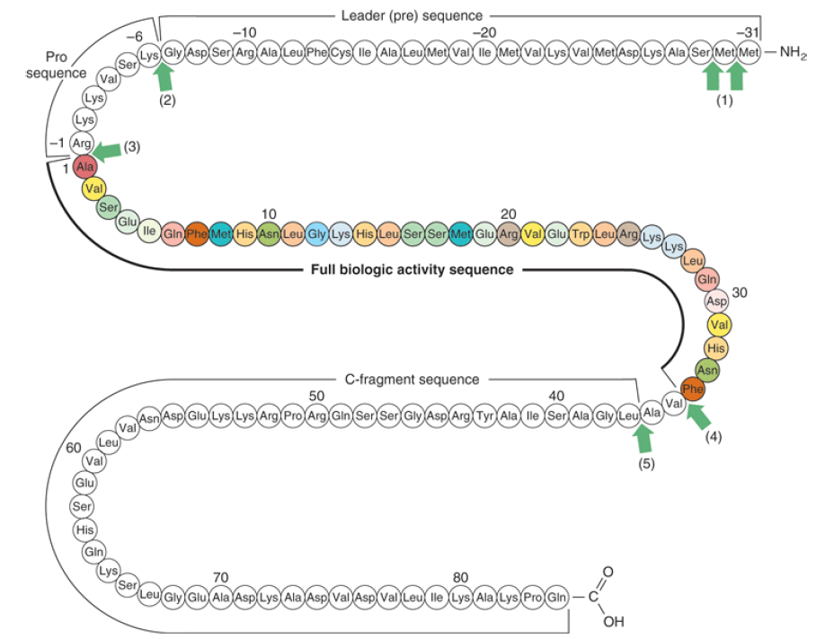
bovine preproparathyroid hormone

Slide 21
The biosynthesis of PTH and its subsequent secretion are regulated by the plasma ionized calcium (Ca2+ )
An acute decrease of Ca2+ results in a marked increase of PTH mRNA, and this is followed by an increased rate of PTH synthesis and secretion.

Slide 22
A number of proteolytic enzymes, including cathepsins B and D, have been identified in parathyroid tissue.
Cathepsin B cleaves PTH into two fragments: PTH 1–36 and PTH37–84 .
PTH37–84 is not further degraded;
PTH1–36 is rapidly cleaved into di- and tripeptides.
Most of the proteolysis of PTH occurs within the gland
Some studies suggested PTH, once secreted, is proteolytically degraded in other tissues, especially the liver, by similar mechanisms.

Slide 23
Angiotensin II Is Also Synthesized from a Large Precursor
The renin-angiotensin system is involved in the regulation of blood pressure and electrolyte metabolism (through
production of aldosterone).
Angiotensin II, an octapeptide made from angiotensinogen
Angiotensinogen, a large α2 -globulin made in liver, is the substrate for renin, an enzyme produced in the juxtaglomerular cells of the renal afferent arteriole.

Slide 24
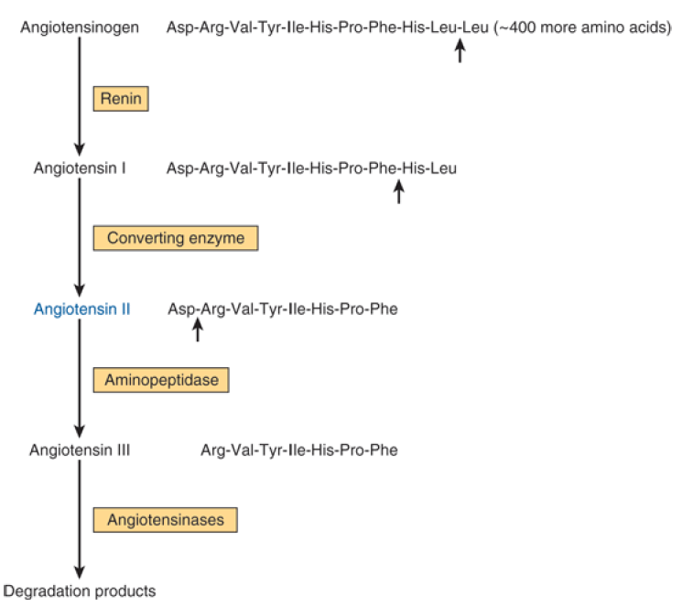

Slide 25
Angiotensin-converting enzyme (ACE), a glycoprotein found in lung, endothelial cells, and plasma, removes two carboxyl terminal amino acids from the decapeptide angiotensin I to form angiotensin II in a step that is not thought to be rate-limiting.

Slide 26
Complex Processing Generates the Pro-Opiomelanocortin (POMC) Peptide Family
The POMC family consists of peptides that act as hormones (ACTH, LPH, MSH)
Thers that may serve as neurotransmitters or neuromodulators (endorphins)
POMC is synthesized as a precursor molecule
of 285 amino acids and is processed differently in various regions of the pituitary.

Slide 27
Mutations of the -MSH receptor are linked to a common, early-onset form of obesity. This observation has redirected attention to the POMC peptide hormones.

Slide 28
