Slide 1
Hormones Are Synthesized & Modified for Full Activity in a Variety of Ways
Some hormones are synthesized in final form and secreted immediately.
Synthesized in final form and stored in the producing cells.
Synthesized from precursor molecules in the producing cell, then are processed and secreted upon a physiologic cue
Converted to active forms from precursor molecules in the periphery

Slide 2
MANY HORMONES ARE MADE FROM CHOLESTEROL
Adrenal Steroidogenesis
Synthesized from cholesterol
Upon stimulation of the adrenal by ACTH, an esterase is activated
Mitochondrial, cytochrome P450 side chain cleavage enzyme (P450scc) converts cholesterol to pregnenolone.
An ACTH-dependent steroidogenic acute regulatory (StAR) protein is essential for the transport of cholesterol to P450scc in the inner mitochondrial membrane.

Slide 4
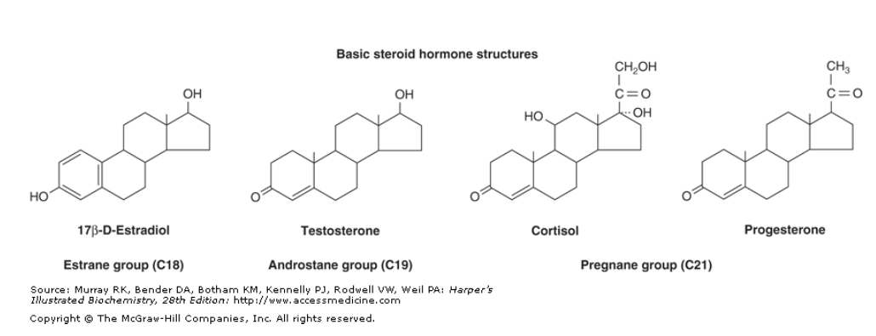
Basic steroid hormone structures
All mammalian steroid hormones are formed from cholesterol via pregnenolone through a series of reactions that occur in either the mitochondria or endoplasmic reticulum of the producing cell.

Slide 5
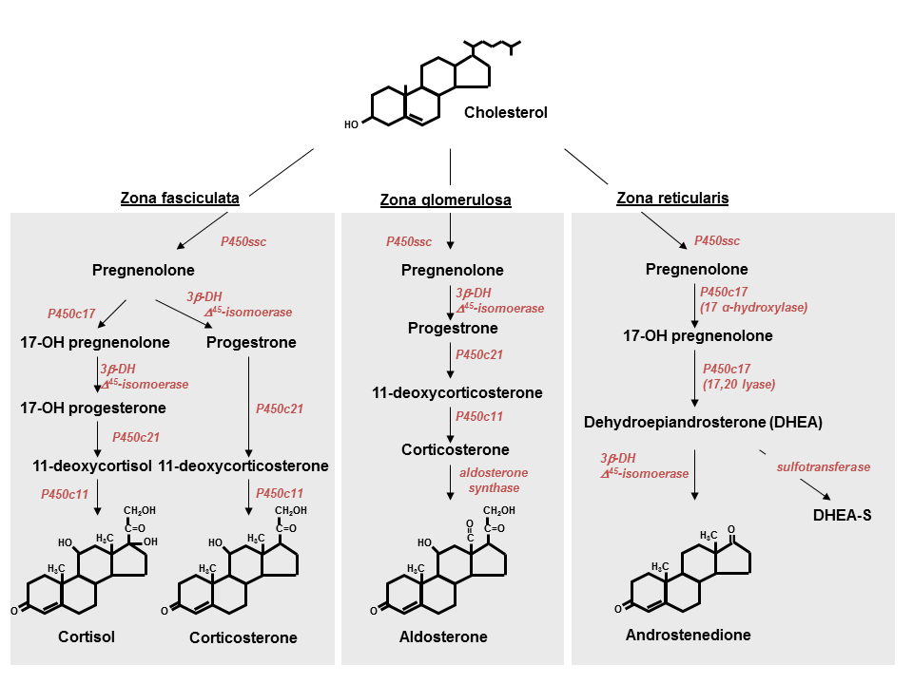
Hydroxylases, Oxygen, NADPH, Dehydrogenases, isomerase, Lyase

Slide 6
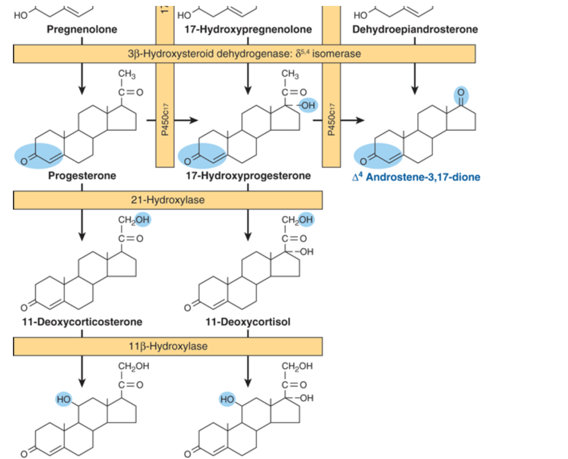

Slide 7
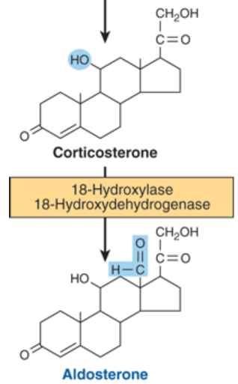
Zona glomerulosa cells

Slide 8
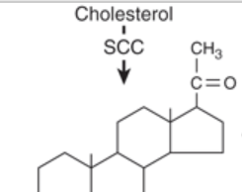
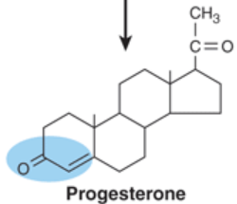
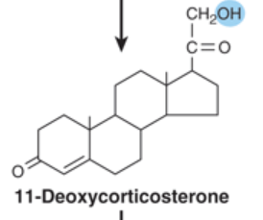
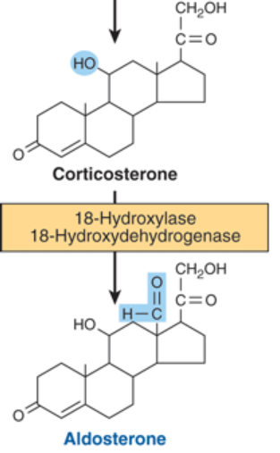
MINERALOCORTICOID SYNTHESIS
Synthesis of aldosterone follows the mineralocorticoid pathway and occurs in the zona glomerulosa.
(aldosterone synthase)

Slide 9
GLUCOCORTICOID SYNTHESIS
Cortisol synthesis requires three hydroxylases located in the fasciculata and reticularis zones of the adrenal cortex
SER
Mito

Slide 10
ANDROGEN SYNTHESIS
The major androgen or androgen precursor produced by the adrenal cortex is dehydroepiandrosterone (DHEA).
Reduction
Small amounts of testosterone are produced in the adrenal

Slide 11
Testicular Steroidogenesis
Testicular androgens are synthesized in the interstitial tissue by the Leydig cells.
The conversion of cholesterol to pregnenolone is identical in testis, ovary (needs LH), and adrenal (needs ACTH).
The conversion of pregnenolone to testosterone requires the action of 5 enzyme activities contained in 3 proteins:

Slide 12
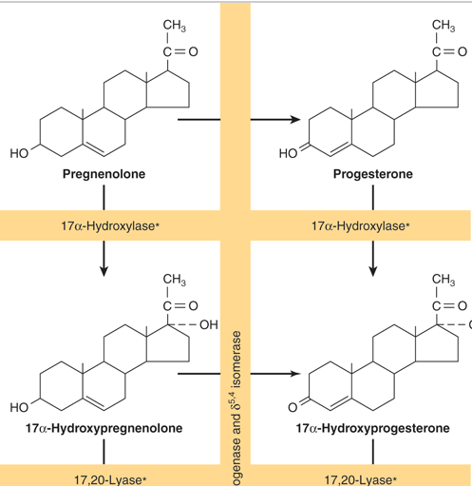
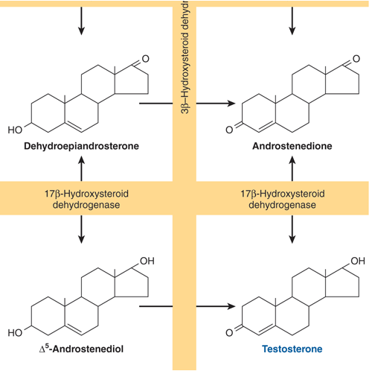
Dehydroepiandrosterone
Pathway
Progesterone pathway

Slide 13
Dihydrotestosterone Is Formed from Testosterone in Peripheral Tissues
Testosterone is metabolized by two pathways.
Oxidation at the 17 position: many tissues, produces less active17-ketosteroids
Reduction of the A ring double bond and the 3-ketone:
in target tissues and produces the potent metabolite dihydrotestosterone (DHT).

Slide 14
Ovarian Steroidogenesis
The estrogens are a family of hormones synthesized in a variety of tissues.
17 Beta-Estradiol is the primary estrogen of ovarian origin.
Theca cells are the source of androstenedione and testosterone.
Granulosa cells convert androstenedione and testosterone to estrone and estradiol

Slide 15
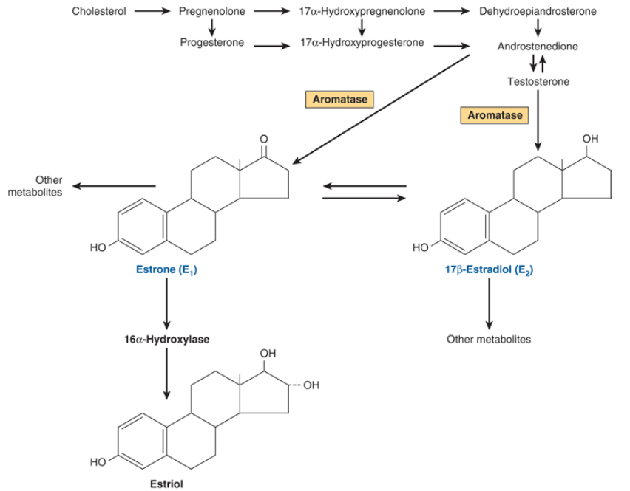
The aromatase enzyme complex is thought to include a P450 monooxygenase.

Slide 16
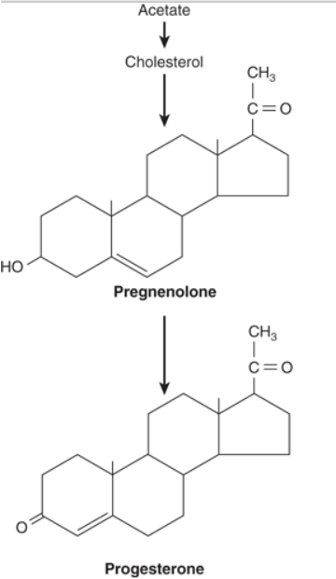
Biosynthesis of progesterone in the corpus luteum

Slide 17
Significant amounts of estrogens are produced by the peripheral aromatization of androgens.
In males, the peripheral aromatization of testosterone to estradiol (E2 ) accounts for 80% of the production of the latter.
In females, 50% of the E2 produced during pregnancy comes from the aromatization of androgens.

Slide 18
1,25(OH)₂ –D3(Calcitriol) Is Synthesized from a Cholesterol Derivative
Produced by a complex series of enzymatic reactions that involve the plasma transport of precursor molecules to a number of different tissues.
As a precursor, Vitamin D—really not a vitamin.

Slide 19
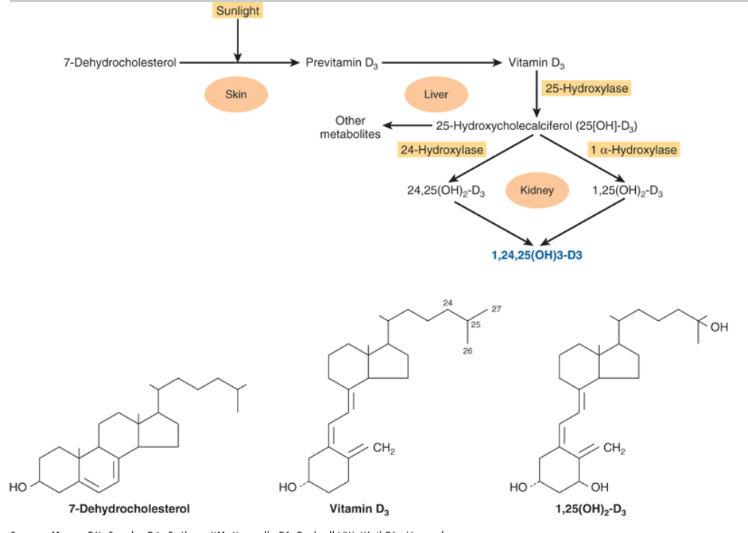
vitamin D–binding protein binds moves vitamin D from the skin or intestine to the liver
nonenzymatic photolysis reaction
mitochondria of the renal proximal convoluted tubule

