Slide 1
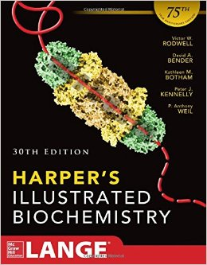
The Diversity of Endocrine System
Chapter 41
30th Ed
The word "hormone" is derived from a Greek term that means to arouse to activity.

Slide 2
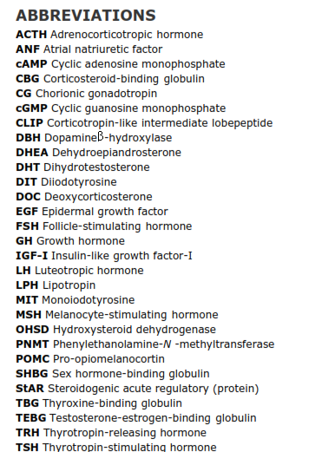
The survival of multicellular organisms depends on their ability to adapt to a constantly changing environment.
Intercellular communication mechanisms are necessary requirements for this adaptation.
The nervous system and the endocrine system provide this intercellular, organism-wide communication.
Neural regulation of the endocrine system is important in the production and secretion of some hormones

Slide 3
A hormone is a substance that is synthesized in one organ and transported by the circulatory system to act on another tissue.
Autocrine and paracrine are also included
Diverse hormones: each with distinctive mechanisms of action and properties of biosynthesis, storage, secretion, transport, and metabolism.

Slide 4
THE TARGET CELL CONCEPT
There are about 200 types of differentiated cells in humans.
Only a few produce hormones.
75 trillion cells in a human are targets of one or more of the over 50 known hormones.

Slide 5
The response of a target cell to a hormone depends on:
The concentration of the hormone at the target cell.
Factors that affect the actual response of the target cell to the hormone.

Slide 6
factors that affect the concentration of the hormone at the target cell.

Slide 7
2. factors that affect the actual response of the target cell to the hormone.

Slide 8
HORMONE RECEPTORS ARE OF CENTRAL IMPORTANCE

Slide 9
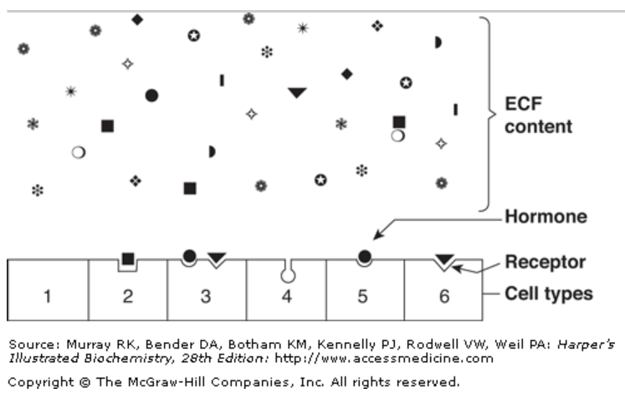
Receptors Discriminate Precisely
Hormones are present at very low concentrations in the extracellular fluid, generally in the atto- to nanomolar range (10 ^{–15} to 10 ^{–9} mol/L).
This high degree of discrimination is provided by cell-associated recognition molecules called receptors.
hormone-induced actions generally but not always terminate when the effector dissociates from the receptor

Slide 10
Both Recognition & Coupling Domains Occur on Receptors
All receptors have at least two functional domains.
Coupling (signal transduction) occurs in two general ways:
Polypeptide and protein hormones and the catecholamines bind to receptors located in the plasma membrane.
Steroid, retinoid, and thyroid hormones interact with intracellular receptors.

Slide 11
Receptors Are Proteins
Insulin receptor is a heterotetramer composed of two copies of two different protein subunits.
Insulin-like growth factor I (IGF-I) and epidermal growth factor (EGF) are generally similar in structure to the insulin receptor.
Receptors of the steroid or thyroid type are members of a large superfamily of nuclear receptors.
Orphan receptors: No ligand was identified

Slide 12
HORMONES CAN BE CLASSIFIED IN SEVERAL WAYS
Chemical composition,
Solubility properties,
location of receptors,
Nature of the signal used to mediate hormonal action within the cell.

Slide 13
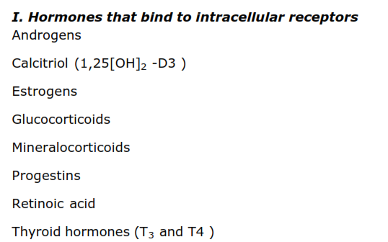
Table 41–3. Classification of Hormones by Mechanism of Action

Slide 14
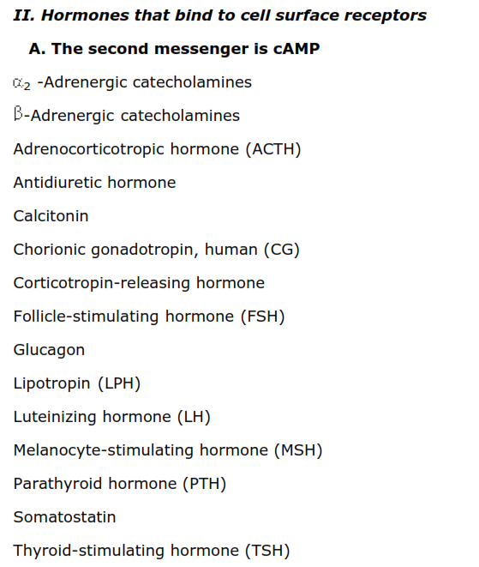

Slide 15
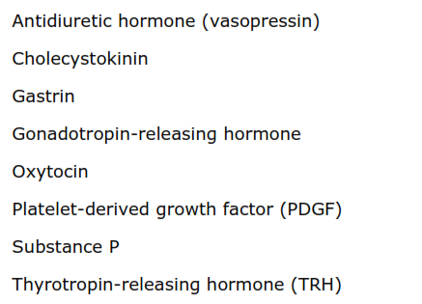

Slide 16
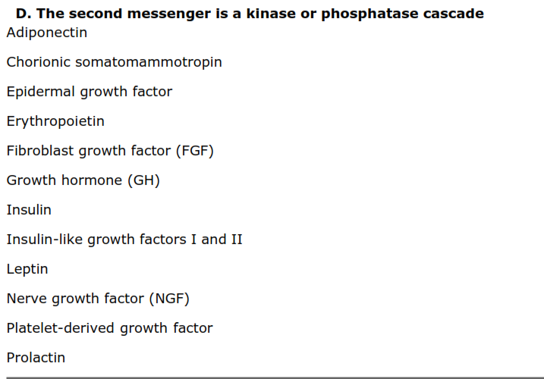

Slide 17
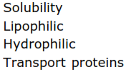

Slide 18
DIVERSITY OF THE ENDOCRINE SYSTEM
Hormones Are Synthesized in a Variety of Cellular Arrangements
Hormones are synthesized in discrete organs designed solely for this specific purpose, such as the thyroid
(triiodothyronine), adrenal (glucocorticoids and mineralocorticoids), and the pituitary (TSH, FSH, LH, growth hormone, prolactin, ACTH).

Slide 19
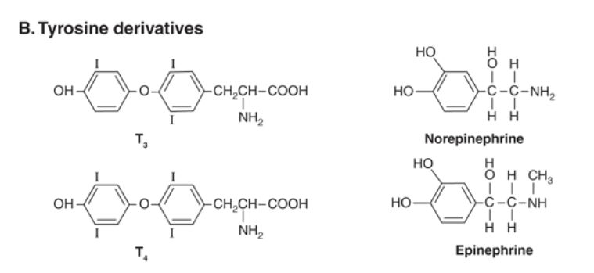
Hormones Are Chemically Diverse

Slide 20
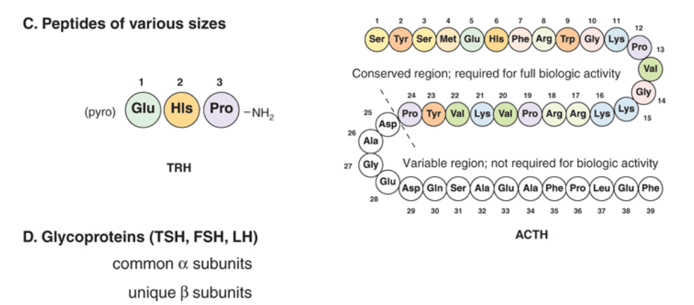

Slide 21
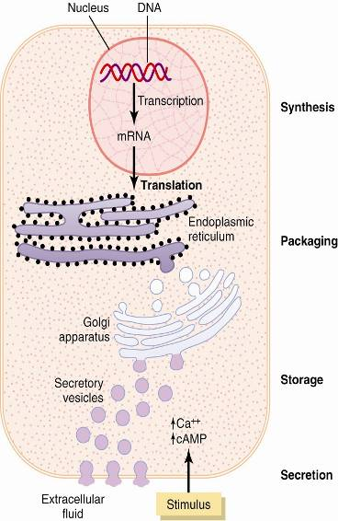
Synthesis & Secretion of Peptide Hormones
Figure 75-2

Slide 22
Signal Transduction Systems
Pathway Second Messenger
G Proteins Coupled to Adenylyl Cyclase cAMP
G Proteins Coupled to Phospholipase C IP₃ & DAG
G Proteins Coupled to Phospholipase A₂ Arachidonic acid metabolies
Receptor Tyrosine Kinases Phosphoproteins
Tyrosine Kinase-Associated Receptors Phosphoproteins
Guanylyl Cyclase cGMP

Slide 23
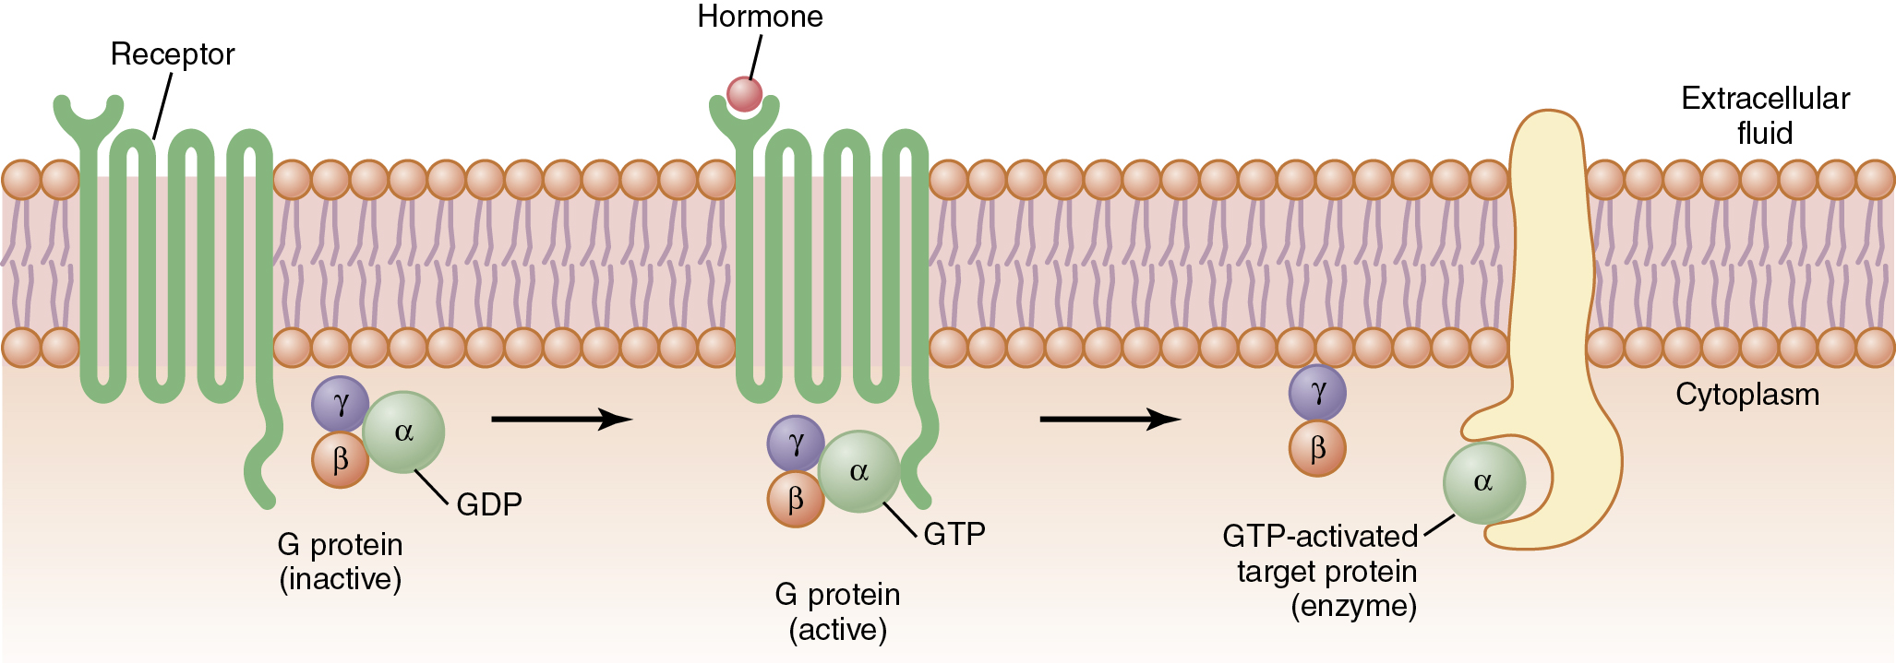
Mechanism of Action of G Protein-Coupled Receptors
Figure 75-4

Slide 24
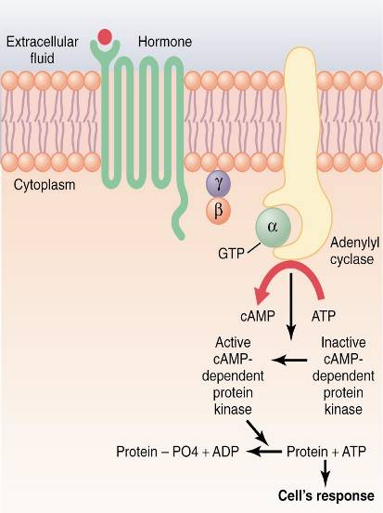
Cyclic Adenosine Monophosphate
(cAMP) Second Messenger Mechanism
Figure 75-7

Slide 25
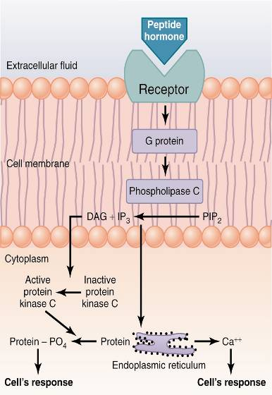
Cell Membrane Phospholipid
Second Messenger System
Figure 75-8

Slide 26
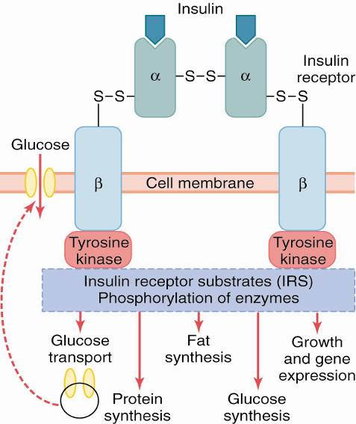
The Insulin Receptor & Mechanisms of Insulin Action
Figure 79-3

Slide 27
Protein Hormones - Mechanisms of Action
Tyrosine Kinase/Cytokine Receptor Mechanism
Adenylyl Cyclase Mechanism
Phospholipid Mechanism
Guanylate Cyclase Mechanism
ACTH LH FSH TSH GHRH Somatostatin ADH (V₂ receptor) HCG MSH CRH Calcitonin PTH Glucagon | GnRH TRH PTH Angiotensin II ADH (V₁ receptor) Oxytocin | ANP | Insulin IGF-1 GH Prolactin

Slide 28
Steroid Hormone Synthesis and Secretion
LDL
ACTH
LDL
Receptor
G-protein
Adenylyl
cyclase
Receptor
*
endocytosis
cAMP
ATP
Cytoplasm
Protein
kinase A
Cholesterol esters
CEH
Cholesterol
Cortisol
Acetyl CoA
Cholesterol
SCC
Mitochondria
CEH
Pregnenolone
11-Deoxycortisol
Cholesterol esters
Pregnenolone
Smooth
Endoplasmic
Reticulum
Cholesterol esters
LIPID DROPLET
Progesterone
17-OH-
Progesterone
11-Deoxycortisol

Slide 29
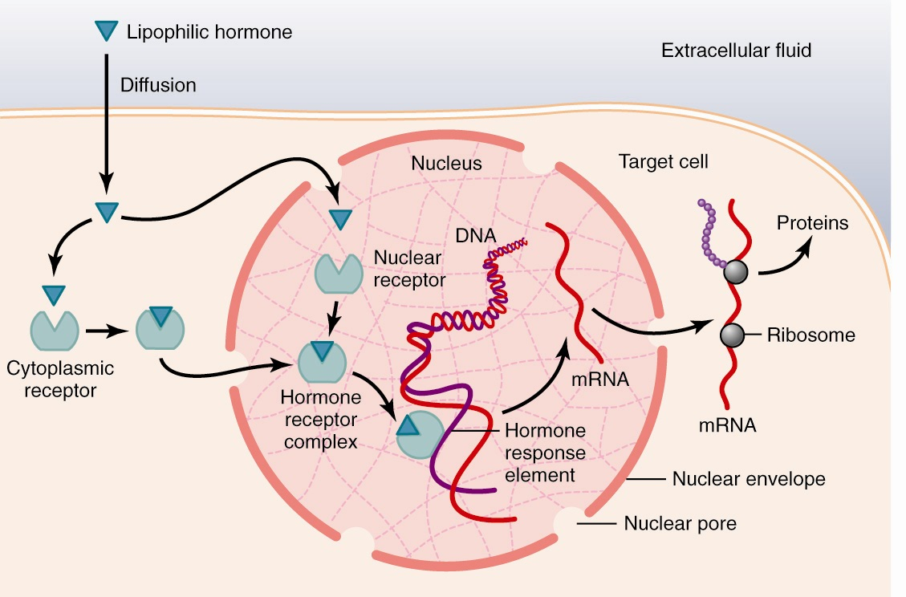
Steroid & Thyroid Hormones - Mechanism of Action
Figure 75-6

Slide 30
Synthesis of Amine Hormones
Tyrosine
tyrosine hydroxylase
L-Dopa
dopa decarboxylase
Dopaminergic Neurons
Dopamine
dopamine β -hydroxylase
Adrenergic Neurons
Norepinephrine
phenylethanolamine-N-methyltransferase
Thyroid Hormones
Epinephrine
Thyroid Gland
Adrenal Glands

Slide 31
Steroid & Thyroid Hormones - Mechanism of Action
Figure 75-6

Slide 32
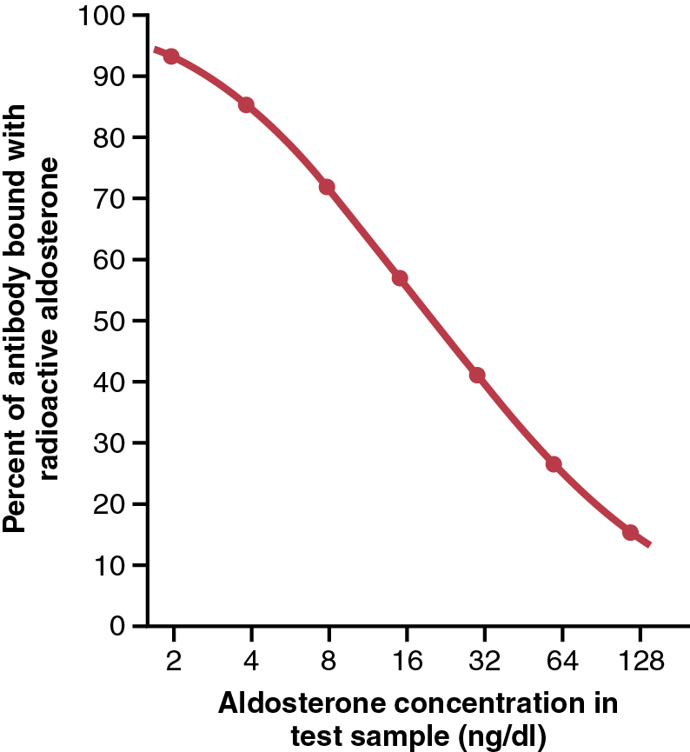
Principles of Radioimmunoassay
Figure 75-9

Slide 33
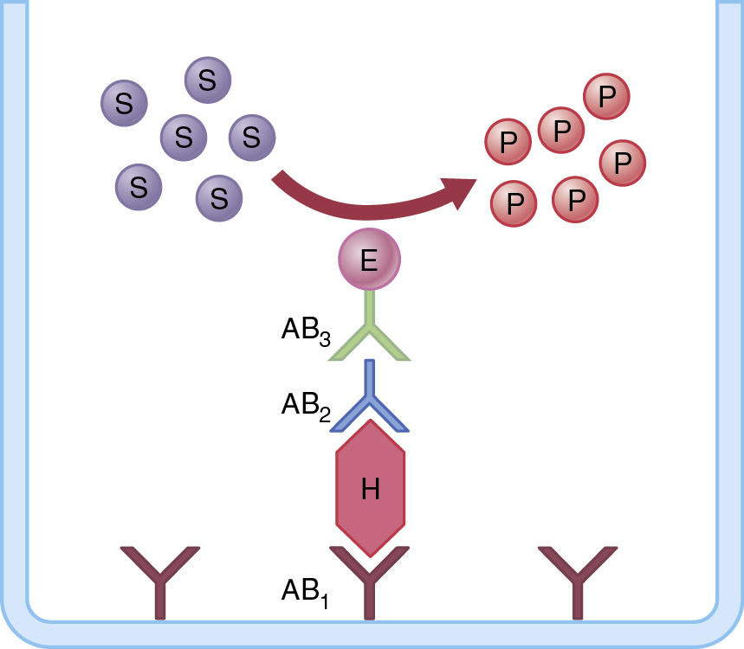
Principles of the ELISA
Figure 75-10

Slide 34
Processing of Preproopiomelanocortin
Signal (26)
Preproopiomelanocortin (265)
N-Terminal Fragment (146)
ß-Lipotropin (91)
ACTH (39)
(76)
γ-Lipotropin (58)
ß-Endorphin (31)
(13)
CLIP
(21)
(27)
γ
α
ß
MSH Sequences

Slide 35
Processing of Prepro-oxyphysin & Prepropressophysin
Signal
Hormone
Neurophysin
oxytocin (9)
AVP (9)
neurophysin I
neurophysin II

Slide 36
Structure-Activity Relationships for Neurohypophyseal Hormones
Oxytocic
(O)
Milk Ejection
(ME)
Vasopessor
(P)
Antidiuretic
(A)
Activity Ratios
O/A O/P A/P
Peptide
Oxytocin
Arginine
Vasopressin
(AVP)
Desmopressin
(dDAVP)
520
14
475
70
4
370
0.5
4
320
955
130
----
----
130
----
----
----
1
2000
1 2 3 4 5 6 7 8 9
Cy-Tyr-Ile-Gln-Asn-Cy-Pro-Leu-Gly-NH₂
S S
Oxytocin
AVP
dDAVP
1 2 3 4 5 6 7 8 9
Cy-Tyr-Phe-Gln-Asn-Cy-Pro-L-Arg-Gly-NH₂
S S
1 2 3 4 5 6 7 8 9
(CH₂)₂-CO-Tyr-Phe-Gln-Asn-Cy-Pro-D-Arg-Gly-NH₂
S S

Slide 37
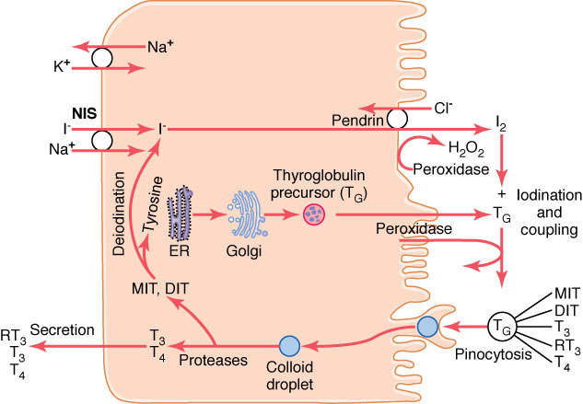
Thyroid Hormone Synthesis & Secretion
Figure 77-2

Slide 38
Thyroid Hormone Synthesis
& Secretion
EVENT
SITE
ENZYME
INHIBITOR
1
Synthesis of TG; extrusion into Rough ER, Golgi
follicular lumen apparatus
2
I⁻ pump Basal membrane Perchlorate, thiocyanate
3
Oxidation of I⁻ I₂ Apical (luminal) Peroxidase Propylthiouracil (PTU)
membrane
4
Organification of I₂ into Apical Membrane Peroxidase Propylthiouracil
MIT & DIT
5
Coupling reaction of MIT & Apical Membrane Peroxidase Propylthiouracil
DIT into T₃ & T₄
6
Endocytosis of TG Apical Membrane
Hydrolysis of T₄,T₃,RT₃,MIT, Lysosomes Proteases
DIT; T₄,T₃, & RT₃ enter
circulation
7
Deiodination of residual MIT Intracellular Deiodinase & DIT. Recycling of ^{I-} & Tyrosine
8

Slide 39
Binding of THs & Precursors to TG During Hormone Synthesis
Tyrosine
H
H
HO
C
C
COOH
H
NH2
I
H
H
3-Monoiodotyrosine (MIT)
HO
C
C
COOH
H
NH2
I
3,5-Diiodotyrosine (DIT)
H
H
HO
C
C
COOH
H
NH2
Thyroglobulin Molecule
I
I
I
3,5,3’-Triiodothyronine (T3)
H
H
HO
O
C
C
COOH
H
NH2
I
I
I
3,3’,5’-Triiodothyronine (RT3)
H
H
HO
O
C
C
COOH
H
NH2
I
I
I
Thyroxine (T₄)
H
H
HO
O
C
C
COOH
H
NH2
I
I

Slide 40
Metabolism of Thyroxine by Deiodination in Peripheral Tissues
I
I
H
H
HO
O
C
C
COOH
5’/3’-monodeiodinase
H
NH2
I
I
I
T3
3'
3
H
H
HO
O
C
C
COOH
5'
5
H
NH2
I
I
T₄
5/3-monodeiodinase
I
I
H
H
HO
O
C
C
COOH
H
NH2
I
RT₃

Slide 41
Synthesis of Amine Hormones in the Adrenal Medulla
Tyrosine
tyrosine hydroxylase
L-Dopa
dopa decarboxylase
Dopaminergic Neurons
Dopamine
dopamine β-hydroxylase
Adrenergic Neurons
Norepinephrine
phenylethanolamine-N-methyltransferase
Epinephrine
Adrenal Glands

Slide 42
Steroid Hormone Synthesis and Secretion
LDL
ACTH
LDL
Receptor
G-protein
Adenylyl
cyclase
Receptor
*
endocytosis
cAMP
ATP
Cytoplasm
Protein
kinase A
Cholesterol esters
CEH
Cholesterol
Cortisol
Acetyl CoA
Cholesterol
SCC
Mitochondria
CEH
Pregnenolone
11-Deoxycortisol
Cholesterol esters
Pregnenolone
Smooth
Endoplasmic
Reticulum
Cholesterol esters
LIPID DROPLET
Progesterone
17-OH-
Progesterone
11-Deoxycortisol

Slide 43
Basic Structure of Adrenocortical & Gonadal Steroids
21
20
22
23
12
18
17
24
26
11
13
16
25
27
1
19
9
C
D
Cholesterol
(27 carbons)
2
10
8
14
15
3
A
B
HO
5
7
CH₃
4
6
C
O
Progesterone
Corticoids
Pregnane derivatives
(21 carbons)
Androgens
Androstane derivatives
(19 carbons)
Estrogens
Estrane derivatives
(18 carbons)

Slide 44
Hormone Biosynthesis in the Zona Fasiculata & Reticularis
Cholesterol
CH₃
CH₃
O
C
O
17a-Hydroxylase
(P450 c17)
C
O
17, 20 Lyase
(P450 c17)
ACTH
OH
Pregnenolone
17-Hydroxypregnenolone
HO
HO
HO
Dehydroepiandrosterone
3b-Hydroxysteroid
dehydrogenase
CH₃
CH₃
O
C
O
C
O
OH
O
Progesterone
17-Hydroxyprogesterone
Androstenedione
O
O
21b-Hydroxylase
(P450 c21)
CH₂OH
CH₂OH
C
O
C
O
OH
11-Deoxycorticosterone
11-Deoxycortisol
O
O
11b-Hydroxylase
(P450 c11)
CH₂OH
CH₂OH
C
O
HO
C
O
HO
OH
Corticosterone
Cortisol
O
O

Slide 45
Hormone Biosynthesis in the Zona Glomerulosa
ACTH
CH₃
Cholesterol
C
O
K⁺, A II
Pregnenolone
HO
CH₃
C
O
Progesterone
O
CH₂OH
C
O
11-Deoxycorticosterone
O
CH₂OH
C
O
HO
Corticosterone
O
K⁺, A II
CH₃
Aldosterone Synthase
O
C
O
HO
HC
Aldosterone
O

Slide 46
Hepatic Metabolism of Cortisol
CH2OH
CH2OH
Cortisol
C
O
C
O
OH
HO
OH
HO
HO
Tetrahydrocortisol
O
H
11β-Hydroxysteroid dehydrogenase I
17-Ketosteroids
CH₂OH
C
O
Cortisone
OH
Tetrahydrocortisol
glucuronide
O
O
Tetrahydrocortisone glucuronide

Slide 47
Hormone Biosynthesis in the Zona Fasiculata & Reticularis
Cholesterol
CH₃
CH₃
O
C
O
17a-Hydroxylase
(P450 c17)
C
O
17, 20 Lyase
(P450 c17)
ACTH
OH
Pregnenolone
17-Hydroxypregnenolone
HO
HO
HO
Dehydroepiandrosterone
3b-Hydroxysteroid
dehydrogenase
CH₃
CH₃
O
C
O
C
O
OH
O
Progesterone
17-Hydroxyprogesterone
Androstenedione
O
O
21b-Hydroxylase
(P450 c21)
CH₂OH
CH₂OH
C
O
C
O
Testosterone
OH
11-Deoxycorticosterone
11-Deoxycortisol
O
O
11b-Hydroxylase
(P450 c11)
CH₂OH
CH₂OH
C
O
HO
C
O
HO
OH
Corticosterone
Cortisol
O
O

Slide 48
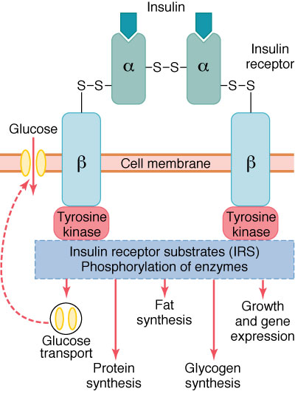
The Insulin Receptor & Mechanisms of Insulin Action
Figure 79-3

Slide 49
Insulin Actions on Glucose and Fatty Acid
Metabolism in the Liver
(Plasma)
Glucose
Glycogen
Glucose-1-P
Glucose
Glucose-6-P
Fructose-6-P
Fructose-1,6-diP
Phosphoenolpyruvate
Pyruvate
Acetyl-CoA
Hydroxymethylglutaryl-CoA
Mevalonate
Cholesterol
1
2
3
4
Ketoacids
CO₂
Acetoacetyl-CoA
FFA-CoA
FFA-Carnitine
FFA-CoA
Triglycerides
5
6
10
Oxalo-
Acetate
14
7
(Plasma)
Lactate
9
14
8
(Plasma)
FFA
CO₂
11
Malonyl-CoA
12
Glycerol-P
13
Insulin effects
Increased activity or concentration
Decreased activity or concentration

Slide 50
Processing of Preproglucagon
Preproglucagon (179)
Signal
Pancreatic islets
(A-cells)
GRPP
Glucagon (29)
Intestine
(L - cells)
Glicentin
GLP-1
GLP-2
Glucagon-like peptides

Slide 51
Formation & Hydroxylation of Vitamin D₃
Diet
skin
OH
liver
HO
UV light
25-Hydroxylase
CH₂
CH₂
7-Dehydrocholesterol (provitamin)
HO
HO
Vitamin D₃ (cholecalciferol)
25-(OH)-cholecalciferol
PTH
+
1α-Hydroxylase
kidney
24-Hydroxylase
OH
OH
OH
CH₂
CH₂
HO
OH
HO
1,25-(OH)₂-cholecalciferol
24,25-(OH)₂-cholecalciferol
(calcitriol)

