Slide 1
Morphology of the endocrine glands
Dr. Ramada Khasawneh
2020

Slide 2
Glands are specialized cell, or multicellular of epithelial origin that specialize in synthesizing and secreting complex molecules including hormones and enzymes.
Types of glands
Exocrine Glands.
Endocrine Glands.
It is important to figuring out the difference between endocrine and exocrine glands, then to understand the basic structure functions and locations of the endocrine glands

Slide 3
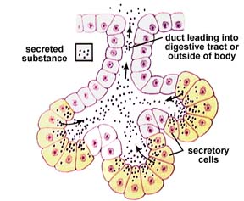
Exocrine Glands
Exocrine glands are specialized secretions which are released through a duct directly into an external or internal surface.
The secretions produced by exocrine glands help in the regulation of multiple phenomena such as regulation of body temperature through sweat glands. Likewise, the lacrimal glands in the eyes help preventing the eyes from dying out.
Examples: Typical exocrine glands are salivary glands, sweat glands, mammary glands, lacrimal glands, digestive system glands.

Slide 4
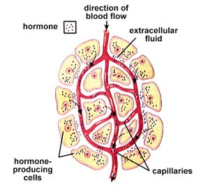
Endocrine Glands
Endocrine glands are specialized organs which release their chemicals directly into blood .
The released chemicals of the endocrine system help in regulation and maintenance of multiple physiological events, such as body metabolism, menstrual flow and uterine changes, reproductive functioning, etc by producing chemical substances called hormones.
Examples : Endocrine glands include thyroid and parathyroid gland, pineal gland, testes and ovaries, pituitary gland, pancreas, hypothalamus and adrenal glands, etc.

Slide 5
Pancreas and liver are the two organs that crossover both exocrine and endocrine glands → they called mixocrine glands
Pancreas:
Exocrine → it secretes enzymes to break down the proteins, lipids, carbohydrates, and nucleic acids in food directly into the duodenum.
Endocrine → secretes the hormones insulin and glucagon to the blood control the blood sugar levels.
Liver:
Exocrine → it secretes bile and pancreatic juice into the gastrointestinal tract
Endocrine → as it secrete other substances directly into the bloodstream.

Slide 6
Difference Between Endocrine and Exocrine Glands
1. Ducts
Endocrine glands do not utilize ducts or tubes to release their secretions, while exocrine glands require some ducts for transportation of their secretions.
For this reason the exocrine glands are classified into two types according to the duct types:
Simple exocrine gland: This has only one single duct or unbranched simple ducts for transportation of released substances.
Compound exocrine gland: They consist of multiple branches of the duct which are secondary and tertiary branches responsible for releasing the substance at the targeted site

Slide 7
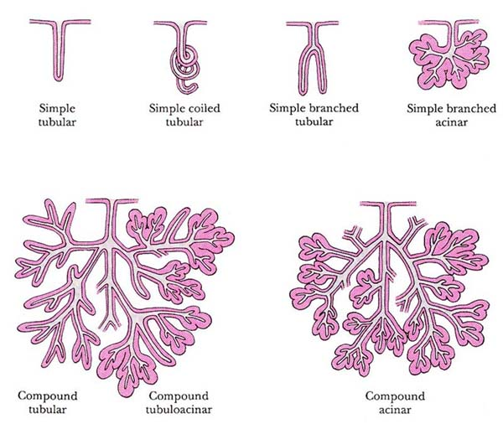
Intestinal glands
Sweat glands
gastric glands of stomach
subaceous glands
Brunner glands
Submandibular gland
Mammary gland

Slide 8
2. Response Time
Response time can be one of the factors of difference between endocrine and exocrine glands.
The response of the endocrine glands is generally delayed due to the release of substances in the blood which then transported to the target tissues.
Exocrine glandular secretion however possesses a quicker response time as they are released directly at the target site.

Slide 9
3. Duration of Action
Although the response time of endocrine glands is longer than that of exocrine glands, the secretions of endocrine glands have longer duration of act → This happens because the blood containing released substances is passed from kidneys for the purpose of filtration where they are reabsorbed and again transported to the target site. On the contrary, the secretions of exocrine glands are not passed to kidney so there is no reabsorption hence the duration or effect is shorter.

Slide 10
Endocrine glands secrete their products (hormones) into the blood stream and the interstitial fluid rather than into ducts → Because of their dependence on the circulatory system to distribute their products, endocrine glands are some of the most vascular tissues in the body. Very small amounts of most hormones are required in most cases to produce a response, so circulating levels typically are low

Slide 11
Summarized comparison between endocrine and exocrine glands
Endocrine Glands | Exocrine Glands
They are hormone secreting glands. | They are mainly an enzyme secreting glands.
The action of released hormones is prolonged | The activity of the enzymes is short term
The secretions are released into blood stream. | The secreted substances are directly released over the target site or tissue.
Some examples include adrenal gland, pituitary gland, thyroid gland, etc. | Some of the examples include sweat glands, gastric glands, etc.

Slide 12
Hormones
Hormones have powerful effects, even when present in very low concentrations.
As a rule, most of the body’s 50 or so hormones affect only a few types of cells.
The reason that some cells respond to a particular hormone and others do not depends on whether the cells have hormone receptors.

Slide 13
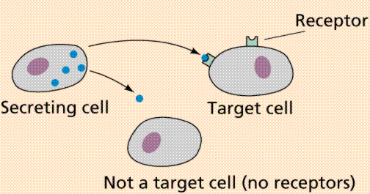

Slide 14
Hormones
Although a given hormone travels throughout the body in the blood, it affects only certain target cells.
Hormones, like neurotransmitters, influence their target cells by chemically binding to specific protein receptors.
Only the target cells for a given hormone have receptors that bind and recognize that hormone.

Slide 15
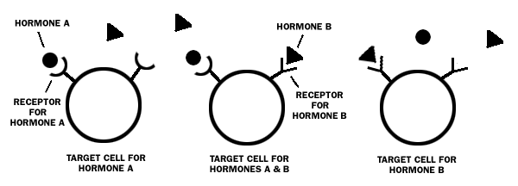

Slide 16
Hormones
Receptors, like other cellular proteins, are constantly being synthesized and broken down. Generally, a target cell has 2000–100,000 receptors for a particular hormone.
When a hormone is present in excess, the number of target-cell receptors may decrease (down regulation) → This decreases the responsiveness of target cells to the hormone.
In contrast, when a hormone is deficient, the number of receptors may increase to make the target tissue more sensitive (up regulation).

Slide 17
The Endocrine Glands
Pituitary Gland
Thyroid & parathyroid Glands
Thymus
Pancreas
Suprarenal Glands (Adrenal Gland )
pineal body Gland
Ovaries
Testes

Slide 18
The Endocrine Glands
Pituitary Gland
Thyroid & parathyroid Glands
Thymus
Pancreas
Suprarenal Glands (Adrenal Gland )
pineal body Gland
Ovaries
Testes

Slide 19
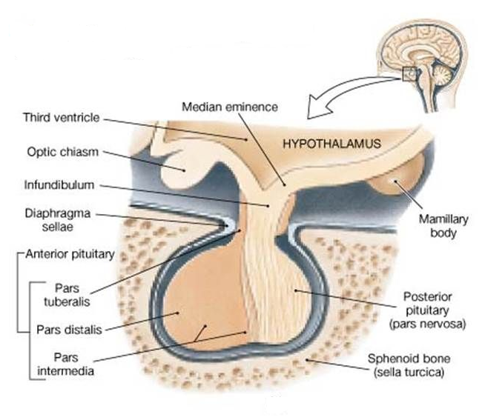
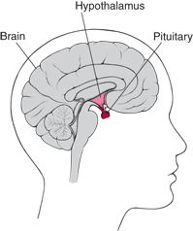
Pituitary Gland
It is a protrusion off the bottom of the hypothalamus at the base of the brain, and rests in a small, bony cavity (sella turcica) covered by a dural fold (diaphragm sellae).
The “master gland”— Primary function is to control other endocrine glands.
Produces many hormones.

Slide 20
Pituitary Gland
Secretion is controlled by the hypothalamus in the base of the brain → This small region of the brain, inferior to the thalamus, is the major integrating link between the nervous and endocrine systems
Connected with the Hypothalamus by the pituitary stalk or hypophyseal stalk.

Slide 21
Subdivision of Pituitary Glandn
The gland is subdivided into:
Anterior lobe (adenohypophysis): true gland, secretes hormones
Posterior lobe (neurohypophysis): connected to hypothalamus through hypothalamo-hypophyseal tract, stores hormones secreted by hypothalamic nuclei Hypothalamo-hypophyseal tract
Between the two portions Pars intermedia is present (it separates the anterior and posterior lobes)
Anterior and posterior pituitary are situated in very close approximation

Slide 22
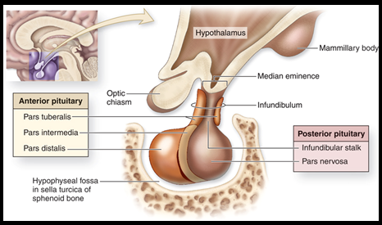
Anterior pituitary (adenohypophysis)
Anterior pituitary consists of three divisions:
Pars distalis →the largest part, responsible for hormone secretion
Pars tuberalis → surrounds the anteriolateral aspect of the infundibulum
Pars intermedia → a thin epithelial layer that separates the para distalis from the posterior lobe

Slide 23
Anterior pituitary (adenohypophysis)
Release of anterior pituitary hormones is stimulated by releasing hormones and suppressed by inhibiting hormones from the hypothalamus.
Hypothalamic hormones that release or inhibit anterior pituitary hormones reach the anterior pituitary through a hypophyseal portal system.

Slide 24
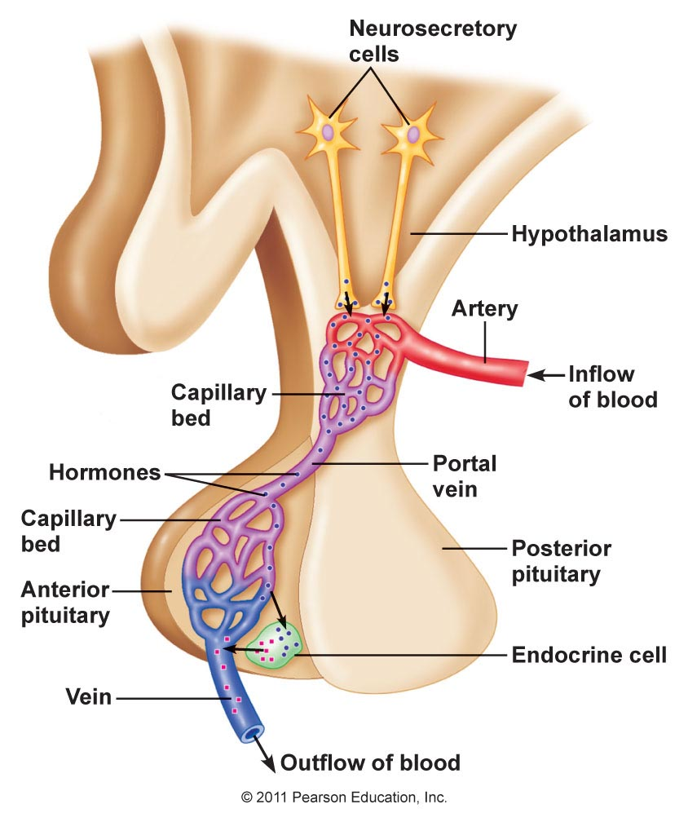
Anterior pituitary (adenohypophysis)
Above the optic chiasm are clusters of specialized neurons called neurosecretory cells.
They synthesize the hypothalamic releasing and inhibiting hormones in their cell bodies and package the hormones inside vesicles, which reach the axon terminals by axonal transport.

Slide 25
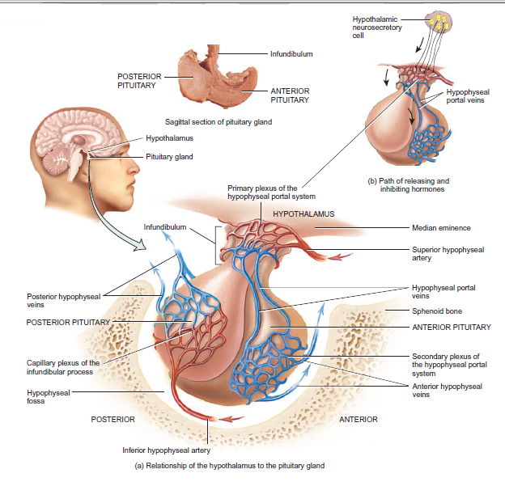
The hormones diffuse into capillaries of the primary plexus of the hypophyseal portal system and are carried by the hypophyseal portal veins to the secondary plexus of the hypophyseal portal system for distribution to target cells in the anterior pituitary.

Slide 26
Anterior pituitary (adenohypophysis)
The following list the major hormones secreted by anterior pituitary cells:
Human growth hormone (hGH), or somatotropin
Thyroid-stimulating hormone (TSH), or thyrotropin
Follicle-stimulating hormone (FSH) and luteinizing hormone (LH)
Prolactin (PRL)
Adrenocorticotropic hormone (ACTH)

Slide 27
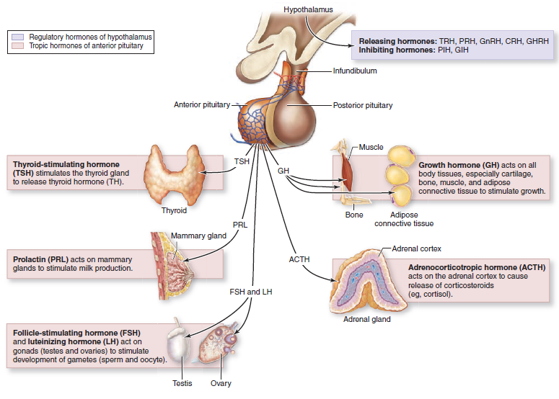

Slide 28
Posterior pituitary (neurohypophysis)
Although the posterior pituitary, does not synthesize hormones, it does store and release two hormones.
Posterior pituitary consists of two divisions:
Pars Nervosa
Infundibular Stalk

Slide 29
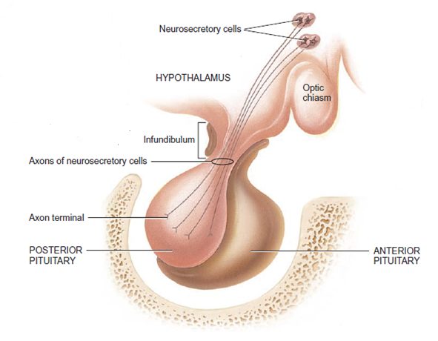
Posterior pituitary (neurohypophysis)
The cell bodies of the neurosecretory cells are in the hypothalamus; their axons form the hypothalamohypophyseal tract, begins in the hypothalamus and ends near blood capillaries in the posterior pituitary gland.
Different neurosecretory cells produce two hormones:
Oxytocin
Antidiuretic hormone (ADH also called vasopressin)
After their production in the cell bodies of neurosecretory cells, oxytocin and antidiuretic hormone are packed into vesicles and transported to the axon terminals in the posterior pituitary gland.
Nerve impulses that propagate along the axon and reach the axon terminals trigger exocytosis of these secretory vesicles.

Slide 30
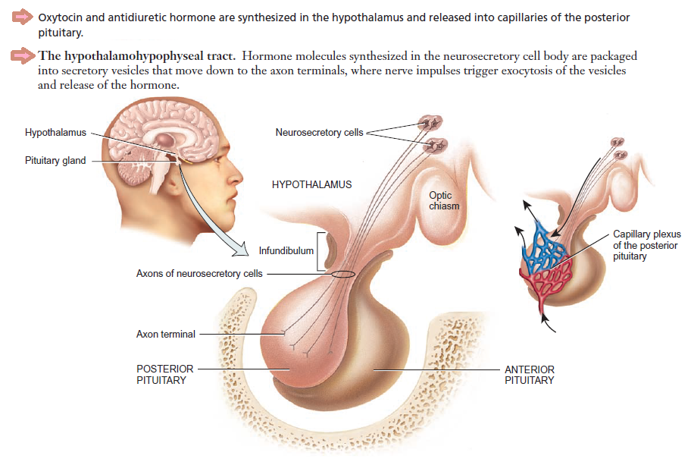
Posterior pituitary (neurohypophysis)

Slide 31
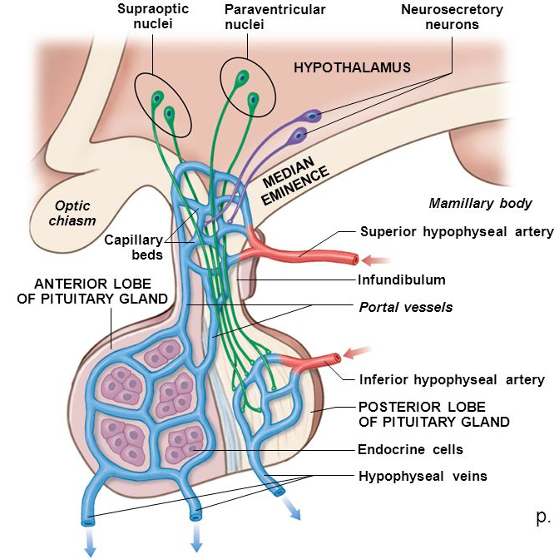
Vascular Supply and Lymphatic Drainage
Arteries→
Superior & inferior hypophyseal arteries (branches of internal carotid artery)
Veins→
hypophyseal veins drain into cavernous sinuses.
Cavernous sinuses

Slide 32
Vascular Supply and Lymphatic Drainage
The superior hypophyseal arteries → branches of the internal carotid arteries, supplies infundibulum and form a capillary network from which vessels pass downward and from sinusoids into the anterior lobe of pituitary gland (primary plexus of the hypophyseal portal system).
The inferior hypophyseal arteries →which branch from the internal carotid arteries, supplies posterior lobe of pituitary gland with small supply to the stalk.

Slide 33
Control Of Pituitary Gland
Pituitary secretion is controlled by either hormonal or nervous signals from hypothalamus.
Anterior→
controlled by hormones (hypothalamic releasing, hypothalamic inhibitory hormones)
is secreted form the hypothalamus then conducted through minute blood vessels (hypothalamic-hypophysial porta vessels) which penetrates substance of median eminance → pituitary stalk → supply the blood for anterior pituitary gland

Slide 34
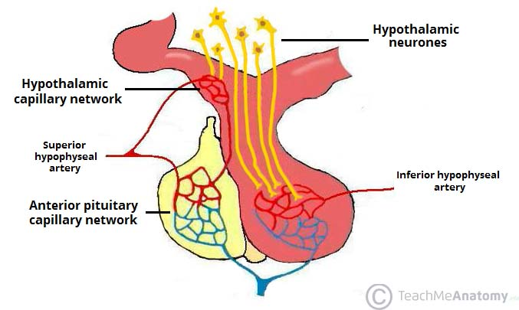
Control Of Pituitary Gland
Posterior→
The neurohypophysis receives a nerve supply from some of the hypothalamic nuclei.
The axons of these nuclei convey their neurosecretion to the posterior lobe of pituitary gland through Hypothalamo-Hypophyseal tract from where it passes into the blood stream

Slide 35
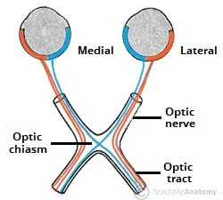
Anatomical relations of Pituitary Gland
Anterior →
anterior intercavernous sinus
Posterior →
posterior intercavernous sinus
Superior →
Diaphragma sellae
Optic chiasma
Inferior →
Sphenoidal air sinuses
Hypophyseal fossa

Slide 36
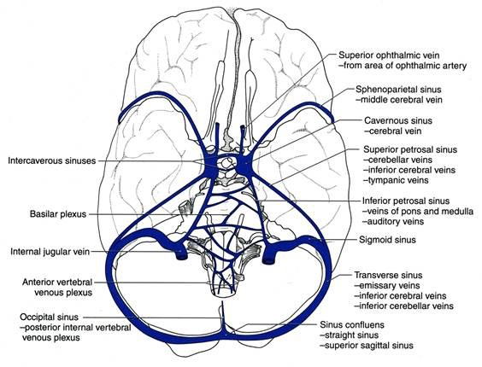

Slide 37
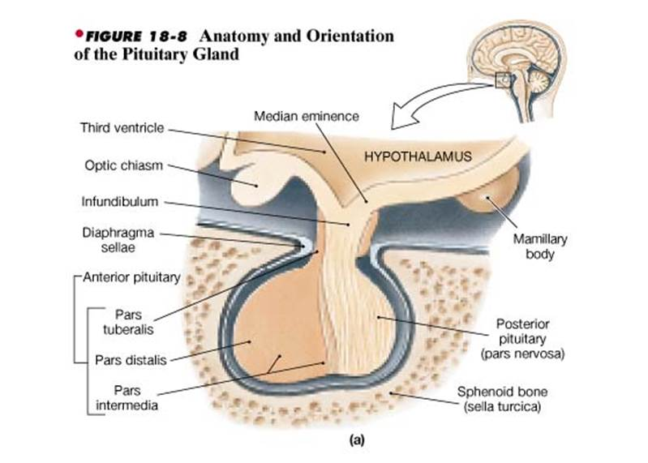

Slide 38
Thyroid & parathyroid Glands

Slide 39
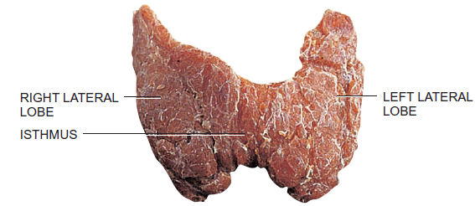
Thyroid Gland
The butterfly-shaped thyroid gland, is a brownish-red and highly vascular, placed anteriorly in the lower neck, level with the fifth cervical to the first thoracic vertebrae, inferior to the larynx and cricoid cartilage.
The gland is slightly heavier in females, and enlarges during menstruation and pregnancy
It is ensheathed by the pretracheal layer of deep cervical fascia and consists of :
Right lobe
Left lobe
connected by a narrow, median Isthmus.

Slide 40
Thyroid gland
The lobes of the thyroid gland approximately conical.
Each lobe is around 5 cm long, its greatest transverse and antero-posterior extents being approximately 0.3 cm and 2 cm respectively.
Its weight is usually 25g, but this varies.
The posteromedial aspects of the lobes are attached to the side of the cricoid cartilage by a lateral thyroid ligament

Slide 41
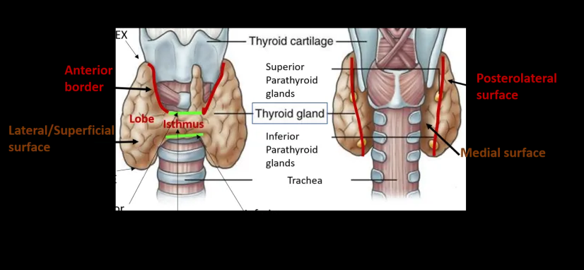
Surfaces and the Anatomical Relation
It has three surfaces:
Lateral surface →convex and covered by :
sternohyoid muscle.
superior belly of omohyoid muscle.
Sternothyroid muscle.
anterior border of sternocleidomastoid muscle.
Medial surface →
Trachea and esophagus.
Inferior constrictor and cricothyroid muscles.
External laryngeal and recurrent laryngeal nerves.
Posteriolateral surface →
is close to the carotid sheath, and overlaps the common carotid artery.

Slide 42
Surfaces and the Anatomical Relation
The isthmus connect the lower parts of the two lobes.
The anterior surface of the isthmus covered by:
Sternothyoid and sternohyoid muscles.
Fascia and skin.
Anterior jugular veins.
Posterior surface is related to:
The 2nd to 4th tracheal rings.

Slide 43
Vascular Supply and Lymphatic Drainage
The thyroid is highly vascular, and a bruit (the sound of turbulent blood flow) is sometimes heard in overactive glands.
It is supplied by two arteries that anastomose within the gland :
Right and left inferior thyroid arteries → branch of the thyrocervical trunk from the subclavian artery
Right and left superior thyroid arteries → is the first branch of the external carotid artery.
A third artery, called the thyroid ima artery, is present in 10% of people. It supplies the isthmus and it arises near the aortic arch, although the exact origin varies

Slide 44
Vascular Supply and Lymphatic Drainage
The thyroid gland is drained by three veins:
Superior thyroid vein.
Middle thyroid vein.
Inferior thyroid vein
The first two veins drain into the internal jugular, whereas the inferior vein drains into the brachiocephalic veins.
Thyroid lymphatics drain into four groups of nodes:
Prelaryngeal lymph nodes.
Pretracheal lymph nodes.
Paratracheal lymph nodes.
Deep cervical lymph nodes

Slide 45
Nerve Supply
Principle innervation of the thyroid gland derives from the autonomic nervous system
Parasympathatic fibers from the vagus nerve.
Sympathatic fibers are distributed from the:
Superior cervical ganglia
Inferior cervical ganglia
Middle cerivcal ganglia
→ Preganglionic fibers to these ganglia are derived from the second through seventh thoracic segments of the spinal cord.

Slide 46
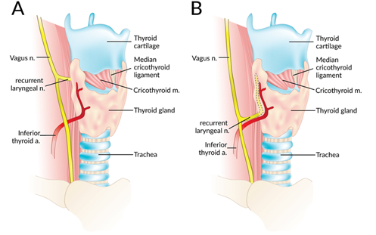
Nerve Supply
The recurrent laryngeal nerve run either in front of or superior to the inferior thyroid artery and it is essential to locate this nerve during thyroid surgery→ the nerve is paired and arise from the vagus nerve
Surgery to the thyroid gland can damage this nerve, causing temporary difficulty with speaking.
To minimize the risk to this nerve, the artery is ligated far away from the thyroid gland during thyroidectomy.

Slide 47
Parathyroid Glands

Slide 48
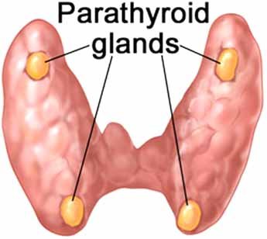
Parathyroid Glands
Parathyroids are four glands partially embedded in the posterior surface of the of the lateral surface of the thyroid gland.
They are small (5x3x2 mm, 20-40 mg) and have a beanlike shape, light yellowish to reddish brown in color.
Anatomically, the glands can be divided into two pairs:
Superior parathyroid glands: They are located approximately 1 cm above the intersection of the inferior thyroid artery and the recurrent laryngeal nerve.
Inferior parathyroid glands: usually found near the inferior poles of the thyroid gland

Slide 49
Vascular Supply and Lymphatic Drainage
The superior parathyroid gland is usually supplied by the inferior thyroid artery or by an anastomotic branch between the inferior thyroid and the superior thyroid artery.
20-45% of cases, the superior parathyroid glands receive significant vascularity from the superior thyroid artery.
The inferior parathyroid gland is supplied by the ascending branch of the inferior thyroid artery or the thyroid ima artery.
in approximately 10% of patients, the inferior thyroid artery is absent, most commonly on the left side. In these cases, a branch from the superior thyroid artery supplies the inferior parathyroid gland

Slide 50
Vascular Supply and Lymphatic Drainage
Venous drainage occurs into superior, middle and inferior thyroid veins
Lymphatic vessels from the parathyroid glands drain into deep cervical lymph nodes and paratracheal lymph nodes.

Slide 51
Nerve supply
The parathyroid glands have an extensive supply of nerves, derived from superior and middle thyroid branches of the cervical (sympathetic) ganglia.
It is important to note that these nerves are vasomotor, not secretomotor – endocrine secretion of parathyroid hormone is controlled hormonally.
Notes:
Vasomotor refers to actions upon a blood vessel which alter its diameter. More specifically, it can refer to vasodilator action and vasoconstrictor action
Secretomotor refers to the capacity of a structure (often a nerve) to induce a gland to secrete a substance (usually mucus or serous fluid).

Slide 52
Thymus

Slide 53
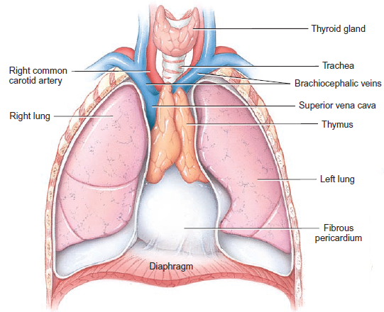
Thymus
Primary central organ of lymphatic system.
Unpaired bi-lobed organ located in the mediastinum between the sternum and the aorta. It extends from the top of the sternum or the inferior cervical region to the 4th costal cartilage.

Slide 54
Thymus
Thymus is pryamid-shaped, pinkish gray in children and wish advancing age, becomes yellowish as lymphatic tissue is replaced by fat.
An enveloping layer of connective tissue holds the two lobes closely together, but a connective tissue capsule encloses each lobe separately.

Slide 55
Structure of the Thymus
It consists of two lateral lobes.
Extensions of the capsule, called trabeculae, penetrate inward and divide each lobe into lobules. Which mean that the lobules are separated from each other by strands of areolar connective tissue the trabeculae.
Each thymic lobule consists of:
Outer cortex → is composed of large numbers of T cells and scattered dendritic cells, epithelial cells, and macrophages.
Central medulla → consists of widely scattered, more mature T cells, epithelial cells, dendritic cells, and macrophages

Slide 56
Anatomical Relation of the Thymus
The thymus overlies the:
Pericardium
Aortic arch
Trachea
The thymus may extend superiorly to the lower pole of the thyroid and inferiorly to the diaphragm
The thymus attach to the thyroid by the thyrothymic ligament.

Slide 57
Vascular Supply and Lymphatic Drainage
The arterial supply to the thymus gland is via the anterior intercostal arteries and small branches from the internal thoracic arteries. Also from the superior thyroid artery and inferior thyroid artery.
Venous blood drains into the left brachiocephalic and internal thoracic veins. Also the thyroid vain.
Channels drain into parasternal, tracheobronchial and brachiocephalic nodes, but the thymus does not receive any afferent lymphatics.

Slide 58
Nerve supply
The nerves are derived from the vagus nerve and the sympathetic nervous system.
Branches from the hypoglossal and phrenic nerves reach the investing capsule, but do not penetrate into the substance of the organ.

Slide 59
Suprarenal Glands (Adrenal Gland)

Slide 60
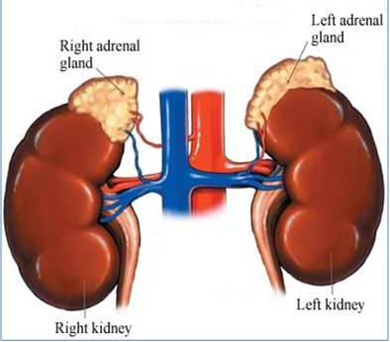
Suprarenal Glands (Adrenal Gland)
The adrenal glands (also known as suprarenal glands) are paired yellowish retroperitoneal endocrine glands that sit at the kidneys just above the level of the last thoracic vertebra (T12).

Slide 61
Suprarenal Glands (Adrenal Gland)
in humans, the right suprarenal gland is triangular shaped, while the left suprarenal gland is semilunar shaped.
In an adult, each adrenal gland is 3–5 cm in height, 2–3 cm in width, and a little less than 1 cm thick; it weighs 3.5–5 g, only half its weight at birth.

Slide 62
Structure of the Adrenal Gland
They are surrounded by two sheaths:
Renal fascia → enclose the suprarenal gland with the kidney
Perirenal fat →fat that separated them from the kidneys
Each gland has:
an outer yellow cortex → representing 80–90 percent of the gland by weight, develops from mesoderm, produces hormones that are essential for life.
an inner dark brown medulla → a small, centrally located develops from ectoderm. Produces two hormones: norepinephrine and epinephrine.
Complete loss of adrenocortical hormones leads to death in a few days to a week due to dehydration and electrolyte imbalances, unless hormone replacement therapy begins promptly.

Slide 63
Structure of the Adrenal Gland
Suprarenal cortex
The suprarenal cortex is the largest part of the gland and is composed of 3 zones:
the zona glomerulosa (outer zone) →15%
the zona fasciculata (middle zone)→75%
the zona reticularis (inner zone) → 10%
Suprarenal medulla
The suprarenal medulla is composed of special cells called chromaffin cells → which are organized in clusters around blood vessels.

Slide 65
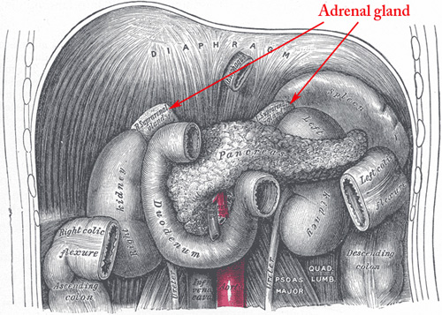
Anatomical relations
Right adrenal gland
Posterior | Anterior
The right curs of the diaphragm | right lobe of the liver inferior vena cava
Left adrenal gland
Posterior | Anterior
The left curs of the diaphragm | Pancreas lesser sac Stomach Spleen

Slide 66
Vascular Supply and Lymphatic Drainage
Each gland is supplied by three arteries from three different sources:
Superior suprarenal arteries → a branch of the inferior phrenic artery
The right and left middle suprarenal arteries → a branch of the abdominal aorta
Inferior suprarenal arteries → a branch of the renal artery

Slide 67
Vascular Supply and Lymphatic Drainage
Each gland is drained by only single vain which emerges from the hilus of the gland:
Right suprarenal vain drains into the inferior vena cava.
Left suprarenal vain drains into the left renal vain
Lymph Drainage:
The lymph drains into the lateral aortic nodes

Slide 68
Nerve supply
Sympathetic
Medulla
Preganglionic sympathetic fibers from the sympathetic trunk directly to the chromaffin cells.
Cortex
Postganglionic fibers from the splanchnic ganglia
Parasympathetic to the adrenal cortex and medulla
Not well defined

Slide 69
Good Luck

