Slide 1
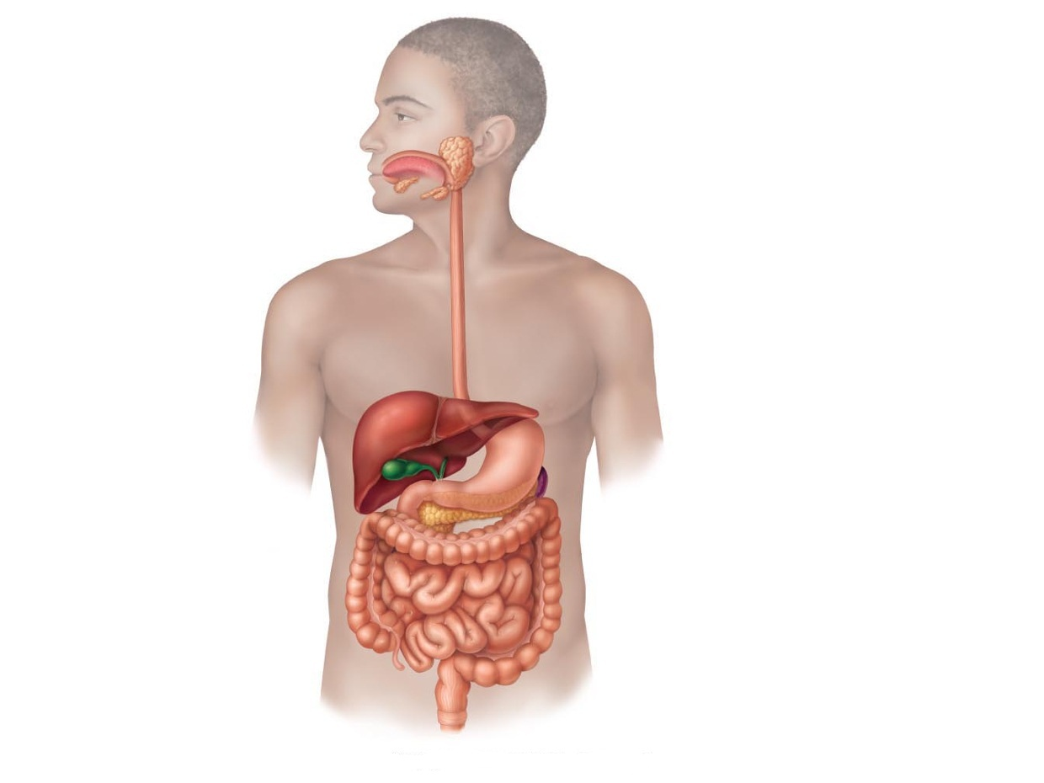
Gastro-Intestinal Tract System
Instructor : Noor Al-Saleh

Slide 2
Introduction
Stool Examination for GIT infections:
Stool culture, to identify Bacteria
Fecal wet mount, to identify Parasites

Slide 3
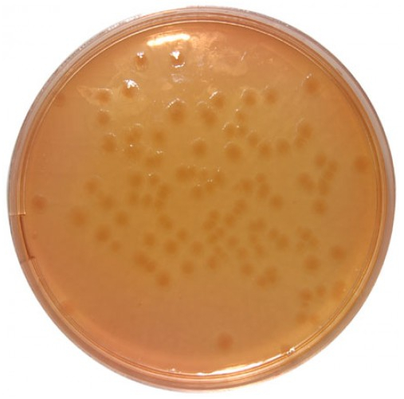
Stool Examination
1- Stool culture (S-S)
(S-S) Agar: is a selective and differential medium for the isolation, cultivation and differentiation of Salmonella spp. and Shigella spp.
Salmonella spp on s-s agar
Colonies with black heads
(H2S producer)
Shigella spp on s-s agar

Slide 4
Stool Examination
2-Fecal wet mount preparation:
GI infections by parasites are primarily diagnosed by:
1- Cysts 4- Helminth eggs
2- Trophozites 5- Helminth larva
3- Oocysts 6- Occasionally adults worms/segments
Saline wet mount:
-demonstrates: eggs, larvae, trophozoites, cysts, RBCs and WBCs
-detects motility of alive trophozites
Lugol’s Iodine wet mount:
-stains nuclei and intra-cytoplasmic organelles
Once Iodine is added, the organism will be killed and motility will be lost

Slide 5
Stool Examination
2-Fecal wet mount preparation:
1- Place one drop of saline/Iodine on different slides
2- Dissolve small amount of stool (size=match head) in each drop, mix
3- place cover slip (avoid air bubbles)
4- Examine under 10X then 40X objective lens
The mount should be just thick that newspaper print can be read through the slide

Slide 6
Parasite Identification
Intestinal protozoa: (unicellular)
- Rhaizopode: Entamoeba histolytica
- Flagellate: Giardia lamblia
- Ciliates: Balantidium coli

Slide 7
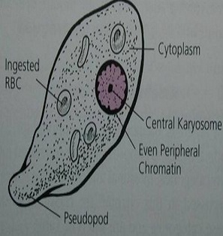
Entamoeba histolytica - Trophozoite
Progressive and directional motility
by pseudopodium
Nucleus: 1N with fine evenly distributed membrane chromatin and small central karyosome
Cytoplasm: contains ingested RBCs (erythrophagocytosis)
Disease: Amoebic Dysentery
Diagnostic stage: Trophozoites or cysts in stool specimen

Slide 8
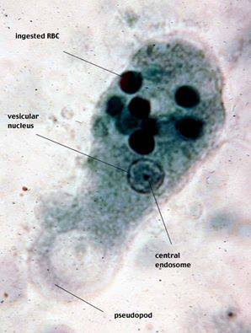
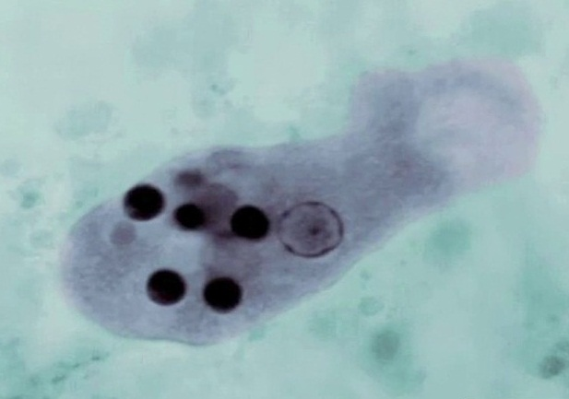
Entamoeba histolytica - Trophozoite

Slide 9
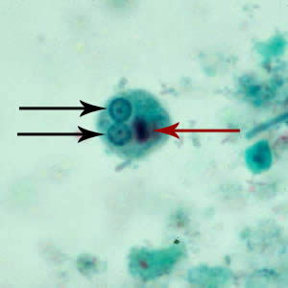
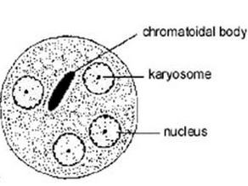
Entamoeba histolytica - Cyst
Round shape
non-motile
Infective stage
Nucleus: 1N or 2N or 4N
Cytoplasm: may contains chromatoidal bars and glycogen vacuoles

Slide 10
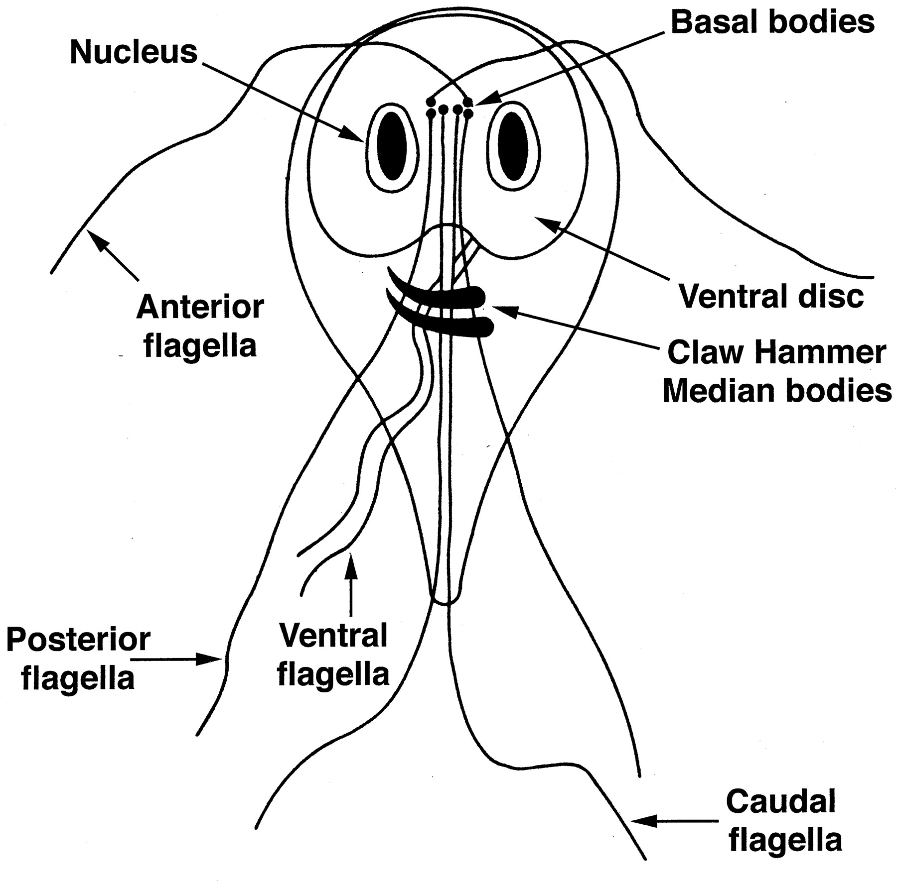
Giardia lamblia - Trophozoite
Pear shaped
Falling leaf movement (erratic)
Nucleus: 2N with giant karyosome, no membrane chromatin
Sucking disk: for attachment
8 Flagella
Axonemes: gives rigidity
2 Median bodies:
composed of microtubules

Slide 11
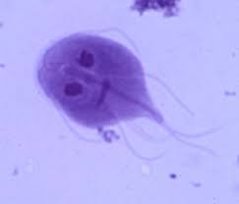
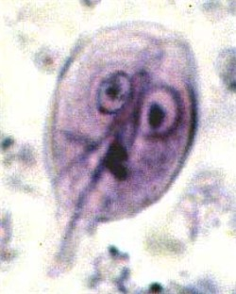
Giardia lamblia - Trophozoite

Slide 12
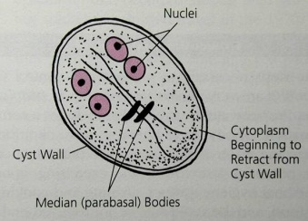
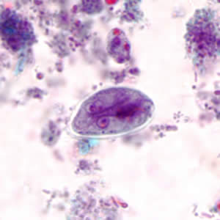
Giardia lamblia - Cyst
Oval shape
Infective stage
Nucleus: 4N
Axonemes present
2 or 4 Median bodies
Disease: Giardiasis (Traveler’s Diarrhea)
Diagnostic stage: Trophozoites or cysts in stool specimen

Slide 13
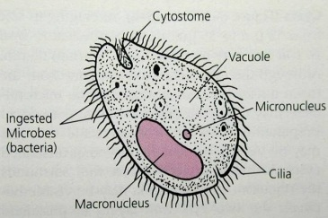
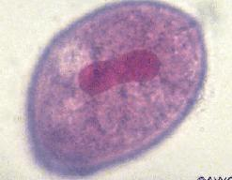
Balantidium coli - Trophozoite
The only ciliate to infect humans
Oval shape
Nucleus: 2N
Macronucleus (kidney shape)
Micronucleus
Cytoplasm:
Food and contractile vacuoles
Funnel-like cytostome
(mouth-like)
Covered with cilia

Slide 14
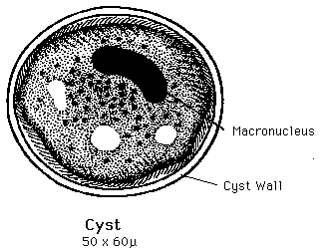
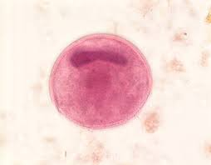
Balantidium coli - Cyst
Oval or spherical shape
Infective stage
Macronucleus
Thick cyst wall with 1 or 2 layers
Disease: Balantidiasis
Diagnostic stage: Trophozoites or cysts in stool specimen

Slide 15
Parasite Identification
Helminthes-Worms: (multicellular)
- Cestodes (Flat worms): Tapeworms - Taenia saginata
Nematodes (Round worm):
= Ascaris – Acaris lumbricoides
= Hook worms - Ancylostoma duodenale / Necator americanus
= Pin worm - Enterobius vermicularis = Whip worm - Trichuris trichura

Slide 16
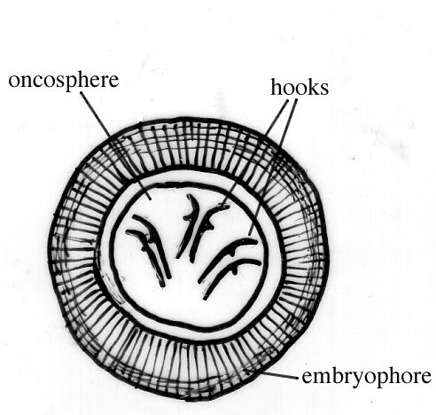
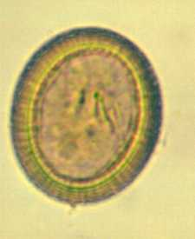
Cestodes - Taenia saginata
Disease: Taeniasis
Diagnostic stage:
A- usually by finding the ova/eggs in stool
B- finding the gravid proglottid in stool
Ova/egg features:
1- Sepherical or slightly oval
2- radially-striated
3- The internal oncosphere contains 6 refractile hooks (hexacanth emryo)

Slide 17
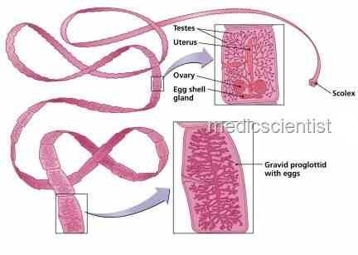
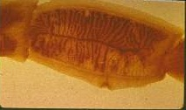
Cestodes - Taenia saginata
Gravid proglottid: very mature segment found posteriorly, contains uterus filled with eggs, occasionally seen in stool

Slide 18
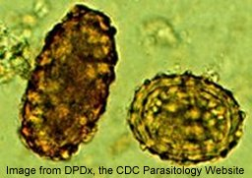
Nematodes - Ascaris lumbricoides
-The most common human helminthic infection
-Largest intestinal nematode
Disease: Ascariasis
Diagnostic stage:
A- fertilized and unfertilized eggs in stool
B- adult worms in stool (rarely)
Ova/egg features:
1-fertilized egg: rounded, thick shell with external mammillated layer
2- unfertilized egg: oval, thin shell with more variable mammillated layer, larger than the fertilized egg, contains a mass of retractile granules

Slide 19
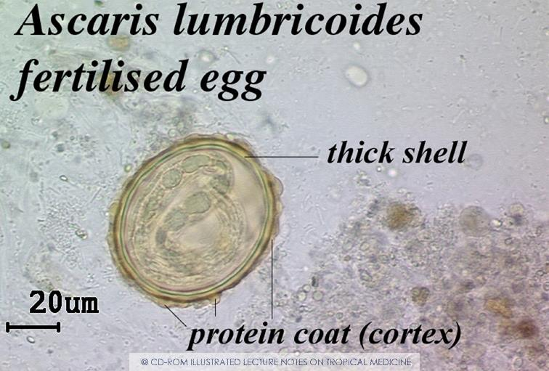
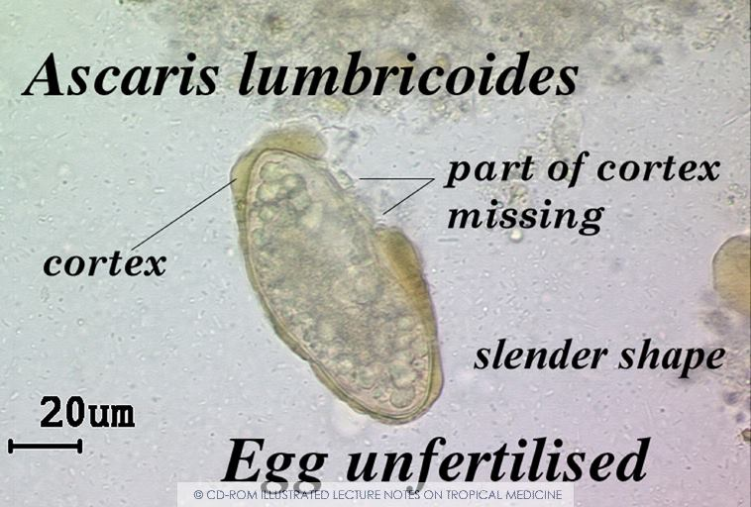
Nematodes - Ascaris lumbricoides

Slide 20
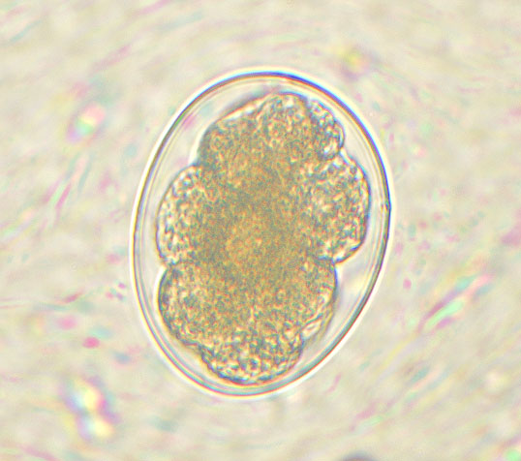
Nematodes - Hookworms
1- Ancylostoma duodenale “old world hookworm” → Ancylostomiasis
2- Necator americanus “ new world hookworm” → Necatoriasis
Diagnostic stage:
Finding eggs in stool
Ova/egg features:
- The eggs of Ancylostoma duodenale and Necator americanus can’t be differentiated microscopically
- Eggs are colorless, thin-shelled

Slide 21
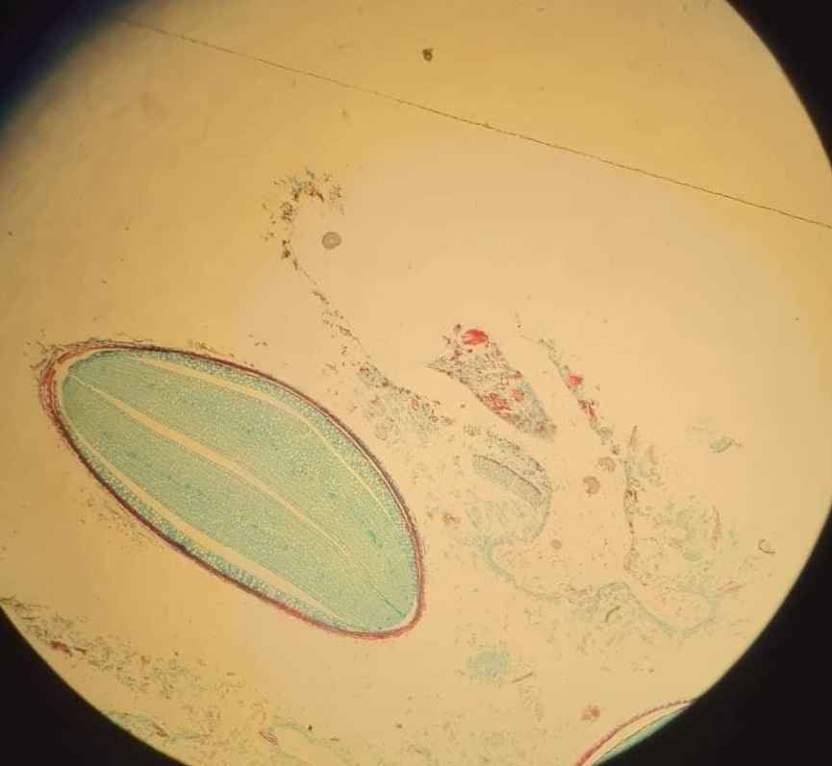
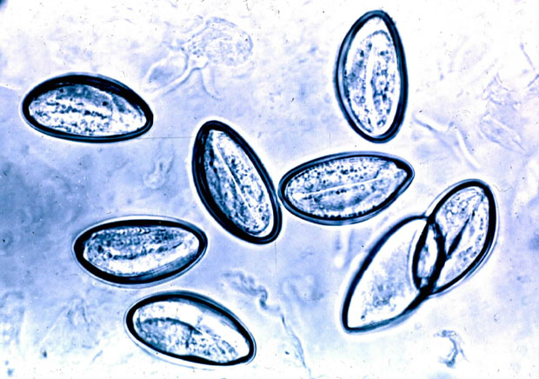
Nematodes (Pin worm) - Enterobius vermicularis
Disease: Entrobiasis
Diagnostic stage:
1- eggs collected from perianal area by “Scotch test”
→Eggs not commonly found in stool
2- adult worms from perianal area or in stool
Ova/egg features:
“D” shaped, elongated-oval slightly flattened on one side
Photo credit:
Mohammad Muneer – Passion Batch

Slide 22
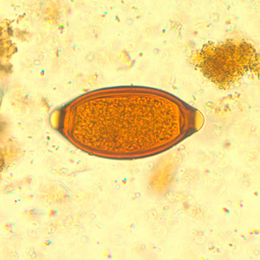
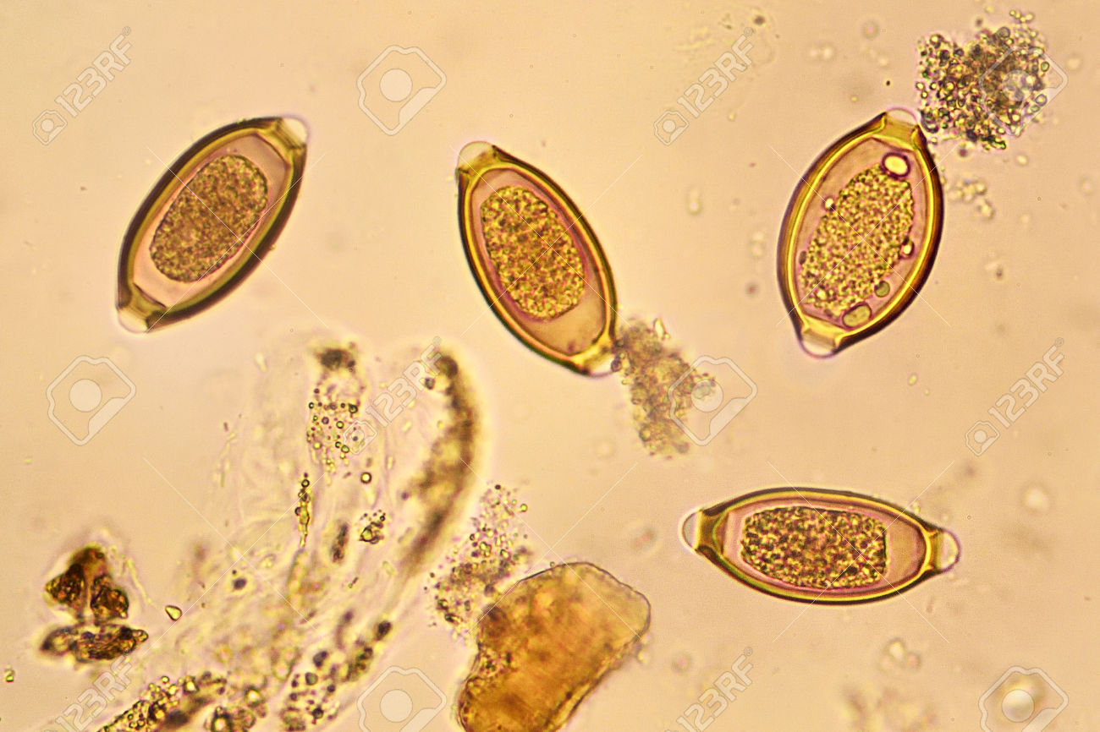
Nematodes (Whip worm) - Trichuris trichura
Diagnostic stage:
Finding unembryonated eggs in stool
Ova/egg features:
Lemon-shaped, thick-shelled with pair of polar plugs

