Slide 1
GIT MODULE
Food Poisoning and Cholera
2019/2020
By
Prof. Dr. Zainalabideen A. Al-Abdulla,
MRCPI, DTM&H., Ph.D., FRCPath. (U.K.)

Slide 2
Learning objectives
1. Understand the role of E. coli, Clostridium perfringens, C. botulinum, Staphylococcus aureus, and Bacillus cereus in food poisoning.
2. Appreciate the pathogenesis & epidemiology of the above mentioned organisms and the type of food common for their transmission.
3. Recognize the morphology, pathogenesis, treatment and prevention of Vibrio cholerae.
4. Look at the clinical significance of all of these organisms.

Slide 3
Food poisoning
1. Escherichia coli (E. coli)
2. Clostridium perfringens
3. Clostridium botulinum
4. Staphylococcus aureus
5. Bacillus cereus
6. Salmonella Typhimurium (already studied)
Topics for each organism
1. Role and epidemiology
2. Pathogenesis
3. Important clinical aspects

Slide 4

E. coli intestinal infections (Diarrhea-causing)
1. Enterotoxigenic (ETEC) – Human only
2. Enteropathogenic (EPEC)
3. Entroinvasive (EIEC) - Human only
4. Enterohaemorrhgic (EHEC)
5. Enteroaggregative (EAEC)
# Uropathogenic E. coli (with UGS)
• E. coli is a gram negative, motile & Lactose-
Fermenter (LF) bacillus. It has peritrichious flagella, and its IMViC tests’ results are (+ + - -)
LF NLF
E. coli

Slide 6
ETEC
- It causes traveler’s diarrhea which affects children of developing countries mainly. This bacteria infects Human only.
- High doses of bacteria in uncooked foods and water are required to produce the disease.
- Colonizing factor (CF) pili for adherence to microvilli & delivery of toxins is also expressed by this bacteria.
- The main factors causing diarrhea are the Heat labile (LT) and heat stable (ST) enterotoxins which cause fluid outpouring in small intestine (SI). LT stimulates
adenylate cyclase (cAMP) and ST stimulates (cGMP) which leads to diarrhea (fluid & electrolytes loss).

Slide 7
EPEC
Epidemiology
1. It causes nursery outbreaks and endemic diarrheas which occur in developing countries with common
12 serotypes.
2. Oral-fecal route, and the bottle-fed of < 1 year (20%) infants is the common mode of infection.
3. Low dose in infants, and high dose in adults (10⁸⁻¹⁰) of bacteria are required to produce the infection.
Pathogenesis (Attachment and Effacing “A/E” lesions, e.g. O126: H6 EPEC)
- A/E is also seen with EHEC (see below)
- A/E is due to effects on cell’s cytoskeleton

Slide 8
EPEC: Left: see cytoskeleton and microvilli.
Middle: Attachment by Bundle Forming pilli (BFP). Then introduce Exporting Secretion Protein (ESPs). Right: Intimin receptor is ESP which Strengthen binding of the bacteria. Other ESPs can cause pedestal cradling of EPEC.
EPEC Attachment/ Effacing (A/E) lesion: Left: see cytoskeleton and microvillous border. Middle: Attachment by Bundle Forming Pilli (BFP). Then insertion of Exporting Secretion Protein (ESPs). Right: Intimin receptor binds ESP/ intimin which results in tight binding of the bacteria to enterocytes. Other ESPs can cause pedestal cradling of EPEC. EHEC has similar effect.

Slide 9
EHEC
Epidemiology
- Consumption of contaminated animal products is the main source (e.g. hamburger), and also unpasteurized drinks, or vegetables.
- Bloody diarrhea and hemolytic uremic syndrome (HUS) is linked to O157:H7 serotype.
- Low infecting dose is required for transmission
- It is more common in developed countries.
-

Slide 10
Pathogenesis of EHEC
- Produce both Stx and A/E lesion
- Circulating Stx causes capillary thrombosis, inflammation and HUS.
- Adhesive pili (long polar fimbriae) can attach the bacteria to the COLON

Slide 11
EIEC
- EIEC closely resembles Shigella
- Mainly infects children < 5 Y by fecal-oral route
- Causes mild version of shigellosis (dysentery)
- Invasion Protein Antigens (Ipas) can result in attachment & secretion of pathogenicity factors
- Only in human

Slide 12
EAEC
- Causes long duration watery diarrhea (>14 D)
- Aggregative Adherence Fimbriae (AAF) attach the bacteria to the intestine
- Adherence and biofilm formation (which is thick mucous-bacteria ) cause diarrhea
- No A/E lesions, but outbreak strain that produces Stx can cause bloody diarrhea.

Slide 13
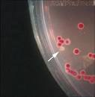

Clinical aspects of E. coli intestinal infection
1. ETEC and EPEC : Cause watery diarrhea
2. EHEC: - Causes bloody diarrhea
- HUS: Starts as oliguria then to
renal failure after EHEC infection.
4. Diarrhea requires immunoassay, or gene probing for LT, ST, and Stx (in all E. coli types except EHEC which is diagnosed by culture):
5. EHEC: Cultured on MacConkey’s agar
with sorbitol (non-sorbitol fermenter “NSF”)

Slide 14
Treatment of E. coli intestinal infections
1. Supportive; usually self-limiting
2. Antimicrobials:
- Fluoroquinolones
- Resistance to ampicillin & cotrimoxazole
3. EHEC: Antimicrobials contraindicated
4. Antimotility: Contraindicated in EIEC/EHEC

Slide 15
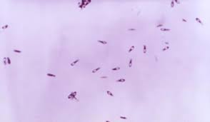
Clostridium perfringens food poisoning
• Gram positive, spore forming anaerobic bacilli
1. Infection is caused by enterotoxin-producing strain of Clostridium perfringens.
2. Rich-meat dishes (e.g. soups,
meat, poultry)
3. Spores converted to vegetative forms
4. I.P. = 8 - 24 hours
5. Followed by nausea, abdominal pain and diarrhea, NO fever, rarely vomiting; recovery within 24 hours.
6. Common in USA (2nd cause of food poisoning).
(Subterminal Spores)

Slide 16
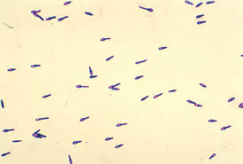
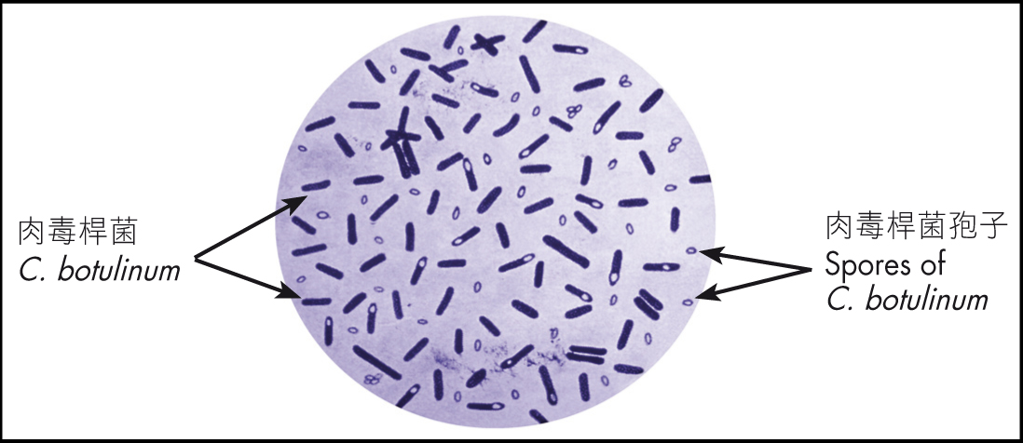
Clostridium botulinum (Botulism)
• Gram positive, spore forming, anaerobic bacilli.
1. Cells germinating from spores produce
neurotoxin (absorbed from intestine, very lethal)
2. Blockage of synaptic acetylcholine release causes neuromuscular paralysis (descending)
3. Toxin destroyed by boiling, NOT spores
cont./…
(Subterminal
Spores)

Slide 17
Cont./… Clostridium botulinum
4. Spores contaminate food (canned food, meat, fish and contaminated vegetables).
5. Foodborne botulism: Intoxication/Not infection
6. I.P.= 12 - 72 hours
7. Diagnosis: Detection of toxin
8. Treatment: Supportive, Anti-toxin serum

Slide 19
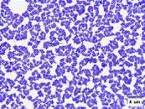
Staphylococcal food poisoning
• Gram positive cocci arranged in clusters
1. Ingestion of staphylococcal enterotoxin-contaminated food (intoxication;
meat, custards, salads)
2. Enterotoxins are stable to boiling and digestive enzymes are produced.
3. Acute vomiting (mainly) and diarrhea: 2 - 4 hours (stimulated by brain-stem mechanism); No fever
3. Recovery: Rapid

Slide 20
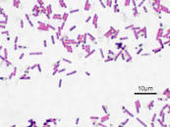
Bacillus cereus
• Gram positive, spore forming (sub-terminal), motile, aerobic and anaerobic, beta-
hemolytic bacilli.
1. Can cause food poisoning by enterotoxin “vomiting toxin” (so it is intoxication)
2. “Fried rice syndrome”, also meat, vegetables
3.Form of disease:
- Emetic form : 1-6 hour that usually occurs with contaminated fried rice; (D/D S. aureus)
- Diarrheal form: 8-16 hour; (D/D C. perfringens)

Slide 21
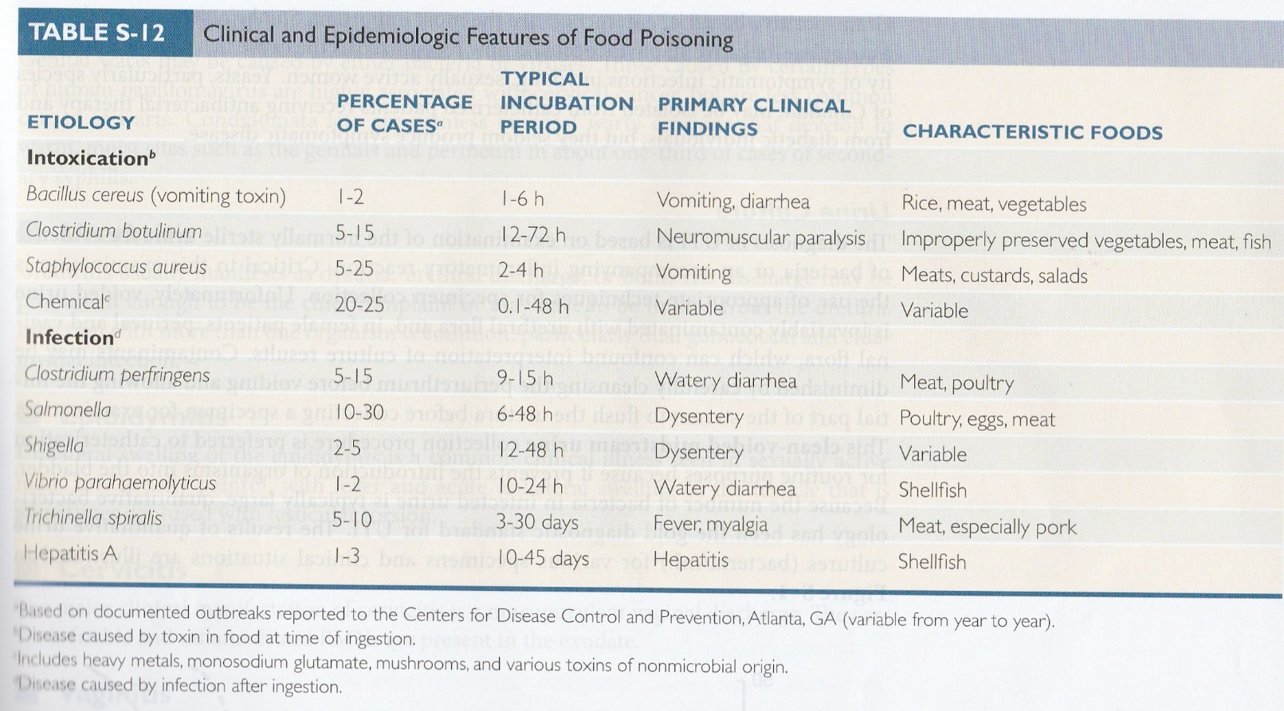

Slide 22
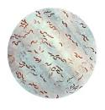
Vibrio cholerae
Morphology
Gram negative curved (comma-shaped) rods, and very motile with a single polar flagellum (H-antigen). There are also >200 O-antigen groups. Group O-1 and O-139 (Bengal strain) only can cause cholera, while the other groups cause cholera-like diarrheal diseases.
The O-1 group is of TWO biotypes:
1. Classical
2. El-Tor (O-139 resembles El-Tor, but capsulated)
The O-1 can be subdivided into serotypes according to A, B, C antigens: Ogawa (A,B), Inaba (A,C), and Hikojima (A, B, C)

Slide 23
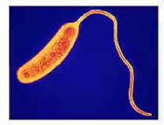
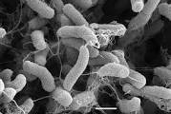

Slide 24
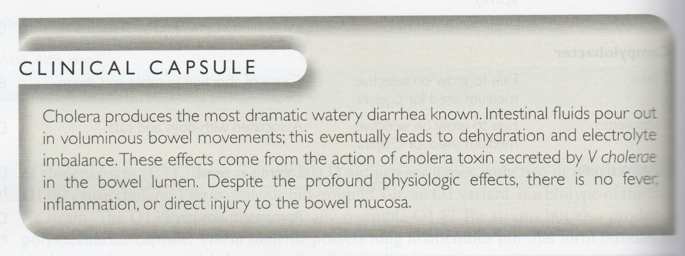

Slide 25
Clinical aspects of cholera
1. Rice-water stool: Extreme watery diarrhea causes large fluid loss (no pus, no blood)
2. No fever
3. Dehydration and electrolyte imbalance are the major problems : Hypotension and death

Slide 26
Treatment
1. Oral or I.V. fluid and electrolyte replacement: Crucial, NaCl (physiologic), K+, HCO3 (higher)
2. Antimicrobial agents: Reduce severity and duration of the disease:
- Azithromycin: A single dose
- Doxycycline, fluoroquinolone, cotrimoxazole

Slide 27
Prevention
1. Water sanitation and cooking (> 10 min.). In USA shellfish cooking prevent infection
2. Vaccines: They are generally Not efficient:
- LPS
- Cholera Toxin B-subunit
- Live attenuated (?); stimulates local sIgA

Slide 28
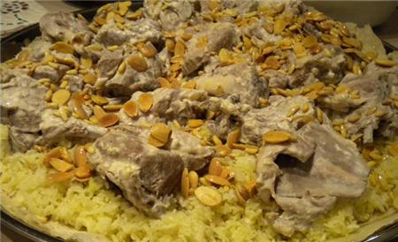
(Mansaf)

Slide 29
Q. What is the expected organism for the food poisoning if the prepared food (mansaf) was kept for few hours before consumption, and the people passing over the dishes of food?
Clostridium perfringens (spores become vegetative forms, then infection occurs)

