Slide 1
Liver Function Test
Glycogen storage diseases
GIT
Dr. Mazhar Al Zoubi
2020

Slide 2
Liver Function Test
ALT, AST, ALP, Bil, Alb, TP, GGT, PT, INR and LDH
Many other specific parameters can be tested according to the case; e.g. Ammonia
Serum or plasma is the target sample from the patient

Slide 3
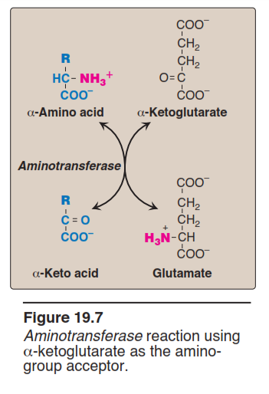

Slide 4
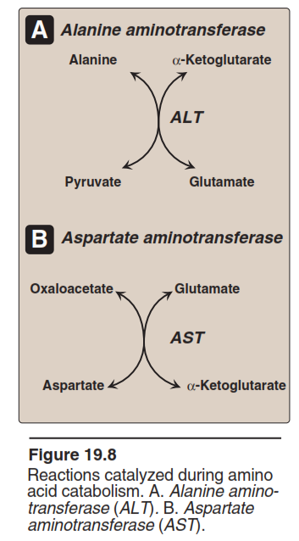

Slide 5
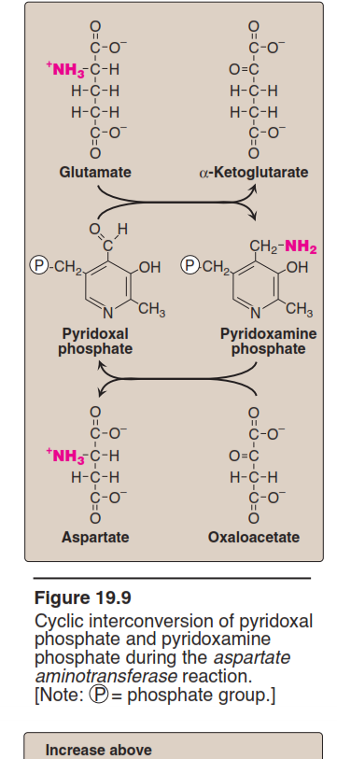

Slide 6
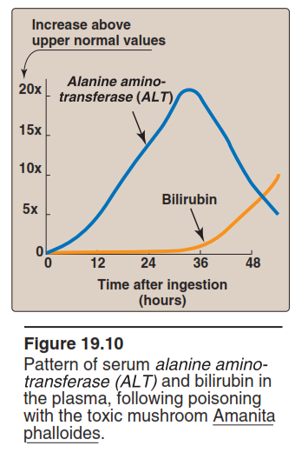

Slide 7
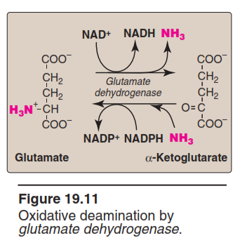

Slide 8
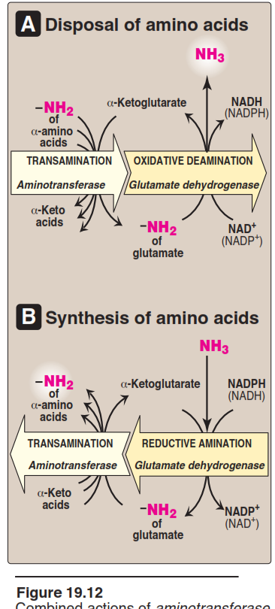

Slide 9
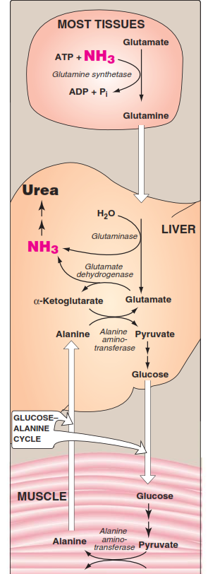
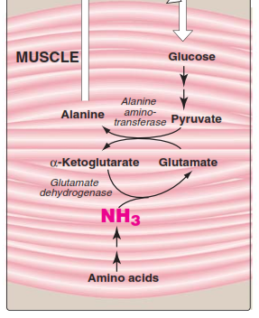

Slide 10
Urea Cycle

Slide 11
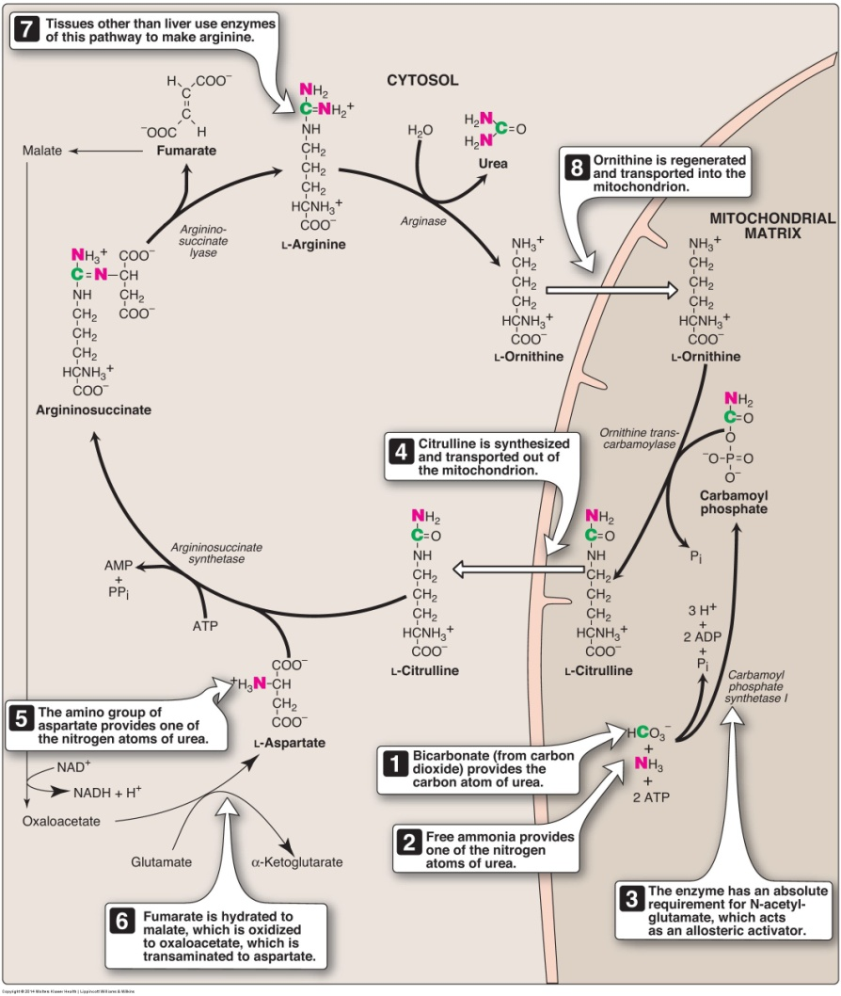

Slide 12
Alanine aminotransferase (ALT): Acute hepatitis, blocked bile ducts, cirrhosis, and liver cancer may have ALT concentrations that are only moderately elevated or close to normal.
Alkaline phosphatase (ALP): Increased with obstructed bile ducts, cirrhosis, liver cancer, and also with bone disease.
Aspartate aminotransferase (AST): A very high level of AST is frequently seen with acute hepatitis. When liver damage is due to alcohol, AST often increases much more than ALT (this is a pattern seen with few other liver diseases). AST is also increased after heart attacks and with muscle injury.
Bilirubin: Increased in the blood when too much is being produced, less is being removed, due to bile duct obstructions, or to problems with bilirubin processing. It is not uncommon to see high bilirubin levels in newborns, typically 1 to 3 days old.
Albumin: Albumin is often normal in liver disease but may be low due to decreased production.
Total protein (TP): Total protein is typically normal with liver disease.

Slide 13
Gamma-glutamyl transferase (GGT): A GGT test may be used to help determine the cause of an elevated ALP. Both ALP and GGT are elevated in bile duct and liver disease, but only ALP will be elevated in bone disease. Increased GGT levels are also seen with alcohol consumption and with conditions, such as congestive heart failure.
Lactate dehydrogenase (LDH): may be elevated with very acute liver disease or liver tumors. It is also elevated with a number of other conditions that do not affect the liver.
Prothrombin time (PT): A prolonged or increased PT can be seen with liver disease, vitamin K deficiency, use of drugs to reduce risk of clotting (warfarin), and with coagulation factor deficiencies.

Slide 14
examples:
People who take medications that may potentially damage the liver
Those who are alcoholics or heavy drinkers
Those who have a history of known or possible exposure to hepatitis viruses
Individuals whose families have a history of liver disease
People who are overweight, especially if they have diabetes and/or high blood pressure

Slide 18
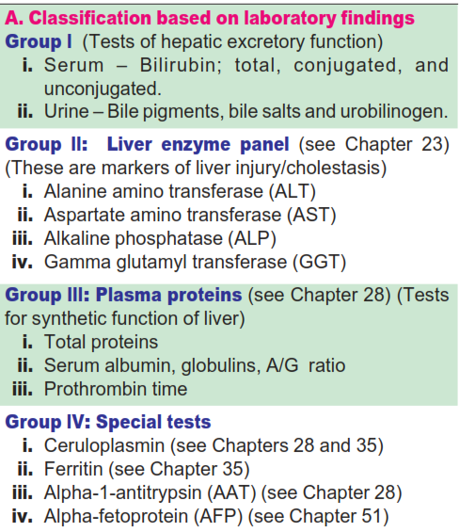
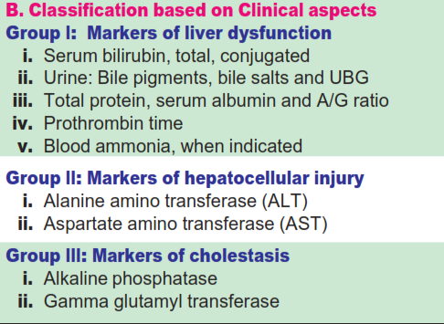

Slide 19
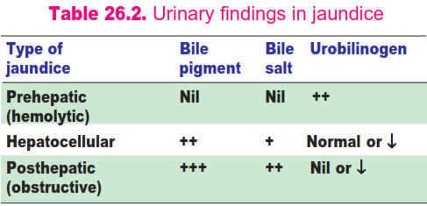

Slide 21
Bilirubin glucuronyl -
transferase
Varying degrees of deficiency of this enzyme result in
Crigler-Najjar I and II.
Gilbert syndrome,
Crigler-Najjar I being the most severe deficiency.

Slide 22
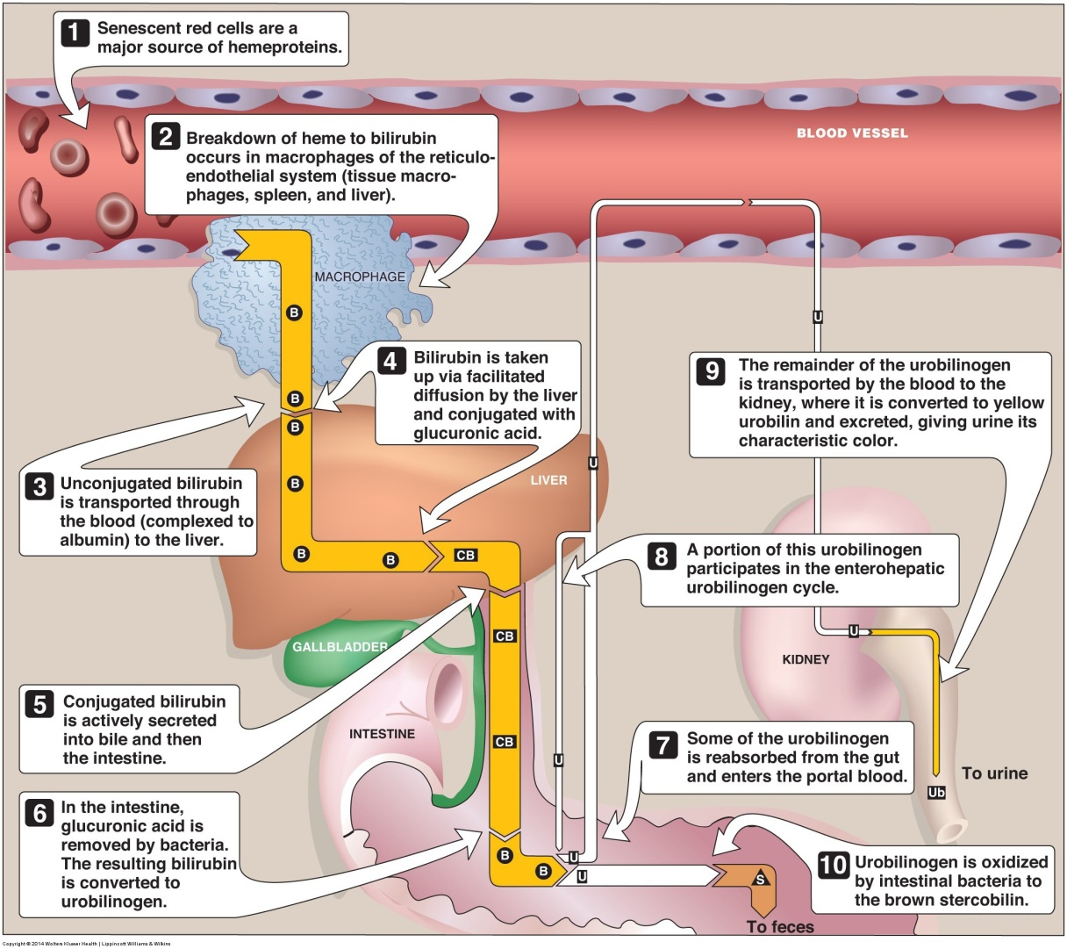

Slide 23
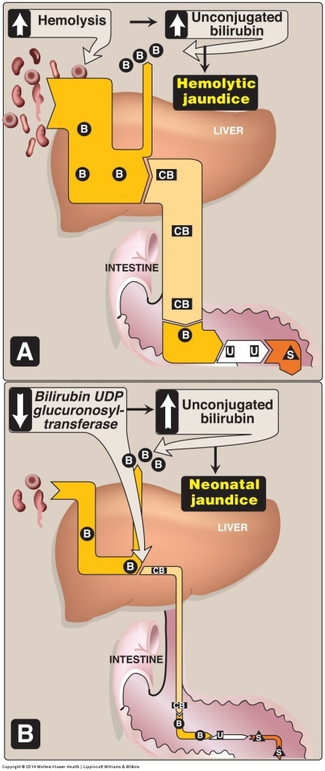

Slide 24
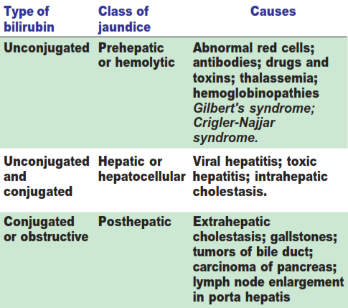

Slide 25
Digestive system disorders: Overview

Slide 26
Describe glycogen storage diseases
Describe inherited disorders of Bilirubin metabolism
Discuss alpha-1 antitrypsin deficiency and its role in liver disorders
Lysosomal storage diseases
Hepatolenticular degeneration (Wilson's disease)

Slide 27
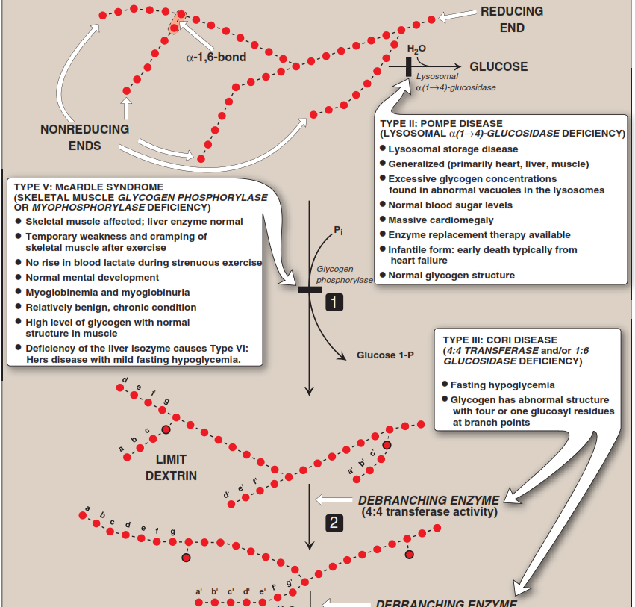
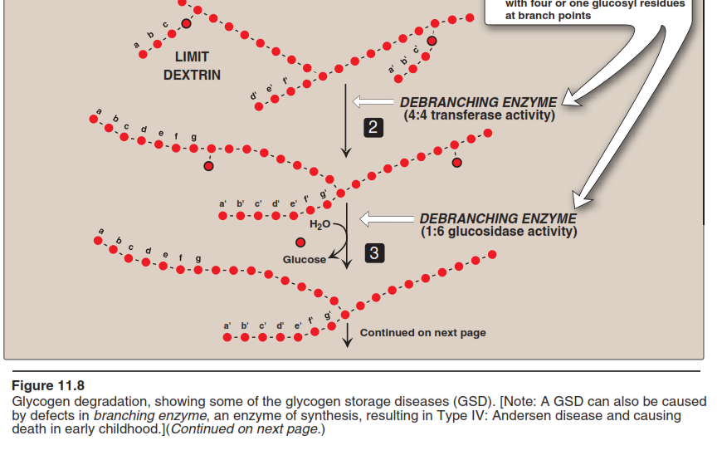

Slide 28
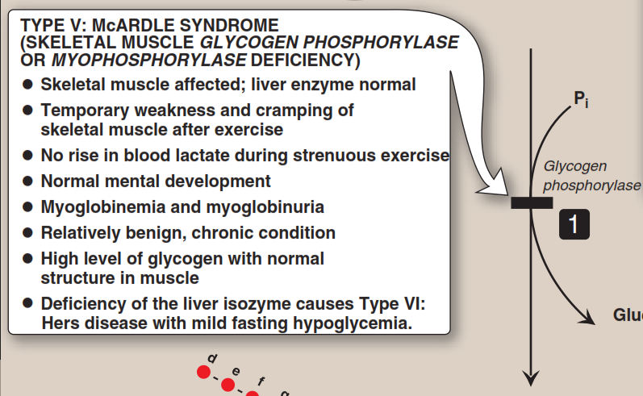

Slide 29
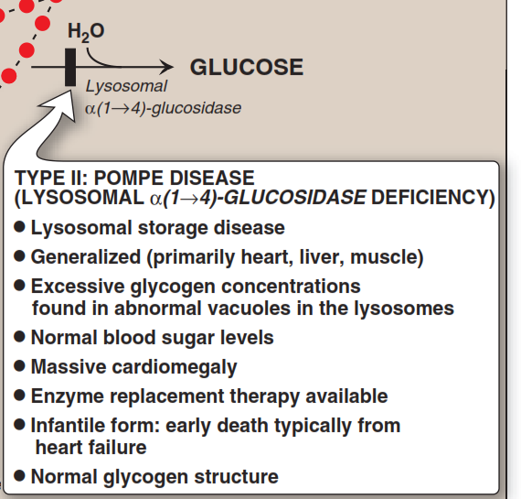

Slide 30
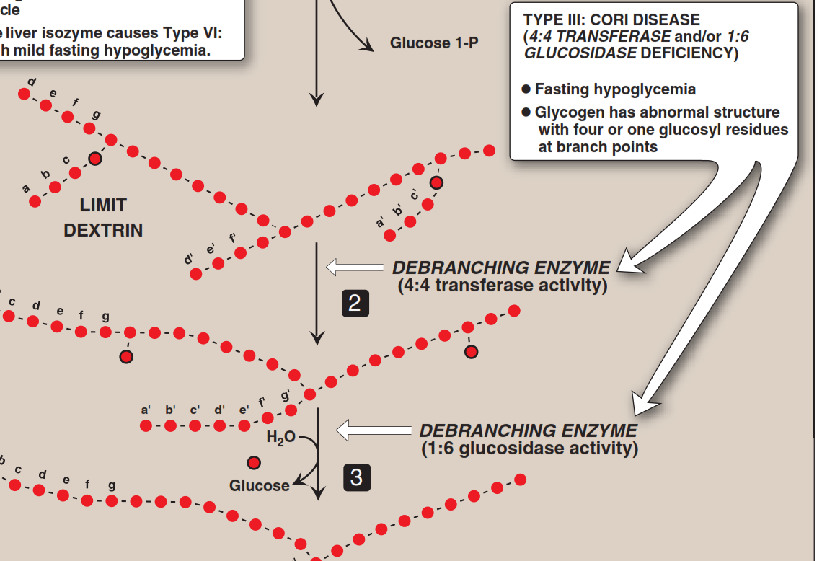

Slide 31
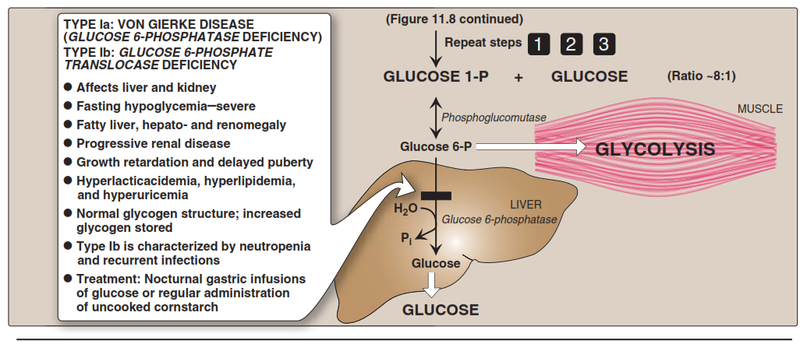

Slide 32
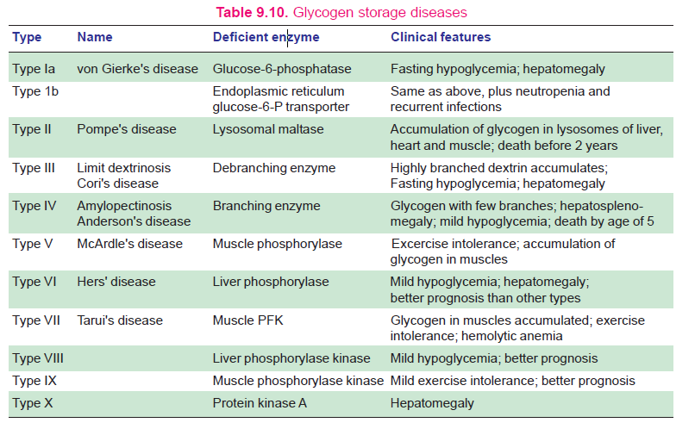

Slide 33
alpha-1 antitrypsin deficiency AATD

Slide 34
Genetic inherited autosomal-codominant condition with more than 120 alleles identified.
Alpha1-antitrypsin is a serine protease inhibitor (serpin) superfamily of proteins.
AATD is caused by mutations in the SERPINA1 gene located in the long arm of chromosome 14.
This genetic defect alters the configuration of the alpha1-antitrypsin molecule and prevents its release from hepatocytes.

Slide 35
Alpha1-antitrypsin molecule normally would serve as protection against proteases such neutrophil elastase.
The resulting protease excess in alveoli destroys alveolar walls and causes emphysema.
The accumulation of excess alpha1-antitrypsin in hepatocytes can also lead to destruction of these cells and ultimately, clinical liver disease.

Slide 36
Wilson’s disease
Wilson disease is a rare autosomal recessive inherited disorder of copper metabolism.
Characterized by excessive deposition of copper in the liver, brain, and other tissues (see the image below).
Wilson disease is often fatal if not recognized and treated when symptomatic.

Slide 37
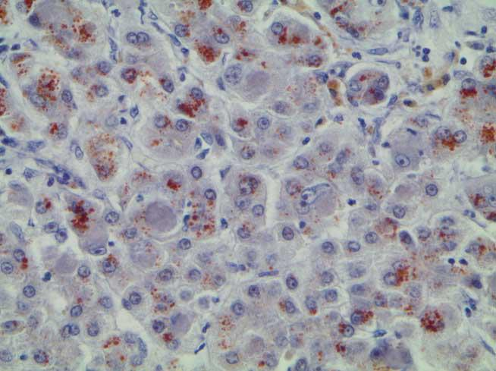

Slide 38
Chronic active hepatitis
Cirrhosis (the most common initial presentation)
Fulminant hepatic failure

Slide 39
