Slide 1
Metabolism of Ethanol
GIT
Dr. Mazhar Al Zoubi
2020

Slide 2
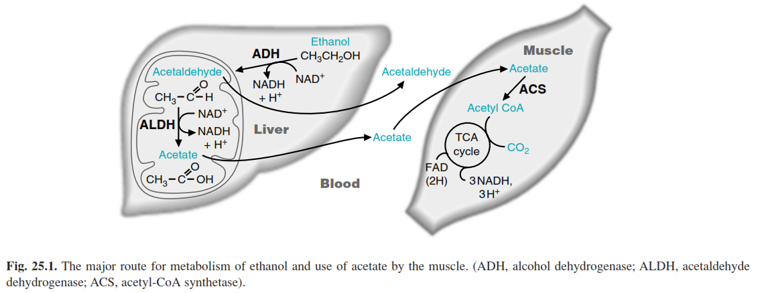

Slide 3
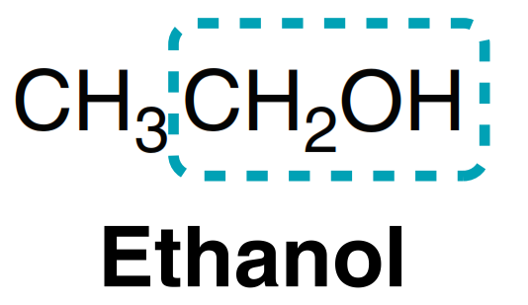
Up to 5% of ingested Ethanol is metabolized by (tongue, mouth, esophagus, and stomach).
85 to 98% is metabolized in the liver.
2 to 10% is excreted through the lungs or kidneys.

Slide 4
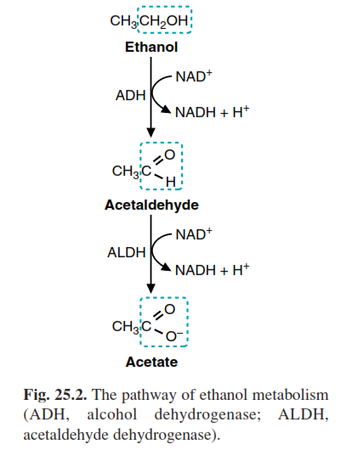
I. The major route
cytosolic enzyme
90 %
toxic
mitochondrial
nontoxic

Slide 5
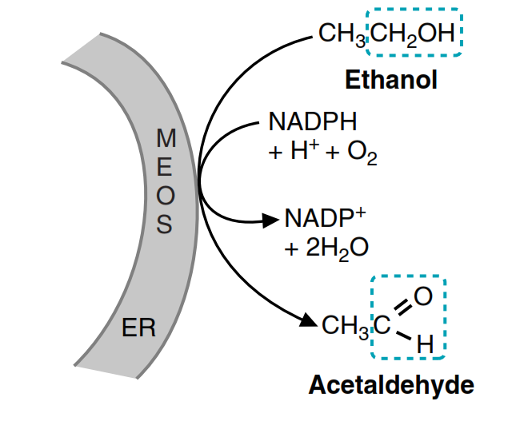
II. Route 2 (microsomal ethanol oxidizing system (MEOS))
10 to 20% of ethanol oxidation in a moderate drinker.

Slide 6
Alcohol Dehydrogenase

Slide 7
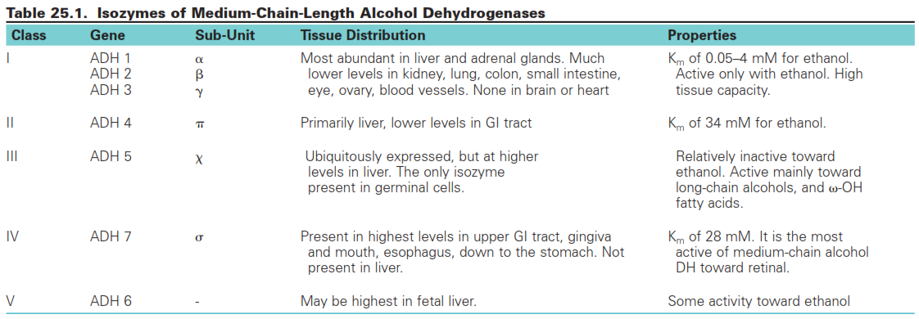

Slide 8
Acetaldehyde Dehydrogenases

Slide 9
More than 80% of acetaldehyde oxidation in the human liver is normally catalyzed by mitochondrial acetaldehyde dehydrogenase (ALDH2)
The remainder of acetaldehyde oxidation occurs through a cytosolic acetaldehyde dehydrogenase (ALDH1)

Slide 10
Fate of Acetate

Slide 11
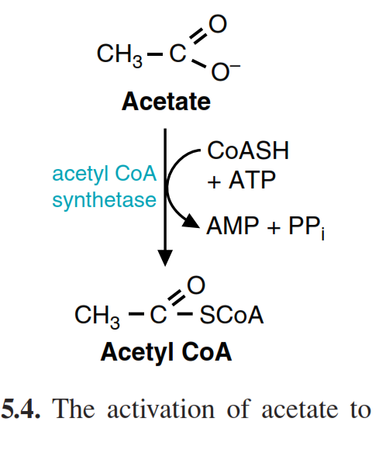
In the liver: The principle isoform of acetyl CoA synthetase (ACS I) is a cytosolic enzyme

Slide 12
In the heart and skeletal muscle, the acetate is metabolized by the mitochondrial acetyl CoA synthetase isoform (ACSII).
Therefore the acetyl CoA can directly enter the TCA cycle

Slide 13
Microsomal Ethanol Oxidizing System

Slide 14
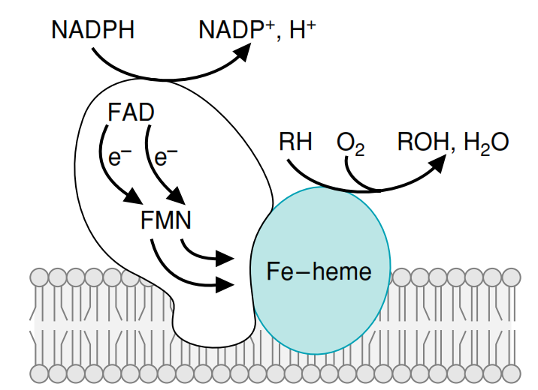
electron-donating reductase system
cytochrome
P450

Slide 15
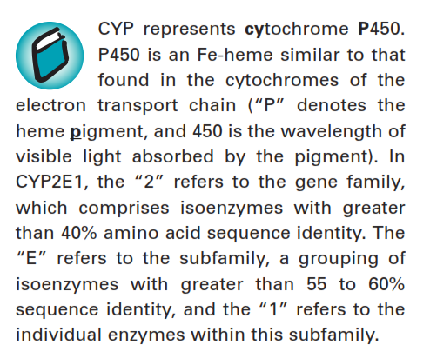

Slide 16
1. CYP2E1
MEOS is part of the superfamily of cytochrome P450 enzymes
More than 10 distinct gene families are found in mammals
More than 100 different cytochrome P450 isozymes
CYP2E1 is the highest active isozyme against ethanol with high Km ????

Slide 17
2. INDUCTION OF P450 ENZYMES
Chronic consumption of ethanol increases hepatic CYP2E1 levels approximately 5- to 10-fold.
Through transcriptional, post-transcriptional, and post-translational regulation.
After treatment with phenobarbital, CYP2B2 is increased 50- to 100-fold. (then drug tolerance)
phenobarbital-oxidizing P450 system.
toxic levels of the barbiturate can accumulate in the blood.
High Ethanol

Slide 18
Impact of ethanol consumption and CYP induction
High Ethanol
CYP induction
High acetaldehyde
Free Radicals
Liver Injury

Slide 19
Variations in the Pattern of Ethanol Metabolism
Factors that determine the rate and route of ethanol oxidation in individuals include:
Genotype
Drinking history
Gender (lower levels of gastric ADH activity in women)
Quantity

Slide 20
The Energy Yield of Ethanol Oxidation
Route dependent

Slide 21
I. The major route (13 ATP)
cytosolic enzyme
5 ATP
mitochondrial
10 ATP
Activation to
Acetyl CoA
-2 ATP

Slide 22
II. Route 2 (microsomal ethanol oxidizing system (MEOS))
Maximum of 8.0 moles of ATP

Slide 23
TOXIC EFFECTS OF ETHANOL METABOLISM

Slide 24
Three forms of alcohol related liver disorders
Fatty liver.
Alcohol-induced hepatitis.
Cirrhosis.

Slide 25
Acute Effects of Ethanol Arising from the Increased NADH/NAD⁺ Ratio
Acetaldehyde Toxicity
Ethanol and Free Radical Formation
Hepatic Cirrhosis and Loss of Liver Function

Slide 26
Acute Effects of Ethanol Arising from the Increased NADH/NAD⁺ Ratio
CHANGES IN FATTY ACID METABOLISM
ALCOHOL-INDUCED KETOACIDOSIS
LACTIC ACIDOSIS, HYPERURICEMIA, AND HYPOGLYCEMIA

Slide 27
CHANGES IN FATTY ACID METABOLISM
Inhibits the oxidation of fatty acids
Increases the availability of glycerol 3-P
Re-esterified into triacylglycerols
Ethanol-induced hyperlipidemia
Fatty liver (hepatic steatosis)
NOTE: Adipose tissue lipolysis increases after ethanol consumption, possibly because of a release of epinephrine

Slide 28
2. ALCOHOL-INDUCED KETOACIDOSIS
The acetyl CoA enters the pathway for ketone body synthesis instead of the TCA cycle.Due to low OAA which is converted to malate due to high NADH/NAD ratio.

Slide 29
3. LACTIC ACIDOSIS, HYPERURICEMIA, AND HYPOGLYCEMIA
The lactate dehydrogenase reaction is shifted toward lactate, resulting in a lacticacidosis
May decrease excretion of uric acid
Increased degradation of purines also may contribute to hyperuricemia
High NADH/NAD ratio prevents major gluconeogenic precursors

Slide 31
B. Acetaldehyde Toxicity
It is highly reactive and binds covalently to amino groups, sulfhydryl groups, nucleotides, and phospholipids to form “adducts.”
1. ACETALDEHYDE AND ALCOHOL-INDUCED HEPATITIS
proteins accumulate in the liver, together with lipid and results in an influx of water.
2. ACETALDEHYDE AND FREE RADICAL DAMAGE
Acetaldehyde binds directly to glutathione and diminishes its ability to protect against H₂O₂ and prevent lipid peroxidation

Slide 32
C. Ethanol and Free Radical Formation
Principally by CYP2E1
The hydroxyethyl radical is produced during ethanol metabolism and can be released as a free radical.
Which will affect the mitochondrial function and impaired the oxidation process.

Slide 33
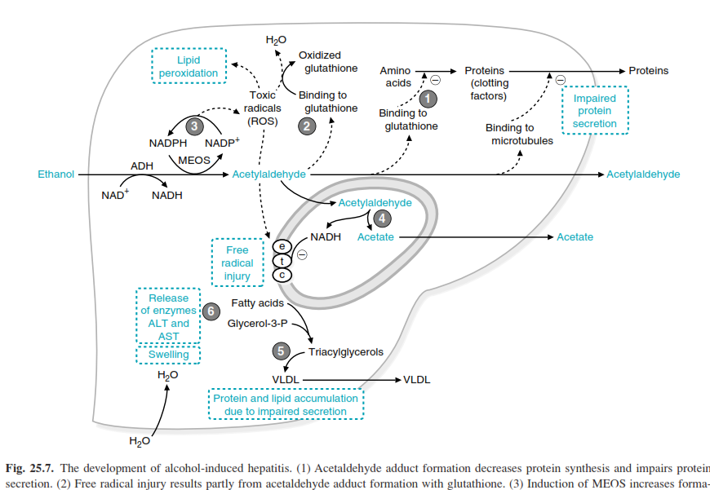

Slide 34
THANKS!
Any questions?

