Slide 1
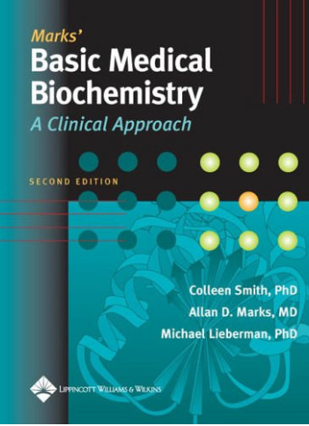
2. Liver Metabolism
Dr. Mazhar Al Zoubi , 2020
Chapters: 46 and 25

Slide 2
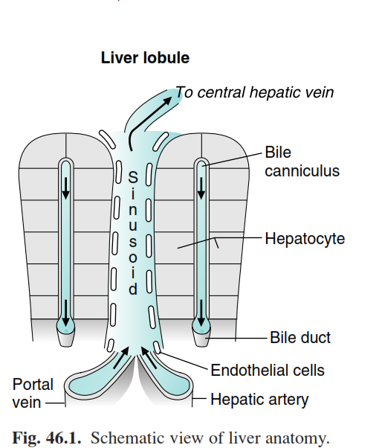
LIVER ANATOMY
Two lobes, each containing multiple lobules and sinusoids.
75% of its blood supply from the portal vein

Slide 3
LIVER CELL TYPES
Hepatocytes :
Endothelial Cells
Kupffer Cells
D. Hepatic Stellate Cells
E. Pit Cells

Slide 4
Hepatocytes (parenchymal cells):
80 % of the liver volume
Almost all pathways of metabolism
Replaceable

Slide 5
B. Endothelial Cells:
lining cells of the sinusoid
They allow for free diffusion of small molecules to the hepatocytes but not chylomicrons-size
capable of endocytosing
lack of tight junction

Slide 6
C. Kupffer Cells (tissue macrophages)
Located within the sinusoidal lining
¼ of liver lysosomes

Slide 7
D. Hepatic Stellate Cells (perisinusoidal or Ito cells)
Lipid-filled cells (the primary storage site for vitamin A)
Involved in liver cirrhosis

Slide 8
E. Pit Cells
liver-associated lymphocytes (are natural killer cell)

Slide 9
MAJOR FUNCTIONS OF THE LIVER

Slide 10
MAJOR FUNCTIONS OF THE LIVER
The Liver Is a Central Receiving and Recycling Center for the Body.
Inactivation and Detoxification of Xenobiotic Compounds and Metabolites
Regulation of Blood Glucose Levels
Synthesis and Export of Cholesterol and Triacylglycerol
Ammonia and the Urea Cycle
Ketone Body Formation
Nucleotide Biosynthesis
Synthesis of Blood Proteins
The Synthesis of Glycoproteins and Proteoglycans
The Pentose Phosphate Pathway

Slide 11
FUELS FOR THE LIVER
Consumes approximately 20% of the body oxygen

Slide 12
The principle forms in which energy is supplied
1. Adenosine triphosphate (ATP).
2. Uridine triphosphate (UTP),.
3. Guanosine triphosphate (GTP).
4. Reduced NADPH.
5. Acyl-CoA thioesters.

Slide 13
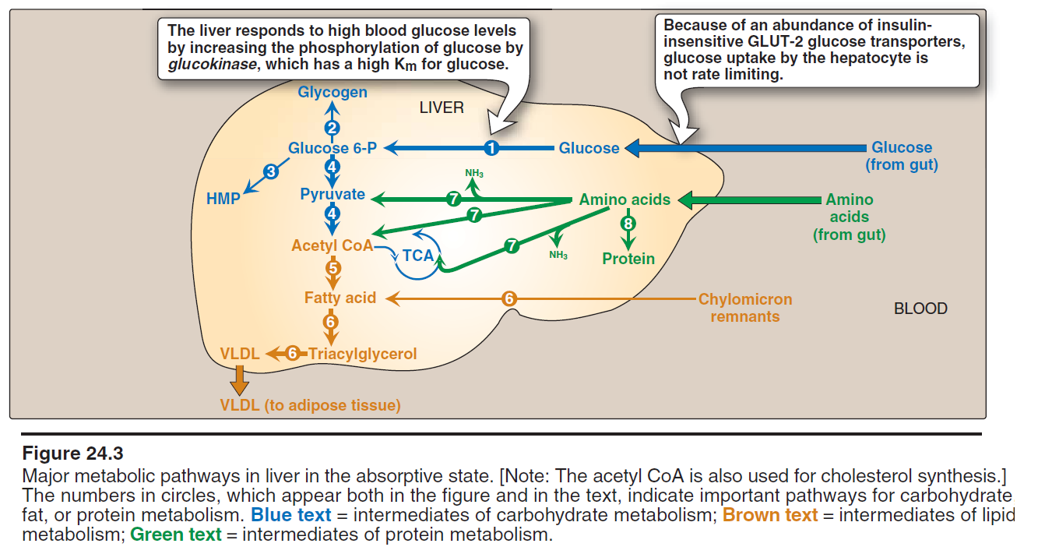
Liver Fueling
Well-fed state: The major fuels used by the liver are glucose, galactose, and fructose.
The major site of ethanol oxidation
Fasting state: Fatty acids become the major fuel for the liver
Can use all of the amino acids as fuels, converting many of them to glucose.
The urea cycle disposes of the ammonia that is generated from amino acid oxidation
Fed state

Slide 14
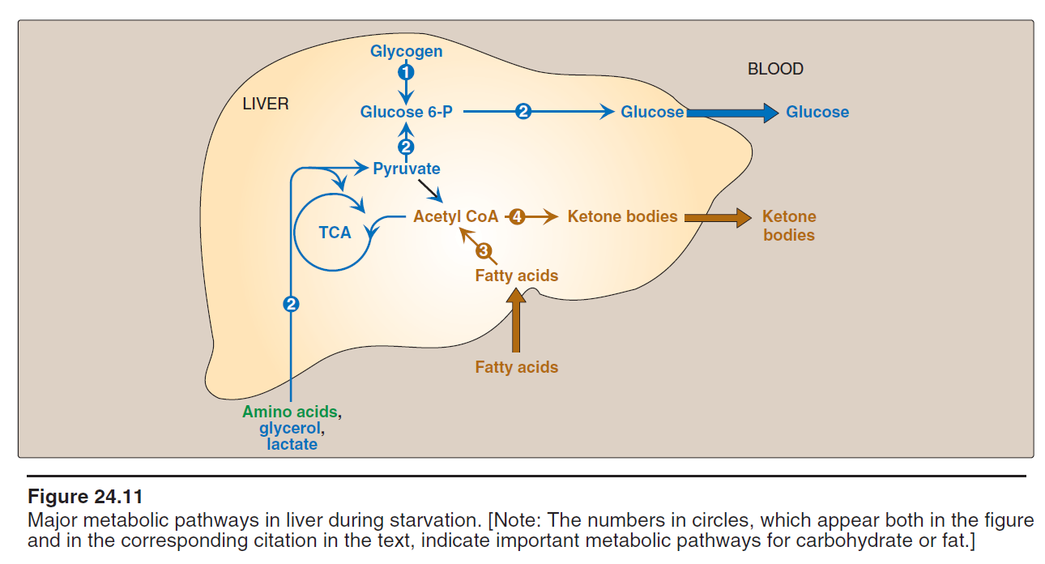
Fasting state

Slide 15
A. Carbohydrate Metabolism in the Liver

Slide 16
B. Glucose as a Fuel
The Km for (GLUT2) and glucokinase is so high (approximately 10 mM).
Glucose will enter after its concentration rises to 10 to 40 mM in the portal blood.
Glycogen synthesis will be increased
Glycolysis will be increased
F. A. Synthesis will be increased

Slide 17
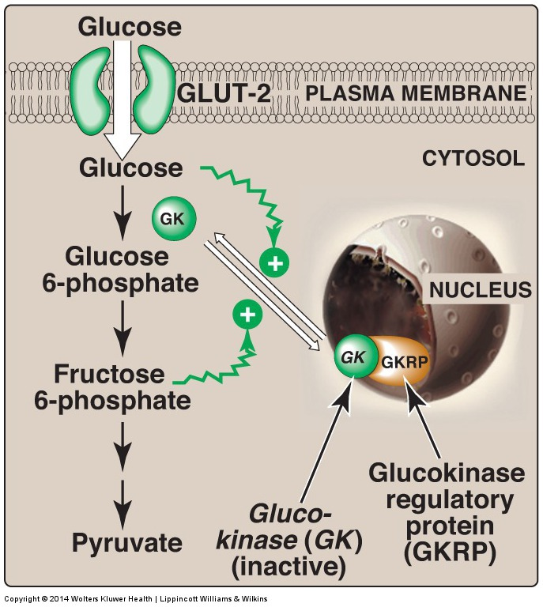

Slide 18
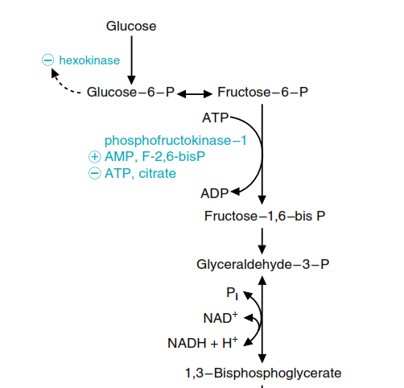
The major regulatory step for liver glycolysis is the PFK-1 step.

Slide 19
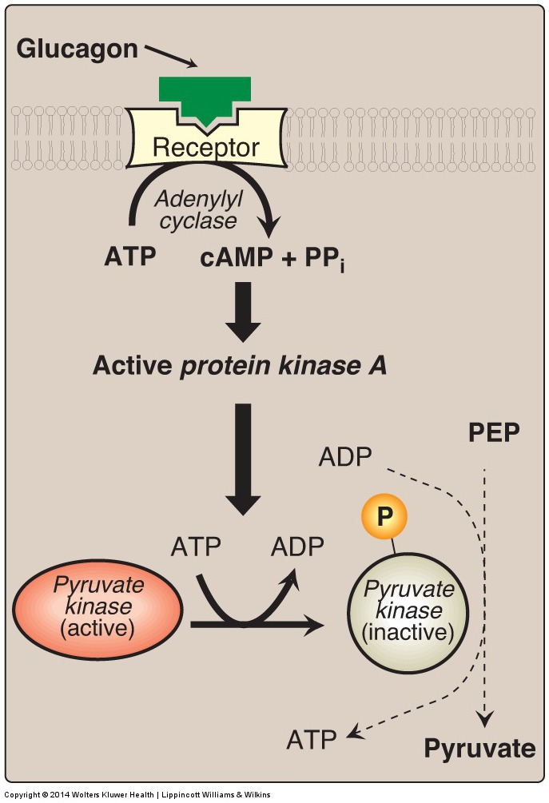

Slide 20
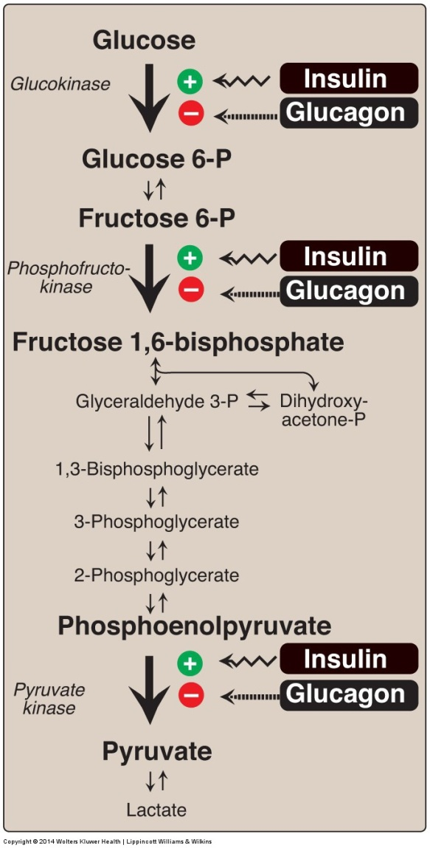
HORMONAL REGULATION OF GLYCOLYSIS
Figure 8.23
Notes:
Effect of insulin and glucagon on the synthesis of key enzymes of glycolysis in liver. P = phosphate.

Slide 21
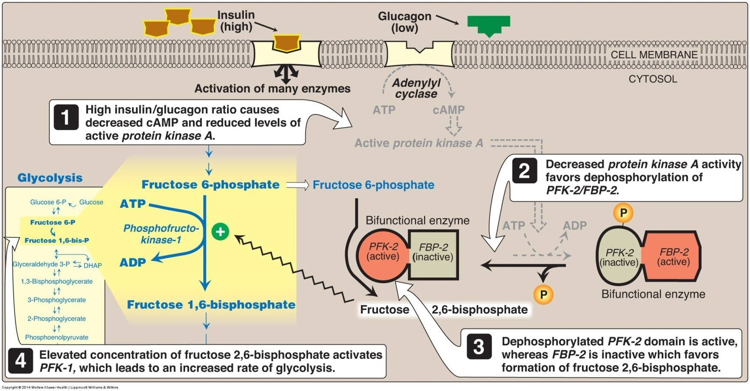
Regulation of GLYCOLYSIS
Figure 8.17
Notes:
Effect of elevated insulin concentration on the intracellular concentration of fructose 2,6-bisphosphate in liver. PFK-2 = phosphofructokinase-2; FBP-2 = fructose 2,6-bisphosphatase; cAMP = cyclic AMP; P = phosphate.

Slide 22
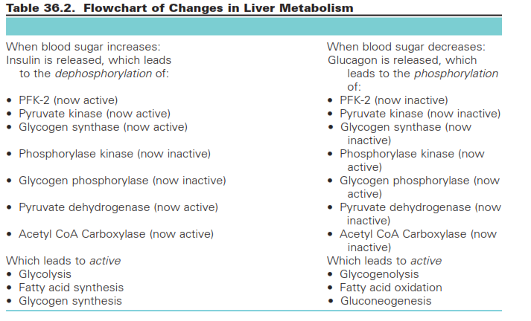

Slide 23
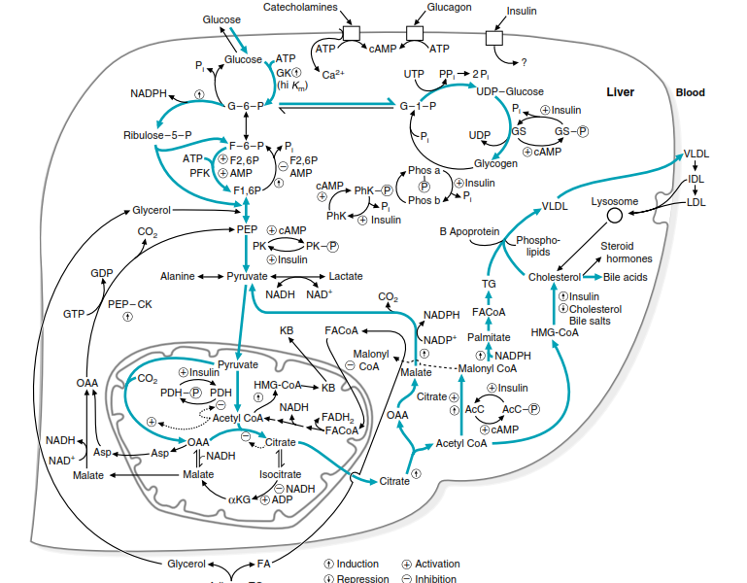

Slide 24
C. Lipid Metabolism
Long-chain fatty acids are a major fuel for the liver during periods of fasting
PEROXISOMAL OXIDATION OF VERY-LONG-CHAIN FATTY ACIDS

Slide 25
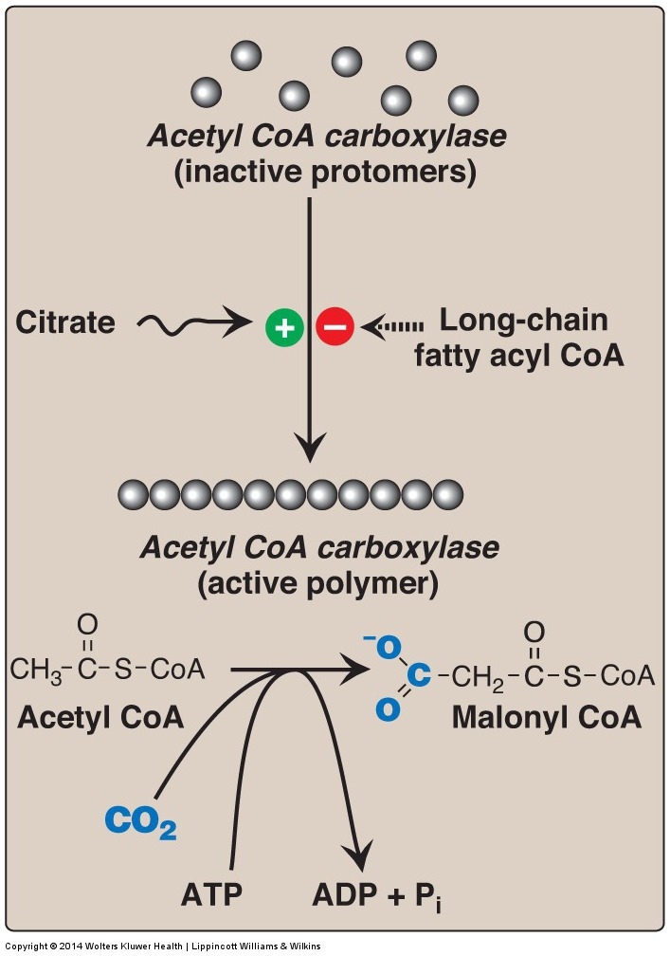
DE NOVO SYNTHESIS OF FATTY ACIDS
Figure 16.7
Notes:
Allosteric regulation of malonyl coenzyme A (CoA) synthesis by acetyl CoA carboxylase. The carboxyl group contributed by dissolved CO₂ is shown in blue. P_{i} = inorganic phosphate; ADP = adenosine diphosphate.

Slide 26
DE NOVO SYNTHESIS OF FATTY ACIDS
Figure 16.13
Notes:
Pathways for production of glycerol 3-phosphate in liver and adipose tissue. [Note: Glycerol 3-phosphate can also be generated by glyceroneogenesis.] NAD(H) = nicotinamide adenine dinucleotide; ADP = adenosine diphosphate.

Slide 27
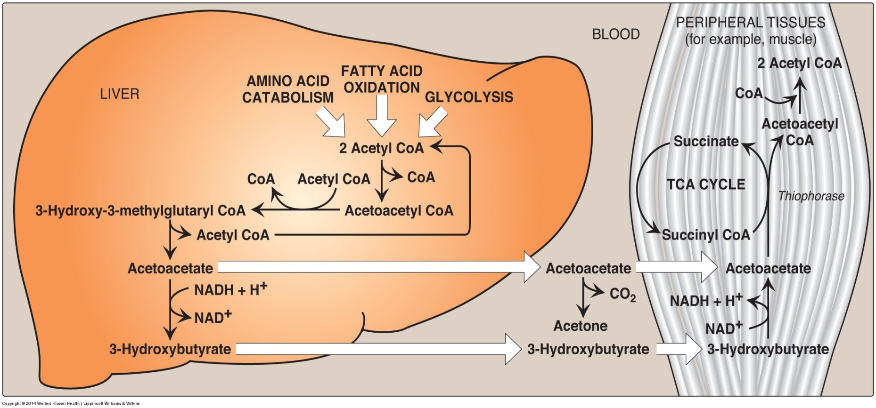
KETONE BODIES: AN ALTERNATE FUEL FOR CELLS (continued)
Figure 16.23
Notes:
Ketone body synthesis in the liver and use in peripheral tissues. Liver and red blood cells cannot use ketone bodies. [Note: Thiophorase is also known as succinyl CoA:acetoacetate CoA transferase.] CoA = coenzyme A; NAD(H) = nicotinamide adenine dinucleotide; TCA = tricarboxylic acid.

Slide 28
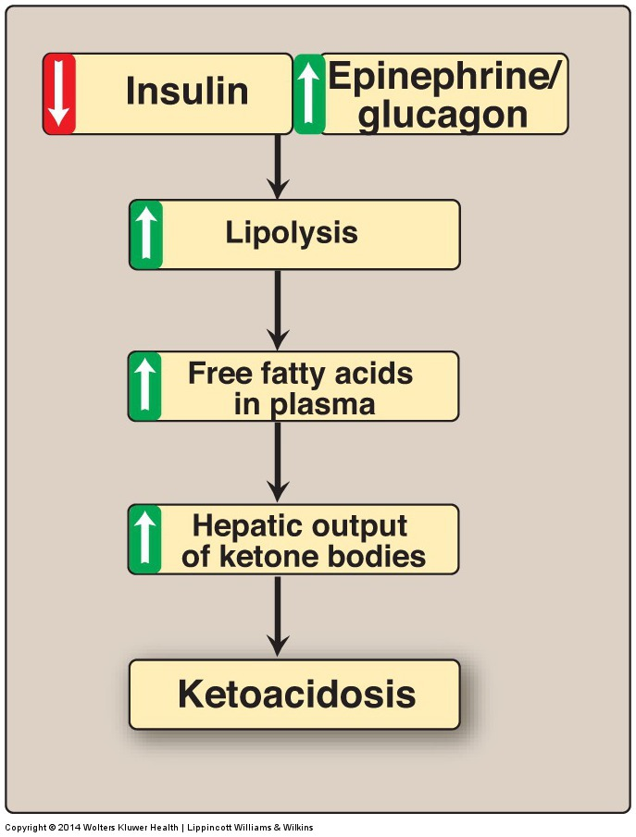
KETONE BODIES: AN ALTERNATE FUEL FOR CELLS
Figure 16.24
Notes:
Mechanism of diabetic ketoacidosis seen in type 1 diabetes.

Slide 29
Amino Acids Metabolism

Slide 30
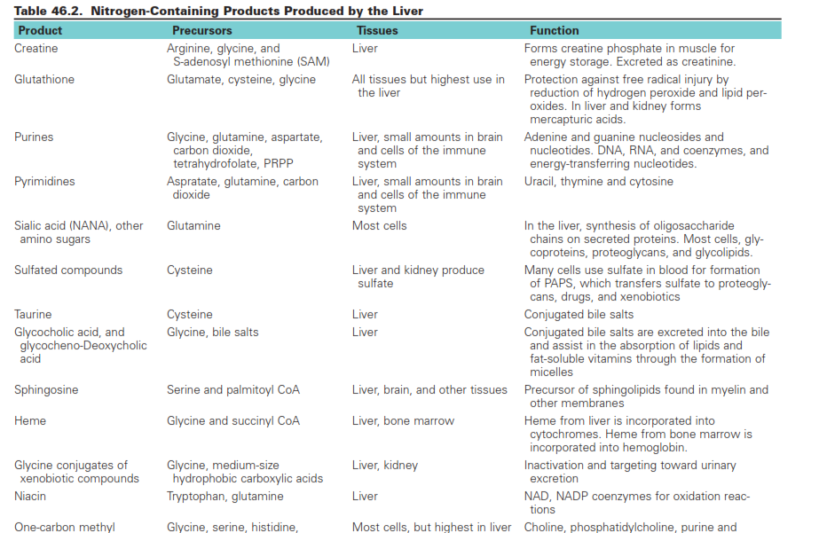

Slide 32
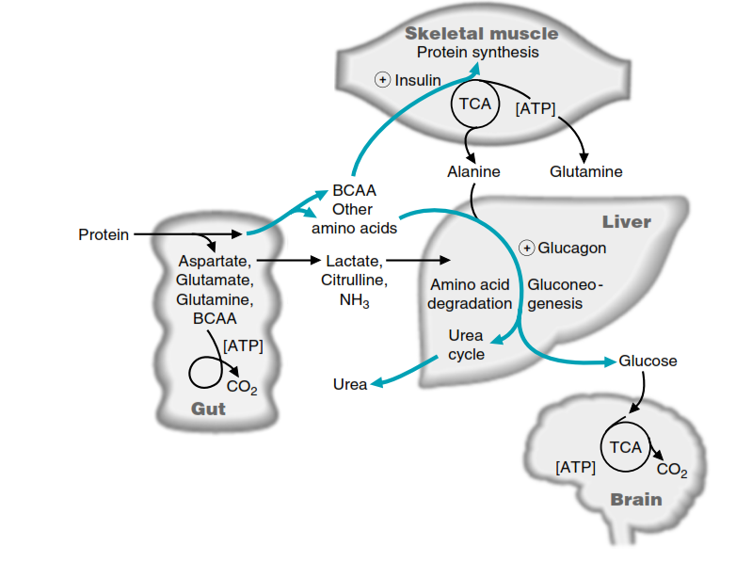

Slide 33
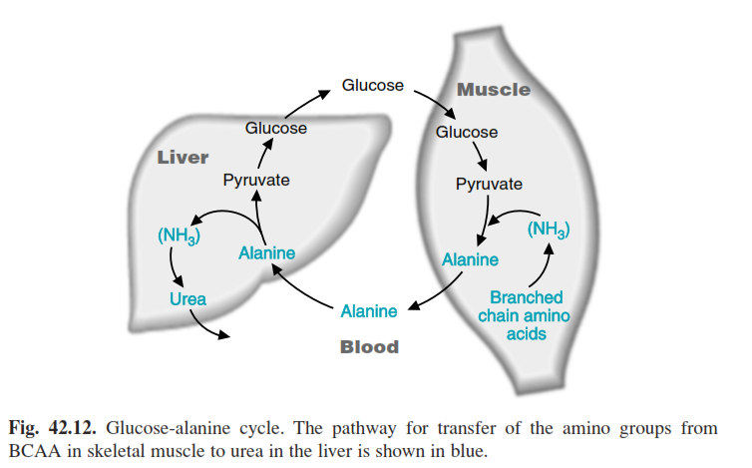

Slide 34
Liver is the principle site of amino acid metabolism in humans.
The liver contains all the pathways for catabolism of all of the amino acids and can oxidize most of the carbon skeletons to carbon dioxide.
It contains the urea cycle.
After a mixed or high-protein meal, the gut uses dietary aspartate, glutamate, and glutamine as a fuel (during fasting the gut uses glutamine from the blood as a major fuel).

Slide 35
Liver is the principle site of amino acid metabolism in humans.
The branched-chain amino acids (valine, leucine, and isoleucine) can be used by most cell types as a fuel, including cells of the gut and skeletal muscle.
Most tissues transfer the amino acid nitrogen to the liver to dispose of as urea
The liver uses amino acids for the synthesis of proteins that it requires as well as for the synthesis of proteins to be used elsewhere.

Slide 36
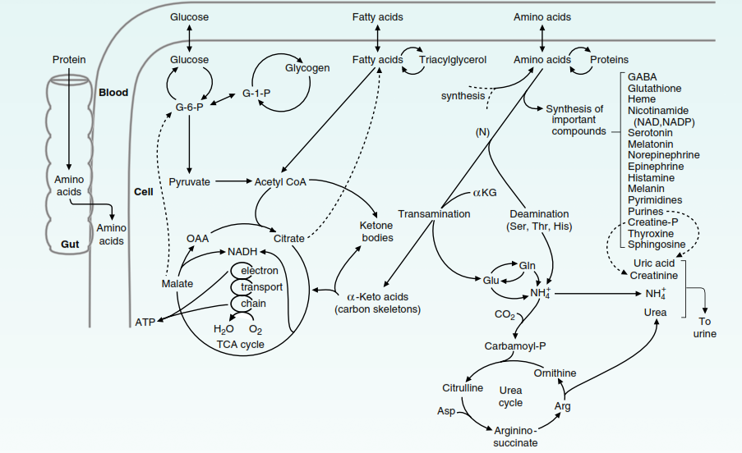
Urea Cycle

Slide 37
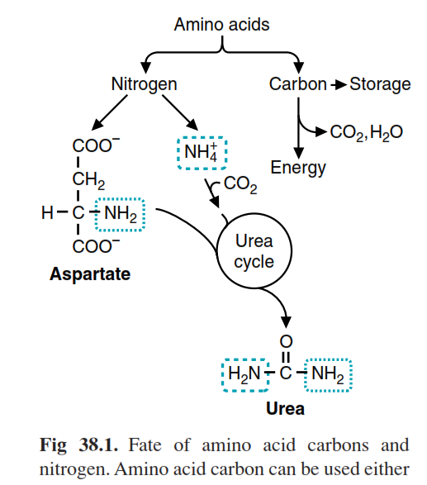

Slide 39
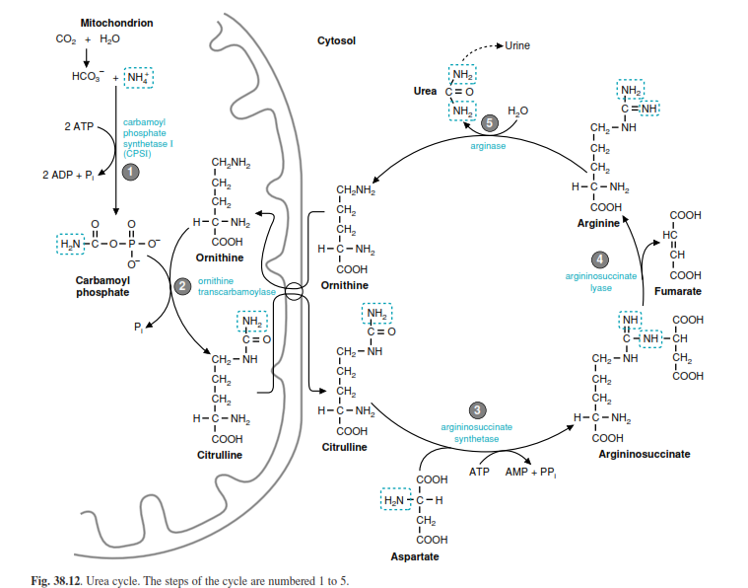

Slide 40
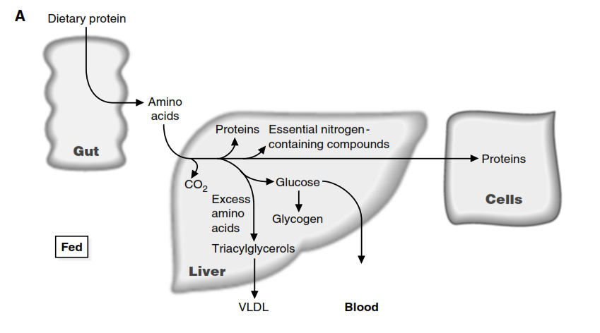

Slide 41
