Slide 1
Diseases of the gastrointestinal tract
Dr. Nesreen Bataineh MD, FRCPath

Slide 2
Adenomas
Neoplastic polyps
Common in colon
The incidence increases with age (∼ 50% after age of 50 y*). M=F.
Sporadic or syndromatic.
Familial predisposition to sporadic adenomas.

Slide 3
Pathology of adenomas
Epithelial proliferation and dysplasia*.
Dysplasia may be of low or high grade .
Increased risk of transformation to carcinoma.

Slide 4
Pathology of adenomas
Subtypes based on the epithelial architecture:
Tubular adenomas → > 75% tubules
Most common.
Common in rectosigmoid.
Usually multiple, small & pedunculated
Villous adenomas → >50% villous projections
Common in rectosigmoid.
Most are large & sessile with cauliflower appearance.
Invasive carcinoma is found in 40% .
Tubulovillous adenomas→ 25-50% villous projections.

Slide 5
Malignant risk in adenomas
Depends on three features:
1. Polyp size
↑ risk if diameter is > 4 cm*.
2. Severity of epithelial dysplasia:
High grade dysplasia → often found in villous areas.
3. Histologic architecture
↑risk in villous adenoma.

Slide 6
Adenomas

Slide 7
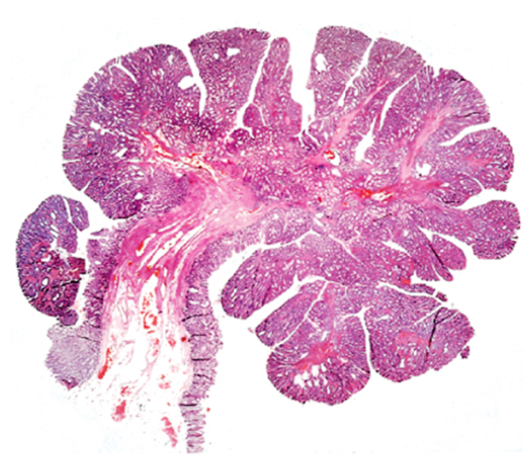
Tubular adenoma
- The head is composed of neoplastic epithelium, forming rounded or tubular glands lined by dysplastic cells
- Notice the contrast between dysplastic & normal tubules

Slide 8
Villous adenoma

Slide 9
Clinical picture of polyps
Most adenomas are asymptomatic.
If large → can cause obstruction.
Most distal adenomas are more symptomatic:
Bleeding per rectum
May prolapse through the anus
Villous adenomas may secrete mucoid material rich in protein and potassium (producing hypoproteinemia or hypokalemia).

Slide 10
Familial Polyposis Syndromes
Uncommon AD disorders.
Most are due to germline mutations in tumor suppressor genes.
Increased risk of intestinal and (in some syndromes) extra-intestinal cancers.

Slide 11
Familial adenomatous polyposis
AD syndrome → Mutation in APC gene.
Classic FAP
Attenuated FAP
Gardner syndrome
Turcot syndrome

Slide 12
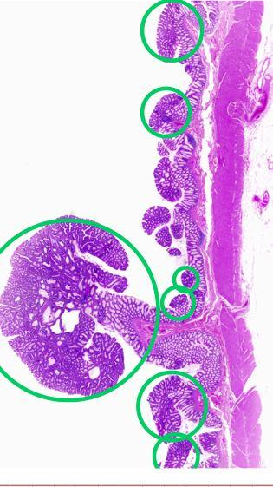
Classic FAP
Innumerable colonic adenomas (usually thousands) carpet the mucosal surface.
A minimum number of 100 polyps is required for the diagnosis.
Most polyps are tubular adenomas.
Multiple adenomas anywhere in the GI including ampulla of Vater and stomach.
A100% lifetime risk of progression to cancer at younger age (< 30yrs) unless prophylactic colectomy is performed.

Slide 13
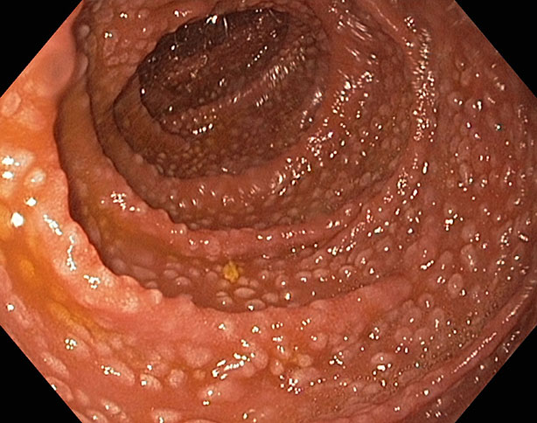
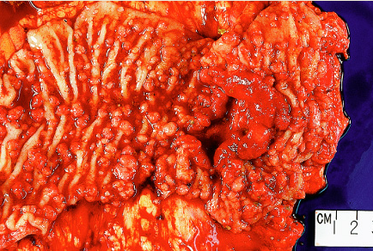
FAP
FAP associated with adenocarcinoma →

Slide 14
Attenuated FAP
Fewer polyps (average 30)
Mainly in the proximal colon.
Increased risk of colonic adenocarcinoma in 50% of cases

Slide 15
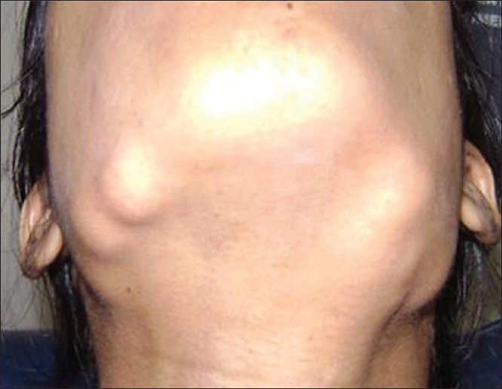
Gardner syndrome
Intestinal polyps as classic FAP
Multiple osteomas
Epidermal inclusion cysts
Fibromatosis*
Abnormal dentition*
Multiple osteomas

Slide 16
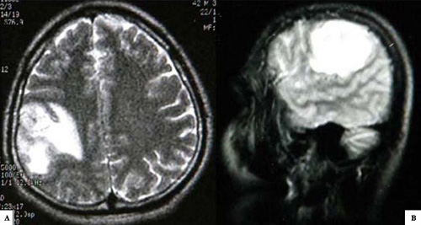
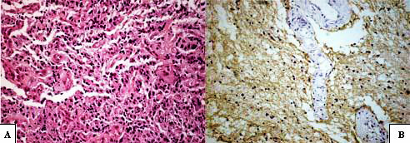
Turcot syndrome
Adenomatous colonic polyposis as FAP
CNS tumors.

Slide 17
Hereditary Nonpolyposis Colorectal Cancer (HNCC) syndrome
Lynch syndrome
AD familial syndrome
Inactivation of DNA mismatch repair genes (esp. MSH2 & MLH1 → Most common).
This leads to genomic instability (microsatellite instability)*.
Subsequent mutations in growth regulatory genes as TGF-B receptor II & BAX

Slide 18
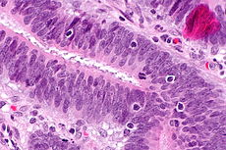
Hereditary Nonpolyposis Colorectal Cancer (HNCC) syndrome
Increased risk of colorectal cancer
Usually multiple.
At younger age*.
Mainly in the cecum & proximal colon.
Usually mucinous or poorly differentiated.
Infiltration by intraepithelial lymphocytes.
Of better Prognosis
Compared to sporadic
Colon cancer .
Notes:
* Patients with HNPCC have far fewer polyps and develop cancer at an older age than that typical for patients with FAP but at a younger age than in patients with sporadic colon cancer.

Slide 19
Hereditary Nonpolyposis Colorectal Cancer (HNCC) syndrome
Risk of gastric and small intestinal adenocarcinoma
Risk of extra-intestinal malignancies as:
Endometrial cancer
Cancer of ureter & renal pelvis
Cancer of pancreas
Cholangiocarcinoma

Slide 20
Juvenile polyposis syndrome
AD syndrome
Mutation of SMAD 4 gene*.
3-100 juvenile polyps**.
Increased risk of adenomas and carcinomas of the GI (stomach, SI, colorectal ).

Slide 21
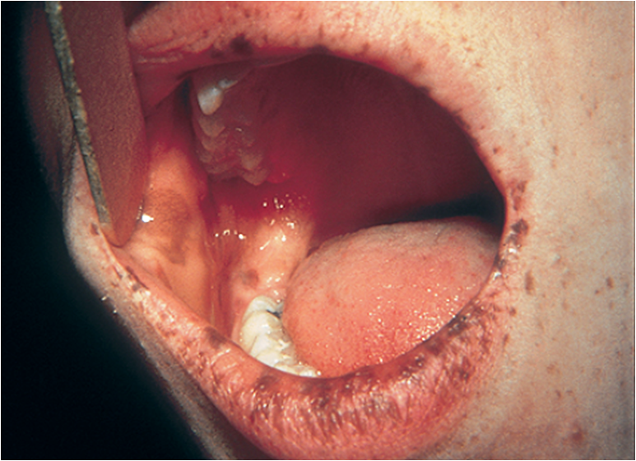
Peutz-Jeghers syndrome
AD syndrome
Mutation in STK11 (LKB1) gene*.
Characterized by:
Multiple hamartomatous (Peutz-Jeghers polyps) in the small intestine (100%), colon (30%) & stomach (25%).
Melanotic mucosal and cutaneous pigmentation around the lips, oral mucosa and genitalia
Increased risk of intestinal & extraintestinal malignancies of (uterine CX, ovary & breast)**

Slide 22
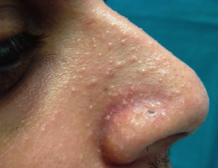
Cowden syndrome
AD syndrome.
Mutation of PTEN tumor suppressor gene.
Intestinal hamartomatous polyps in the GI.
Oral keratosis and oral papilloma.
Benign skin tumors (trichilemmomas).
Increased risk of thyroid and breast cancer.
No increased risk of GI cancer.

Slide 23
Colorectal Carcinoma
Colorectal CA has a worldwide distribution.
Age: The peak incidence is 60 to 70 ys
(< 20% occur < age of 50).
Gender: M>F.
Most arises sporadically in adenomas.
Risk factors:
Genetic & environmental influences

Slide 24
Risk factors of colorectal cancer
Dietary factors: Low fiber diet High content of refined carbohydrates High fat content (as from meat) Decreased intake of micronutrients such as vitamins A, C, and E.
The use of aspirin and other NSAIDs are protective Inhibition of cyclooxygenase-2 (COX-2)
The presence of adenomas (the precancerous lesions)
Preexisting UC or one of the familial syndromes

Slide 25
Colorectal Carcinogenesis
Two pathogenetically distinct pathways:
The APC/β-catenin pathway
(the adenoma-carcinoma sequence)
80% of sporadic colorectal CA.
The mismatch repair
(microsatellite instability) pathway
10% to 15% of sporadic colorectal CA.

Slide 26
Adenoma-carcinoma sequence

Slide 27
The microsatellite instability pathway

Slide 28
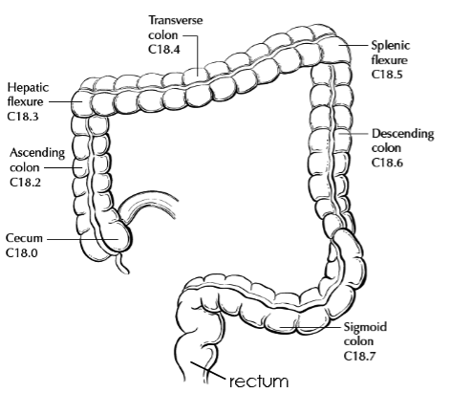
Morphology
Site in order of frequency:
The rectosigmoid
The cecum or ascending colon
The transverse colon
The descending colon
May be single or multiple

Slide 29
Gross appearance
Tumors in the proximal colon:
Grow as polypoid, exophytic masses
Obstruction is uncommon.
Tumors in the distal colon:
Annular encircling lesions (napkin-ring constrictions) and narrow the lumen.
Both forms of neoplasm directly penetrate the bowel wall and may appear as firm masses on the serosal surface.

Slide 30
Colon CA – polypoid mass

Slide 31
Microscopic apearance
Almost all colorectal CA are adenocarcinomas
Mucinous adenocarcinoma
> 50% extracellular mucin Poor
Signet ring adenocarcinoma Px
> 50% signet ring
Cancers of the anal zone are squamous cell carcinoma.
Grading: G1 (well diff.), G2,G3 & G4 (undiff.).

Slide 32
Adenocarcinoma of colon

Slide 33
Tumor spread
Direct spread.
Lymph node metastasis.
Distant metastasis to liver (mainly), lungs and bones.
Carcinomas of the anal region:
Locally invasive and metastasize to regional lymph nodes and distant sites.

Slide 34
Clinical Features
Asymptomatic for years.
Symptoms develop insidiously.
Cecal and right colonic cancers:
Fatigue, weakness, & iron deficiency anemia
Left-sided cancers:
Occult or frank bleeding, changes in bowel habit (partial obstruction), or crampy left lower quadrant pain.

Slide 35
Staging of colorectal CA

Slide 36
Prognosis
The single most important prognostic indicator is the STAGE at time of diagnosis.
(depth of invasion T, LNs N, distant mets M)
Microscopic type.
Mucinous & signet ring are poor
Histologic grade.

Slide 37
Appendix
The appendix is a normal true diverticulum of the cecum.
Diseases of the appendix:
Acute appendicitis.
Appendiceal tumors.

Slide 38
Acute Appendicitis
Most common in adolescents and young adults, but may occur in any age group.
The lifetime risk for appendicitis is 7 %.
M:F → 1.5: 1.
Need to be differentiated from other causes of acute abdomen (False positive ~ 20%)*.

Slide 39
Pathogenesis
In 50% - 80% luminal obstruction:
Small stone-like mass of stool (Fecalith).
Mass of worms (oxyuriasis vermicularis).
Gallstone.
Tumor.
In minority, no significant obstruction.

Slide 40
Pathogenesis
Progressive increases in intraluminal pressure
⇓
Compromise of venous outflow
⇓
Ischemic injury & stasis of luminal contents
⇓
Bacterial proliferation
⇓
Inflammation with tissue edema & neutrophilic infiltration of the lumen, muscular wall & periappendiceal soft tissues

Slide 41
Morphology
Early acute appendicitis:
Gross appearance:
A dull, granular, erythematous surface.
Microscopic appearance:
Diagnosis requires neutrophilic infiltration of the muscularis propria*.
Subserosal vessels are congested.
Mild perivascular neutrophilic infiltrate within all layers of the wall.

Slide 42
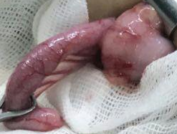

Slide 43
Morphology
Acute suppurative appendicitis*:
The serosa is covered by fibrinopurulent exudate.
Focal abscesses may be formed within the wall.
Acute gangrenous appendicitis:
Gangrenous necrosis.
Often followed by rupture and suppurative peritonitis.

Slide 44
Acute suppurative appendicitis

Slide 45
Acute suppurative appendicitis

Slide 46
Perforated gangrenous appendix

Slide 47
Clinical Features
Periumbilical pain that ultimately localizes to the right lower quadrant.
Nausea, vomiting & low-grade fever.
McBurney’s sign.
Mildly elevated peripheral white cell count.
Complications:
Appendiceal perforation.
Peritonitis.
Portal venous thrombosis.
Liver abscess.
Bacteremia.

