Slide 1
Diseases of the gastrointestinal tract
Dr. Nesreen Bataineh MD, FRCPath

Slide 2
COLONIC DIVERTICULOSIS (DIVERTICULAR DISEASE)
The most common type of acquired diverticulua (False).
50% of western countries people older than 60 years.
→ Consumption of a refined low-fiber diet.

Slide 3
Pathogenesis
Two important influences:
Exaggerated peristaltic contractions with abnormal elevation of intraluminal pressure due to low fiber diet.
Focal defects peculiar to the normal muscular colonic wall (where nerves and arterial vasa recta penetrate the muscular wall).

Slide 4
Focal defect in the muscle wall

Slide 5
Exaggerated peristalsis
Low-fiber diet results in:
Reduced stool bulk
↑difficulty in passage of intestinal contents.
Segmentation:
Exaggerated spastic contractions isolate segments of the colon with high intraluminal pressure
Consequent herniation of the bowel wall through the anatomic points of weakness.

Slide 6
Morphology
Site: In the sigmoid colon in 95% of patients.
Gross appearance:
Multiple, Small, flask-like or spherical outpouchings.
Located in the mesentric & lateral aspect of the bowel along sides of taeniae coli.
Prominent taenia coli and circular muscle bundles (due to hypertrophy).

Slide 7
Diverticulosis
Section through the sigmoid colon showing multiple saclike diverticula protruding through the muscle wall into the mesentery

Slide 8
Diverticulosis

Slide 9
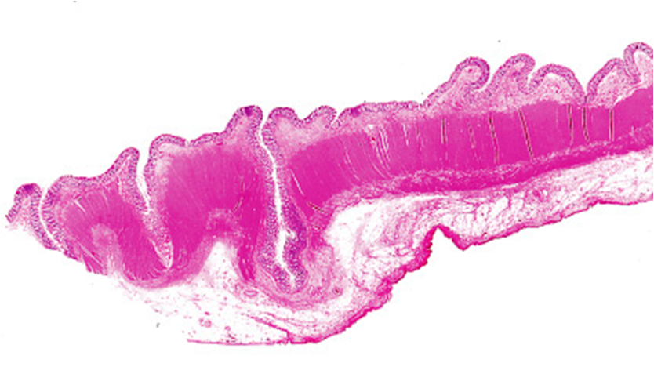
Morphology
Microscopic appearance:
The walls are very thin, made up of mucosa and submucosa enclosed within fat or peritoneal covering.
Protrusion of mucosa and submucosa through the muscle wall

Slide 10
Clinical features
Diverticular disease is usually asymptomatic.
In 20% of cases, intermittent cramping or continuous left lower quadrant pain.
Complications:
Diverticulitis & peridiverticulitis* (left lower quadrant tenderness and fever).
Stricture formation.
Lower GI bleeding (Chronic intermittent or rarely massive).
Perforation may lead to pericolic abscess, fistula formation or localized peritonitis.

Slide 11
Malabsorption Syndromes
Characterized by defective absorption of fats, vitamins, proteins, carbohydrates, electrolytes, minerals, and water.
The most common presentation is chronic diarrhea – the hallmark of malabsorption is steatorrhea (excessive fecal fat content).
Notes:
Diarrhea is defined as an increase in stool mass, frequency, or fluidity, typically to volumes greater than 200 mL per day.
• Secretory diarrhea is characterized by isotonic stool and persists during fasting.
• Osmotic diarrhea, such as that occurring with lactase deficiency, is due to osmotic forces exerted by unabsorbed luminal solutes. The diarrheal fluid is more than 50 mOsm more concentrated than plasma, and the condition abates with fasting.
• Malabsorptive diarrhea caused by inadequate nutrient absorption is associated with steatorrhea and is relieved by fasting.
• Exudative diarrhea is due to inflammatory disease and characterized by purulent, bloody stools that continue during fasting.

Slide 12
Etiology
Disturbance in one of the digestive functions:
Intraluminal or terminal digestion
Mucosal absorption
Nutrient delivery from intestinal cells to lymphatics
The most common causes in the west are pancreatic insufficiency, celiac disease, and Crohn disease.

Slide 13
Major malabsorption syndromes
Defective Intraluminal Digestion
Pancreatic insufficiency: pancreatitis or cystic fibrosis
Zollinger-Ellison syndrome: inactivation of pancreatic enzymes by excess gastric acid secretion
Ileal dysfunction or resection: decreased bile salt uptake
Cholestasis: cessation of bile flow from obstruction
Bacterial overgrowth with nutrient preabsorption or modification
Total or subtotal gastrectomy
Primary Mucosal Cell Abnormalities
Disaccharidase deficiency (lactose intolerance)
Bacterial overgrowth with brush-border damage
Abetalipoproteinemia
Notes:
+ Table page 577
مواضيع متبقية → Abetalipoproteinemia + Lactase (Disaccharidase) Deficiency + Irritable Bowel Syndrome + Microscopic Colitis → Pages 579+580
+ Cystic fibrosis → Ch.6

Slide 14
Major malabsorption syndromes
Reduced Small Intestinal Surface Area
Gluten-sensitive enteropathy (celiac disease)
Short-gut syndrome after surgical resections
Crohn disease
Infections
Infectious enteritis
Parasitic infestation
Tropical sprue
Whipple disease
Lymphatic Obstruction
Lymphoma
Tuberculosis and tuberculous lymphadenitis

Slide 15
Clinical features of malabsorption
Symptoms:
Steatorrhea: The passage of abnormally bulky, frothy, greasy, yellow stools.
Weight loss & muscle wasting.
Abdominal pain & distention, borborygmi.
Hematopoietic system:
Anemia from iron, pyridoxine, folate, or vitamin B₁₂ deficiency
Bleeding from vitamin K deficiency

Slide 16
Clinical features of malabsorption
Musculoskeletal system:
Osteopenia and tetany from defective calcium, magnesium, vitamin D, and protein absorption
Endocrine system:
Amenorrhea, impotence, and infertility from generalized malnutrition
Secondary hyperparathyroidism from calcium and vitamin D deficiency

Slide 17
Clinical features of malabsorption
Skin:
Purpura & petechiae from vitamin K deficiency.
Edema from protein deficiency.
Dermatitis, hyperkeratosis & mucositis from deficiencies of vitamin A, zinc, essential fatty acids, and niacin.
Nervous system:
Peripheral neuropathy from B₁₂ deficiencies.

Slide 18
Celiac disease/sprue (Gluten-sensitive enteropathy)
Common, 1 in 300 persons.
Affects adults > children. White > black.
Many patients have subclinical disease.
The basic disorder is immunological sensitivity to gluten (the component of wheat, oat, barley, and rye) that contains the water-insoluble protein gliadin.

Slide 19
Pathogenesis
Strong genetic susceptibility:
95% have an HLA-DQ2 haplotype and most of the remainder having HLA-DQ8.
The small intestinal mucosa accumulates:
Intraepithelial CD8+ T cells
Lamina propria CD4+ T cells sensitized to gliadin.
Notes:
Pathogenesis → Page 578

Slide 20
Morphology
The small intestinal mucosa appear flat or scalloped by endoscopy.
Affect the proximal more than the distal small intestine (duodenum & jejunum).

Slide 21
Normal villi
Celiac
Scalloping of the mucosal folds (arrows)
Villous atrophy

Slide 22
Microscopic picture
Increased intraepithelial (CD8+ T lymphocytes) more than 25/100 cells.
Villous atrophy or total loss of villi.
The crypts are hyperplastic and show increased mitotic figures (the overall mucosal thickness remain the same)
Increased chronic inflammatory cells in the lamina propria.

Slide 23
Celiac disease, jejunum

Slide 24
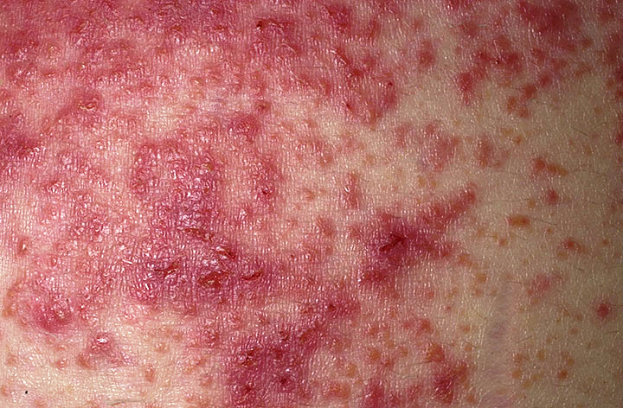
Clinical picture
Differ according to the age of presentation:
In infants: diarrhea & failure to thrive
In mid-adulthood:
Diarrhea, flatulence, weight loss and fatigue
Some patients with celiac disease have:
Associated skin disorder called
Dermatitis herpetiformis*.
Increased incidence of
Lymphocytic colitis and
gastritis.
Long-term risk of Intestinal
lymphomas, especially
Enteropathy associated T cell lymphoma**

Slide 25
Diagnosis
Detection of anti-gliadin, anti-endomysial or anti-tissue transglutaminase (anti-tTG) antibodies .
Definitive diagnosis depends on:
Documentation of malabsorption.
Endoscopy and small bowel biopsy.
Removal of gluten from the diet is met with dramatic improvement.

Slide 26
INFLAMMATORY BOWEL DISEASE (IBD)
Crohn disease (CD) and Ulcerative colitis (UC) are idiopathic chronic relapsing inflammatory disorders, which share many features → UC>CD.
Age: Adolescence or young adults.
F>M, White>Black. > in Jews.
More in: North America, Northern Europe, and Australia (less in Africa & Asia) … WORLD WIDE.
They differ in many respects:
The natural history of the disease.
The distribution of affected sites and their morphological expression.
The types of therapies & responses to treatment.

Slide 27
Pathogenesis
Not well known, But involves:
Genetic susceptibility
Abnormal immune response
Triggering by microbial flora
→ Leading to inappropriate mucosal immune activation
→ Inflammation & tissue damage

Slide 28
Theory
Transepithelial flux of luminal bacterial components activates innate and adaptive immune responses in a genetically susceptible host.
The subsequent release of TNF and other immune-mediated signals direct epithelia to increase tight junction permeability, which further increases the flux of luminal material.
→ These events may establish a self-amplifying cycle.

Slide 29
Genetic Predisposition
Both Crohn disease and ulcerative colitis have been linked to HLA & non-HLA genes
CD is associated with:
Mutation in NOD2 gene (CARD15) which is expressed by paneth cells & encodes an intracellular sensor of bacteria.
HLA-DR7 and DQ4 alleles.
IL-23 receptor (IL-23R) gene*.
UC is associated with:
HLA-DRB1 & IL-23 receptor (IL-23R) gene.

Slide 30
Diagnosi of IBD
Clinical history
Radiographic examination
Endoscopic findings
Lab findings
Pathologic examination of tissue (macroscopic & microscopic)
→ No single test is diagnostic

Slide 31
Microscopic picture of IBD
More common and severe in UC
Chronicity:
Disturbed architecture*:
Crypt disarray
Crypt branching
Crypt atrophy
Duplication of muscularis mucosa
Paneth cell metaplasia**
Basal cell plasmacytosis
Mucosal atrophy (late).
Activity:
Mucous cell depletion***
Cryptitis
Crypt abscesses
Ulceration with exudation

Slide 32
Chronic IBD

Slide 33
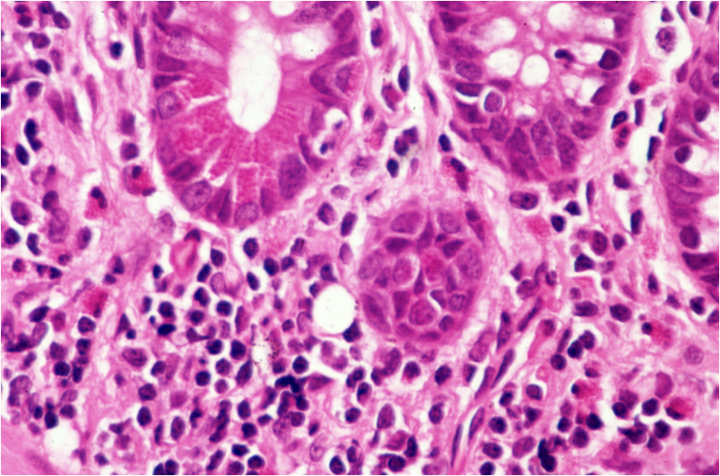
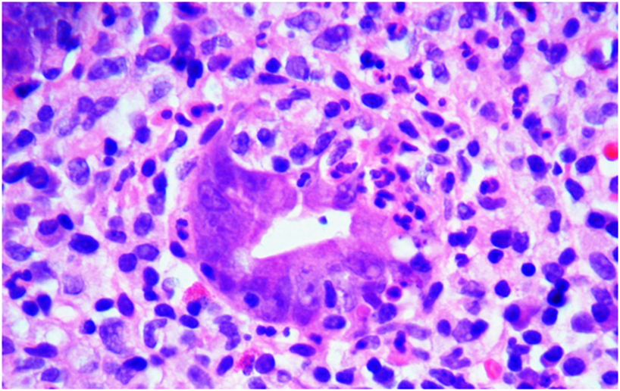
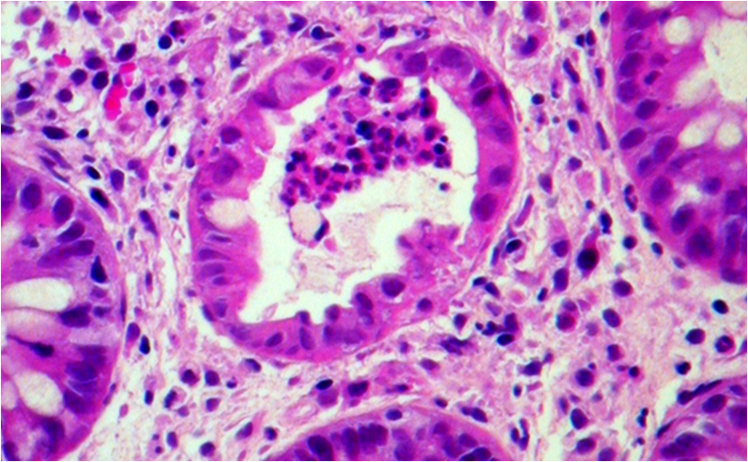
Basal cell plasmacytosis
Paneth cell metaplasia
Cryptitis
Crypt abscess

