Slide 1
Diseases of the gastrointestinal tract
Dr. Nesreen Bataineh MD, FRCPath

Slide 2
Diseases of the small and large intestine
Developmental anomalies
Vascular disorders
Colonic diverticulosis
Bowel obstruction
Malabsorption syndromes
Inflammatory bowel disease
Tumors

Slide 3
DEVELOPMENTAL ANOMALIES
Meckel diverticulum (most common)
Atresia
Stenosis
Duplication
Omphalocele
Gastroschisis
Malrotation

Slide 4
Meckel diverticulum
It is present in 2% of population.
It results from failure of involution of the proximal portion of the vitelline (omphalomesenteric) duct.
More common in males
30% have other congenital anomalies including tracheoesophageal fistula.

Slide 5
Omphalomesenteric duct

Slide 6
Pathology
The usual location is in the distal ileum – 80 cm proximal to the ileocecal valve
Always on the antimesenteric border.
Blind tubular pouch of variable length (1-8 cm).
True diverticulum composed of all layers of the normal small intestine.
The lining is of small intestinal type.
May contain: Gastric, duodenal or colonic mucosa

Slide 7
Meckel diverticulum

Slide 8
Meckel diverticulum
The blind pouch is located on the antimesenteric side of the small bowel

Slide 9
Clinical picture
Generally asymptomatic.
Bacterial overgrowth may lead to vitamin B₁₂ deficiency.
Heterotopic gastric mucosa may cause peptic ulcer in the adjacent intestinal mucosa
Intestinal bleeding or
Symptoms resembling acute appendicitis

Slide 10
BOWEL OBSTRUCTION
Major causes of intestinal obstruction
Mechanical Obstruction → Usually affects the small intestine
Hernias
Adhesions
Intussusception
Volvulus
Tumors
Infarction
Inflammatory strictures*
Obstructive gallstones, fecaliths, foreign bodies
Congenital stricture, atresias
Congenital bands
Meconium in cystic fibrosis
Imperforate anus
Most common (80%)
Less common

Slide 11
Hernia
A weakness or defect in the wall of the peritoneal cavity may permit protrusion of serosa-lined sac of peritoneum (hernial sac).
The usual sites of weakness are:
The inguinal canal
The femoral canals
The umbilicus
Surgical scars.
Segments of viscera (most commonly small bowel*) or omentum intrude and become trapped in the hernial sacs.

Slide 12
Hernial sac
Inscisional

Slide 13
Complications
Pressure at the neck of the pouch may impair venous drainage of the trapped viscus.
Subsequent stasis & edema leading to permanent entrapment(incarceration).
Further compromise of its blood supply lead to infarction of the trapped segment (strangulation).

Slide 14
Adhesions
Causes of intra-abdominal adhesions:
Surgical procedures.
Infection (localized or generalized peritonitis).
Endometriosis .
The intestines may become trapped within the loops of adhesion (internal herniation).

Slide 15
Intussusception
Telescoping of a proximal segment of bowel (intussusceptum) into the immediate distal segment (intussuscipiens).
Causes:
In children, may be due to viral infection.
In adults, intraluminal mass or tumors.
Complications:
Intestinal obstruction.
Compromised vascular supply & infarction.

Slide 16
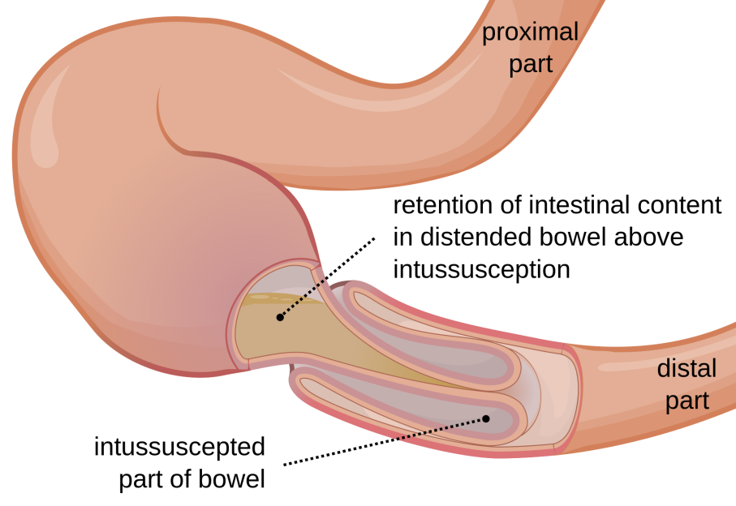
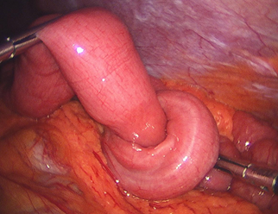
Intussusception

Slide 17
Intussusception
Adenocarcinoma present at the tip of intussusceptum

Slide 18
Volvulus
Twisting of a loop of bowel about its mesenteric base of attachment (usually clockwise), constricting the venous ± arterial flow
Complications:
Intestinal obstruction
+ Infarction

Slide 19
Intestinal obstruction

Slide 20
VASCULAR DISORDERS
Ischemic bowel disease
May affect small or large intestine or both.
Common in later age of life.
Angiodysplasia
Hemorrhoids

Slide 21
Ischemic Bowel Disease
Predisposing factors
Arterial thrombosis: Severe atherosclerosis (at the origin of the mesenteric BVs) Systemic vasculitis Dissecting aneurysm
Arterial embolism: Cardiac vegetations & mural thrombi (IE, MI, AF) Aortic atheroembolism
Venous thrombosis (rare): Venous stasis & hypercoagulable states
Non-occlusive ischemia: Cardiac failure, shock & vasoconstrictive drugs
Miscellaneous: Radiation injury, aortic aneurysm, volvulus, stricture, hernias, tumors, portal HTN, & trauma

Slide 22
The effect of ischemia
Depends on:
Acute or insidious onset
The vessel involved
The presence of collateral circulation
Acute occlusion of a major trunk - celiac, superior, & inferior mesenteric arteries-may lead to infarction of extensive segment.

Slide 23
Acute bowel ischemia
Acute ischemia

Slide 24
Transmural infarction
Infarction involving all visceral layers
Usually caused by acute occlusion of a major mesenteric vessel.
Gross appearance:
Dark red hemorrhagic appearance
Begins in the mucosa and extends to serosa that becomes covered with fibrinous exudate within18 to 24 hours

Slide 25
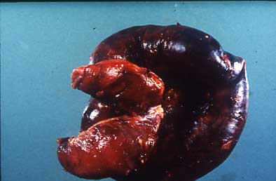
Infarcted small bowel

Slide 26
Transmural infarction
Microscopic appearance:
Hemorrhagic infarction*
Marked edema, hemorrhage, necrosis, and sloughing of the mucosa.
Complications:
Within 24 hours intestinal bacteria produce gangrene** and sometimes perforation.

Slide 27
Transmural infarction of small bowel

Slide 28
Clinical Features
Sudden onset of severe abdominal pain
Bloody diarrhea.
May lead to shock and vascular collapse within hours.
Diagnosis requires a high index of suspicion in the appropriate context (e.g., old age with recent major abdominal surgery, recent MI, AF, or IE).
The mortality rate approaches 90%.

Slide 29
Mural and mucosal infarctions
Mural infarction:
Infarction of the mucosa and submucosa sparing the muscular wall.
Mucosal infarction:
Infarction of the mucosa no deeper than the muscularis mucosae.
Both result from acute or chronic hypoperfusion or more localized anatomic defects.

Slide 30
Mural and mucosal infarctions
Gross appearance:
Multi-focal lesions, usually not be visible from the serosal surface.
Upon opening, the mucosa is hemorrhagic & edematous ± superficial ulcerations.
Microscopic appearance:
Acute ischemia - hemorrhagic infarction
Chronic ischemia

Slide 31
Mucosal infarction of small bowel

Slide 32
Hemorrhoids
Definition:
“ Variceal dilations of the anal and perianal submucosal venous plexuses”
After age of 30 yrs as a result of ⇑ venous pressure within the hemorrhoidal plexus.

Slide 33
Hemorrhoids
Predisposing conditions:
Chronic constipation
Venous stasis of pregnancy
Portal hypertension
Intra-abdominal tumors

Slide 34
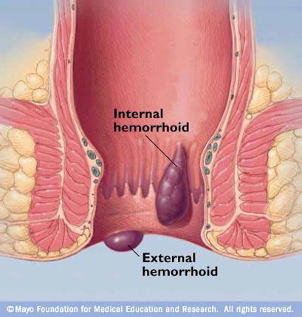
Hemorrhoids
Internal hemorrhoids:
Varicosities in the superior and middle hemorrhoidal veins.
Appear above the anorectal line.
Covered by rectal mucosa .
External hemorrhoids:
Varicosities of inferior hemorrhoidal plexus
Appear below the anorectal line
Covered by anal mucosa.

Slide 35
Clinical picture
Asymptomatic.
Bleeding.
Thrombosis (pain).
Internal hemorrhoids may prolapse during straining at stool, and become trapped by the anal sphincter and lead to:
Painful, edematous hemorrhagic enlargement
Strangulation

Slide 36
لا أعلم علمًا بعد الحلال والحرام، أنبل من الطب
الإمام الشافعي رحمه الله

