Slide 1
Diseases of the gastrointestinal tract
Dr. Nesreen Bataineh MD, FRCPath

Slide 2
STOMACH

Slide 3
GASTRIC ULCERATION
Ulcer:
A breach in the mucosa that extends through the muscularis mucosae into the submucosa or deeper.
Erosion:
A breach in the mucosa only
May heal within days

Slide 4
Acute Gastric Ulceration
Definition:
“Focal acute gastric mucosal defects that appear after severe stress”.
Not precursors of chronic peptic ulcers

Slide 5
Pathogenesis
Conditions associated with acute ulcer
Chronic exposure to gastric irritant drugs: NSAIDs & corticosteroids
Severe trauma (including major surgical procedures) Sepsis, shock & critically ill pts (stress ulcers)
Extensive burns (Curling ulcers)
Traumatic or surgical injury to the CNS or an intracerebral hemorrhage (Cushing ulcers) ↑ ICP may stimulate vagal nuclei and cause gastric acid hypersecretion High risk of perforation

Slide 6
Morphology
Site:
Anywhere in the stomach
Occasionally in the duodenum.
Size & shape:
Usually circular and small (<1 cm).
The ulcer base is stained dark brown by the acid digestion of extruded blood.
Often multiple, but may be single

Slide 7
Multiple stress ulcers

Slide 8
Microscopic picture
Abrupt lesions with normal adjacent mucosa.
Superficial erosions OR
Deep ulcers involving the entire mucosa but do not penetrate the muscularis propria

Slide 9
Clinical Features
A high % of persons admitted to hospital ICU develop superficial gastric erosions or ulcers
May be:
Of limited clinical consequence (N+V, minor hematemesis) to a life-threatening condition.
The single most important prognostic factor is the outcome of the underlying condition.

Slide 10
Peptic Ulcer Disease
Definition:
Chronic ulcers that occur in any portion of the GIT exposed to the aggressive action of acidic peptic juices.
Defect in the mucosa that penetrate into the submucosa or deeper.
98% are in D1 or in the stomach (antrum).
DU: GU ratio is 4:1.
Most often solitary, may be multiple.

Slide 11
Epidemiology
Age: usually adults
Gender:
M>F (M:F ratio in DU is 3:1 & in GU is 1.5-2:1).
Race: all races, with little difference
Notes:
Genetics: Blood group O, ??? Personality
PUD is common and is a frequent cause of physician visits worldwide (lifetime risk of developing an ulcer is approximately 10% for males and 4% for females).
Duodenal ulcers are more frequent with:
Alcoholic cirrhosis
Chronic obstructive pulmonary disease
CRF & hyperparathyroidism (Ca stimulates gastrin production & acid secretion).

Slide 12
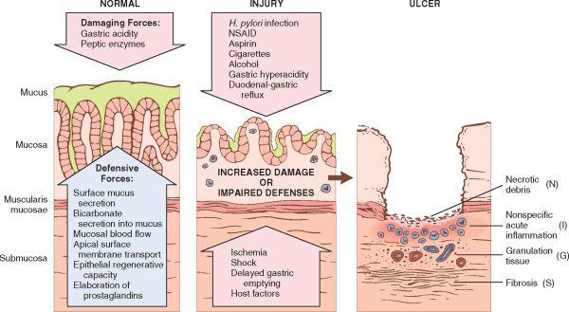
Pathogenesis
Imbalance between the mucosal defenses and the damaging forces → Mucosal exposure to gastric acid and pepsin

Slide 13
key factors of peptic ulcers:
H. pylori infection, the most important (discussed before)
Present in 70-90% of DU & 70% of GU
NSAID use *(2nd):Suppression of mucosal PG synthesis* * & ↑ HCL.
Others: Smoking, alcohol, CS, Z-E syndrome, psychological stress…
So, NSAIDS can lead to:
Acute erosive gastritis
Acute gastric ulcer
Peptic ulceration

Slide 14
Morphology
Favored sites:
The anterior > posterior wall of D1.
The lesser curvature of the stomach.
Gross appearance:
Most are round sharply punched-out defect with sharp margins and clean base (due to peptic digestion of the exudate and necrotic tissue).
+ Eroded artery or perforation.

Slide 15
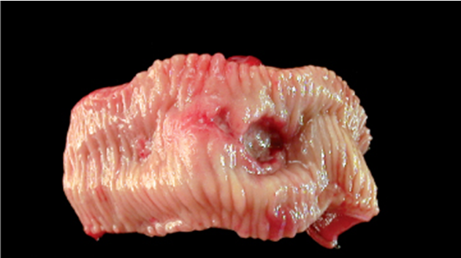
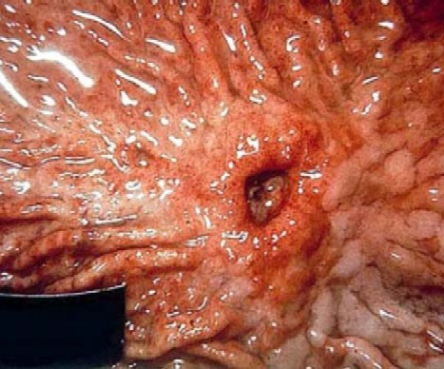
Peptic ulcer vs malignant ulcer
Notes:
ALL gastric ulcers and ALL gastric masses must be biopsied, because it is not possible to tell from gross appearance alone which are benign and which are malignant. In contrast, virtually all duodenal peptic ulcers are benign.

Slide 16
Microscopic appearance
Four zones at the base:
Necrotic debris
Inflammatory infiltrate (mainly neutrophils)
Granulation tissue
Fibrous scar
Chronic gastritis commonly seen in surrounding mucosa

Slide 17
Clinical Features
Asymptomatic
Epigastric pain:
Chronic, recurrent + relapsing, and worse at night.
DU: Pain is relieved by alkalis or food (6-8 hrs after meals).
GU: Pain is aggravated by food (1-3 hrs after meal).
+ Nausea, vomiting, bloating and belching.
Complications can be the early manifestation

Slide 18
Complications of Gastric Ulcers
Bleeding: in 20-30 % of patients Most frequent complication May be life-threatening Accounts for 25% of ulcer deaths May be the first manifestation (iron def. anemia or UGIT bleeding)
Perforation: in up to 5% of patients Accounts for 2/3 of ulcer deaths Rarely a first manifestation
Obstruction: in about 2% of patients Mostly in chronic ulcer of pylorus (sometimes duodenum) Secondary to edema or scarring Causes crampy abdominal pain (& rarely a total obstruction and severe vomiting).
Gastric carcinoma is a rare complication of gastric ulcer

Slide 19
Course and treatment
Recurrent → Impair the quality of life rather than shorten it.
Treatment:
Triple therapy
(two antibiotics against H. pylori and PPIs)
Surgery in complications or resistant ulcers

Slide 20
GASTRIC TUMORS
Benign tumors & tumor-like conditions:
Mucosal: Gastric polyps
Mesenchymal tumors: Leiomyoma, lipoma
Malignat:
Gastric carcinoma (~90%)
Malignant lymphoma (5%)
Carcinoid tumor (3%)
Gastrointestinal stromal tumor(2%)

Slide 21
Gastric Polyps
Gastric polyps are uncommon.
Types:
(1) Hyperplastic polyps (~75%),
(2) Fundic gland polyps (∼10%),
(3) Adenomatous polyps (∼10%).

Slide 22
Hyperplastic (Inflammatory) polyps
Not true neoplasms → exuberant response to chronic gastritis
Hyperplastic mucosal epithelium and an inflamed edematous stroma.

Slide 23
Fundic gland polyps
Small collections of dilated corpus-type glands.
May occur due to excessive use of PPIs*
May occur in persons with (FAP) but do not have neoplastic potential.

Slide 24
Adenomas
True neoplasms
Contain dysplastic epithelium
Risk of malignant transformation ⇑ with polyp size (>2cm).

Slide 25
Gastric Carcinoma
Epidemiology:
High incidence in Japan, southern Korea, Chile …
Low socioeconomic groups.
There is a steady decline in overall incidence and mortality (except CA OF CRDIA ??).
Notes:
Mass endoscopic screening programs can be successful in regions of high incidence, such as Japan, where 35% of newly detected cases are early gastric cancer, or tumors limited to the mucosa and submucosa. Unfortunately, mass screening programs are not cost-effective in regions in which the incidence is low, and less than 20% of cases are detected at an early stage in North America and northern Europe.
In the United States, gastric cancer rates dropped by more than 85% during the 20th century. Similar declines have been reported in many other Western countries, reflecting the importance of environmental and dietary factors. Despite this decrease in overall gastric adenocarcinoma incidence, cancer of the gastric cardia is on the rise. This trend probably is related to increased rates of Barrett esophagus and may reflect the growing prevalence of chronic GERD and obesity.
→ This applies only to the intestinal type

Slide 26
Classification of gastric carcinoma
WHO classification
-Adenocarcinoma (90%) Intestinal type Diffuse type Papillary adenocarcinoma Tubular adenocarcinoma Mucinous adenocarcinoma Signet ring adenocarcinoma Adenosquamous carcinoma Squamous cell carcinoma Undifferetiated cacrinoma

Slide 27
Intestinal type | Diffuse type
The more common type in high risk population Age of 50 y M > F | Less common. Uniform incidence among populations Earlier age M=F
Arise from intestinal metaplasia, then dysplasia in the setting of chronic gastritis * | Arise de novo from native gastric mucous cells Not associated with chronic gastritis
Usually form a bulky mass. | No definite mass. May lead to hardening of the wall (linitis plastica)
Better differentiated | Poorly differentiated

Slide 28
Risk factors
Intestinal-type adenocarcinoma
Chronic gastritis with intestinal metaplasia
Infection with Helicobacter pylori
Diets containing foods that may generate nitrites that form nitrosamines and nitrosamides (smoked foods, pickled vegetables and excessive salt intake)
Decreased intake of fresh vegetables and fruits (antioxidants present in these foods may inhibit nitrosation)
Partial gastrectomy
Pernicious anemia (Autoimmune gastritis)
Diffuse-type adenocarcinoma
Risk factors are undefined Rare inherited mutation of E-cadherin. Infection with H. pylori and chronic gastritis often absent
Etiology and Pathogenesis Body_ID: HC015058 Intestinal-Type Adenocarcinoma

Slide 29
Morphology
Location:
Pylorus and antrum (50% to 60%) > Cardia (25%) > body & fundus.
Lesser curvature > Greater curvature,
→ Lesser curvature of the antropyloric region

Slide 30
Morphology
Classification based on depth of invasion:
Early gastric carcinoma: Confined to the mucosa & submucosa*.
Advanced gastric carcinoma: Extended below the submucosa.

Slide 31
Early gastric carcinoma

Slide 32
Advanced gastric carcinoma
Usually with diffuse type.
Evoke a desmoplastic reaction & wall hardening
May mimic chronic peptic ulcer
Heaped-up (raised) margins

Slide 33
Malignant ulcer

Slide 34
Linitis plastica

Slide 35
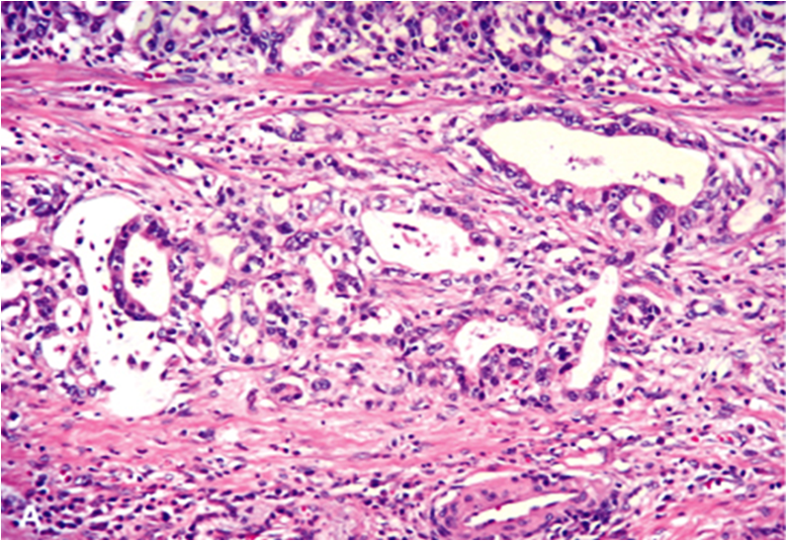
Microscopic appearance
The intestinal type:
Malignant cells forming neoplastic glands resembling those of colonic adenocarcinoma.

Slide 36
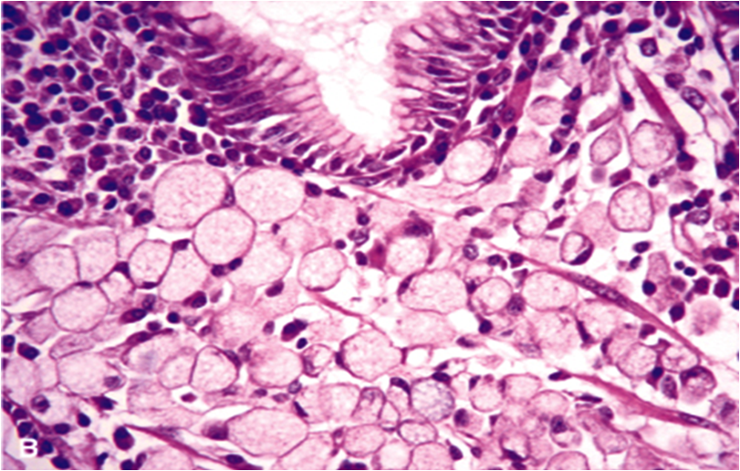
Microscopic appearance
The diffuse type:
Composed of gastric-type cells invading the wall in infiltrative pattern (NO gland formation).
Some cells contain mucous “signet-ring" cells

Slide 37
Tumor spread
Direct spread (wall → serosa).
Regional and distant LNs
The earliest LN mets may involve a supraclavicular lymph node (Virchow node).
Distant metastasis (mainly to liver).
Intraperitoneal spread: In females may involve both ovaries (Krukenberg tumor).
Notes:
Sister mary Joseph - Ovary

Slide 38
Clinical Features
Early gastric cancer:
Usually asymptomatic.
Abdominal discomfort, dyspepsia & nausea.
Advanced carcinoma:
May be asymptomatic
Iron deficiency anemia, anorexia, bleeding, weight loss…
Tumors of the cardia may cause dysphagia.
Tumors of pylorus may cause gastric outlet obstruction.

Slide 39
Prognosis
Prognostic factors:
Stage (TNM): Most important.
Type: Signet ring & diffuse type carry a poor prognosis.
5 year survival is:
Early CA →90%.
Advanced CA → < 20%*.

Slide 40
وَمَنْ أَحْيَاهَا فَكَأَنَّمَا أَحْيَا النَّاسَ جَمِيعًا

