Slide 1
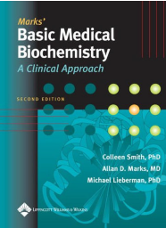
Digestion and Absorption of Basic Nutritional Constituents
Dr. Mazhar Al Zoubi, 2020
Chapters: 27, 32 and 38

Slide 2
Nutrient Types
Digestible
Proteins
Carbs
Fats
Nucleic acids
Indigestible (Fibers)
Cellulose
Pectin (complex mixture)
Others
Chapters 27, 32 and 37

Slide 3
Digestion, Absorption and transport of carbohydrates
The major carbohydrates in the American diet are starch, lactose, and sucrose.

Slide 4
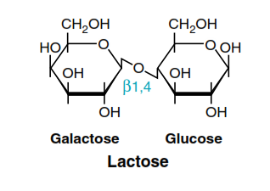
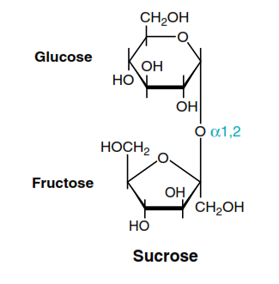

Slide 5
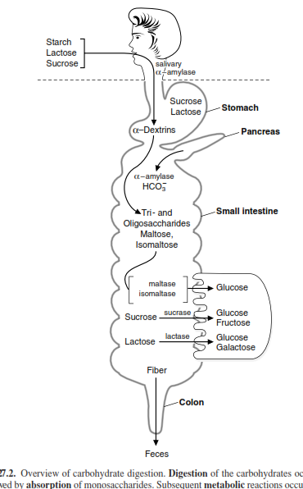
Overview of carbohydrate digestion.

Slide 6
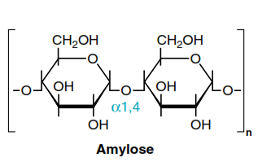
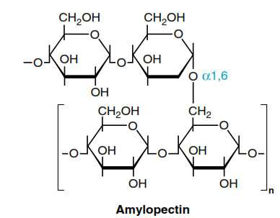
I. DIETARY CARBOHYDRATES
40 to 45% of caloric intake in USA diet.
50-60 % came from starch
The animal origin carbs is lactose (milk and milk products)
Sucrose and small amounts glucose and fructose are the major natural sweeteners found in fruit, honey, and vegetables.

Slide 7
Inter-conversion of Monosaccharaides
Amino acids
Glucose
Fructose, galactose, xylose, and all the other sugars

Slide 8
II. DIGESTION OF DIETARY CARBOHYDRATES
Glycosidase exhibit some specificity for the glycosidic bond and number of residues
Undigested Carbs
Bacterial Fermentation

Slide 9
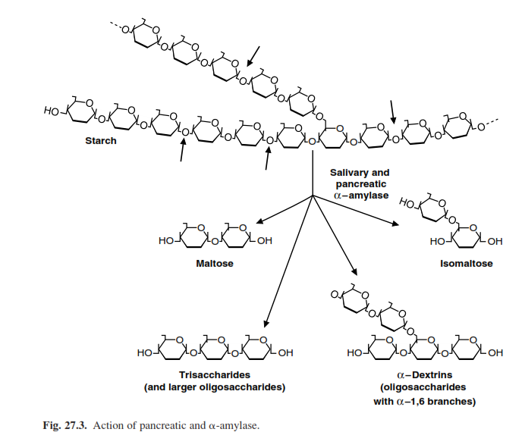
A. Salivary and Pancreatic-Amylase
1 L of saliva/Day
1.5 L of pancreatic juice/Day
Limit dextrins: are oligosaccharides ( 4 -9 residues with one or more α-1,6 branches).

Slide 10
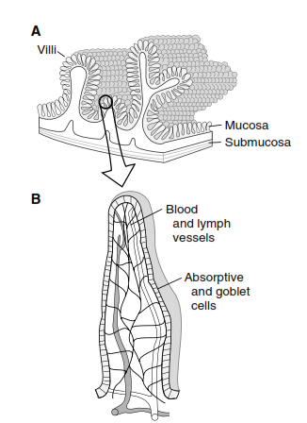
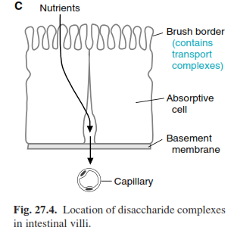
B. Disaccharidases of the Intestinal Brush-Border Membrane
Glucoamylase.
Sucrase–maltase complex.
Trehalase.
Lactase-glucosylceramidase

Slide 11
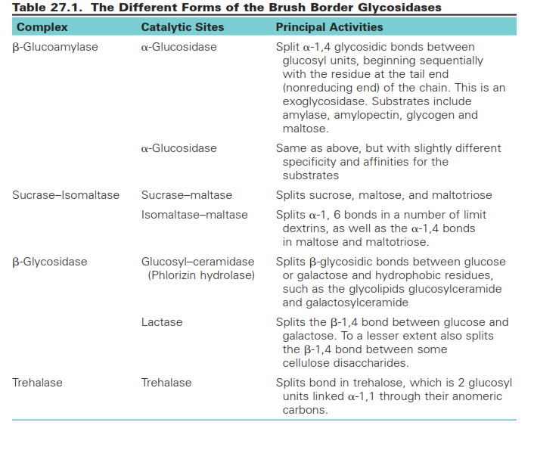

Slide 12
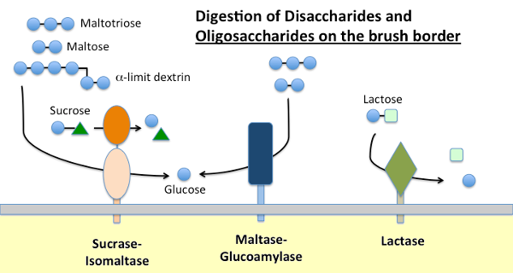

Slide 13
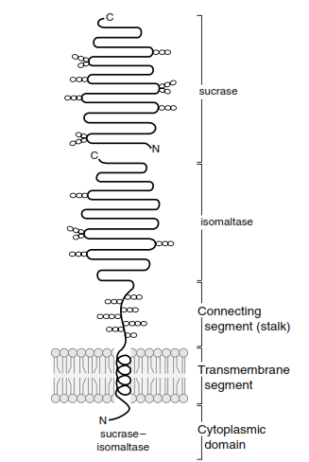
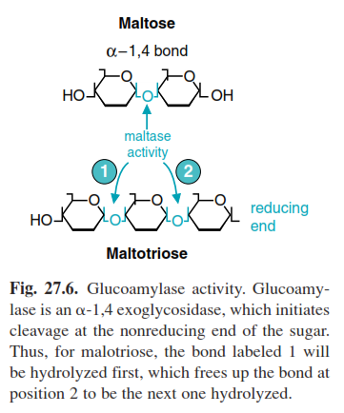
1. Maltase-GLUCOAMYLASE
Glucoamylase
Glucoamylase is similar to the sucrase–isomaltase complex structures
It is an exoglucosidase that is specific for the α–1,4 bonds
begins at the non-reducing end of a polysaccharide or limit dextrin
Maltase

Slide 14
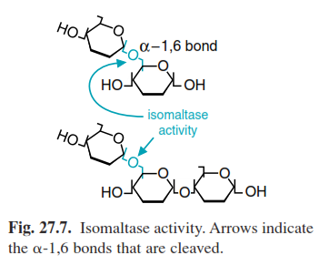
2. SUCRASE–ISOMALTASE COMPLEX
similar structure to the glucoamylase

Slide 15
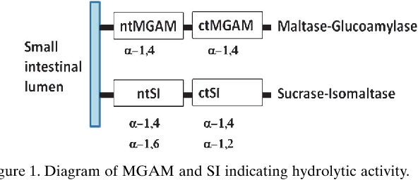

Slide 16
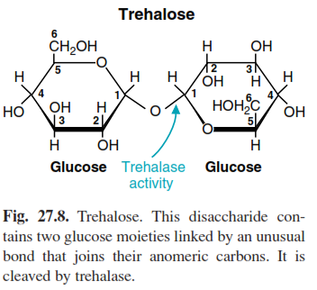
3. TREHALASE
has only one catalytic site.
Trehalose (insects, algae, mushrooms, and other fungi) is not currently a major dietary component
Trehalase deficiency (a woman became very sick after eating mushrooms and was initially thought to have α–amanitin poisoning.

Slide 17
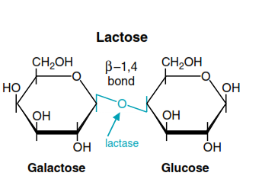
4. -GLYCOSIDASE COMPLEX (LACTASE-GLUCOSYLCERAMIDASE)
hydrolyzes the -bond connecting glucose and galactose in lactose

Slide 18
5. LOCATION WITHIN THE INTESTINE
The production of maltose, maltotriose, and limit dextrins by pancreatic –amylase occurs in the duodenum
Sucrase–isomaltase, β-Glycosidase activity is highest in the jejunum
Glucoamylase activity progressively increases along the length of the small intestine, and its activity is highest in the ileum.

Slide 19
Metabolism of Sugars by Colonic Bacteria
lactate
Starches high in amylose, or less well hydrated (e.g., starch in dried beans), are resistant to digestion and enter the colon.
Dietary fiber and undigested sugars also enter the colon.
gases
saccharides
short-chain fatty acids
Colonic bacteria

Slide 20
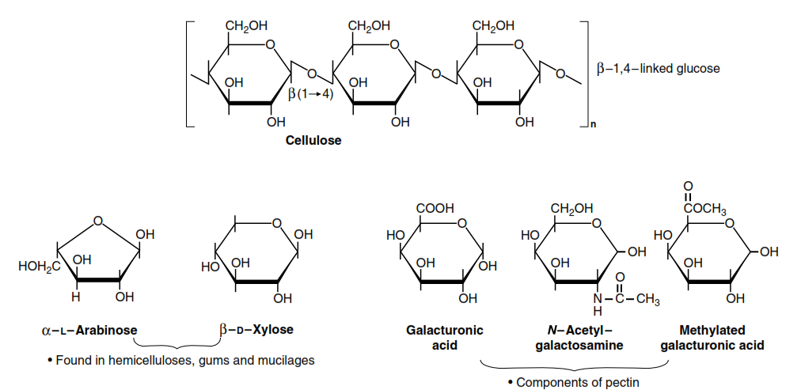
Indigestible carbohydrates

Slide 21
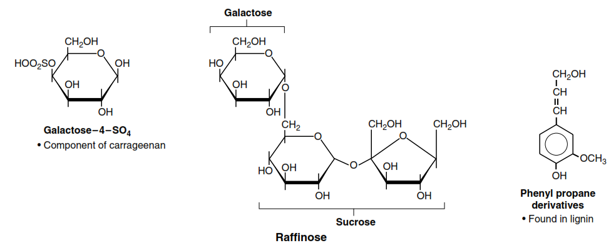
Indigestible carbohydrates

Slide 22
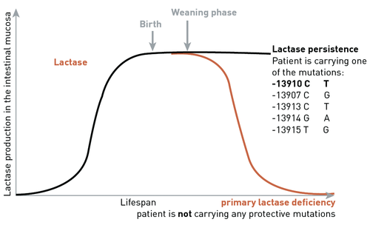
Lactose Intolerance
caused by low levels of lactase
1. NONPERSISTENT AND PERSISTANT LACTASE
Adult levels are less than 10% of that present in infants (lactase non-persistence phenotype).
When the levels of lactase remain at, or only slightly below infant levels throughout adulthood (lactase persistence phenotype)
https://www.imd-berlin.de/en/special-areas-of-competence/food-intolerances/lactose-intolerance.html

Slide 23
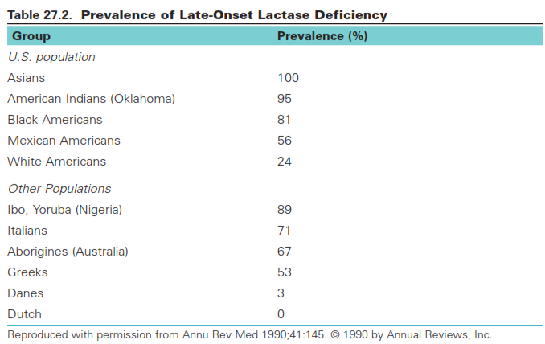

Slide 24
2. INTESTINAL INJURY
Lactase is usually the first activity lost and the last to recover.

Slide 25
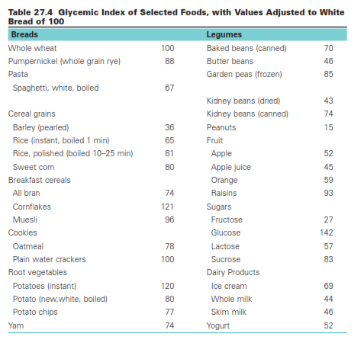
ABSORPTION OF SUGARS
Glucose and maltose have the highest glycemic indices

Slide 26
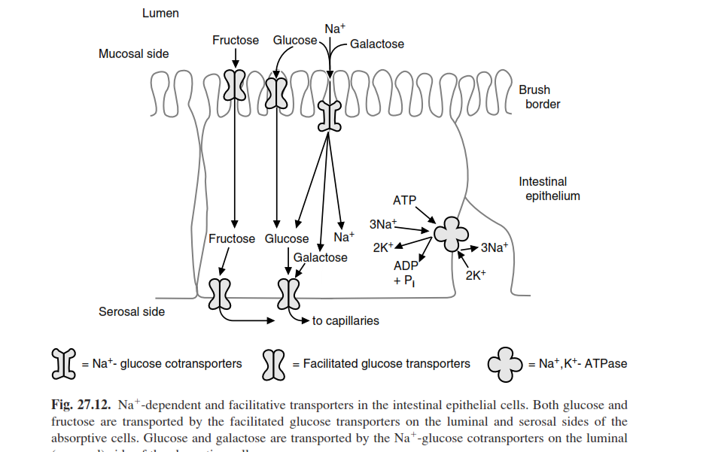
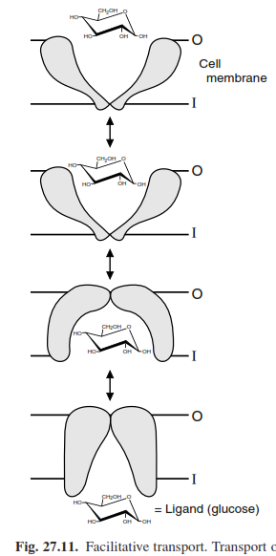
A. Absorption by the Intestinal Epithelium

Slide 27
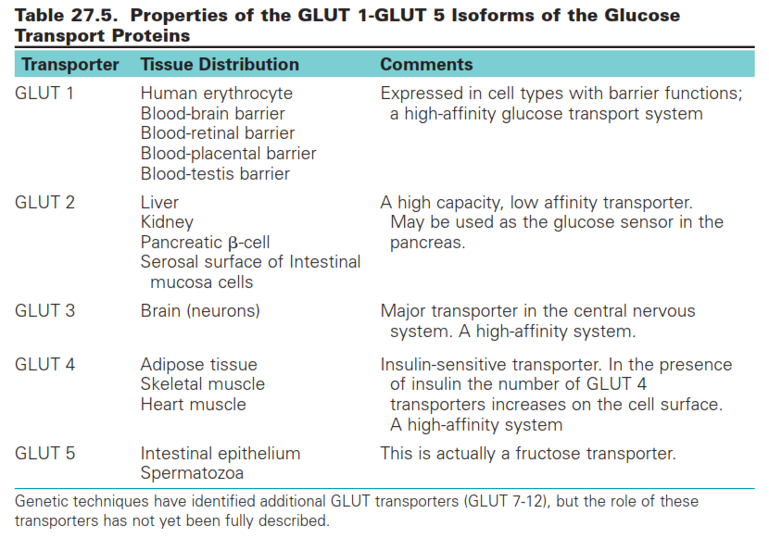

Slide 28
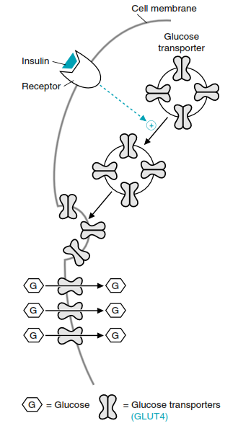
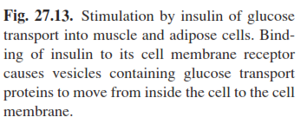
Insulin Stimulation

Slide 29
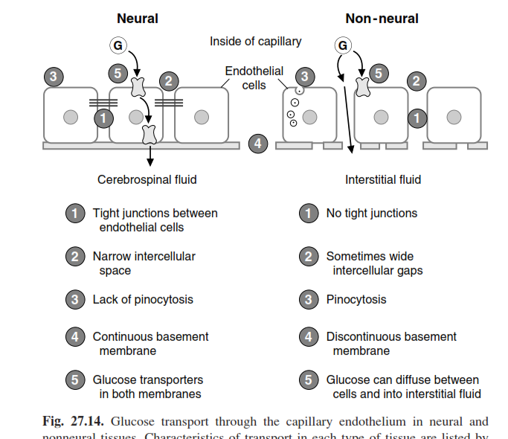
GLUCOSE TRANSPORT THROUGH THE BLOOD-BRAIN BARRIER AND INTO NEURONS

Slide 30
Digestion and Transport of Dietary Lipids

Slide 31
DIGESTION OF TRIACYLGLYCEROLS
Triacylglycerols are the major fat in the human diet because

Slide 32
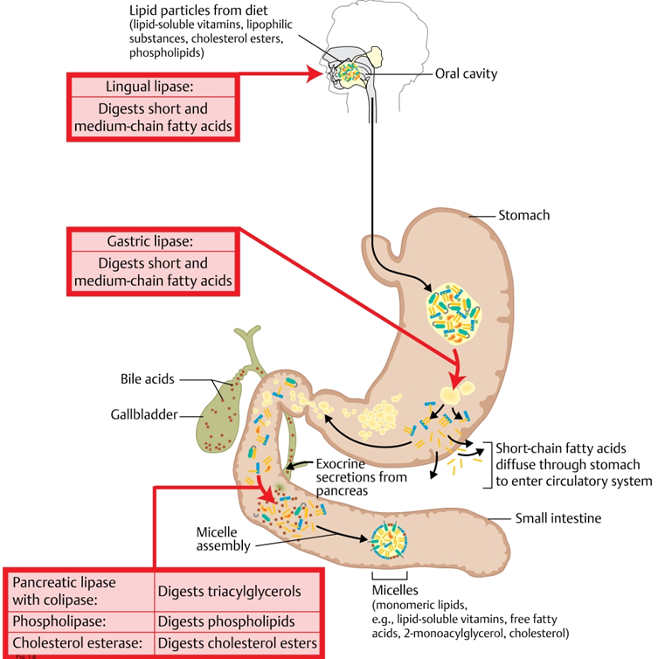
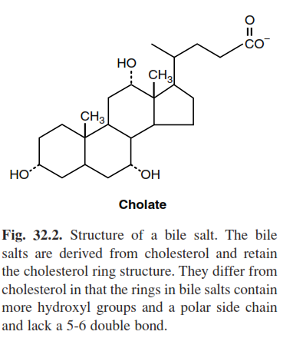

Slide 33
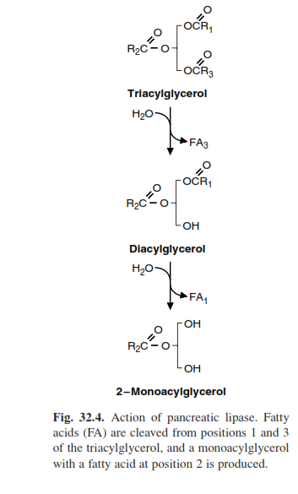
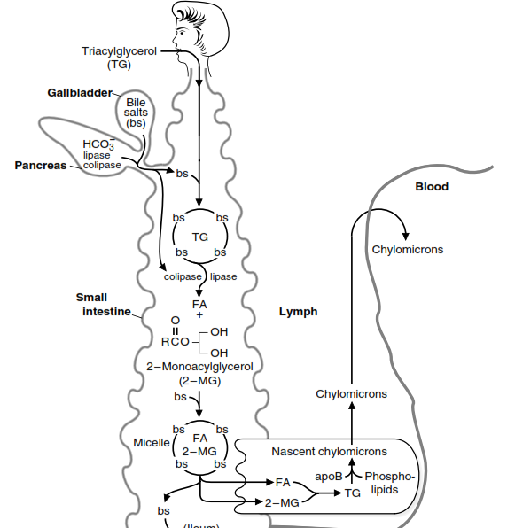
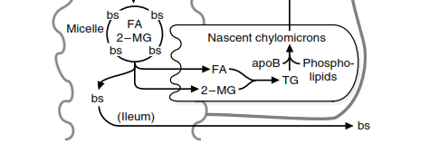
Short- and medium-chain fatty acids (C4 to C12) do not require bile salts for their absorption.
The colipase binds to the dietary fat and to the lipase, thereby increasing lipase
activity.

Slide 34
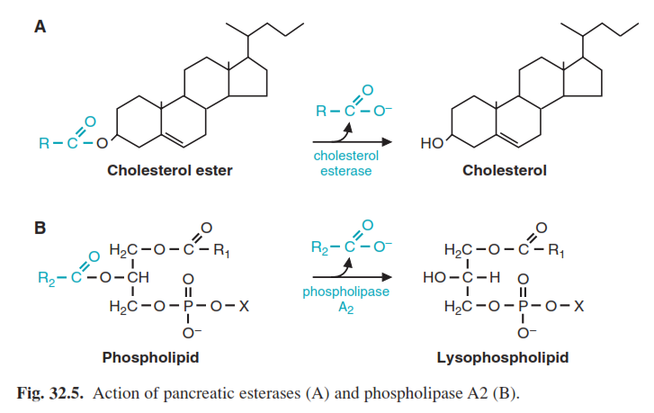
pancreatic esterases and phospholipase A2.

Slide 35
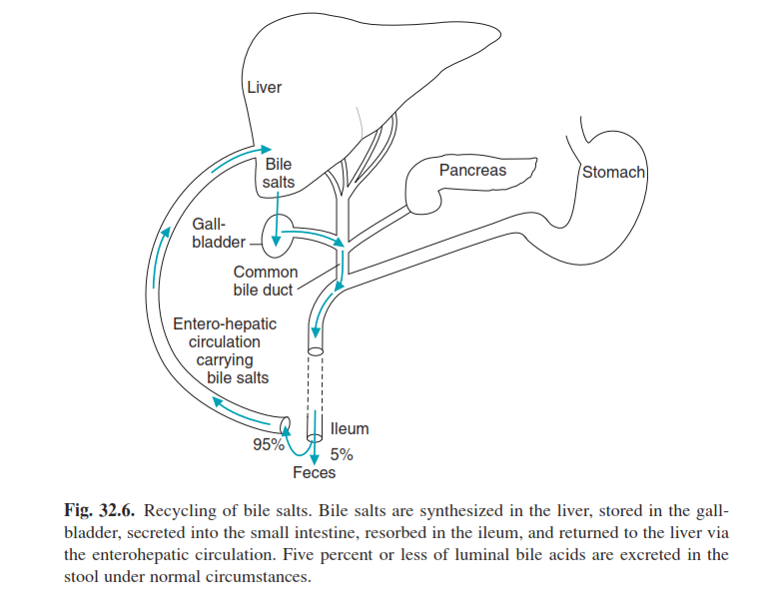

Slide 36
Protein Digestion and Amino Acid Absorption

Slide 37
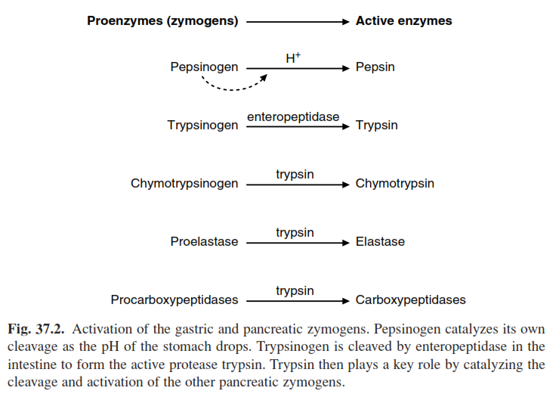
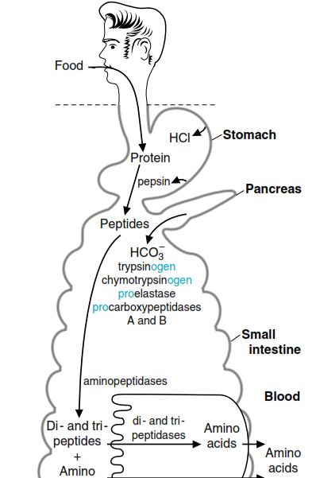
The digestion of proteins begins in the stomach and is completed in the intestine

Slide 38
Digestion of Proteins in the Stomach
chief cells
broad specificity
parietal cells

Slide 39
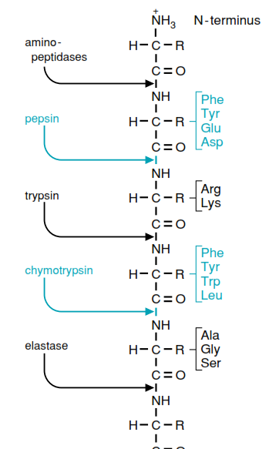
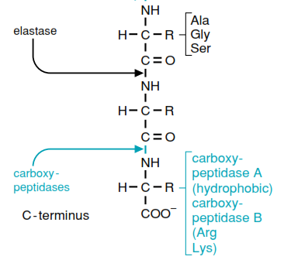
Digestion of Proteins by Enzymes from the Pancreas

Slide 40
Digestion of Proteins by Enzymes from Intestinal Cells
Aminopeptidases, located on the brush border, cleave one amino acid at a time from the amino end of peptides.
Intracellular peptidases act on small peptides that are absorbed by the cells.

Slide 41
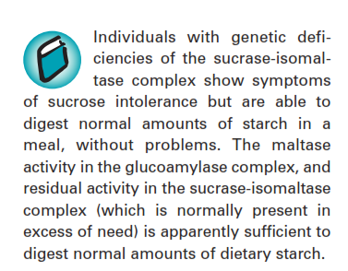
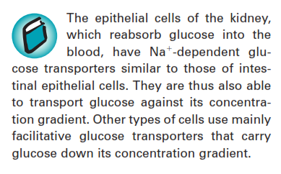
Clinical correlations

Slide 42
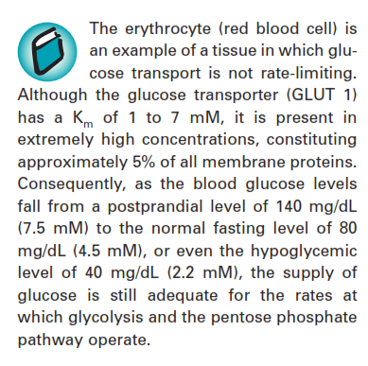

Slide 43
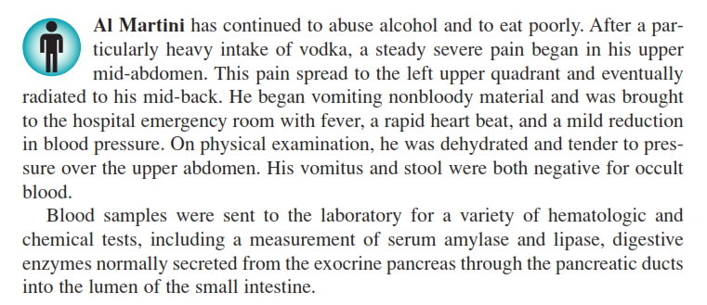

Slide 44
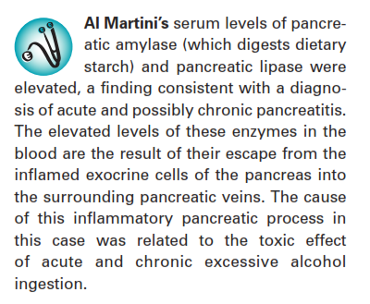
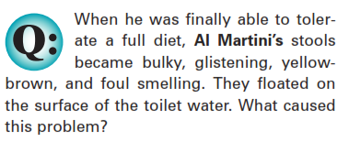

Slide 45
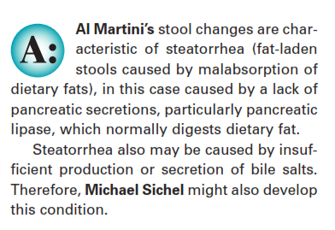

Slide 46
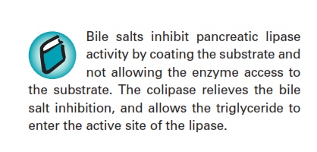
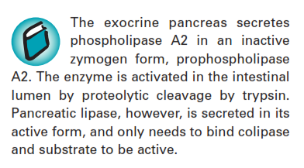

Slide 48
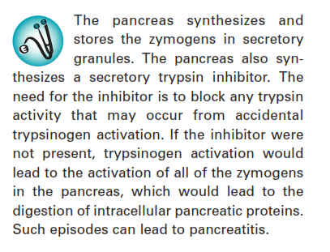

Slide 49
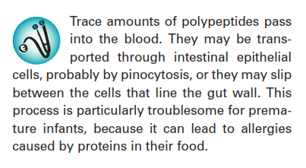
intestinal epithelial pinocytosis,

Slide 50
Excess proteins and muscle mass

