Slide 1
GIT MODULE
“TWO LECTURES”
Bacterial Infections of the GI Gastritis Helicobacter pylori
Shigella and Salmonella
By
Prof. Dr. Zainalabideen A. Al-Abdulla,
MRCPI, DTM&H., Ph.D., FRCPath. (U.K.)

Slide 2
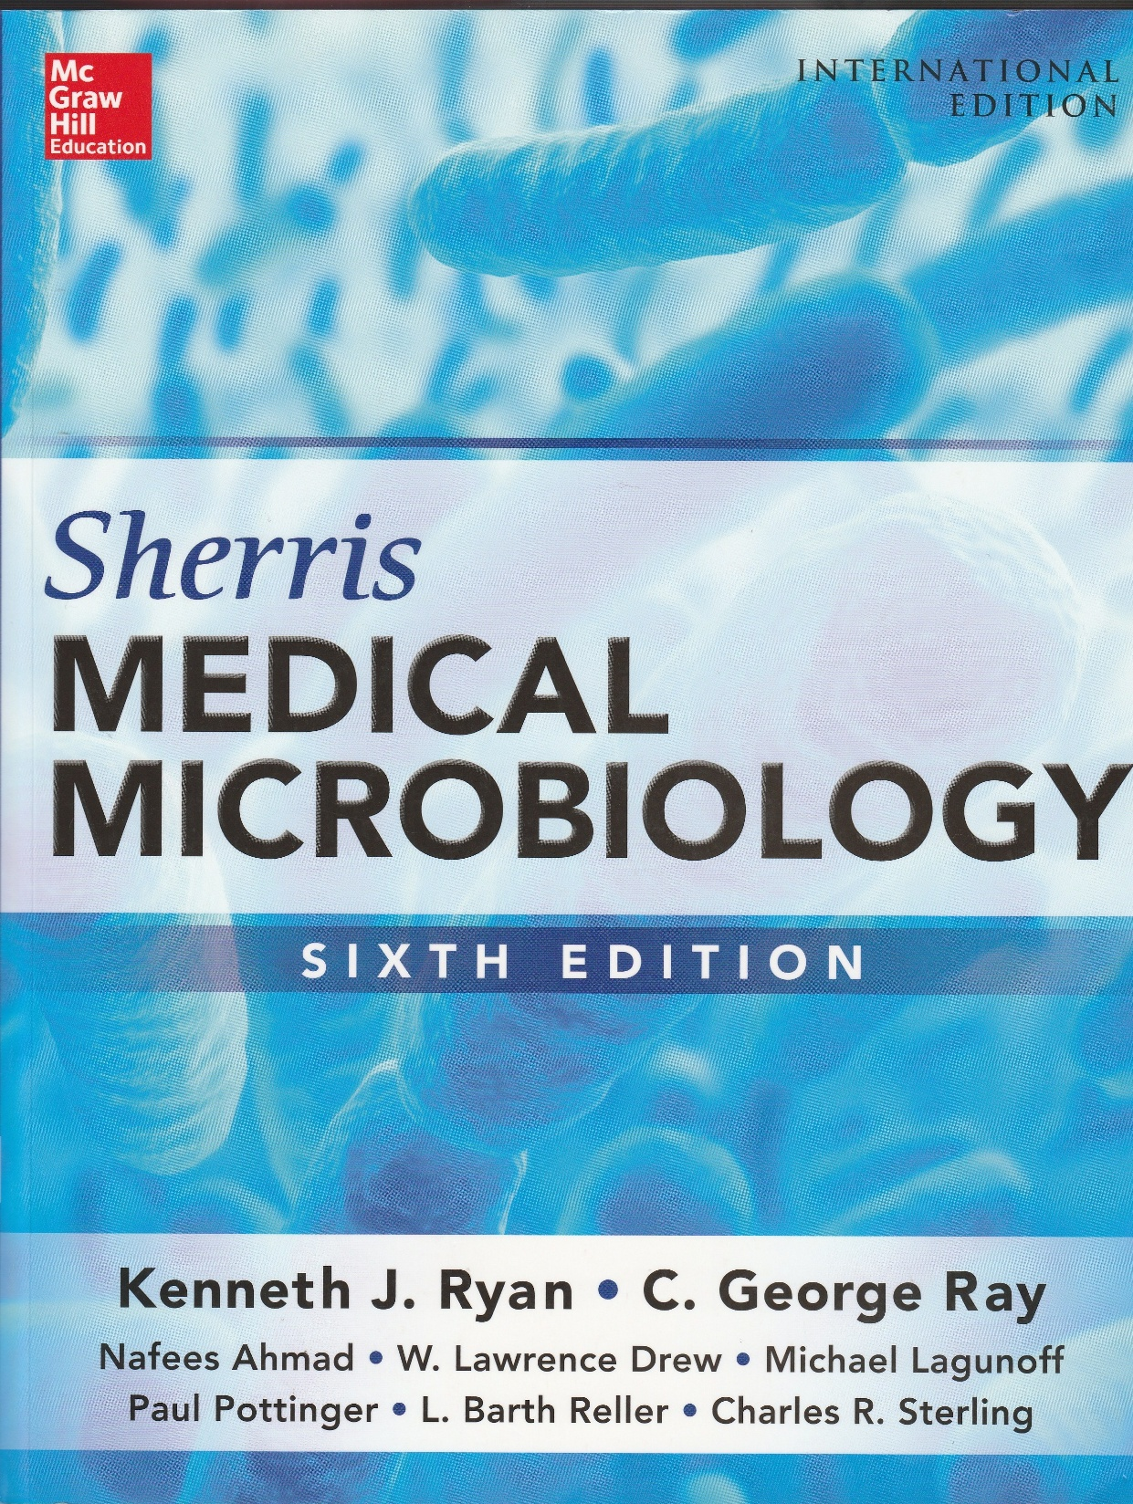

Slide 3
Learning objectives (two lectures)
1. Understand the role of Helicobacter pylori in gastritis, peptic ulcer disease (PUD), gastric adenocarcinomas, and MALT lymphoma.
2. Learn the laboratory diagnosis and anti-biogram (sensitivity to antibiotics) of H. pylori
3. Recognize the morphology, culture and pathogenesis of other causative bacteria of the GIT namely Campylobacter, Salmonella, and Shigella .
4. Appreciate the epidemiology and treatment of the above mentioned microorganisms.

Slide 4
Helicobacter pylori
- Gram-negative, helix-shaped (spiral), motile (4-6 polar flagella) & microaerophilic organism.
- The organism is highly specialized to exist within the acidic environment of the stomach.
# It can change its membrane potential at
external pH levels from 3 to 7 in order to
maintain its neutral internal pH.
- It uses virulence factors such as urease and its flagella to establish infection.
- It can also use molecular mimicry to evade the host immune response.

Slide 5
Cont./… Helicobacter
- Warren and Marshall identified (1983) them in gastritis & peptic ulcers; so are infectious diseases
H. pylori is similar to Campylobacter jejuni (morphology, cultural requirements & motility).
H. pylori is unique by:
- Urease; which raises gastric pH
- Vacuolating cytotoxin A (VacA): Which injures (death) lysosomal and endosomal membranes
- Cytotoxin-associated gene A (CagA) protein: Which induces multiple cytoskeletone changes.
- Adhesins (BabA) & Outer Inflammatory Pr. A (oipA)

Slide 6
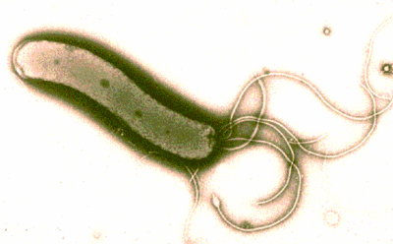
Helicobacter pylori
Gram negative Spiral Microaerophilic
Motile Bacteria

Slide 7
Epidemiology of H. pylori infections
- Found in normal people both in developed (25-50%) and developing (75-90%) countries which depends on mode of transmission, & ethnicity; but in some people it can lead to the followings:
- Gastritis
- Gastric and duodenal ulcers (PUD)
- Gastric adenocarcinoma
- Gastric mucosa-associated lymphoid tissue (MALT) lymphoma (MALTOMA).
# NOTE: WHO declared H. pylori as a class-I carcinogen (induces cancer)

Slide 8
Pathogenicity of H. pylori
1. Motility
2. Urease
3. Adherence
4. VacA (cell death), and CagA (cytoskeleton)
- Colonization: Minimal to extensive infiltrate
- Ulcers at colonization of antrum of the stomach
- Duodenal ulcer: Mainly at the duodenal bulb.
- Metaplasia leading to cancer (mechanism?):
a. Role of CagA b. Long time inflammation
- Affects hormones controlling glucose (DM?)

Slide 9
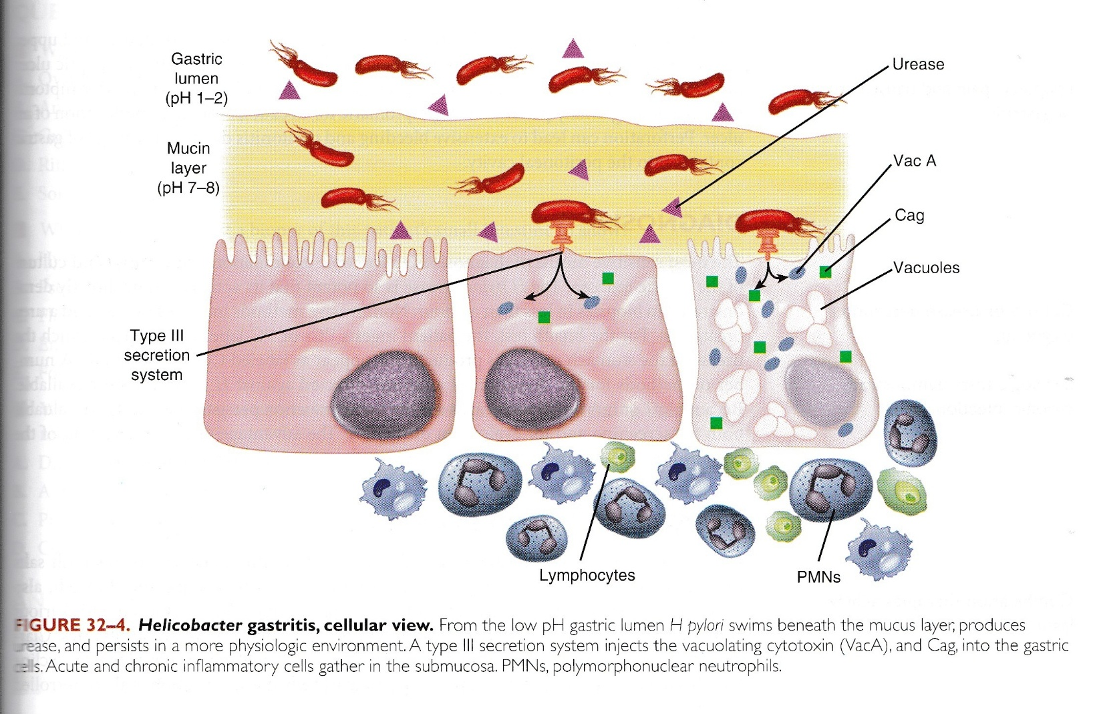

Slide 10
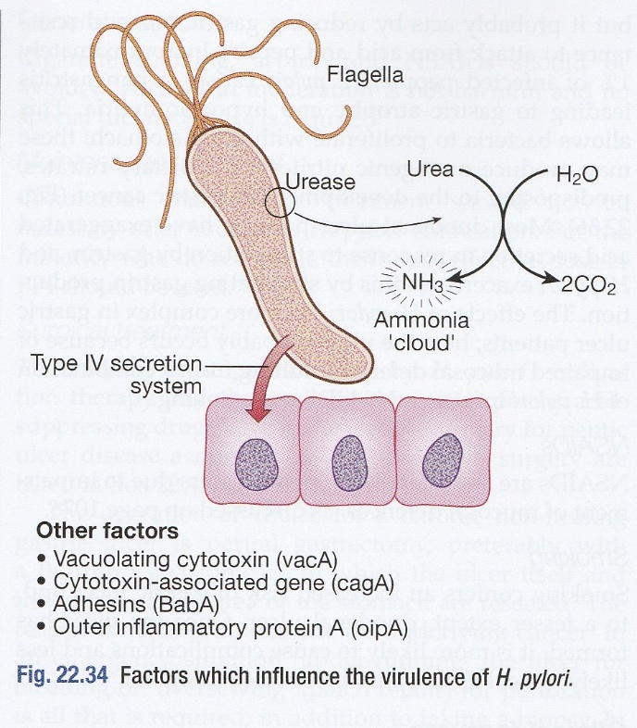

Slide 11
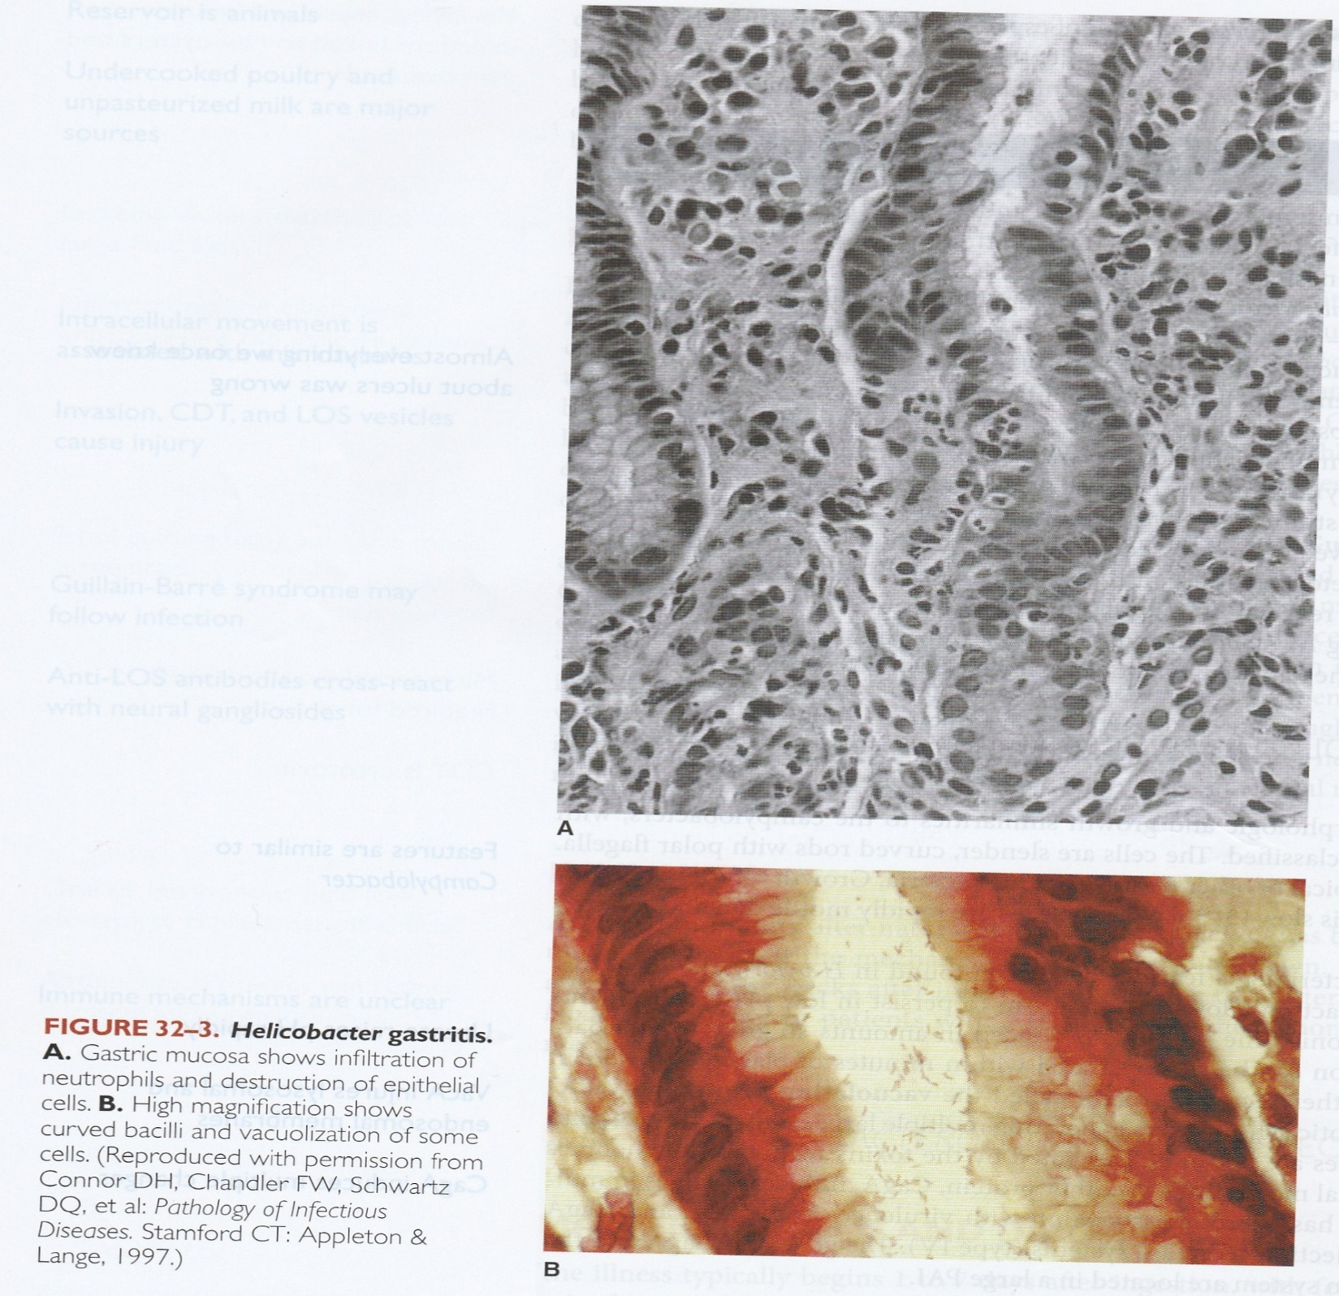

Slide 12
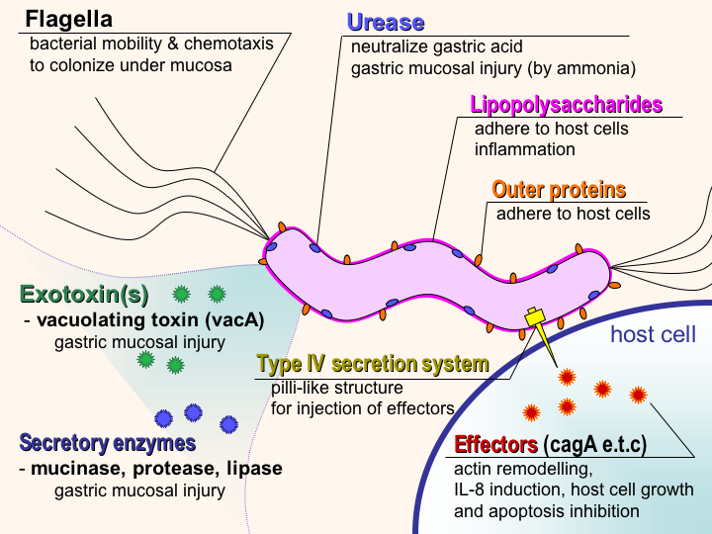

Slide 13
Immunity
1. Role of natural immunity- limited
2. VacA: Also, immunosuppressive effects
Clinical aspects of Helicobacter disease
Manifestations
Asymptomatic (silent)
Symptomatic
Gastritis and peptic ulcers
* Perforation

Slide 15
Diagnosis
1. Biopsy of gastric mucosa:
a. Culture
b. Rapid urease test
2. Urea breath test
3. Serology: Specific IgG and IgA (chronic)
4. Ammonia excretion test in urine

Slide 16
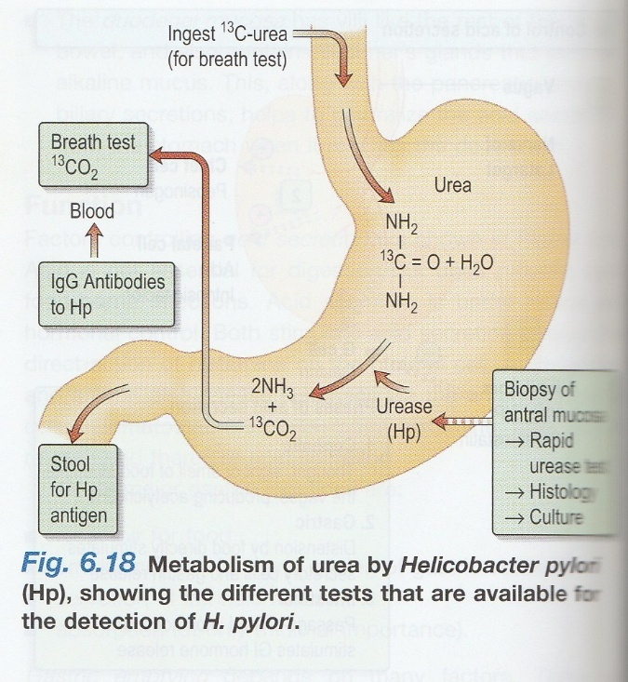

Slide 17
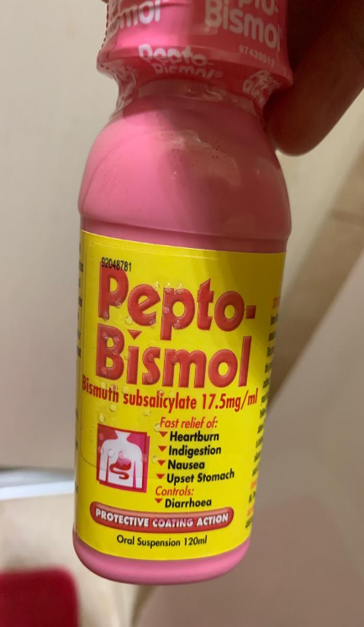
Treatment and prevention
- Multiple (triple or quadriple) therapy:
1. Proton-Pump inhibitors
2. Two antibiotics (A or B could be used):
A. Clarithromycin plus either amoxicillin
or metronidazole
B. Levofloxacin (or tetracycline)
plus metronidazole
3. ( + ) Bismuth sub-salicylate (e.g. Pepto-Bismol)
- Cure rate is high with multiple therapy
Prevention
- Further understanding; good hygiene
- Prophylactic treatment of asymptomatic persons?

Slide 18
Campylobacter
- Morphology (S-shaped, Spiral, “Seagull”, G- )
- Similarity to H. pylori (previously: C. pylori)
- Have different species
C. jejuni
- Campylobacter enteritis (campylobacteriosis)
- Cultural characteristics (Microaerophilic,
Capnophilic, and Thermophilic “up to 42º”)
- CHO/ amino acids use the microbe.
- Cytolethal distending toxin (CDT)
- Lipooligosaccharides (LOS) and LPS

Slide 19

Culture of Campylobacter
- Microaerophilic: N2 85%, CO2 10%, and
O2 5% (provided by gas-
generating kit)
- Capnophilic : CO2 10%
- Thermophilic : 42 °C
Biochemical tests
- Catalase positive (H. pylori is also +ve)
- Oxidase positive (H. pylori is also +ve)
- Urease negative (H. pylori is POSITIVE)

Slide 20

Campylobacter: Seagull-like wings appearance

Slide 21

Fig.: Seagull Bird

Slide 22
Epidemiology of Campylobacteriosis
- Rate of infection: 4-30% of diarrhea
- Primary reservoir: Sheep, cattle, chicken, birds
(in gastrointestinal tract)
- Transmission (uncooked poultry, and
unpasteurized milk)
Immunity
- Acquired immunity develops after infection.
- IgA (secretory in the GIT and serum)
- Cellular immunity is also important

Slide 23
Pathogenesis
1. Adherence
2. Invasion of enterocytes, microtubules
3. Damage to infected cells ( by CDT and LOS)
Guillian-Barre' syndrome
It is an acute demyelinating neuropathy:
- A complication of campylobacteriosis
- Type-II hypersensitivity (molecular
mimicry) by anti-LOS antibody

Slide 24
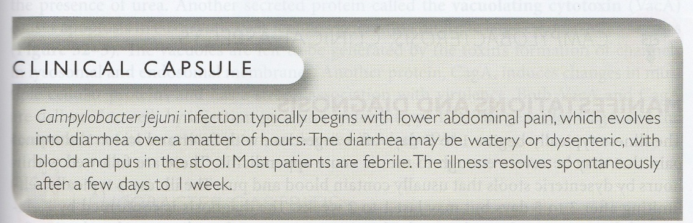

Slide 25
Clinical aspects of campylobacteriosis
Manifestations and Diagnosis
- Course of the disease (abd. pain, dysentery)
- Diagnosis (clinical and laboratory)
Treatment
- Indications of antimicrobial therapy: Severe or
prolonged (>1 week) cases.
- Macrolides (Erythromycin, Azithromycin)
- Fluoroquinolones resistance as in HIV infection
- N.B.: Resistant also to Beta-lactam antibiotics

Slide 26
Second Lecture
Shigella & Salmonella

Slide 27
Shigella
Morphology: Gram negative, non-motile, non-
lactose fermenter (NLF) bacilli
• Family: Enterobacteriaceae
Species/ serogroups:
1. Shigella dysenteriae (serogroup A)
2. Shigella flexneri (serogroup B)
3. Shigella boydii (serogroup C)
4. Shigella sonnie (serogroup D)
* Serotypes: A (15), B (6), C (19), D (1)

Slide 28
Pathogenicity of Shigella
1. Invasiveness
- Adhere M cells, invade these cells assisted
by Ipa-A to D (Invasion Plasmid Antigen;
under control of specific genes), escape
endocytic vacuoles, then enter Enterocytes,
reinvade other cells, then produce colon
ulcers, diarrhea/dysentery (proportional “//”
to EIEC “ Entero-Invasive E. coli”)
- Bloodstream invasion is uncommon (vs:
Salmonella)

Slide 29
Cont./… Pathogenicity of Shigella
2. Stx toxin production
- S. dysenteriae type A1 (Shiga Bacillus) can
produce this toxin which is:
# Serious ( may lead to Hemolytic Uremic
Syndrome “HUS”, and meningismus effect)
# That is why this serogroup (A1) is quite
dangerous

Slide 30
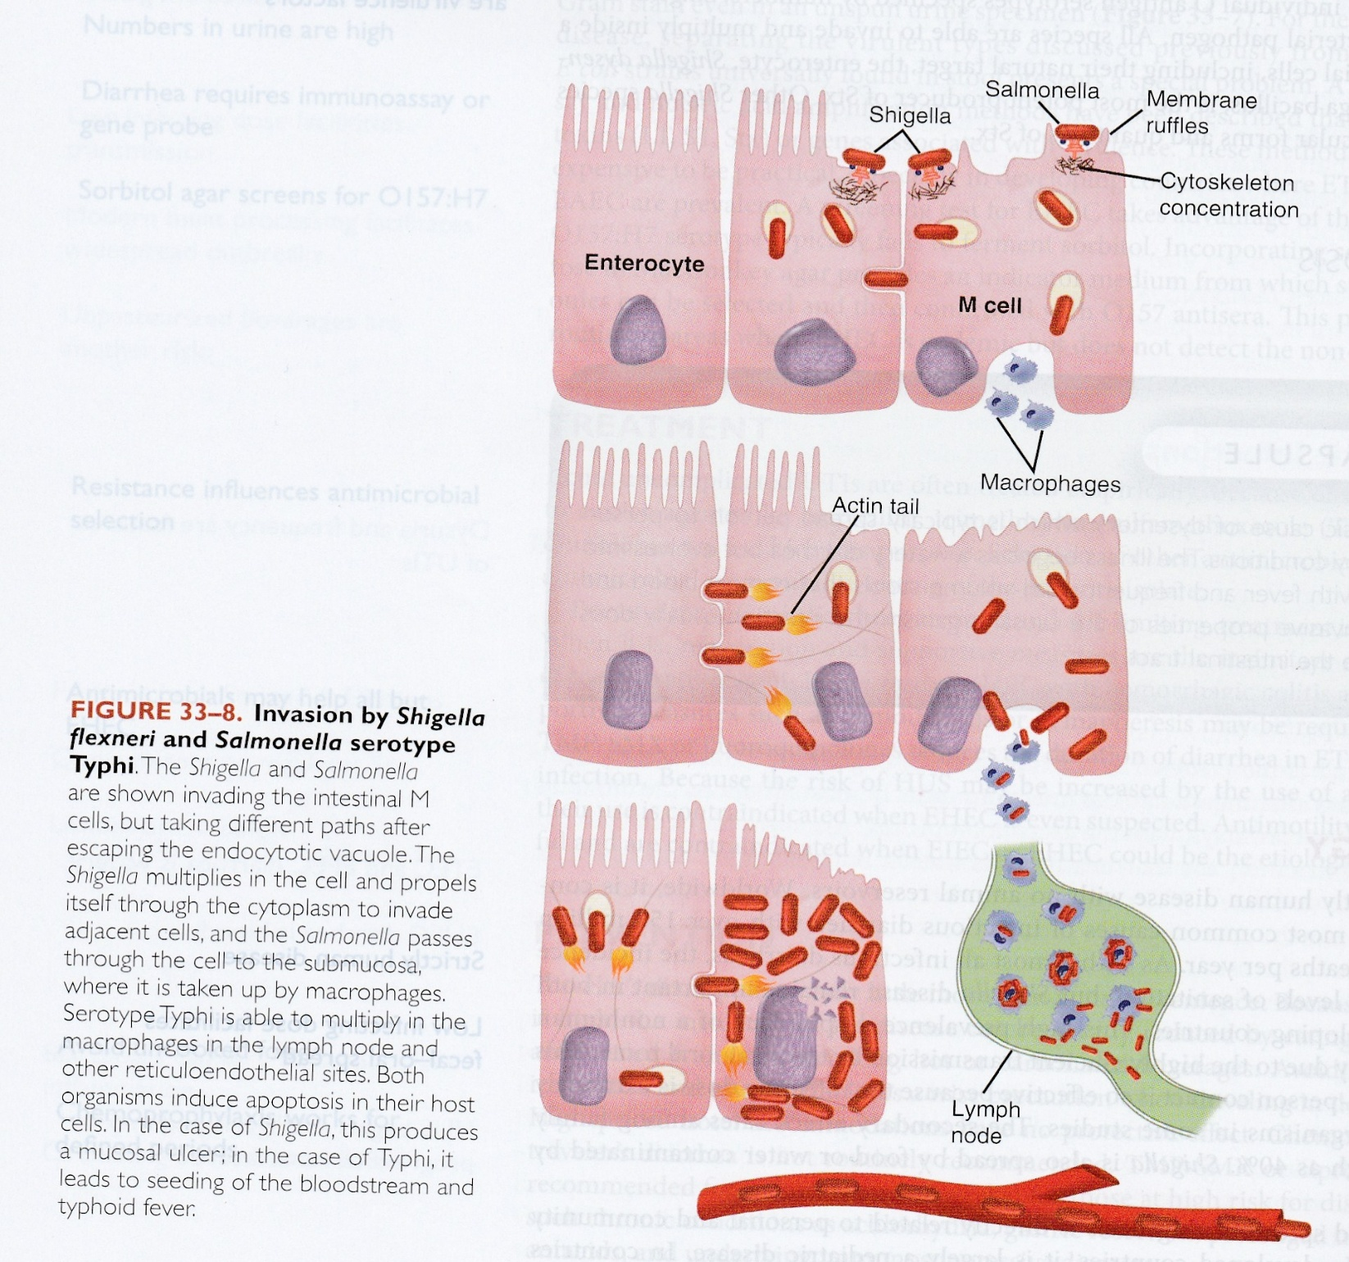

Slide 31
Shigellosis and epidemiology
Human disease, very infectious, pediatric
Transmission (Fecal-Oral route)
Sanitation (personal and community).
Watery diarrhea evolves to dysentery (stool
with blood and mucous)
Immunity: - Short-lived
- Against homologous serotype

Slide 32
Clinical manifestations
Acute inflammatory colitis /dysentery syndrome
Symptoms:
- Non-specific
- Tenesmus (needs to pass stool despite
empty colon)
- Dysentery (diarrhea with blood + mucous)
• Severity:
- S. dysentery type A1, Serious
- S. flexneri (Middle East), less severe
- S. sonnie (USA), mild

Slide 33
Laboratory diagnosis
Culture of stool or rectal swabs
A. Hektoen enteric (HE) agar:
- Green colonies, Non-Lactose
Fermenter (NLF); no black color
(vs Salmonella; see Figure)
B. Shigella-Salmonella (SS) agar:
- Pale (NLF) and have no black
color because non-H2S producer
(vs Salmonella)

Slide 34
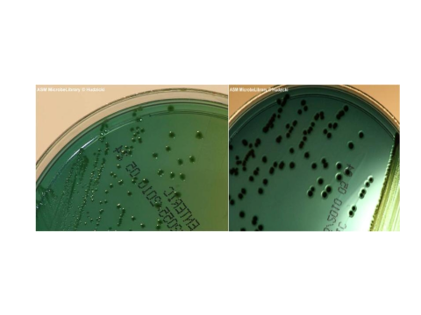
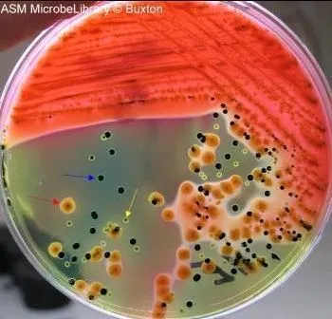
Hektoen Enteric Agar (HEA)
Left/ Shigella: Green colonies (non-lactose fermenter “NLF”; non-H2S producer)
Right/ : Black colonies due to H2S Production; Salmonella is also NLF
Lactose Fermenter: Red
Shigella
Salmonella

Slide 35
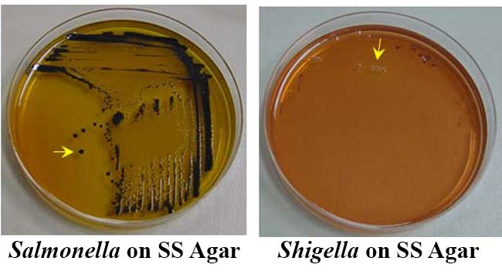
“Black colonies”
“Pale colonies”

Slide 36
Treatment
1. Antimicrobial agents:
- Aims: To shorten duration of illness
and period of excretion of organisms
- Selection of AB is based on C/S
- Agents:
A. Ampicillin (Resistance 5% - 50%)
B. Ciprofloxacin, ceftriaxone, or
azithromycin are alternatives
2. Anti-spasmodic contraindicated (for any
invasive diarrhea as a rule)

Slide 37
Prevention
1. Standard sanitation
2. Vaccination:
- Oral live attenuated vaccine (“?” no
licensed vaccines available yet)
- Mucosal IgA is to be produced after
the presumptive vaccine.

Slide 38

The TSI agar contains three sugars: lactose, sucrose, and glucose, as well as a pH-sensitive dye such as phenol red, sodium thiosulfate, ferrous sulfate, or ferrous ammonium sulfate.
Shigella: Due to the organism's fermentation of glucose in the absence of oxygen, an acid is produced, changing the dye from red to yellow early on in the experiment. However, after all glucose has been consumed by the Shigella bacteria, they will begin to use oxygen in their catabolic reaction, leading to the formation of alkaline end-products, thereby, changing the phenol-red dye back to a red color in the region of the slant. K : A (Alkaline slant, Acidic butt)
Salmonella: K:A:G (Bubbles/Cracks)
: H2S (Black)

Slide 39
Salmonella
• Family : Enterobacteriaceae
• Gram negative, motile, non-lactose fermenter
(NLF) bacilli, H2S-producer (Black colonies,
& positive TSI “triple sugar iron” or KIA)
Complex classification: Are of two species:
1. S. enterica (species) which has:
- Six (I-VI) subspecies, e.g. S. e. enterica
which infects human & are of > 2600 serovars
(serotypes). Based on O, H & Vi antigens
2. S. bongori (in animals “reptiles mainly”)

Slide 40
Classification of Salmonella
• Is based on: Kauffman-White classification:
Full name (example):
- Salmonella enterica subsp. Enterica
# Serovars of subsp. Enterica:
• Typhoidal: Typhi, Paratyphi- A, B, C
• Non-Typhoidal: Enteritidis, Typhimurium,
Choleraesuis, and others
Abbreviation:
- Salmonella Typhimurium.
- Salmonella Typhi.

Slide 41
Cont./… classification
• S. Typhimurium and S. Enteriditis serovars
cause food poisoning (gastroenteritis).
# S. Enteritidis is now more common & rapidly
transmitted from hen to hen and to man.
Antigens of Salmonella: O (somatic),
H (flagellar), K (capsular) and Vi (virulence)
Pili type-I (binds to mannose receptor, which is proportional to E. coli) for attachment.

Slide 42
Clinical manifestations
1. Gastroenteritis / Non-typhoidal
Salmonella serovars) food poisoning
(to be considered in this lecture)
2. Bacteraemia and metastatic infection
# caused by Salmonella Choleraesuis
(Non-typhoidal Salmonella serovar)
3. Enteric fevers (Typhoidal Salmonella)
# Salmonella Typhi & Paratyphi- A,B,C
(studied with the HLS module)
4. Asymptomatic carrier state

Slide 43
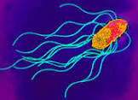

Salmonella: Bacilli
Salmonella: Peritrichous Flagella
Salmonella: Bacilli

Slide 44
Epidemiology of gastroenteritis
• Gastroenteritis (food poisoning) caused by
S. Typhimurium and S. Enteritidis (Non-invasive
Non-typhoidal Salmonella)
Doses of infecting bacteria (> 10⁵ )
Source: Poultry products
Usually occurs in institutes
Age of patients (< 5, 20-30, >70 Y)
Carriers, modern food delivery systems can also spread the organism.

Slide 45
Pathogenesis
Adherence to M cells and/or Enterocytes
Formation of surface ruffles (actin); which
function for pinocytosis (entrance)
Secretion system genes located in the Pathogenicity Islands (PAIs).
Phagocytosis (Neut. and Mac.); multiplication
Acute inflammatory process (in mucosa and
sub-mucosa)
Immunity: Humoral and cellular immunity.

Slide 46
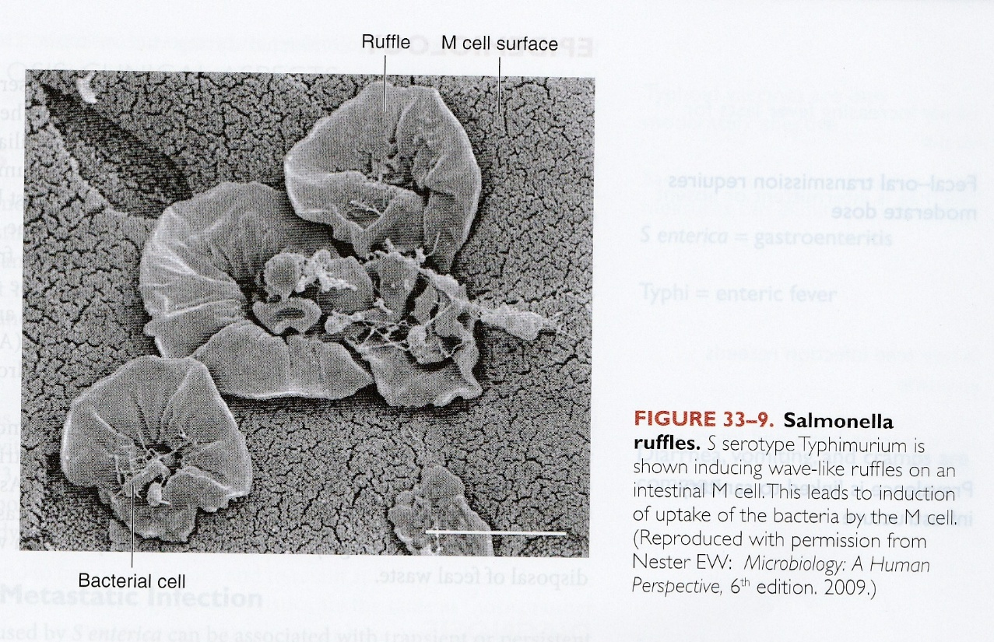

Slide 47
Clinical aspect of gastroenteritis
Course of the disease: 24 - 48 hours after ingestion of an infected food.
Manifestations: N/V, abdominal cramps and diarrhea (for 3-4 days that resolves spontaneously in 1 week). Stool may be loose (usually) to dysentery-like (rarely).
Diagnosis
- Clinical & laboratory (stool culture/ biochemical)
- Serological diagnosis is not useful

Slide 48
Treatment of Gastroenteritis
Fluid and electrolytes
Antimicrobials are of limited use (why?): Because increases duration and frequency of the carrier state.
Prevention
1. Sanitation and public health measures
2. Elimination of the carrier states (treatment by antibiotics and not to allow them to serve food or drink)

Slide 49


Slide 50
