Slide 1
Treatment of Inflammatory bowel disease (IBD) and irritable bowel syndrome (IBS)
Dr. Romany H Thabet

Slide 2
Differences between Crohn's disease and UC
Ulcerative colitis | Crohn's disease
Restricted to colon & rectum | affect any part of the GIT, from mouth to anus | Location
Continuous area of inflammation | Patchy areas of inflammation (Skip lesions) | Distribution
Shallow, mucosal | deep into tissues | Depth of inflammation
Toxic mega colon Colon cancer | Strictures, Obstruction Abscess, Fistula | Complications

Slide 3
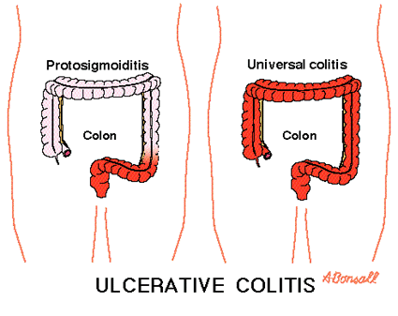
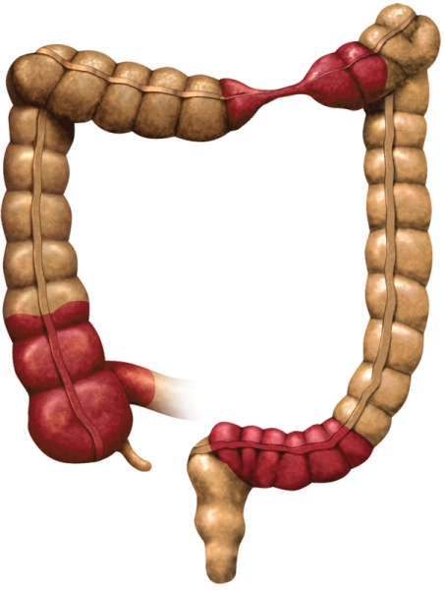
Ulcerative colitis
Crohn's disease

Slide 4
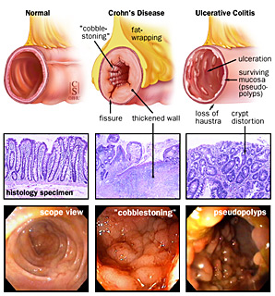
SUMMARY- Crohn’s Vs. UC (3)
Notes:
There are, however, important pathological and clinical differences that distinguish these inflammatory disease processes. Clinically, Crohn’s disease tends to present more frequently with abdominal pain and perianal disease, whereas ulcerative colitis is more often characterized by gastrointestinal bleeding. Cobblestoning mucosa and aphthous or linear ulcers characterize the endoscopic appearance of Crohn’s disease. Ulcerative colitis presents with diffuse continuous involvement of the mucosa. Radiographic studies of patients with Crohn’s disease characteristically show fistulas, asymmetry and ileal involvement. In contrast, radiographic studies of patients with ulcerative colitis show continuous disease without fistulizing or ileal disease (Figure 3).
Pathologically, Crohn's disease features mucosal discontinuity, transmural involvement and granulomas. In contrast, ulcerative colitis does not. Crypt abscesses and granulomas are present only in Crohn's disease. Figure 4 compares the appearance of the colon, the histology, and endoscopic views of normal, Crohn’s disease, and ulcerative colitis patients.

Slide 5
Symptoms and complications
Symptoms
Vomiting
Abdominal pain
Diarrhea
Rectal bleeding.
Weight loss
Complications
Anemia
Abdominal obstruction (Crohn’s disease)
Mega colon
Colon cancer

Slide 6
Treatment of IBD
There is no cure for IBDs but treatment options are restricted to controlling symptoms, maintaining remission, and preventing relapse.

Slide 7
Treatment of IBD
5-amino salicylic acid compounds (5-ASA).
Glucocorticoids
Immunomodulators
Biological therapy (TNF-α inhibitors).
Surgery in severe condition

Slide 8
5-amino salicylic acid compounds (5-ASA)
Aminosalicylates
Topical anti-inflammatory drugs
5-ASA itself is absorbed from small intestine.
Different formulations are used to overcome rapid absorption of 5-ASA from the proximal small intestine
Azo compounds
Mesalamine compounds

Slide 9
Azo compounds
Compounds that contain 5-ASA and connected by azo bond (N=N) to sulfapyridine moiety, another molecule of 5-ASA or to inert compound.
Sulfasalazine: 5-ASA + sulphapyridine
Olsalazine: 5-ASA + 5-ASA
Balsalazide: 5-ASA + inert carrier

Slide 10
Azo compounds
Azo structure reduces absorption in small intestine
In the terminal ileum and colon, bacterial flora release azoreductase that cleaves the azo bond (N=N) and releases 5-ASA.

Slide 11
Sulfasalazine (Azulfidine)
Pro-drug
A combination of 5-ASA and sulfapyridine
Is given orally.
Little amount is absorbed (10%)
In the terminal ileum and colon, sulfasalazine is broken by azoreductase into:
5-ASA (not absorbed, active moiety)
Sulphapyridine (absorbed, side effects)

Slide 12
Mechanism of action of sulfasalazine
5-ASA has anti-inflammatory action due to:
inhibition of prostaglandins and leukotrienes.
decrease neutrophil chemotaxis.
Antioxidant activity (scavenging free radical production).

Slide 13
Side effects of sulfasalazine
Crystalluria.
Bone marrow depression
Megaloblastic anemia.
Folic acid deficiency (should be provided).
Impairment of male fertility (Oligospermia).
Interstitial nephritis due to 5-ASA.

Slide 14
Mesalamine compounds
Formulations designed to deliver 5-ASA in terminal small bowel & large colon
Mesalamine formulations are
Sulfa free
well tolerated
have less side effects
useful in patient sensitive or allergic to sulfa drugs.

Slide 15
Mesalamine compounds
Oral formulations
Asacol: 5-ASA coated in pH-sensitive resin that
dissolved at pH 7 (controlled release).
Pentasa: time-release microgranules that release
5-ASA throughout the small intestine (delayed
release).
Rectal formulations
Canasa (suppositories)
Rowasa (enema)

Slide 16
Clinical uses of 5-amino salicylic acid compounds
Induction and maintenance of remission
in mild to moderate ulcerative colitis & Crohn’s disease (First line of treatment).
Rheumatoid arthritis (Sulfasalazine only)
Rectal formulations are used in active distal
UC ulcerative proctitis and proctosigmoiditis.

Slide 17
Glucocorticoids
Prednisone, prednisolone (orally)
Higher rate of absorption
More adverse effects compared to rectal administration
Hydrocortisone (enema or suppository):
Less absorption rate than oral.
Minimal side effects & Maximum tissue effects.

Slide 18
Budesonide:
A potent synthetic compound
Given orally (controlled release tablets) so release drug in ileum and colon.
Low oral bioavailability (10%).
Is subject to first pass metabolism
Used in treatment of active forms of moderate to severe UC & Crohn’s disease involving ileum and proximal colon.

Slide 19
Mechanism of action of glucocorticoids
Inhibits phospholipase A2
Inhibits gene transcription of NO synthase, cyclooxygenase-2 (COX-2)
Inhibit production of inflammatory cytokines
Decrease antigen-antibody reaction

Slide 20
Uses of glucocorticoids
Induction of remission in moderate & severe active IBD.
Not used for maintaining remission.
Oral glucocorticoids is commonly used in active condition.
Rectal glucocorticoids are preferred in IBD involving rectum or sigmoid colon

Slide 21
Uses of glucocorticoids
Asthma
Rheumatoid arthritis
immunosuppressive drug for organ transplants
Antiemetics during cancer chemotherapy

Slide 22
Immunomodulators
Are used to induce remission in IBD in active,
severe conditions or steroid resistant patients.
Immunomodulators include:
Methotrexate
Purine analogs:
(azathioprine & 6-mercaptopurine).

Slide 23
Purine analogs
(azathioprine & 6-mercaptopurine)
Azathioprine
is a pro-drug of 6-mercaptopurine
Inhibits purine synthesis
Induction and maintenance of remission
in IBD

Slide 24
Adverse effects:
Bone marrow depression: leucopenia, thrombocytopenia.
Gastrointestinal toxicity.
Hepatic dysfunction.
Complete blood count & liver function tests are required in all patients

Slide 25
Methotrexate
a folic acid antagonist
Inhibits dihydrofolate reductase required for folic acid activation
Orally, S.C., I.M.
Used to induce and maintain remission in inflammatory bowel diseases.
Rheumatoid arthritis
Cancer

Slide 27
Adverse effects of methotrexate
Bone marrow depression
Megaloblastic anemia

Slide 28
Monoclonal antibodies used in IBD (TNF-α inhibitors)
Infliximab
Adalimumab
Certolizumab

Slide 29
Infliximab
a chimeric mouse-human monoclonal antibody
25% murine – 75% human.
TNF-α inhibitors
Inhibits soluble or membrane –bound TNF-α located on activated T lymphocytes
Given intravenously as infusion (5-10 mg/kg).
has long half life (8-10 days)
2 weeks to give clinical response

Slide 30
Uses of infliximab
In moderate to severe active Crohn’s disease and ulcerative colitis
Patients not responding to immunomodulators or glucocorticoids.
Treatment of rheumatoid arthritis
Psoriasis

Slide 31
Side effects
Acute or early adverse infusion reactions (Allergic reactions or anaphylaxis in 10% of patients).
Delayed infusion reaction (serum sickness-like reaction, in 5% of patients).
Pretreatment with diphenhydramine, acetaminophen, corticosteroids is recommended.

Slide 32
Side effects (Cont.)
Infection complication (Latent tuberculosis, sepsis, hepatitis B).
Loss of response to infliximab over time due to the development of antibodies to infliximab
Severe hepatic failure.
Rare risk of lymphoma.

Slide 33
Adalimumab (HUMIRA)
Fully humanized IgG antibody to TNF-α
Adalimumab is TNFα inhibitor
It binds to TNFα, preventing it from activating TNF receptors
Has an advantage that it is given by subcutaneous injection
is approved for treatment of, moderate to severe Crohn’s disease, rheumatoid arthritis, psoriasis.

Slide 34
Summary for drugs used in IBD
5-aminosalicylic acid compounds
Azo compounds:
sulfasalazine, olsalazine, balsalazide
Mesalamines:
Pentasa, Asacol, Rowasa, Canasa
Glucocorticoids
prednisone, prednisolone, hydrocortisone, budesonide
Immunomodulators
Methotrexate
Purine analogues:
Azathioprine &6-mercaptopurine
TNF-alpha inhibitors (monoclonal antibodies)
Infliximab – Adalimumab - Cetrolizumab

Slide 35
Ulcerative Colitis- Management
a) Topical aminosalicylate alone (suppository or enema
b) ?ADD PO aminosalicylate to a topical aminosalicylate OR
c) consider an PO aminosalicylate alone
a) PO Aminosalicylate - High induction dose of an
b) ?ADD topical Aminosalicylate OR PO beclometasone dipropionate
If no improvement 72 hrs despite IV Hydrocortisone OR
Symptoms worsen to pancolitis:
a) ADD IV Ciclosporin to IV steroids
Notes:
Aminosalicylates- in 1977 S Kalsi demonstrated that 5-aminosalicylic acid (5-ASA) and mesalazine was the therapeutic compound in sulfasalazine
Corticosteriods-
Immune supperessive drugs- azathioprine, methotrixate, tacrolimus
Biologic- Infliximab
Treatment of acute UC- NICE
1) mild to moderate first presentation or inflammatory exacerbation of proctitis or proctosigmoiditis:
a) offer a topical aminosalicylate[1] alone (suppository or enema
b) consider adding an oral aminosalicylate[2] to a topical aminosalicylate or
c) consider an oral aminosalicylate[2] alone 2) mild to moderate first presentation or inflammatory exacerbation of left-sided or extensive ulcerative colitis: a) offer a high induction dose of an oral aminosalicylate b) consider adding a topical aminosalicylate or oral beclometasone dipropionate 3) ACUTE SEVERE COLITIS: Consider adding intravenous ciclosporin[6] to intravenous corticosteroids or consider surgery
for people:
-who have little or no improvement within 72 hours of starting intravenous
corticosteroids or
-whose symptoms worsen at any time despite corticosteroid treatment

Slide 37
Irritable Bowel Syndrome
Psychosocial
Factors
Biopsychosocial Disorder
Psychosocial
Motility
Sensory
? Infectious
Visceral hypersensitivity
Increased visceral afferent response to normal as well as noxious stimuli
Mediators include 5-HT, bradykinin, tachykinins, CGRP, and neurotropins
Vagal nuclei
Sympathetic
S2,3,4
Altered
Motility
Altered
Sensation
Notes:
Irritable Bowel Syndrome Slide 4
IBS as regarded as a biopsychosocial disorder in which 3 main etiopathogenetic factors are important: (1) psychosocial disturbance, (2) altered motility, (3) heightened sensation. There is some evidence that an infectious process may also be important in the development of IBS. Thus, about 1/3 of patients with IBS have a preceding episode of gastroenteritis which is presumed to be infectious. The overall prevalence in the U.S. is around 10%, and preliminary evidence suggests that the incidence (that is, the number of new cases per year) is 1-2%. IBS disturbs the quality of life and social function, and results in considerable healthcare utilization.
References
Camilleri M, Choi M-G: Irritable bowel syndrome. Aliment Pharmacol Ther 11:3-15, 1997
Drossman DA, Whitehead WE, Camilleri M: Irritable bowel syndrome: a technical review for practice guidelines. Gastroenterology 112:2120-2137, 1997
Drossman DA, Corazziari E, Talley NJ, Thompson WG, Whitehead WE, et al. Rome II: A multinational consensus document on functional gastrointestinal disorders. Gut 45(Suppl. II):II1-II81, 1999
Camilleri M, Northcutt AR, Kong S, Dukes GE, McSorley D, Mangel AW: Efficacy and safety of alosetron in women with irritable bowel syndrome: a randomised, placebo-controlled trial. Lancet 355:1035-1040, 2000
Prather CM, Camilleri M, Zinsmeister AR, McKinzie S, Thomforde GM: Tegaserod accelerates orocecal transit in patients with constipation-predominant irritable bowel syndrome. Gastroenterology 118:463-468, 2000
Bouras EP, Camilleri M, Burton DD, Thomforde G, McKinzie S, Zinsmeister AR: Prucalopride accelerates gastrointestinal and colonic transit in patients with constipation without a rectal evacuation disorder. Gastroenterology

Slide 38
IBS
Hallmark symptoms of IBS
Affects predominantly females (~70% of sufferers) Chronic or recurrent GI symptoms
– lower abdominal pain/discomfort
– altered bowel function (urgency, altered stool consistency, altered stool frequency, incomplete evacuation)
– bloating
Not explained by identifiable structural or biochemical abnormalities

Slide 39
Currently available Rx treatments for IBS
Dicyclomine HCl
Hyoscyamine sulfate (± other anticholinergics/sedatives)
Belladonna and phenobarbital
Clidinium bromide with chlordiazepoxide
^{Tegaserod} (^{serotinin 4 receptor agonist)}
^{Alosetron} (5-HT3 antagonist )

Slide 40
Multiple medications needed to treat multiple symptoms
IBS – Management
Lower abdominal pain
Bloating
Altered stool form
Altered stool passage
Urgency
Anticholinergics X X
Tricyclic antidepressants X and SSRIs
Antidiarrheals X X X
Bulking agents X X X
Laxatives X X
Notes:
Since IBS generally presents as a complex of symptoms, management options traditionally have included specific agents for specific symptoms. For example, anticholinergics have been useful in cases of severe pain. When constipation is the predominant symptom, fiber or psyllium products can be beneficial. When diarrhea is the predominant symptom, antidiarrheals are used to decrease intestinal transit, enhance water and ion absorption, and strengthen rectal sphincter tone.
Reference:
Drossman, DA. Review article: an integrated approach to the irritable bowel syndrome. Aliment Pharmacol Ther. 1999:13(suppl 2):3-14.

Slide 41
Tegaserod (serotinin 4 receptor agonist)
Approved for constipation predominant IBS
1 pill given twice daily
Improvement of symptoms in women but not men
Use up to 12 weeks
Mild side effects: diarrhea the most prominent side effect

