Slide 1
Antidiarrheal Agents
Dr.Romany H Thabet, PhD

Slide 2
Diarrhea
Abnormal frequent passage of loose stool (3 or more loose watery stools in 24 hours)
or
Abnormal passage of stools with increased frequency, fluidity, and weight, or with increased stool water excretion

Slide 3
Diarrhea (cont'd)
Acute diarrhea
Sudden onset in a previously healthy person
less than 3 days (self limited, infection)
Self-limiting
Resolves without sequelae

Slide 4
Diarrhea (cont'd)
Chronic diarrhea
longer than 14 days
Associated with recurring passage of diarrheal stools, fever, loss of appetite, nausea, vomiting, weight loss, and chronic weakness

Slide 5
Pathophysiology of Diarrhea
Decreased electrolyte and water absorption
Increase secretion of intestinal mucosa
Irritation of mucosal lining ( by drugs or infection)
Stimulation of parasympathetic nervous system
Antibiotics that create an imbalance in normal intestinal flora

Slide 6
Goals of treatment of Diarrhea
Manage the diet
Control the loss of fluids, electrolyte
Identify and treat the cause
Provide symptomatic relief
Sometimes diarrhea is a defense mechanism against pathogen
Treatment:
Diet management
Treatment of fluid depletion, shock and acidosis
Drug therapy

Slide 7
Diet management & Rehydration
Diet Management
Avoid dairy product
Stop solid hard food for 24 hours
Continue soft digestible food
Rehydration
Not to stop diarrhea
To restore and maintain hydration
Maintain electrolyte and PH balance

Slide 8
Rehydration
Oral rehydration (ORS)
Isotonic
contain K+ , Na+ , Cl-, Citrate and glucose
Use in mild cases of dehydration (loss 5% of BW)
Drink every ½ -1 hour interval
5 ml/kg/hr in children
IV Rehydration
Volume = 10% of BW should be infused
In sever dehydration, vomiting or very weak
Include : 1 L solution of NaCl, KCl, NaHCo3 or 5% glucose

Slide 9
Rationale for antibiotic therapy
Limited rule in the treatment of diarrhea ????
Two types of diarrhea are caused by pathogens:
Watery diarrhea without mucous with no fever :rota virus
ORS is the therapy not antimicrobial
Watery diarrhea with mucous or / and blood : shigela , C. difficile, E.Histolytica, E. Coli:
This case need antimicrobial

Slide 10
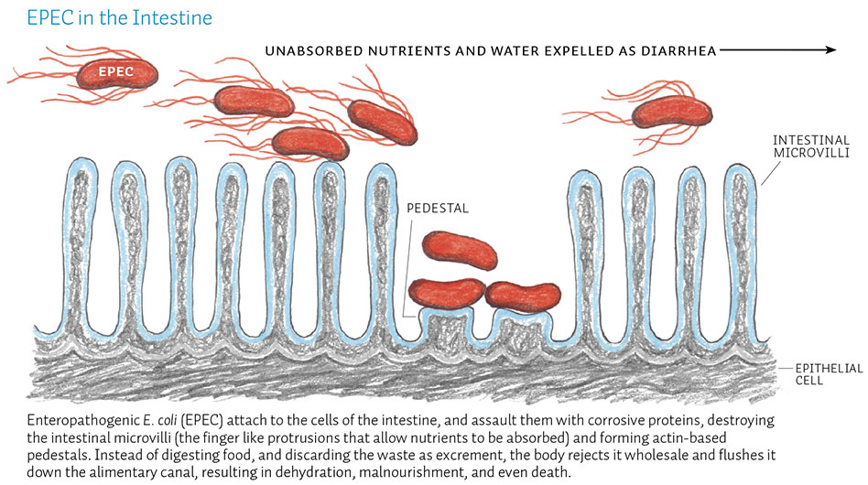
Rationale for antibiotic therapy
Salmonella :
ciprofloxacin , azithromycin or I.V Ceftriaxone
Cholera: Tetracycline and cotrimoxazole
Clostridium difficile: Metronidazole and vancomycin
Ameabiasis : Metronidazole or Diloxinide furoate
Shigella enteritis: :
Bloody and mucus stool
Treated with fluoroquinolone: ciprofloxacin or norfloxacin, Cotrimoxazole is alternative
Enteropathogenic Escherichia coli (EPEC): Cotrimoxazole or fluoroquinolone

Slide 11
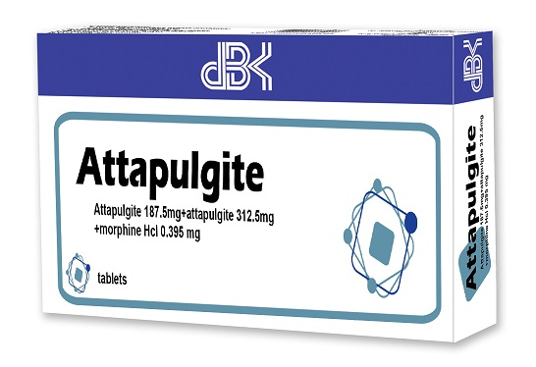
Antidiarrheals:Adsorbents
Coat the walls of the GI tract
Bind to the causative bacteria or toxin, which is then eliminated through the stool
less effective than antimotility agents and they can interfere with the absorption of other drugs
Examples: bismuth subsalicylate (Pepto-Bismol), kaolin-pectin, activated charcoal, attapulgite (Kaopectate)

Slide 12
Antidiarrheals: Antisecretory
Octreotide
It is a synthetic somatostatin analog
Highly effective in relieving diarrhea of Carcinoid syndrome
Given SC or in an IV infusion
Bismuth Subsalicylate
used for traveler’s diarrhea
MOA: decreases chloride and fluid secretion in the bowel.
Its action may be due to its salicylate component as well as its coating action
Suspension: 60 ml 6 hourly

Slide 13
Antidiarrheals:Anticholinergics
Decrease intestinal muscle tone and peristalsis of GI tract
Result: slowing the movement of fecal matter through the GI tract, facilitate water absorption
Examples: belladonna alkaloids (Donnatal), atropine

Slide 14
Antidiarrheals: Antimotility
Opiates
Decrease bowel motility and relieve rectal spasms
Decrease transit time through the bowel, allowing more time for water and electrolytes to be absorbed
Ex: paregoric (Anhydrous Morphine), opium tincture, codeine, loperamide ,Diphenoxylate + Atropine (Lomotil ) 5 mg first followed by 2.5 mg every 6 hours

Slide 15
Antidiarrheals: Antimotility
The utility of antimotility drugs in diarrhea is limited to :
non-infective diarrhea
Traveler diarrhea
Idiopathic diarrhea in AIDS
In chronic diarrhea of mild IBD at low doses
antimotility drugs is contraindicated in:
Acute infective diarrhea ?? Because they delay clearance of the pathogen from intestine, if shigela, EC, EH present the use of antimoitility increase risk of systemic invasion.
Sever IBD

Slide 16
Adverse effects of antimotility drugs
Most frequent adverse effect is constipation
dizziness, blurred vision, nausea, and rash
Abdominal cramps and distension
Loperamide is contraindicated in children < 4 years
Diphenoxylate is contraindicated in children < 6 years
Overdose toxicity:
Respiratory depression
paralytic ileus in children
Notes:
Teach patient to take medications 1 hour before or 2 hours after other medications. Just to be safe don’t take with any other medicaitons.

Slide 17
Antidiarrheals:Intestinal flora modifiers
Bacterial cultures of Lactobacillus organisms work by:
Supplying missing bacteria to the GI tract
Suppressing the growth of diarrhea-causing bacteria
Example: L. acidophilus (Lactinex)

