Slide 1
ANTIEMETICS
Dr. Romany H Thabet, PhD

Slide 2
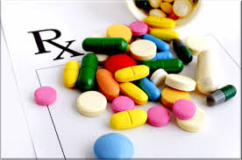
What is an Antiemetic? Emesis: The involuntary expulsion of the stomach’s contents through the mouth. It serves as a protective function to rid the body of harmful substances that have been ingested, rather than allowing them to be retained and absorbed by the intestine. An antiemetic is a drug that completely inhibits or reduces vomiting and nausea.

Slide 3
Common Uses of Antiemetics
Used before and after surgery to prevent nausea after administration of anesthesia
Motion sickness
Nausea associated with Chemotherapy and Chemoradiation patients
Prevent dehydration with gastroenteritis; more harmful in younger and older age groups

Slide 4
Different Causes for Nausea and Vomiting Different antiemetics treat different types of nausea
-Chemotherapy: Chemotherapeutic agents are cytotoxic drugs that circulate the blood commonly causing nausea and emesis.
-Motion Sickness: An imbalance that results in conflicting information from the visual and vestibular systems. Motion sickness is due to labyrinth stimulation. The labyrinth is a part of the inner ear involved in balance and perception of movement.
-Gastroenteritis: Inflammation and irritation of the GI tract
-Sensory Information: Various stimuli (fears, smells, anticipations, pain) cause nausea.
-Toxins or irritants that will stimulate emesis and nausea as a defense.

Slide 5
What is the Physiological Process of Emesis?
Chemoreceptor Trigger Zone- Located in the medulla of the brain. It has a defensive blood-brain barrier for detecting circulating toxins in the blood and cerebrospinal fluid (CSF), and is sensitive to a number of circulating emetic agents, including morphine. When activated, the CTZ does not initiate vomiting itself, but relays stimuli to the integrative vomiting center which produces the actual act of emesis.
Vomiting Center- Coordinates activities of the nearby neural structures to produce a complex patterned response, resulting in the processing and action of the vomiting reflex. The center is located in the medulla. The motor component is controlled by both somatic and autonomic systems, meaning that both voluntary and involuntary systems are involved in the process.
Three primary pathways are involved in the stimulation of the vomiting center in the medulla oblongata that directly mediates nausea and vomiting:
Vestibular Stimulation (Release Histamine, Acetylcholine)
Visceral Stimulation (Release Dopamine, Serotonin)
Chemoreceptor Trigger Zone Stimulation (Release Dopamine, Serotonin)

Slide 6
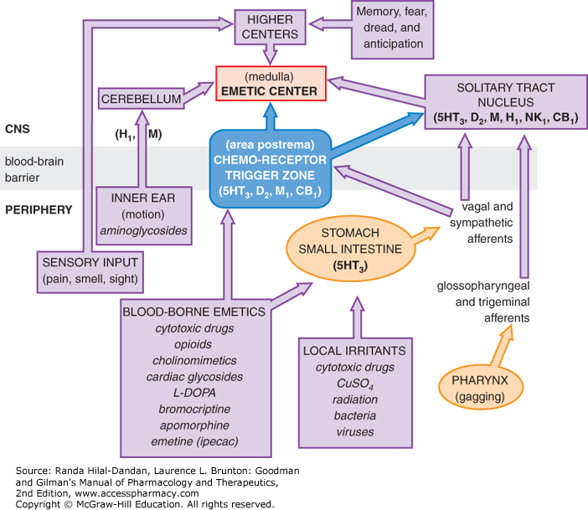
NEUROTRANSMITTERS Involved in Emesis:
Acetylcholine
Histamine 1
Dopamine 2
Serotonin 3
Antiemetic medications target these receptors and inhibit/reduce vomiting.

Slide 7
Acetylcholine (Cholinergic) Antagonists -Block muscarinic receptors and inhibit cholinergic transmission from the vestibular nuclei to the vomiting center. These medications are used mainly to treat and prevent motion sickness.
Scopolamine (Hyoscine) Treats motion sickness and post-operative nausea and vomiting.
Side Effects: Dry mouth, dizziness, blurry vision

Slide 8
Histamine Antagonists
At the vestibular system, which sends information to the brain via CN VIII (vestibulocochlear nerve), antihistamines block emetic H1-receptors to prevent motion sickness.
Treat nausea caused by motion sickness and some morning sickness caused during pregnancy.
The only FDA-approved drug for treating nausea and vomiting in pregnancy is doxylamine/pyridoxine
Cyclizine
Dimenhydrinate
Diphenhydramine
Side Effects: Drowsiness, dry mouth, constipation

Slide 9
Serotonin Antagonists -Inhibit the action of serotonin at the 5-HT3 receptor. These receptors are located in both the peripheral and central nervous systems. These medications are used mostly to treat chemotherapy-induced nausea and vomiting.
Dolasetron
Palonosetron
Ondansetron (Zofran)
Granisetron
Side Effects: Headaches, constipation, dizziness

Slide 10
Dopamine Antagonists
Minimize the effect of dopamine at the D2 receptor in the Chemoreceptor Trigger Zone. This limits the emetic input to the vomiting center. Many dopamine receptor antagonists are antipsychotic medications. Under long-term use, side effects can include muscle and movement problems throughout the body.
Metoclopramide
Prochlorperazine Trimethobenzamide
Domperidone (Motilium)
Side Effects: Drowsiness, fatigue, constipation, muscle spasms

Slide 11
NK1 receptor blocker
Aprepitant substance P antagonist
Mainly for Chemotherapy induced vomiting (Cisplatin)
Dose (125 mg + 80 mg+80 mg) for 3 days combined with ondansetron + dexamethasone
Can be used for PONV 40 mg single dose
Fosaprepitant: prodrug given only parenterally

Slide 12
Over The Counter Options
Emetrol: (Fructose, Dextrose, and Phosphoric Acid)
Pepto-Bismol: (Bismuth-Subsalicylate)

Slide 13
Natural Antiemetic Options
Ginger: Tea or Ale
Peppermint
Chamomile Tea
Lemon
Cinnamon
Baking Soda
“Let food be thy medicine and medicine be thy food.”

Slide 14
Antiemetics are drugs used to inhibit dopamine, serotonin, histamine, and acetylcholine receptors in signaling the chemoreceptor trigger zone and vomiting center.
Vomiting center is activated by visceral, vestibular, or chemoreceptor trigger zone stimulation.
Antihistamines and anticholinergics aim to treat motion sickness related nausea.
Dopamine and Serotonin antagonists aim to treat cytotoxic drug and post-operative nausea.

