Slide 1
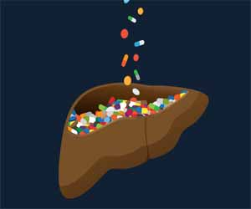
Drug-induced Hepatotoxicity
Dr. Romany H Thabet

Slide 4
Drug-induced Liver Disease (DILD)
Predictable
Dose related
Intrinsically hepatotoxic drugs
Acute (hours)
Injury pattern is usually necrosis
Clinically → Fulminant (Acute Hepatitis)
Example: Acetaminophine
Unpredictable
Not dose related
Rare 0.01-1.0 %
Weeks to months after ingestion of drug
Idiosyncratic
Immune mediated idiosyncrasy (Hypersensitivity)
Rash
Fever
Arthragia
Eosinophilia
Example: Phenytoin, Sulfonamides, Valproate
Metabolic idiosyncrasy (Production of toxic metabolites)
Example: INH, Ketoconazole, and Diclofenac

Slide 5
Diagnosis of (DILD)
High index of suspicion
Abnormalities in hepatic associated enzymes
Hepatitis like symptoms
Jaundice
Drug history
Dose
Duration of therapy
Time between initiating therapy and the development of hepatic injury (latency)
Exclusion of other causes of liver diseases
Hepatitis B
Hepatitis C
Alcoholic liver diseases
Non alcoholic fatty liver diseases
Hemochromatosis

Slide 6
Diagnosis of (DILD)
Most cases of acute DILD occurring within 1 week to 3 months of exposure
Positive response to discontinuing the agent (Dechallenge)
In acute hepatocelluler injury
50% reduction in hepatic –associated enzymes after 2 weeks
Return to normal by 4 weeks
In cholestatic injury
May have prolonged recovery time

Slide 7
Risk Factors For Susceptibility to DILD
Methotrexate
Alcohol
Obesity
D.M
Chronic hepatitis
INH
HBV,HCV,HIV
Alcohol
Older age
Female
Acetaminophen
Alcohol
Fasting
INH
Valproate
Young age
Anticonvulsants
Diclofenac
Female
Osteoarthritis

Slide 10
Paracetamol-induced hepatotoxicity

Slide 11
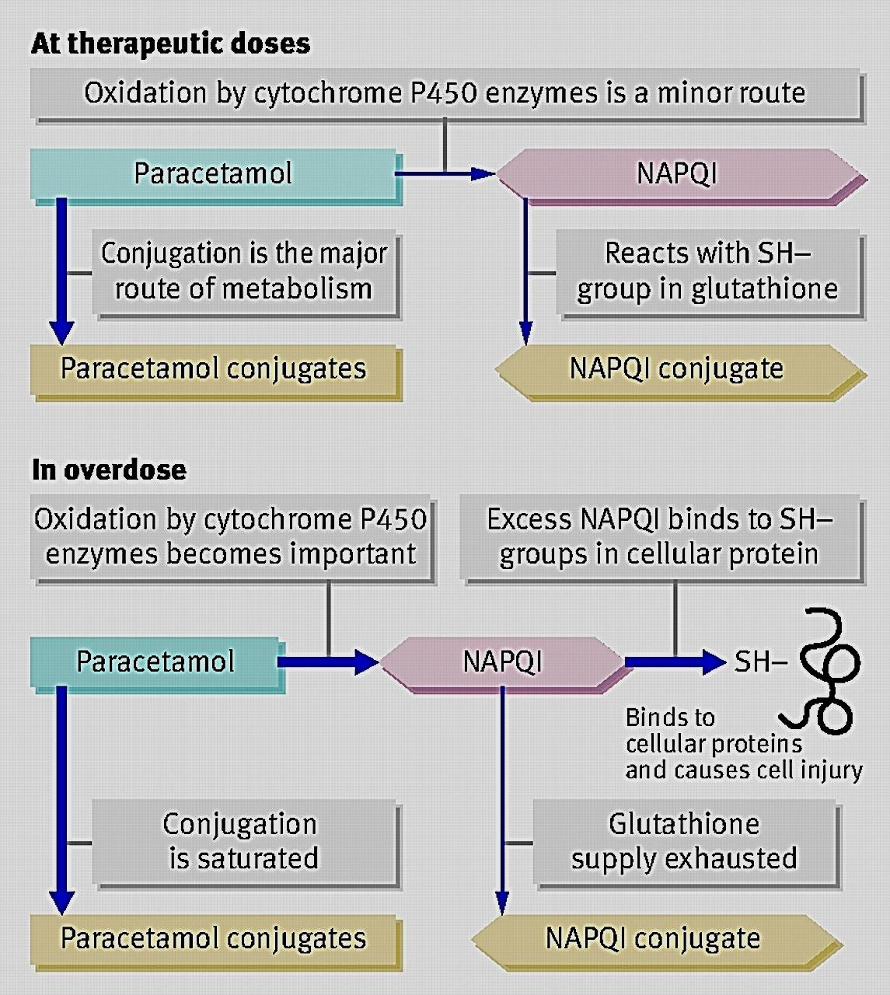
Paracetamol-induced hepatotoxicity

Slide 12
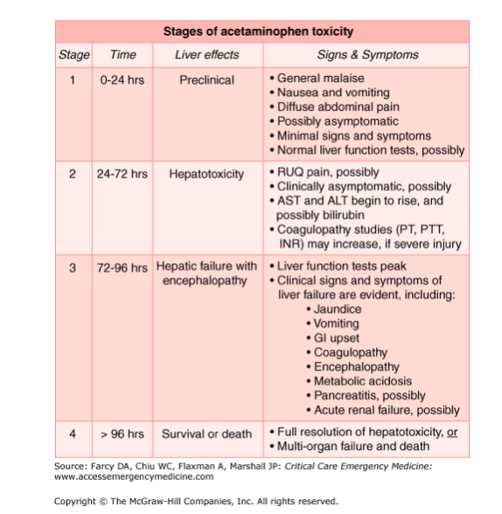
Paracetamol-induced hepatotoxicity

Slide 13
Paracetamol-induced hepatotoxicity

