Slide 1
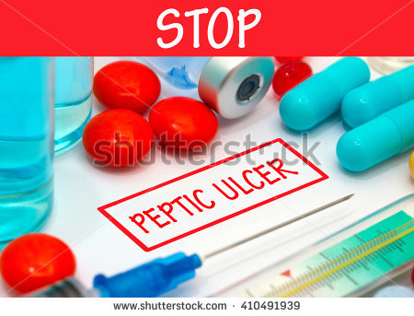
Treatment of Peptic Ulcer
Dr. Romany H Thabet

Slide 2
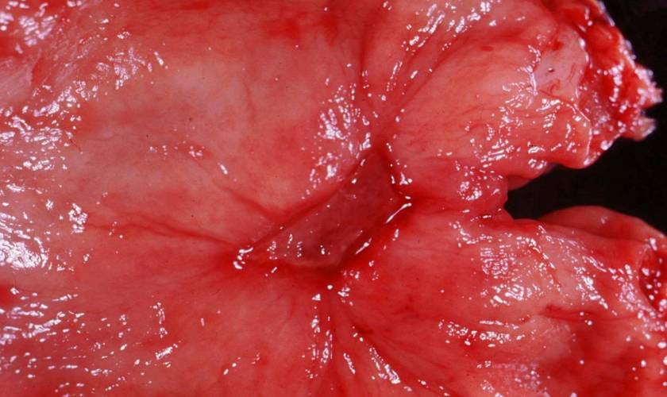
Peptic Ulcer
A breach in the mucosa of the alimentary tract, which extends through the muscularis mucosa into the submucosa or deeper.

Slide 3
Pathogenesis of Ulcers
Aggressive Factors
Acid, pepsin
Bile salts
Drugs (NSAIDs)
H. Pylori
Tumors (rare)
Defensive Factors
Mucus, bicarbonate layer
Blood flow, cell renewal
Prostaglandins
Free radical scavengers

Slide 4
Therapy is directed at enhancing host defense or eliminating aggressive factors; i.e., H. pylori.
Aggressive factors
Mucosal defense
Acid
HP
NSAIDs
Lifestyle
Prevent/treat ulcer
Acid suppressants
Lifestyle advice

Slide 5
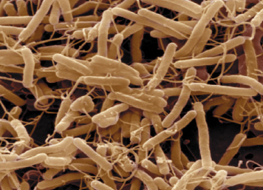
Helicobacter pylori
Gram negative bacilli
Do not invade cells – only mucous
Break down mucosal defense
Chronic Superficial inflammation
Notes:
Helicobacter pylori in GERD
In general, infection with the bacterium H. pylori is detrimental to health. This bacterium has been implicated in a variety of gastric diseases, including chronic active gastritis, peptic ulcer disease, ulcer bleeding, mucosa-associated lymphoid tissue (MALT) lymphoma and distal gastric cancer.
In the context of GERD, H. pylori may have certain beneficial effects: protection against reflux esophagitis, protection against serious complications of GERD and improvement of the efficacy of PPI therapy. These effects are described in more detail on the slides that follow.
It is important to note that the relationship between H. pylori and GERD is complex and not yet fully understood. This is why the titles of the following slides end with a question mark.

Slide 6
Helicobacter pylori
Most common infection in the world (20%)
Positive in 70-100% of PUD patients.
Treated by 1-2 weeks antimicrobials:
1. Metronidazole
2. Amoxycillin
3. Clarithromycin
4. Tetracyclin
5. Bismuth salts
Eradication of the infection usually results in long-term remission of the ulcer.
Notes:
Lifestyle measures
Lifestyle measures that are sometimes recommended to GERD patients include avoiding factors that are known to aggravate GERD symptoms, such as certain foods, avoiding lying down after meals, raising the head of the bed to reduce nocturnal reflux, and losing weight.

Slide 7
Aim of therapy
Relief pain
Promote healing
Prevent recurrence
Prevent complications
Documented eradication of H. pylori in patients with PUD is associated with a dramatic decrease in ulcer recurrence to 4% (as compared to 59%) in GU patients and 6% (compared to 67%) in DU patients.

Slide 8
Treatment approaches include:
Eradicating the H. pylori infection,
Reducing secretion of gastric acid with the use of PPIs or H 2 -receptor antagonists, and/or
Providing agents that protect the gastric mucosa from damage, such as misoprostol and sucralfate. [Note: If patients are unable to tolerate the above therapies, neutralizing gastric acid with nonabsorbable antacids is an option].
Figure 28.1 summarizes agents that are effective in treating peptic ulcer disease.

Slide 10
Lifestyle measures
Stop smoking
Avoid spicy foods, caffeine
Avoid Aspirin and other NSAIDs
Manage stress
Avoid alcohol
Notes:
Lifestyle measures
Lifestyle measures that are sometimes recommended to GERD patients include avoiding factors that are known to aggravate GERD symptoms, such as certain foods, avoiding lying down after meals, raising the head of the bed to reduce nocturnal reflux, and losing weight.

Slide 11
Antimicrobial agents
Optimal therapy for patients with peptic ulcer disease (both duodenal and gastric ulcers) who are infected with H. pylori
To document infection with H. pylori, endoscopic biopsy of the gastric mucosa or various noninvasive methods are used, including serologic tests and urea breath tests.
Eradication of H. pylori results in rapid healing of active peptic ulcers and low recurrence rates (less than 15 % compared with 60 to 100 % per year for patients with initial ulcers healed by traditional antisecretory therapy).

Slide 12
Currently, either triple therapy consisting of a PPI combined with either metronidazole or amoxicillin plus clarithromycin
or quadruple therapy of bismuth subsalicylate and metronidazole plus tetracycline plus a PPI, are administered for a 2-week course.
This usually results in a 90 % or greater eradication rate.

Slide 13
Bismuth salts do not neutralize stomach acid, but they do inhibit pepsin and increase the secretion of mucus.
Bismuth /inhibit Pepsin / cytoProtective / inhibit H Pylori
Treatment with a single antimicrobial drug is less effective results in antimicrobial resistance, and is absolutely not recommended.
Switching antibiotics is also not recommended (that is, do not substitute amoxicillin for ampicillin, erythromycin for clarithromycin, or doxycycline for tetracycline).

Slide 14
Drug therapy for peptic ulcer
↓ acid secretion
H₂ receptor antagonist
Proton pump inhibitors
Anticholinergic drugs
Acid neutralization:
Antacids
Mucosal protective factors:
Sucralfate.
Colloidal bismuth.
Prostaglandins
Carbenoxolone

Slide 15
P. 353 FIG 28.4
Gastric parietal cell
H₂
histamine
H⁺
K⁺
G
Gastrin
H⁺/ K⁺ ATPase, proton pump
M1
Ach
Histamine is necessary for the action of gastrin & Ach

Slide 16
H₂ receptor antagonists
Act as reversible competitive inhibitors of the H₂ receptors, resulting in decrease of gastric acid secretion.
Histamine is the predominant final mediators that stimulate parietal acid secretion.
Particularly effective against nocturnal acid secretion
Potently inhibit basal, food-stimulated, and nocturnal secretion of gastric acid after a single dose.
Cimetidine is the prototype
Used for 4-6 weeks + eradication of H.pylori

Slide 17
Therapeutic uses
Peptic ulcers
Acute stress ulcers; associated with high-risk patients in intensive care units. However, because tolerance may occur with these agents in this setting, PPIs have gained favor for this indication.
Gastroesophageal reflux disease

Slide 18
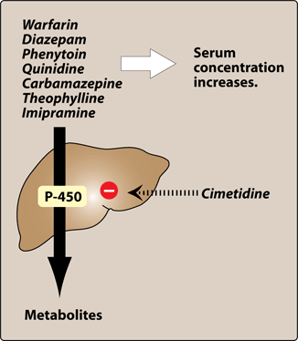
Cimetidine
Adverse effects:
The most common side effects are headache, dizziness, diarrhea, and muscular pain.
Other central nervous system effects (such as confusion and hallucinations) occur primarily in elderly patients and after intravenous administration.
Inhibitor of cytochrome p450, increase levels of warfarin, theophylline and phenytoin.
Act as androgen receptor antagonist causing reversible gynecomastia, galactorrhea and sexual dysfunction in males.

Slide 19
Others
Ranitidine: Does not bind to the androgen receptors, no enzyme inhibition. longer acting. FDA investigating Zantac for carcinogenic chemicals
Famotidine:
Twice as potent as ranitidine, has longer duration of action.
Nizatidine: eliminated principally by the kidneys. Because little first-pass metabolism occurs with nizatidine, its bioavailability is nearly 100 percent.

Slide 20
Proton-Pump Inhibitors
Omeprazole:
Causes irreversible inhibition of the H⁺/ K⁺ ATPase, blocking the transport of hydrogen into the lumen.
Reduces both basal and stimulated acid secretion
Single 20mg dose ↓ acidity by 90% over 24h
Biological half life of omeprazole outlasts its plasma half life (Hit & Run).
Prodrugs
Must be given as enteric coated granules as it’s degraded by low pH
Absorbed in the Small intestine
Excreted in urine and feces.

Slide 21
Preparations
Lansoprazole
Dexlansoprazole,
Esomeprazole,
Pantoprazole, and
Rabeprazole.
Omeprazole and lansoprazole are available over the counter for short-term treatment of GERD.

Slide 22
Indications:
Peptic ulcer
Stress ulcer
Drug of choice for Zollinger-Ellison syndrome?
Gasrtin-producing tumor of the pancreas
3. GERD

Slide 23
Proton-Pump Inhibitors
Adverse effects:
Diarrhea, colic, headache and diziness
Inhibit metabolism of warfarin, phenytoin
Prolonged inhibition of acid secretion ↑ risk of gastric neoplasia, low vit B12 and incomplete absorption of calcium carbonate products. An effective option would be to use calcium citrate as a source of calcium.
Increased risk of fractures of the hip, wrist, and spine (for one year or greater)
PPIs, particularly omeprazole, have been shown to decrease the effectiveness of clopidogrel due to inhibition of CYP2C19.

Slide 24
Anticholinergic drugs
Selective M₁ receptor antagonists: (M₁ receptors in autonomic ganglia)
Pirenzepine, Telenzepine
Inhibit gastric acid secretion with minimal unwanted effects of cholinergic blockade
Less effective than other antisecretory drugs.

Slide 25
Protective agents: PGS Misoprostol
Congener of prostaglandin E₁ that acts on the parietal cells to:
1. Inhibit acid secretion
2. Stimulate bicarbonate secretion
3. Stimulate mucus production.
4. Increase blood flow
Used in patients taking NSAIDs who are at risk for gastric ulcers (cytoprotective effect)
May cause diarrhea and stimulation of uterine contraction

Slide 26
Protective agents: Sucralfate
Sucrose sulphate+ Aluminum hydroxide gel
Low pH in the stomach causes release of Alu leaving the compound with a strong negative charge (only active in acid media)
Adhere to the proteins in the ulcer base, protecting it from further damage.
Stimulates mucus production and inactivate pepsin & bile
Can cause constipation and can interfere with absorption of other drugs

Slide 27
Protective agents: Carbenoxolone
Derived from liquorice
Enhances mucus secretion
Reduces peptic activity and increases PG
Causes sodium retention, hypokalemia and edema
Its effect is antagonized by spironolactone

Slide 28
Protective agents:Colloidal bismuth
Combine with proteins in the ulcer base
Stimulate mucus production
Eradicate H.pylori
Dark discoloration of teeth and tongue
Promotes healing of both duodenal and gastric ulcers

Slide 29
Antacids
Weak bases, neutralize gastric acid and reduce pepsin activity
Hydroxide is the most common base but trislicate, carbonate are also used
Reduce pain and may promote healing
Tab act more slowly than liquid antacid unless sucked or chewed

Slide 30
Antacids:Sodium bicarbonate
Absorbed systematically and should not be used for long-term treatment (alkalosis).
Release Carbon dioxide
Contraindicated in hypertension due to its high sodium content

Slide 31
Antacids: Calcium carbonate
Partially absorbed, has some systemic effect
Can cause hypercalcemia
Should not be used for long-term treatment
May stimulate gastrin release causing rebound acid production
Contraindicated in renal disease

Slide 32
Antacids ( the good ones)
Magnesium hydroxide:
Not absorbed, no systemic effects
Causes diarrhea
Aluminum hydroxide:
Not absorbed, no systemic effects
Causes constipation
Combination is logical to produce a balance
between the agents’ adverse effects on the bowel

Slide 33
Antacids:Adverse effects
Bind drugs: tetracycline, digoxin and prevent their absorption
Change in bowel habits
Calcium-based antacids cause rebound acid secretion
Milk-alkali syndrome, rare
Aluminum containing antacids can cause hypophosphatemia

