Slide 1
Haneen bani younis
Tasneem Migdadi

Slide 2
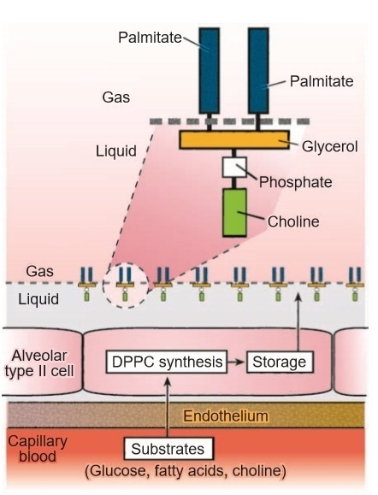
Pulmonary Surfactant: Action and Structure
Structure and Composition:
Pulmonary surfactant is a mixture of lipoprotein:
lipids (85% to 90%, predominantly phospholipids) and proteins (10% to 15%)
The principal surface tension­ lowering agent in surfactant is dipalmitoylphosphatidyl­choline (DPPC).
Source:
Alveolar type II cells.
Electron-dense lamellar inclusion bodies.
Functions of Surfactant :
Prevents lung collapse
Promotes alveolar stability
Helps to prevent edema in the lung
decreases the work of breathing
Regulation of Synthesis and Secretion:
Hormonal factors: Glucocorticoid, insulin, thyroxine
Stretching of lungs
Surface tension between the fluid and the air is 7-14 times more than that between surfactant and the air.

Slide 3
Structure of surfactant :
Surfactant is lipid molecule ,synthesized by alveolar cell type 2 ,it is amphipathic molecule which means it has 2 positions :1.hydrophilic 2. hydrophobic
The raw materials : glucose ,fatty acids and more other which are necessary- to synthesis the surfactant- from the circulation .these raw materials are stored within a structure located also inside type 2 cells election dense lamilar bodies .
There are two theories about that :
1.the raw materials stored and then used when need
2.the surfactant is already synthesized and stored the (type 2cells)
there are many stimuli that affect its synthesis like hormones ,cortisone ,insulin ....etc .which have an important role in controlling surfactant synthesis and the bodies mentioned above .
* surfactant is a lipoprotein =lipid +protein.

Slide 4
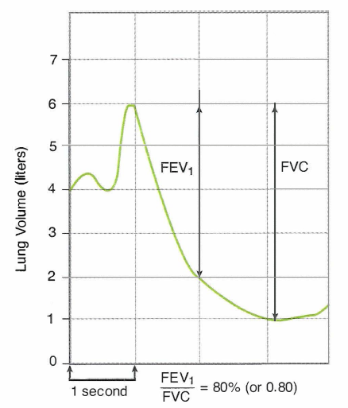
PULMONARY FUNCTION TESTS
Pulmonary function tests
Are very useful tests to diagnose
several lung diseases.
The most informative tests of lung function is Forced Expiratory Volume (FEV1)
It is the volume of gas exhaled in one second by a forced expiration following a full inspiration.
The total volume of the gas exhaled after a full inspiration represents the vital capacity. However, the total volume of the gas exhaled forcefully after a full inspiration represents forced vital capacity (FVC).
The normal ratio of the FEV1 is 80 % of FVC.

Slide 5
function of surfactant :
1.Reduction of surface tension .how ?
since it is an amphipathic molecule, so has two portions ,hydrophilic +
hydrophobic. The hydrophilic portions dissolves in watery ,while the hydrophobic portions is oriental toward due alveolar gas or air .so ,now there is a layer of surfactant between fluid and air. reduction in surface tension by 7-14 times .(note :no complete elimination of surface tension occurs ).
2.By reduction of surface tension ,this prevents (lung collapse ) consequently .
*at low lung volume ,surfactant is more action and so prevent lung collapse in this law volume during expiration to prevent the lung from biro totally collapsed.حكي كثير بس الفكرة وحدة
*(it is more efficient in smaller alveoli than in the larger one because it is more concentrated in the lower surface areas rather than larger ones )

Slide 6
3.prevent edema formation :
-surface tension does not just collapse the alveoli ,it sucks the fluids from the alveoli to the capillaries .(more filtration ).proteins cannot leave the capillaries since they large ,so they create a pressure which lead to the suction of fluids edema
*the process of exchange controlled by 2 pressures :
1. hydro static pressures :filtration of the fluid .
2.colloid osmotic pressure :by the presence of proteins ,suck the fluid from the interstitial to the capillaries.
*But in the percent of surfactant ,that does not happen .
4.decreases the work of breathing cause we need more effort to re-inflate the lungs if surfactant is not present .(surfactant increases the compliance )

Slide 7
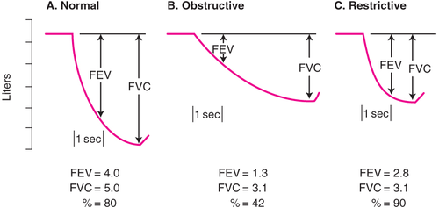
Interpretation of tests of forced expiration

Slide 8
*pulmonary function test :
very important to measure the efficiency of RS ,and to determine if there are any lung disease, specifically ,it determines or distinguish the presence or absence of restrictive and obstructive lung disease
*forced expiratory volume 1:the volume of gas expiration forcefully and rapidly ,(because time is important )in the first second.

Slide 9
*while the volume of air expired normally (not forclly after deep and maximum inspiration ) called vital capacity (VC)
*FVC :forced vital capacity ,almost this volume is less than VC ,because in vital capacity it is static volume ,time is not considered like in FVC is considered .The portion of FVC which expired at the first second called (FEV1)
*so the FVC is the maximum amount of air expired , and this air may go out of the lung completely during 4 seconds after forced inhalation .
*FEV1/FVC=4/5=0.8=80% Of air expired at the first second

Slide 10
*but in the case of obstructive and restrictive disease this ratio changes :
FEV1:in both cases reduction
FVC :in both cases reduction
*the ratio decreased in "obstructive case "
the ratio increase in "restriction case "or normal.
مرات النسبة بتكون نورمال بس ال FEV1 بتكون مش طبيعية مثلا
*what is the obstructive disease ?(RV).(difficult in expiration (trapping the air inside ).due do resistant
وممكن النسبة تكون عالية ,بس كيف ؟بكون الهواء اللي دخل اصلا قليل ,وما عندي مشكلة بال expiration وبالتالي اللي فات علية رح يطلع وهو بتكون النسبة تقريبا عالية عند ال restrictive disease

Slide 11
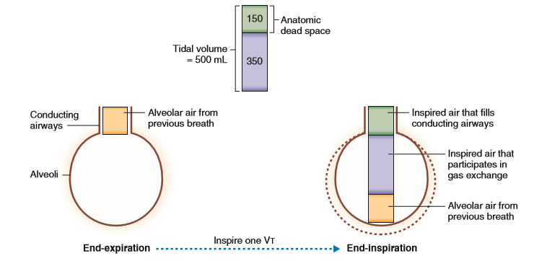
Alveolar Ventilation
Important Terms:
Ventilation: is a dynamic process that moves air in and out of the lungs.
Minute ventilation:
is the volume of air that enters the lung each minute.
This is the product of tidal volume (500 ml) and respiratory rate (12 per minute).
Expired minute ventilation:
is the volume of air that leaves the lung each minute.
amount of expired minute ventilation at rest is same as minute ventilation as the inspired and expired tidal volume is the same.
Alveolar ventilation: The volume of the gas reaching the respiratory zone of the airways. However, not all of the Minute ventilation volume reaches the alveoli. 150 ml of the TV (500 ml) is left behind in the airways, which does not contain alveoli, therefore does not contribute the diffusion (Anatomic death space).
Dead Space:
Anatomic dead space
Alveolar (functional), dead space

Slide 12
*Alveolar Ventilation
-Ventilation(generally): the amount of enter and leaves the lung or the exchange of air between the lung and the environment .
* Minute Ventilation :exchange of air between the lung and the environment in one minute
- 500X12=600ml= 6 Liter inspired and expired
* expired minute Ventilation : but just expired which is the same as inspired ,but differs in the contact ( Presence of co2).
*Now, The alveolar Ventilation: The Volume of air Reaching the alveoli or the Respiratory Zone.
*The Tidal volume is 600 ml ,just 2/3 reach to the R Zone (=350ml). The remaining I50 ml, Still in the Conducting Zone, does not have o2 and does not do through gas exchange (1/3) .which Called dead space (wasted air).
* Alveolar ventilation rate = Volume x R rate (at rest) 350 (fresh air
=350 X 12
=4.2 Liter
*Anatomical dead space : the volume of air remaining in the C Zone (150 ml ) From nose to the terminal alveoli
*alveolar dead space :in alveoli and not functional

Slide 13
* and it is a mismatch between Ventilation airation and perfusion .occurs when Perfusion is little or not percent (no Ventilation)- non Functional alveolar dead space.مثلا وعاء دموي مسكر على الاخر ما رح يصير فيه تبادل للهواء رغم وجود الهواء ولذلك لعدم وصول الدم الى هذه المنطقة بحيث انه يذهب لمنطقة فيها B.V diluted .
*Physiological dead space = Anatomical t Alveolar ( called space )
*in normal Person: Phy dS = anatomical dead space (because this is no alveolar ds)
* So, by Comparing physiological ds with the TV we can estimate How much air wasted .
* Many ways to measure the phys ds ,one of them by calculating the Fractional Concentration of Co2 in the alveoli or the partial pressure of it( Co2) in the expired air (tidal volume) :1.alveolar volume 2.anatomical dead space).

Slide 14
Anatomic Dead Space
Refers to the volume of air present in the conducting zone of the respiratory passage, i.e. from nose to terminal bronchioles. Since, the dead space is due to the anatomy of the airways, it is referred to as anatomical dead.
Due to the anatomical dead space, out of 500 ml of tidal inspiration, 350 ml of air enters the alveoli. Thus, the normal anatomical dead space volume is 150 ml.

Slide 15
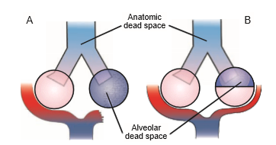
Alveolar Dead Space
Ventilated alveoli that do not participate in gas exchange
Mismatch of ventilation and perfusion
The sum of the anatomical dead space and alveolar dead space is called physiological dead space.
In normal persons, the physiologic dead space is nearly equal to the anatomic dead space
By comparing the physiologic dead space with the tidal volume, it is possible to estimate how much ventilation is “wasted.”

Slide 16
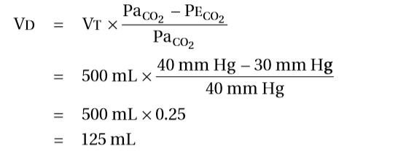
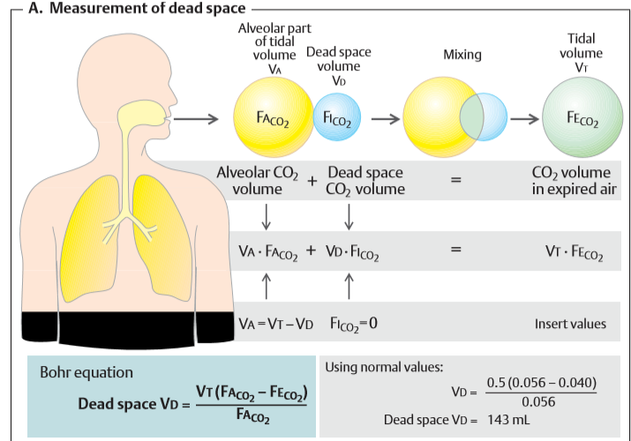
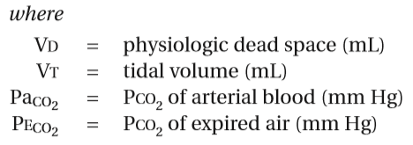
Measurement of Physiological Dead Space
For example, if the alveolar PCO2 is 40 mm Hg and the mixed-expired PCO2 is 28 mm Hg, then
Normally, V_{D}/V_{T} is 20% to 30% of minute ventilation.
If V_{D}= zero??

Slide 17
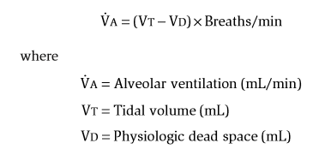
ALVEOLAR VENTILATION
Alveolar ventilation.
Only the alveolar part (V_{A}) of the tidal volume (V_{T}) reaches the alveoli. The rest goes to dead space (V_{D}). The volume of air that actually reaches the alveoli per minute is known as alveolar ventilation. Therefore, to know the volume of air that takes part in alveolar ventilation, first the dead space volume is subtracted from the tidal volume:
V_{A} = V_{T} – V_{D} (L).
Multiplying alveolar volume by the respiratory rate (f in min^{–1}) results in alveolar ventilation (.V_{A}): Which is the volume of fresh air per minute actually reaching the alveoli.
Alveolar ventilation is given by the following equation:
If anatomic dead space volume is increased due to any cause, alveolar ventilation decreases.

Slide 18
the amount of Co2 In alveolar air= alveolar volume concentration of Co2
* Co2 in dead space = Volume of ds* its conc. in inspired air (no exchange in gases) ولكن تركيز ثاني اكسيد الكربون صفر في ال inspired air
the amount of Co2 in expired =VT * its Conc. in inspired air
= VA*conc of co2 in alveoli
=CVT-dead space V)*conc. of Co2 in alveoli=
VT * Conc. of co2 in expired air
المعادلة النهائية :
dead space volume =TV *factor this factor represent dilution of co2
=alveolar conc. of co2 - conc. of co2 in expired air
alveolar conc. of co2
*المشكله هون ما بقدر اقيس co2 in alveoli ...كيف ؟
لأنة بصير عندي اتزان systemic artery
يعني لما يصير عندي تبادل غازات بين ال alveoli and capillary equilibrium

Slide 19
*بالتالي لما احسب عينة دم وأقيس منها تركيز ثاني اكسيد الكربون بكون نفسه في ال alveoli
*tidal volume =500
*pco2 in blood =40
*pco32 =30
*قيمة تركيز الco2 في expired بتكون dilution عشان هيك في dilution factor ,لأنة رح يختلط بالهواء اللي بال C zone ,ف رح يقل تركيزه
*the co2 in expired air is lower than in alveolar
(40-30)/40=125 ml ع اساس 150؟ حسب 500,600
*in another way :
dilution factor =vd/vt =(40-28)/40 =30%
the portion of dead space is 30% of tidal volume
(30/100)*500=150 ml
*alveolar volume =tidal volume-dead space volume
*alveolar ventilation =alveolar volume * breathing frequency
* اذا صار عندي زيادة في ال ds alveolar ventilation رح تقل
وبالتالي الطريقة الوحيدة حتى ازيدة ازيد TV
deep breath

Slide 20
لو كان ال tidal v =150 رح يغطي بس منطقة ال dead space ما رح يفوت لجوا صفر
على الرغم انو زدنا ال frequency
لو زدنا ال frequency وثبتنا ال TV رح يزيد الalveolar ventilation
*in excurses :frequency and TV BOTH increase
لكن في حاله كانت ال frequency عالية ولكن TV قليل short breath ما رح يوصل لجوا وعالفاضي
*hypercapnia :increasing in breathing frequency تختلف عن hyper/hypo لها علاقة بتركيز co2

Slide 21
ALVEOLAR VENTILATION
Physiological Significance
hypercapnea
hypocapnea
Notes:
In rapid and shallow breathing, though minute ventilation does not change much, alveolar ventilation is grossly impaired because most of the air inhaled is utilized to occupy the anatomic dead space (the air available to enter into alveoli is less). 1. Therefore, patients with rapid and shallow breathing develop hypoxia and hypercapnea. 2. In contrast, a subject with deep and slow breathing will have adequate alveolar ventilation though the minute ventilation does not change much. Such subjects have alveolar ventilation even greater than subjects with normal breathing. 3. Thus, to improve alveolar ventilation, it is important to increase the depth of breathing than to increase the frequency. In fact, during moderate to severe exercise, a trained athlete achieves the target alveolar ventilation by mainly increasing the depth rather than the frequency of breathing.
Since VD is anatomically determined, V _{D}. =(V_{D}.f) rises with f.

