Slide 1
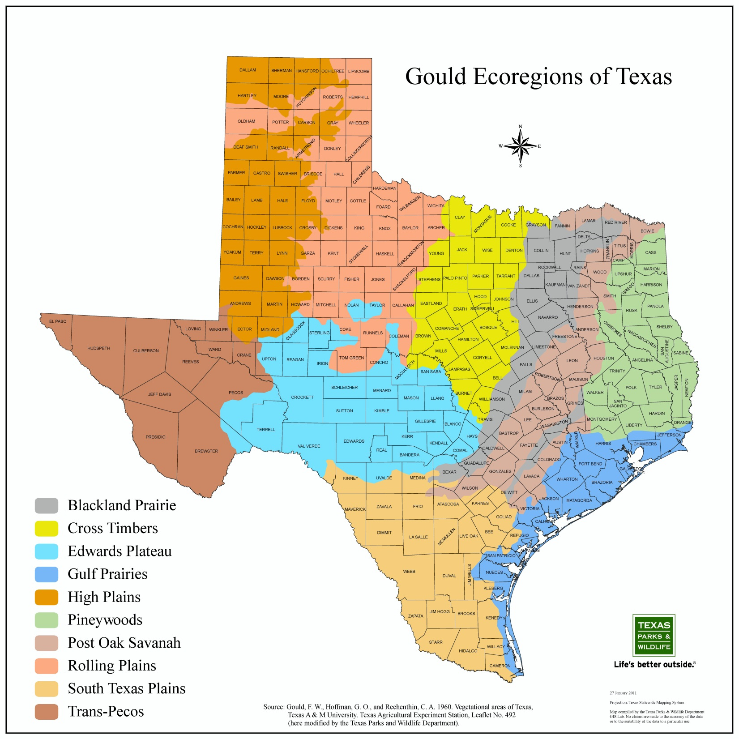

Slide 2
Rolling and High Plains
© Sheri Amsel
www.exploringnature.org

Slide 3
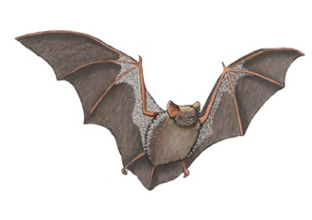
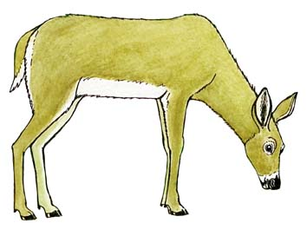
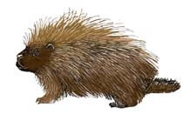
Pineywoods
Red-tailed hawk
Hoary bat
White-tailed deer
Eastern Gray Squirrel
Porcupine

Slide 4
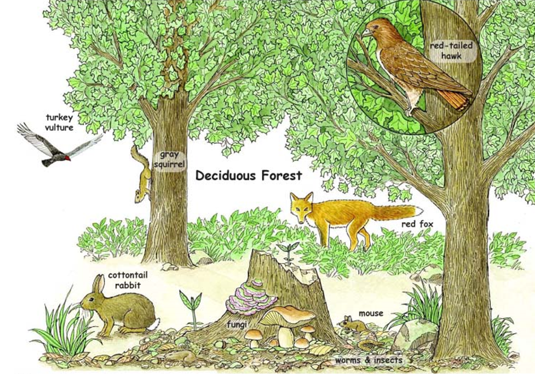
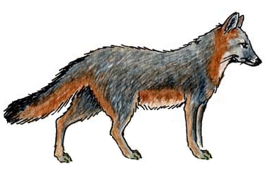
Edwards Plateau
grey fox
white-tailed deer
© Sheri Amsel
www.exploringnature.org

Slide 5
Gulf Prairies
© Sheri Amsel
www.exploringnature.org

Slide 6
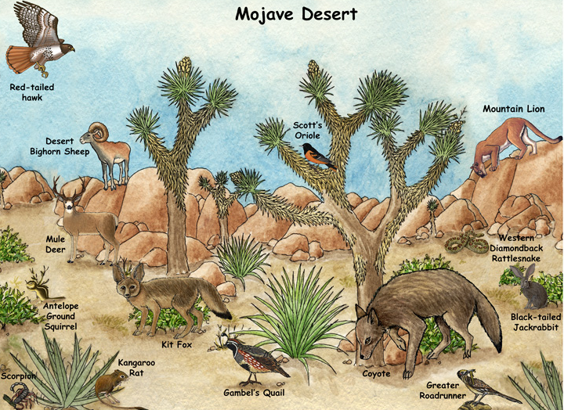
Trans-Pecos
© Sheri Amsel
www.exploringnature.org

Slide 7
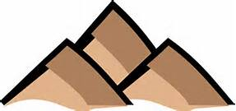
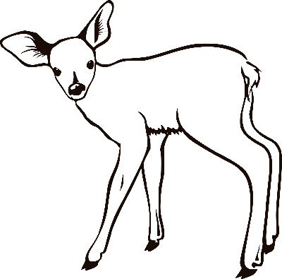
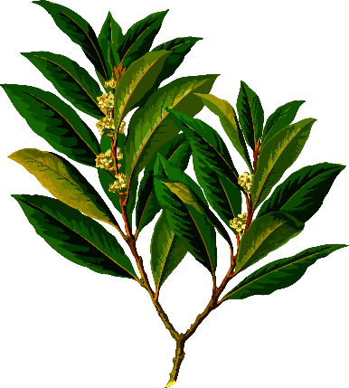
BROWN - landforms,
such as mountains or hills
BLUE - water
ORANGE - animals
GREEN - plants
Note: This slide is only to be used with the K-2 version of this lesson
openclipart.org

