Slide 1
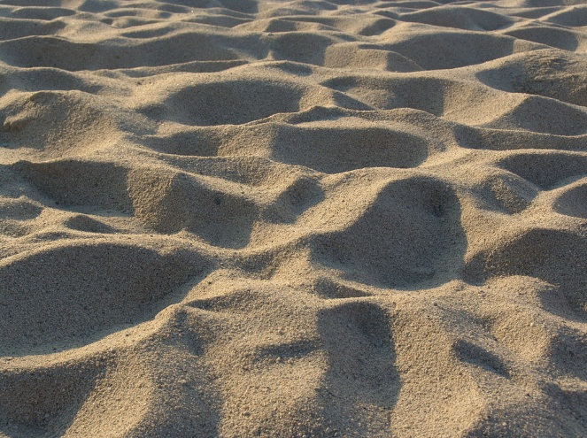
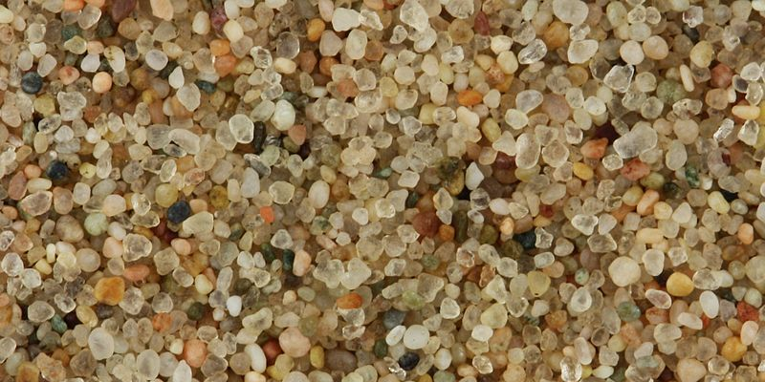
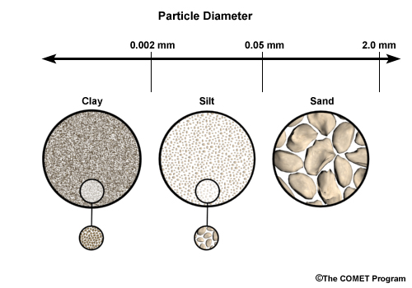
Sand
Color - brown, tan, black, or white, depending on location and mineral content
Texture - rough and gritty
Particle Size – large
Capacity to retain water - poor due to large particle spaces
Ability to support plant growth - lacks nutrients, add humus to decrease large air spaces
Air and water - runs freely in between particle spaces, causing plants to wilt and dry out quickly
‘Ribbon test’ - unsuccessful results, ribbon falls apart due to rough texture

Slide 2
Silt
Color - black or brown, depending on its location and mineral content
Texture - soft and smooth, much like flour or butter
Particle Size - medium
Capacity to retain water - average, but not likely to become waterlogged
Ability to support plant growth - successful growth due to rich nutrients, add humus as needed
Air and water - moves more freely through silt than through clay, but not as freely as through sand
‘Ribbon test’ - successful, ribbon falls apart once application of pressure is stopped

Slide 3
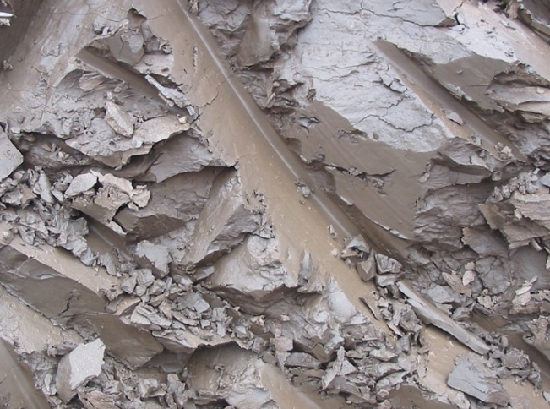
Clay
Color - brown, red, or grey, depending on location and mineral content
Texture - smooth when dry, sticky when wet
Particles Size - small
Capacity to retain water - high, with plant roots holding water and nutrients causing compaction and waterlog
Ability to support plant growth - poor, due to small texture and compaction, add humus and sand to improve
Air and water - difficult moving through small particle spaces
‘Ribbon test’ - successful, ribbon will not fall apart

Slide 4
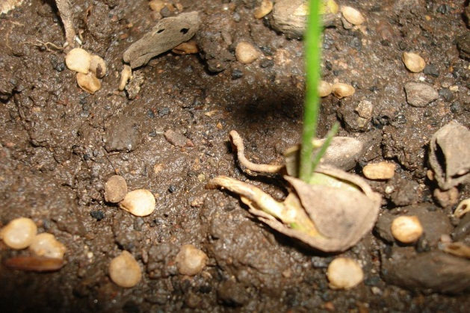
Humus
Organic material made up of decayed plant and animal
matter that has been broken down or decomposed by
living organisms
May contain living organisms such as earthworms and
insects, as well as microorganisms such as bacteria,
both aerate the soil
Color - black or dark brown
Texture Size - generally soft to the touch, but can be coarse depending upon the origin of its contents
Capacity to retain water - good drainage, adding nutrients to soil
Ability to support plant growth - excellent as it improves sandy, silty, or clayey soils
Air and water - moves freely from the soil surface into plant roots
Loam, being the favorite soil mixture by most landowners, contains the most desired percentages of sand, silt, clay, and humus.

