Slide 1
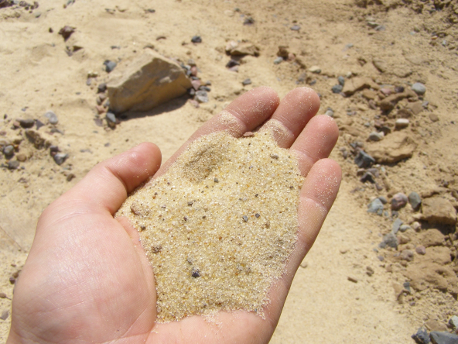
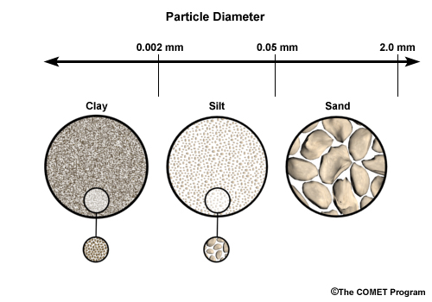
Properties of Sand
banzaisurfschool.com
Color Choices - tan, brown, brown, grey, white, black
Texture Choices - gritty, smooth, hard, rough, soft, sticky
Particle Size - large, allowing
air and water to move freely
in between the particle spaces

Slide 2
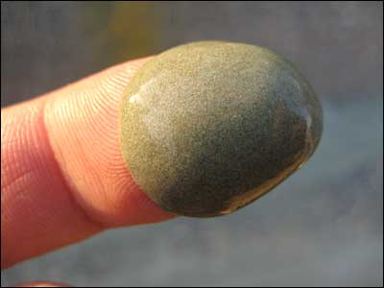
Properties of Silt/Loam
Rana Salem
Color Choices - tan, brown, brown, grey, white, black
Texture Choices - gritty, smooth, hard, rough, soft, sticky
Particle Size - medium,
allowing some air and water
to move freely in between
air spaces

Slide 3
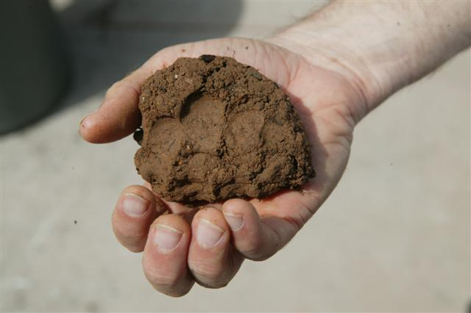
Properties of Clay
Rana Salem
Color Choices - tan, brown, brown, grey, white, black
Texture Choices - gritty, smooth, hard, rough, soft, sticky
Particle Size - small, allowing
very little air and water to
move freely in between particle
spaces

