Slide 1
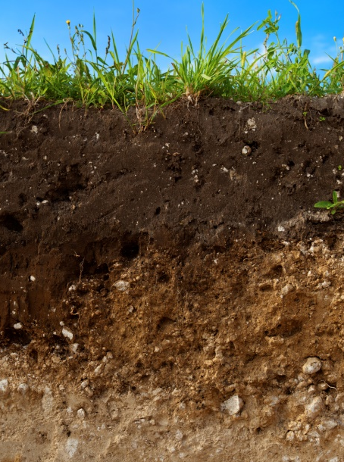
Sampling Soil
Soil provides a cover over the surface of the earth and is one of our most valued natural resources. Natural resources are substances that occur naturally and are not manmade. Soil is critical to the growth of plants that provide us with food (a basic need), as well as plants such as cotton, that we use for clothing. Soil also provides a home for many living (biotic) things.
Soil is a mixture made up of several components. The first component of soil consists of three (3) particle types known as sand, silt, and clay that come from mineral rich rocks. Sand, silt, and clay are inorganic substances as they are derived from nonliving things. The second component of soil is composed of organic matter, known as humus. Humus is made of rotted plants or dead animals that have been broken down or decomposed by living organisms living in the soil. The third component of soil is water and the last component of soil is air. All of the components that create soil change over time.
USDA

Slide 2
Physical properties or characteristics are observations that describe substances, such as soil. Soil has physical properties or characteristics that help determine how suitable it is for growing plants. These properties consist of:
Color
Texture
The capacity to hold or retain water
The ability to support the growth of plants.
When two (2) or more substances combine to create a soil mixture, it is important to know that each of the substances maintain their original properties. In addition, they can be separated back into their original substances.

Slide 3
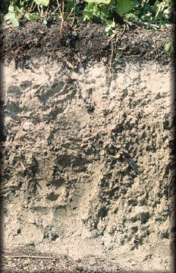
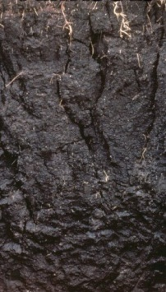
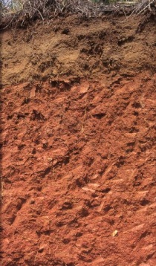
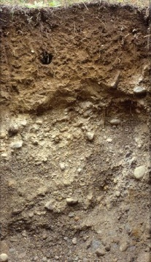
Soil color is a property that is easy to observe. Farmers, ranchers, and gardeners can determine a lot of information by looking at its color. Scientists classify soil color as dark or light, consisting of shades of black, brown, red, gray, and white. Currently, there are over 170 different soil colors recognized by scientists. Generally, the darker the soil is the more nutrient rich it is, containing a great deal of decomposed organic matter or humus.

Slide 4
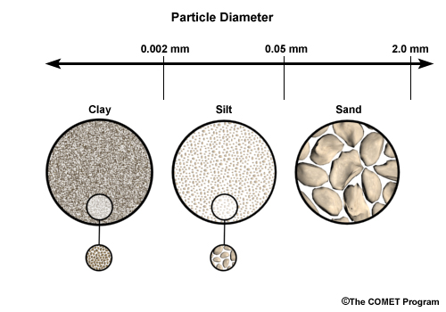
Soil texture is determined by the size of particles found in sand, silt, and clay. Each soil component is formed over time as a result of weathered or broken down rock. Knowing the texture of soil can provide information about how much water will flow or drain through it, as well as its capacity to hold or retain water. Particle sizes found in sand, silt, and clay can best be determined by the way it feels when it is slightly wet. If a soil contains a lot of sand, its particles are large, giving it a texture that feels gritty like salt or sugar. If a soil contains a lot of clay, its particles are very small, giving it a texture that feels hard when dry and sticky when wet, much like peanut butter. Soils with silt do not feel gritty or sticky when wet. They feel soft or smooth much like flour or butter. Their particles are medium sized, meaning they are smaller than those of sand, but larger than those of silt.

Slide 5
Another property of soil is its capacity to hold or retain water and is closely related to particle size. Soil requires both water and oxygen to support plant growth. Too much or too little water in the soil can lead to undesirable results. Too much water can cause plant roots to rot because as water fills the spaces between soil particles, it pushes air out. Too little water causes plants to wilt and possibly die. A good soil must be able to retain some water but allow for adequate drainage. As soil drainage increases, water retention decreases.
Sand, having large particles, has a poor capacity to hold or retain water. Therefore, plants grown in sandy soils need lots of water.
Silt, with medium sized particles, has a capacity to hold or retain water longer than sand, but not as long as clay.
Clay, having small particles, has a capacity to hold lots of water, so plants living in clay soils do not need to be watered often.

Slide 6
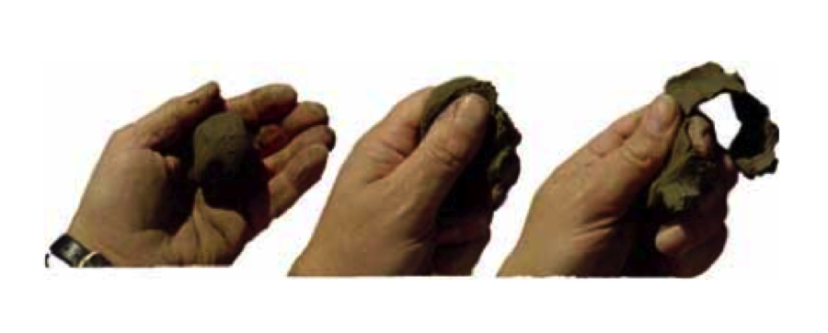
Farmers, ranchers, and gardeners can determine much about a soil’s ability to retain water by picking up a handful and doing a simple test known as a structure or ‘ribbon test.’ To perform this test, please a slightly damp soil sample into the hand of the tester. Next, the tester attempts to form a ribbon shape with the soil by rubbing it in between the thumb and forefingers. If it forms a ribbon shape, it contains clay. The larger the ribbon, the more clay is in the soil. If it is does not form a ribbon shape, it is sand or silt. Using sand, forming a ribbon will be unsuccessful due to its gritty texture, and it will fall completely apart. Using silt, a ribbon shape will form, but fall apart soon after the application of pressure stops.

Slide 7
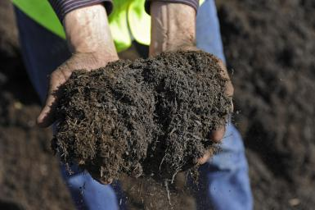
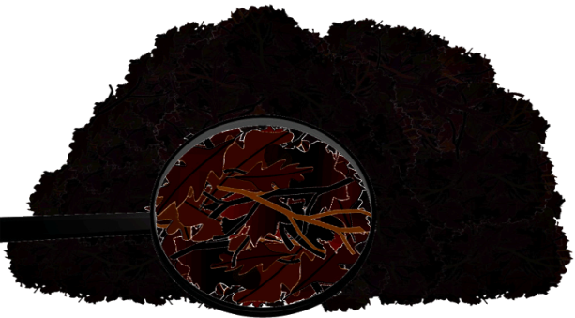
The fourth property of soil is its ability to support plant growth. Although most soil types will support plant growth, most landowners prefer a soil mixture known as loam. Loam has mixed amounts sand, silt, clay, as well as an important component known as humus. Humus is organic material that forms from the remains of once living things, such as dead plants and grass clippings. Humus is dark in color, supports living organisms, and retains water well. Adding humus to soil improves its properties, making it suitable for living organisms and healthy plants.
Loam
Humus
Matthew Brown
www.edupic.net/sci_gr.htm

Slide 8
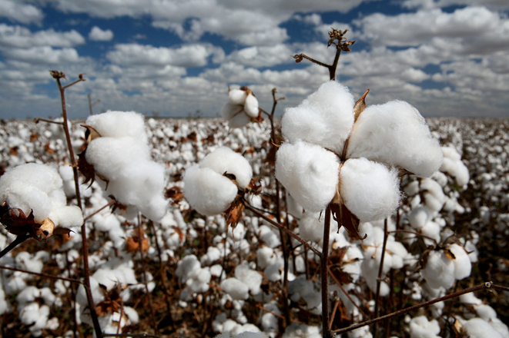
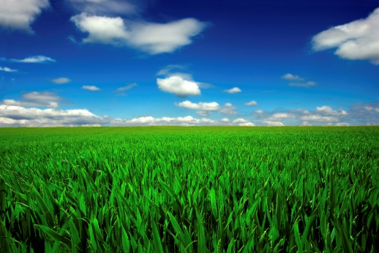
By learning properties of soil, including color, texture, capacity to retain water, and its ability to support plant growth, landowners are likely to have success growing healthy plants. This knowledge will help them determine the nutrients needed in the soil to enhance plant growth. It takes a long time for soil to form which makes it important to conserve and protect. We all need this natural resource so that it may continue to support life.
Cotton
Wheat
www.agrodaily.com
USDA

Slide 9
Stewardship is defined as the responsible planning and management of resources such as land, water, and animals. Land owned by people is known as private land. To protect it, landowners must be caretakers. One way private landowners can protect and care for their soil is to keep plants rooted in the soil throughout the year. Plants hold the soil in place, which helps prevent it from being blown away by strong winds, or carried away by water that comes as a result of heavy rain.
www.nature.com

Slide 10
Soil Shake
Use a metric ruler to measure the total thickness of the soil components in the jar. Place the ruler in a vertical position next to the jar and measure in centimeters the distance from the bottom of the jar to bottom of the water level. Next, break the layers down into individual measurements.
Example: Total distance from bottom of jar to bottom of water level = 16 cm
The individual layer measurements should equal a total 16 cm.
Sand (bottom layer) = 8cm
Silt (middle layer) = 2cm
Clay (top layer) = 6cm
Calculate the percentages of each soil type by dividing the measurement of each layer by 16, as seen below.
Sand 8 ÷ 16 = .5 = 50%
Silt 2 ÷ 16 = .125 = 12.5%
Clay 6 ÷ 16 = .375 = 37.5%
= 100 %
Round up the above percentages to a ratio of 50% sand, 40% clay, and 10% silt

Slide 11
The Soil Textural Triangle is used to classify soil types.
Use any two (2) percentages to find the name for the soil type.
The percentages from the example are 50% sand, 40% clay and10% silt.
Locate 50% along the bottom (sand) line of the triangle, and then follow
the slanted line up and to the left.
Locate 40% along the left (clay) side of the triangle. Stop at the horizontal line
where it intersects with 50% to determine the soil type. The example is identified
as sandy clay.
Locate 10% along the right (silt) side of the
triangle. Follow the slanted line down to
where it intersects with sand and clay.
The ideal soil is loam, containing a ratio
of 40% sand, 20% clay, and 40% silt.
Can you locate it on the triangle?
http://soils4teachers.org/physical-properties

Slide 12
