Slide 1
Top Ten Agriculture Products of Texas
1. Cattle 46.40%
2. Cotton 9.40%
3. Dairy Products 7.90%
4. Broilers or Chickens 7.60%
5. Nursery & Greenhouse 5.90%
6. Corn 5.50%
7. Grain Sorghum 3.00%
8. Wheat 2.80%
9. Vegetables & Melons 1.90%
10. Chicken Eggs 1.90%
Others 7.70%

Slide 2
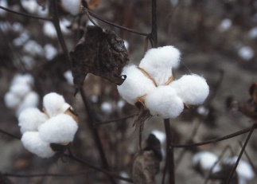
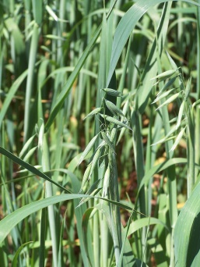
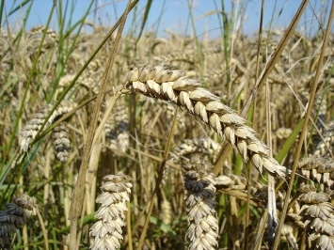
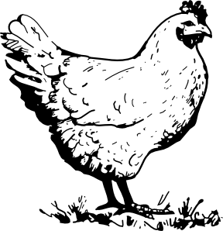
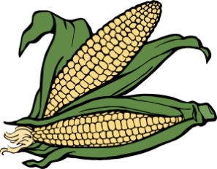
Cattle
Nursery/Greenhouse
Cotton
Grain Sorghum
Dairy
Wheat
Broilers/Chickens
Vegetables &
Melons
Corn
Chicken Eggs
www.clker.com

