Slide 1
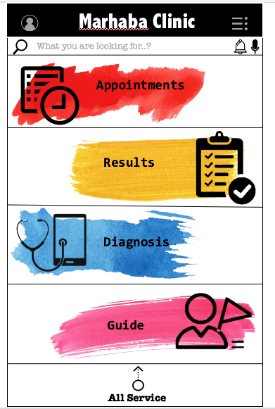
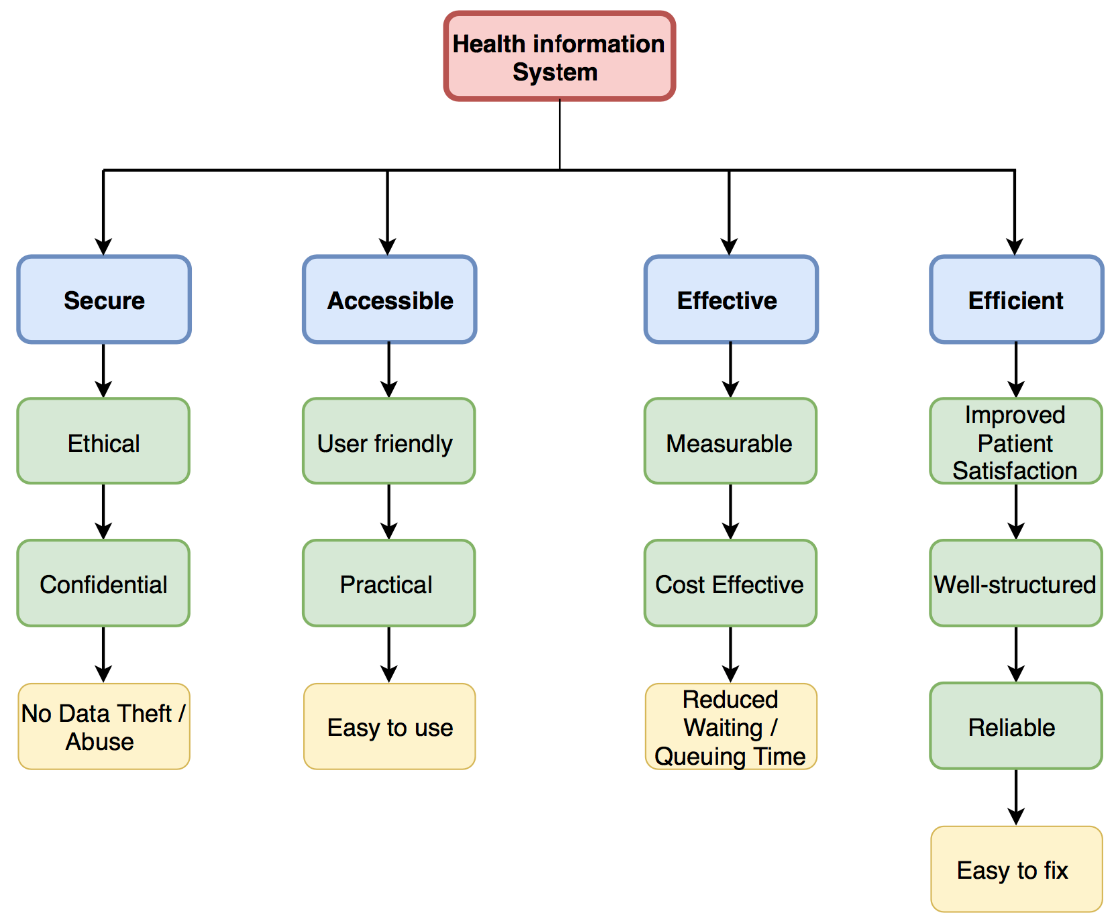
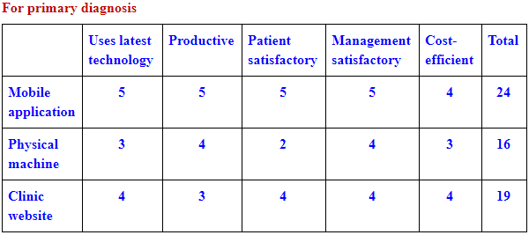
Informatics and Technology for Improving Health Care Systems
Hanin Abu Alrub Meera Al Suwaidi
Khalid Al Hammadi Rashid Hassan
Problem Statement: Find a 21st century solution for Marhaba Clinic’s overall underperformance
and patient dissatisfaction.
Background
Issues include privacy & ethical concerns [1].
Smartphones & data analysis improve healthcare [2].
Patients want more personalized & comprehendible lab results & medical prescriptions [3].[3].
Scope
* Included
Patient data
Pharmaceuticals
Medical diagnosis
Medical results
* Excluded
Emergency department &
Health sciences details
Recommendations:
Mobile application & Clinic website
Medicine vending machine
Objectives
Process
Created a journey map to find weaknesses of health systems
Identified areas of concerns
Possible solutions for each area of concern
Matrices to evaluate the solutions.
References
[1] P. Bath, "Health informatics: current issues and challenges,“J.I.S, vol. 34, no. 4, pp. 501-518, 2008.
[2] A.A Roa and A.Sriastava, "Big data in health informatics,“ASCI J.o.M, vol. 47, no. 2, pp. 36-46, 2018.
[3] T. Goetz. "It’s time to redesign medical data,“ YouTube. [Video file].

