Slide 1

LIT 5073 Module 4 Application: Activating Higher Order Thinking Skills Faye Gillespie American College of Education

Slide 2
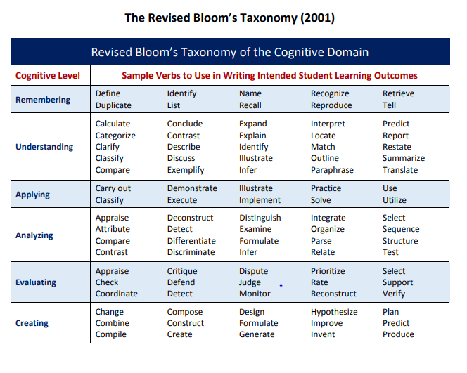

Slide 3
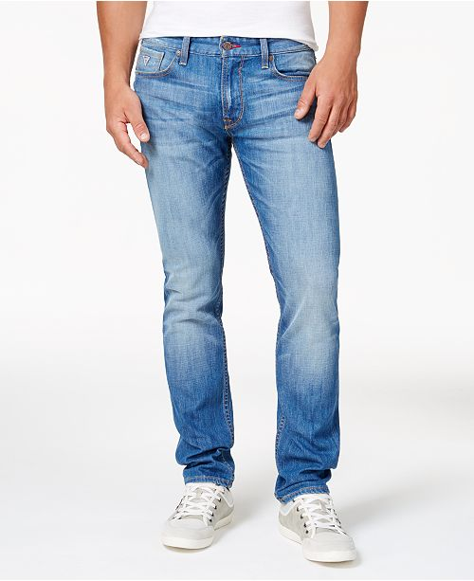

Picture Prompts for “Out of the Blue”

Slide 4
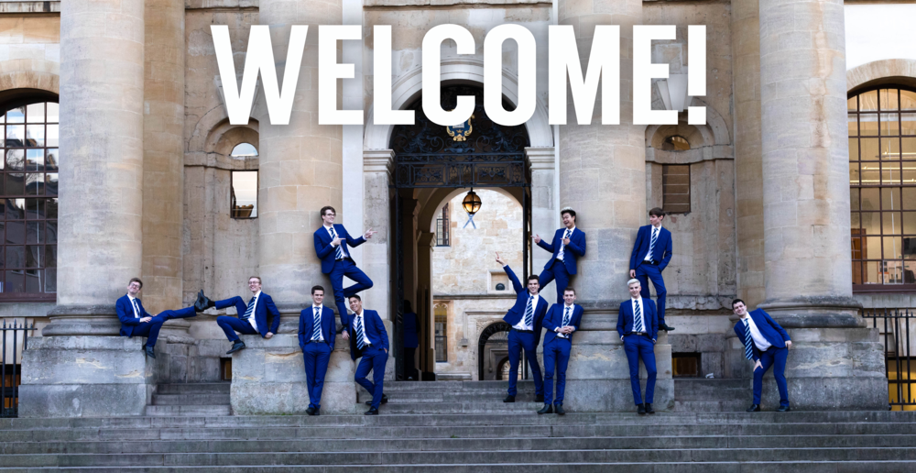
Prompts:
Evaluate what type of place you think this might be? (Evaluation)
If you were to build this type of structure, what it might be used for based on what (Evaluation)
Hypothesize the reason that the individuals are dressed alike. (Application)

Slide 5
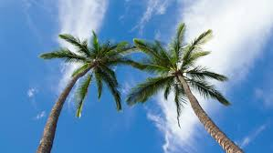
Prompts:
Based on the picture, what region do you think we are in and why? (Analysis)
Discuss the climate that you would expect to find it this place. (Comprehension)
Generate ideas about what type of activities might be going on under the trees. (Synthesis)
Categorize this type of tree based on clues you see in the picture. (Analysis)

Slide 6
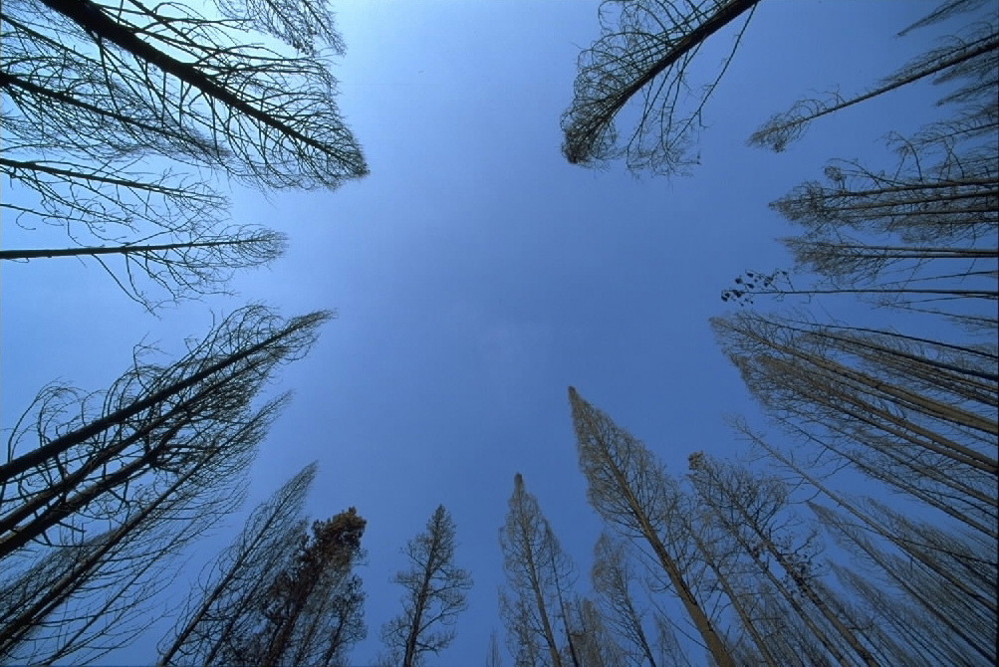
Prompts:
What region do you believe that these trees are located in? (Evaluation)
What reasons might exist for these trees to appear the way they do? (Analysis)
Compose a story that starts with a character gazing up at this view. (Synthesis)

Slide 7
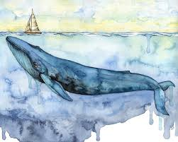
Prompts:
Identify the location based on your schema. (Knowledge)
Who would you take with you if you were a passenger in the sail boat? (Evaluate)
Write a story about n adventure based on this picture. (Synthesis)
Describe your favorite real water adventure or sea animal other than the blue whale. (Knowledge)

Slide 8
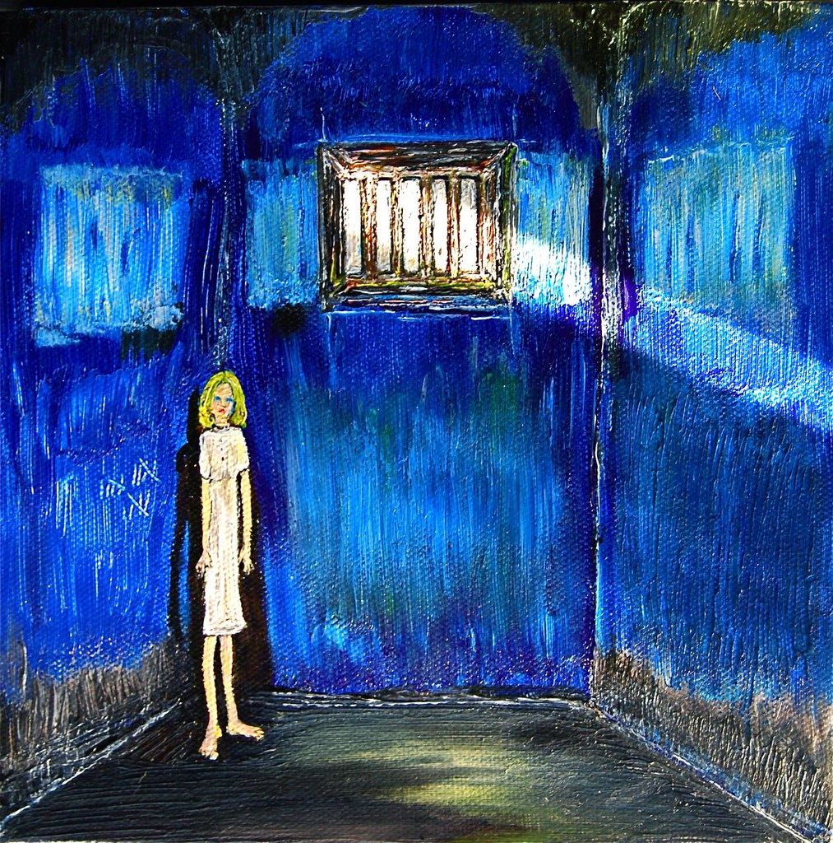
Prompts:
Where do you believe the girl is at ? (Application)
Explain why she might feel blue. (Evaluate)
What might have caused the girl to be cast in the blue shadows of the room? (Synthesis)
Hypothesize the outcome of a story about the girl in the picture. (Application)

Slide 9


Prompts:
What do you think are some reasons people feel blue? (Knowledge, Evaluate)
What emotional characteristics are associated with feeling Blue? (Knowledge, Application)
Imagine you are feeling blue. How might you change your feeling? (Analysis)

Slide 10
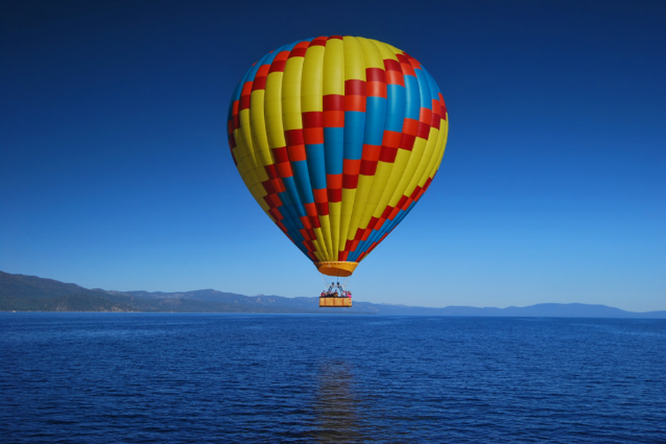
Prompts:
How does hot air balloon fly or operate? (Analysis, Knowledge)
How would you feel if you were to take a ride in this balloon and why? (Analysis)
Compose a story where you take a trip in a hot air balloon. (Synthesis)
If you could only take four items with you for a day long hot air balloon journey, what would they be and why? (Analysis)

Slide 11
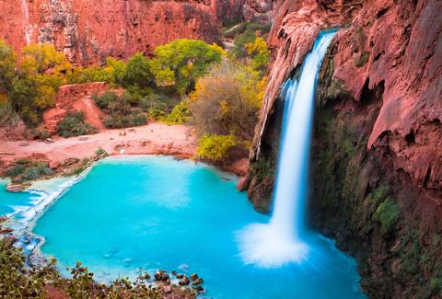
Prompts:
Generate five descriptive words for this location. (Synthesis)
What type of climate do think would experience in this location? (Application)
What do you imagine might live in this place? (Analysis)
What name would you give to this picture and why? (Application)

Slide 12
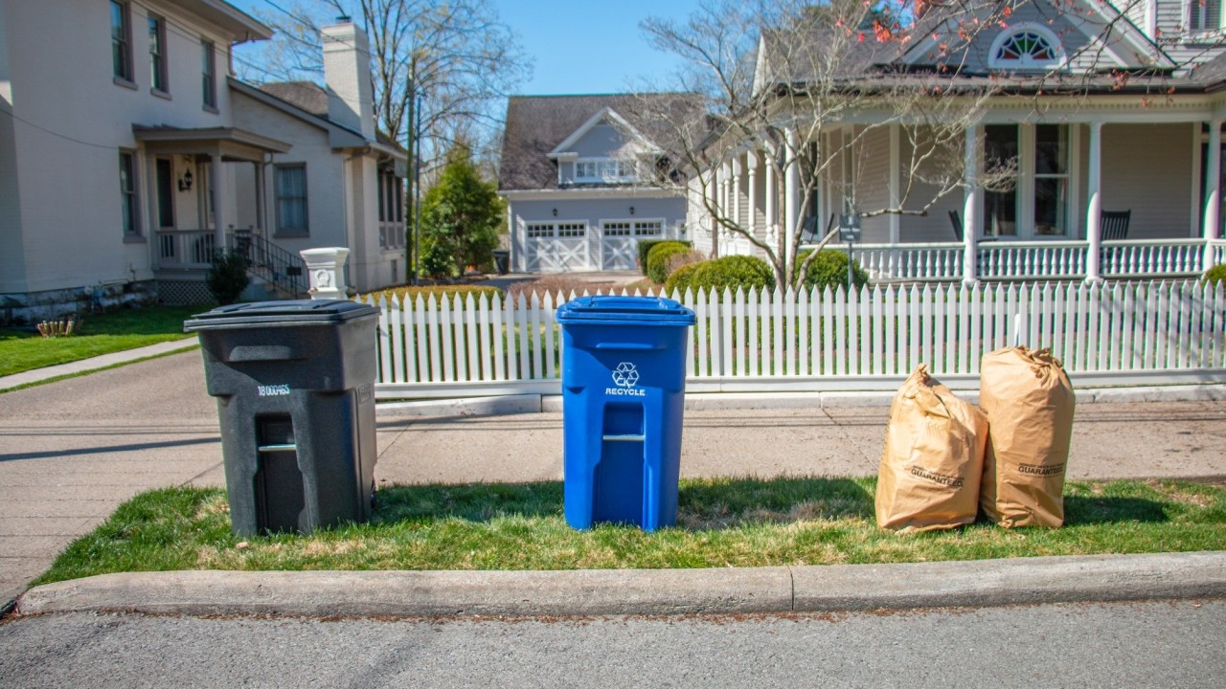
Prompts:
Informational: Based on being an expert in the field of conservation and recycling, create a informational text that provides information on the effects recycling can make on the Earth
Narrative: Create a story that elaborates on the characteristics of young boy, named Ted, that starts a neighborhood recycling program but not without first facing conflict. (see story map next slide).
Explanatory: Explain the recycling process and cycle. Include a diagram or process chart.

Slide 13
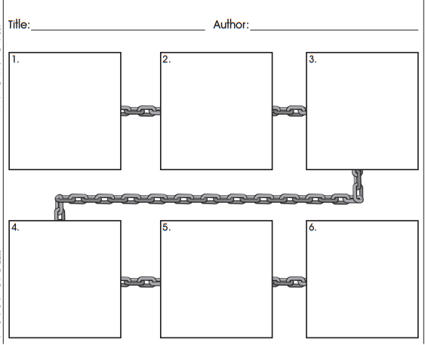
Narrative Story Map

Slide 14
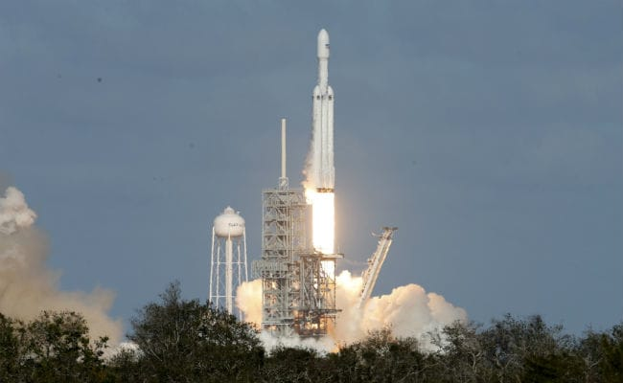
Text Structures:
Based on the picture what is taking place? (Knowledge and Analysis)
Imagine your are aboard the rocket. What emotions might you have? (Synthesis)
Explain the process of preparing to go into space. (Comprehension)

Slide 15
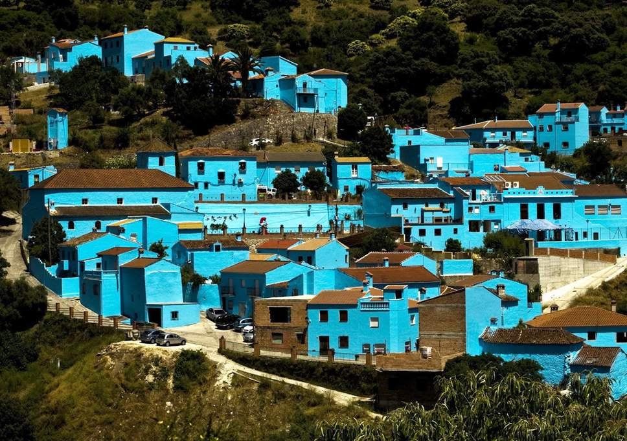
Prompts:
Hypothesize why all the buildings are blue. (Analysis)
Name and just the name of the location you provide based on what you see in the picture. (Knowledge and Evaluation)
Sketch and describe what of furnishings you would expect to see inside a building. (Application)
Discuss what living here might be like. (Comprehension)

Slide 16
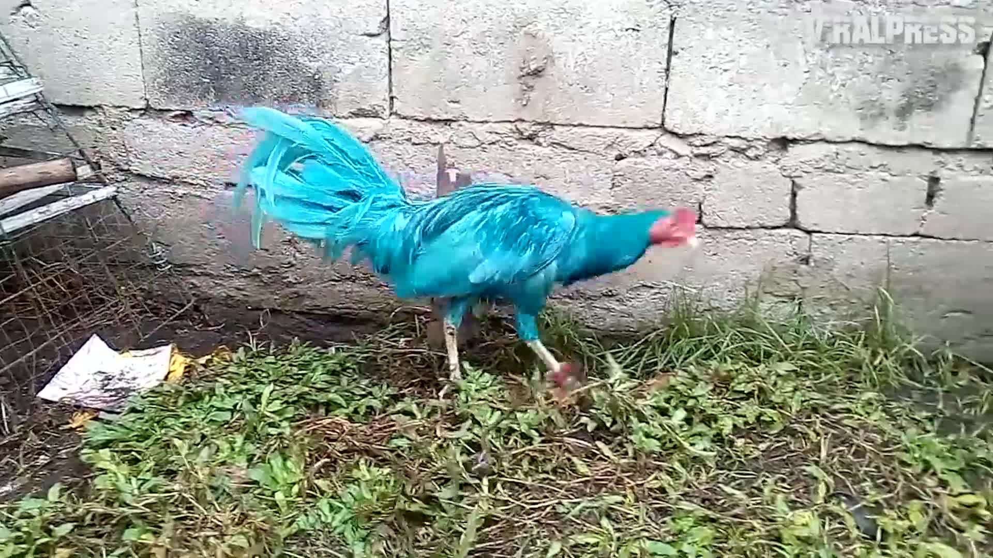
Prompts:
Do you believe this is a real bird? (Analysis)
What name might fit this bird. (Application)
Imagine you are walking along the street and see this bird, describe the characteristics of the bird. (Application)
Create a story about your adventure with your pet blue chicken. (Synthesis).

Slide 17
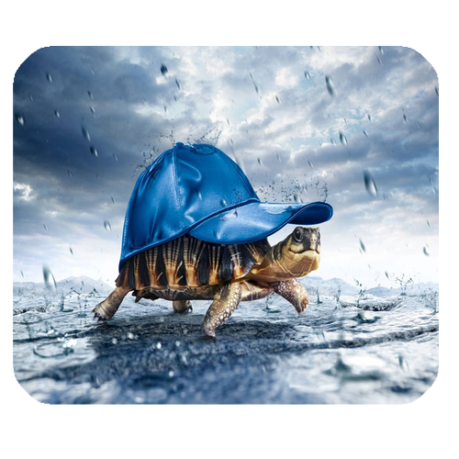
Prompts:
Identify what type of animal is in the picture. (Knowledge)
What type of story or book would you expect this picture to be part of? (Knowledge and Application)
Predict where this setting is and explain why you think that. (Evaluation)
Identify possible reasons that the animal is wearing a hat. (Comprehension)

Slide 18
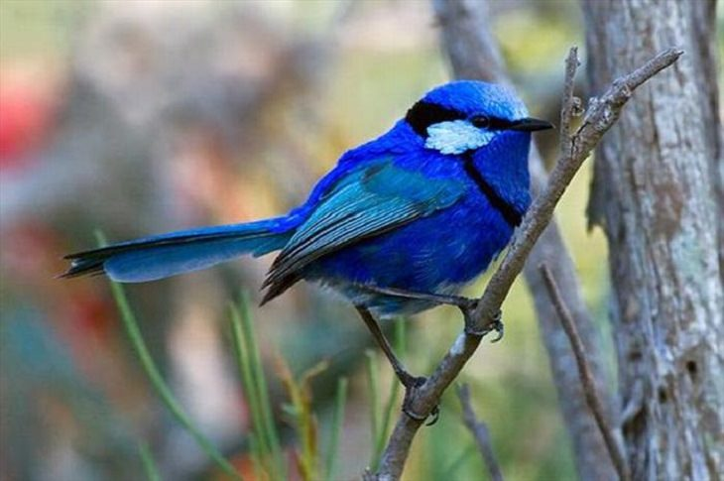
Prompts:
Identify the animal that is in this picture. (Knowledge)
What sex is the bird and why to you believe as you do? (Knowledge)
Generate 3 words that describe what you believe flying would feel like. (Synthesis)
Describe what you know about how birds care for their young. (Knowledge)

Slide 19
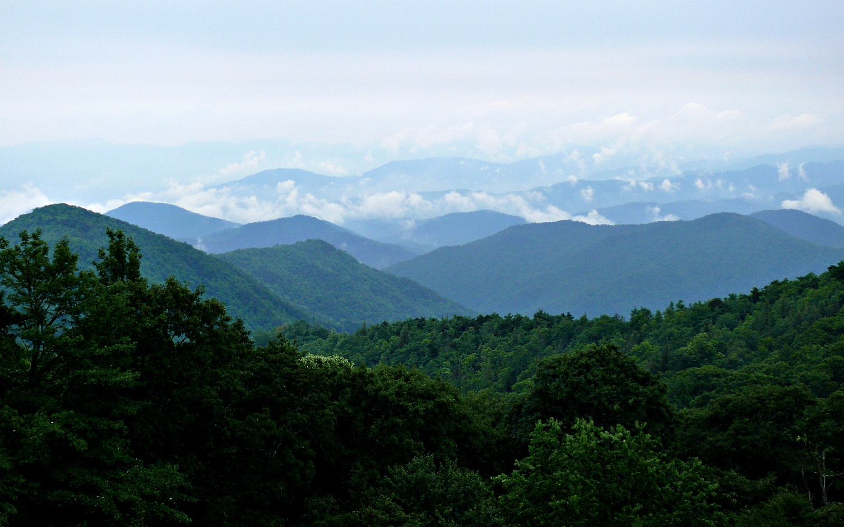
Prompts:
Analyze what you think this is a picture of. (Analysis)
Based on knowing that this presentation is on blue things, what do you believe this mountain range might be called? (Knowledge)
What part of the United States, is the mountain range located? (Application)
What is the value of this natural treasure? (Comprehension)
Compare this scene during different seasons.(Analysis)
What is this structure made of? (Analysis)

Slide 20

REFERENCES
Anderson, J. (2007). Everyday editing: Inviting students to develop skill and craft in writer’s workshop. Portland, ME: Stenhouse.
Duke, N. K. (2000). 3.6 minutes per day: The scarcity of informational texts in first grade. Reading Research Quarterly, 35(2), 202–224
Kelley, M. J. and Clausen-Grace, N. (2010), Guiding Students Through Expository Text With Text Feature Walks. The Reading Teacher, 64: 191-195.
.

