Slide 1
National implementation of international standards and due process in prison confinement: Two complementary tools against torture
Gaia Pergolo

Slide 2
OVERVIEW
1) three areas of inadequate implementation:
- obligation to criminalize
- interpretation of national laws
- obligation to investigate
2) consequences of inadequate implementation
3) recommendations

Slide 3
areas of inadequate implementation
1
OBLIGATION TO CRIMINALIZE:
make torture an offence under criminal law in accordance with international law
eliminate barriers to effective prosecution, e.g. statutes of limitation

Slide 4
Convention against torture (1984), Article 1(1)
[…] any act by which severe pain or suffering, whether physical or mental, is intentionally inflicted on a person for such purposes as obtaining from him or a third person information or a confession, punishing him for an act he or a third person has committed or is suspected of having committed, or intimidating or coercing him or a third person, or for any reason based on discrimination of any kind, when such pain or suffering is inflicted by or at the instigation of or with the consent or acquiescence of a public official or other person acting in an official capacity. It does not include pain or suffering arising only from, inherent in or incidental to lawful sanctions.

Slide 5
Convention against torture, Article 4
Each State Party shall ensure that all acts of torture are offences under its criminal law. The same shall apply to an attempt to commit torture and to an act by any person which constitutes complicity or participation in torture.
Each State Party shall make these offences punishable by appropriate penalties which take into account their grave nature.

Slide 6
CAT COMMITTEE, GENERAL COMMENT 3, para. 40
“On account of the continuous nature of the effects of torture, statutes of limitations should not be applicable as these deprive victims of the redress, compensation, and rehabilitation due to them.”

Slide 7
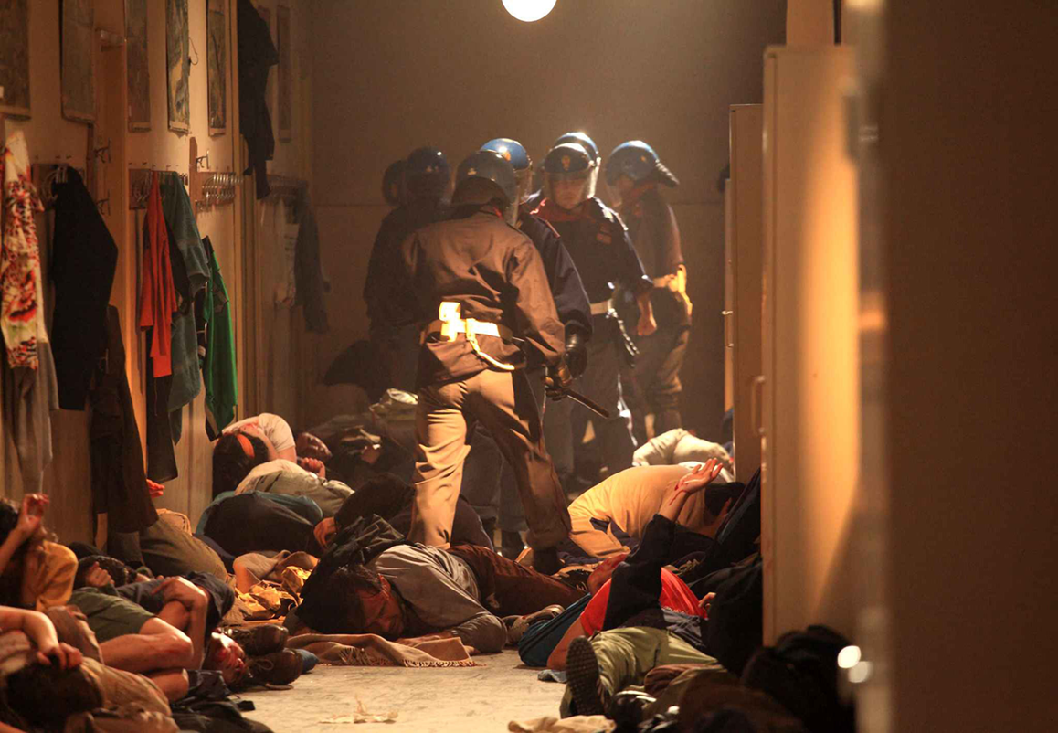
torture not a crime
ECtHR, Cestaro v. Italy (2015)

Slide 8
torture not defined as in international law
IACHR, Azul Rojas Marín v. Peru (2018)

Slide 9
PERUVIAN CRIMINAL CODE, ArtICLE 321*
The civil or public servant or any person, with the consent or acquiescence of the former, who inflicts upon another severe pain or suffering, whether physical or mental, or subject him to conditions or methods that annul his personality or diminish his physical or mental capacity, even if they do not cause physical pain or psychic affliction, in order to obtain a confession or information from the victim or a third party, or punish her for any act that she has committed or is suspected of having committed, or to intimidate or coerce her, will be punished with custodial sentence of not less than five nor more than ten years.
* until 2016

Slide 10
areas of inadequate implementation
1
JUDICIAL INTERPRETATION OF NATIONAL LAWS:
importance of interpreting and applying domestic laws in accordance with international standards
e.g. assessment of severity of pain and suffering

Slide 11
NO HOLISTIC APPROACH
Ugaz case

Slide 12
areas of inadequate implementation
1
OBLIGATION TO INVESTIGATE:
Prompt, genuine, impartial and effective investigation, irrespective of victim’s complaint
Appropriate and thorough medical examination in accordance with Istanbul Protocol

Slide 13
Consequences of inadequate implementation:
2
acts of torture characterized and prosecuted as OTHER offences
- Minimize gravity of crime – no stigma
- Lenient sentences
- Statutes of limitation - IMPUNITY
- No reparation for victims
- Incentive further perpetration

Slide 14
recommendations
3
strong national anti-torture legal framework
capacity building of domestic justice system

