Slide 1

Stelvio Motorsport Isolation Test Hour
Stelvio Automotive Presents…...
Or Smith

Slide 2
Format
Each player has their own section with there specialist subjects (decided by me!)
6 questions in each section
4 sections in total
With a bonus questions at the end
25 questions overall
25 points
Send me the answer in Messenger

Slide 3
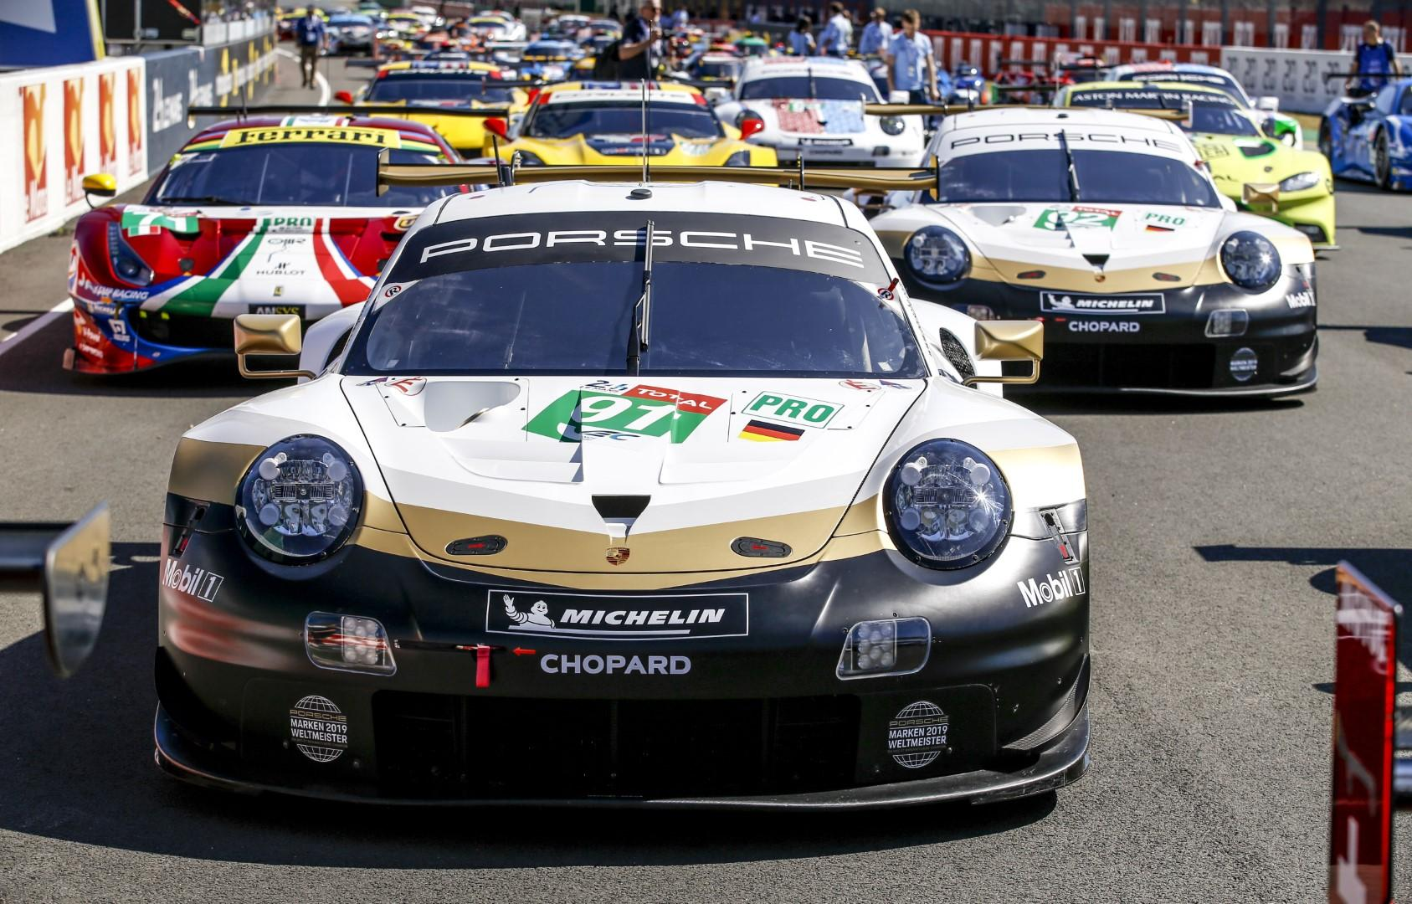
Question 1 Al’s Section
Since the inception of the WEC (2012), how many class wins has the almighty German Porsche works outfit won in the GTE Pro class?

Slide 4
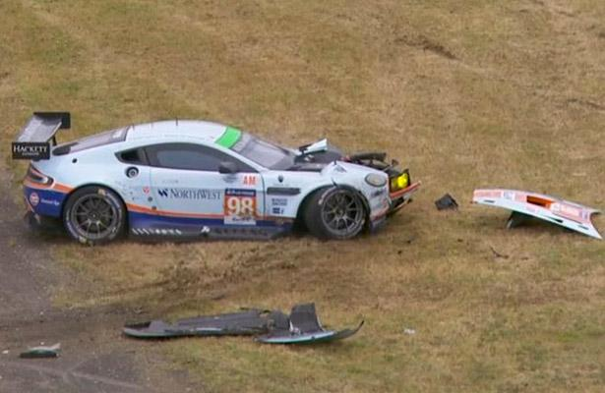
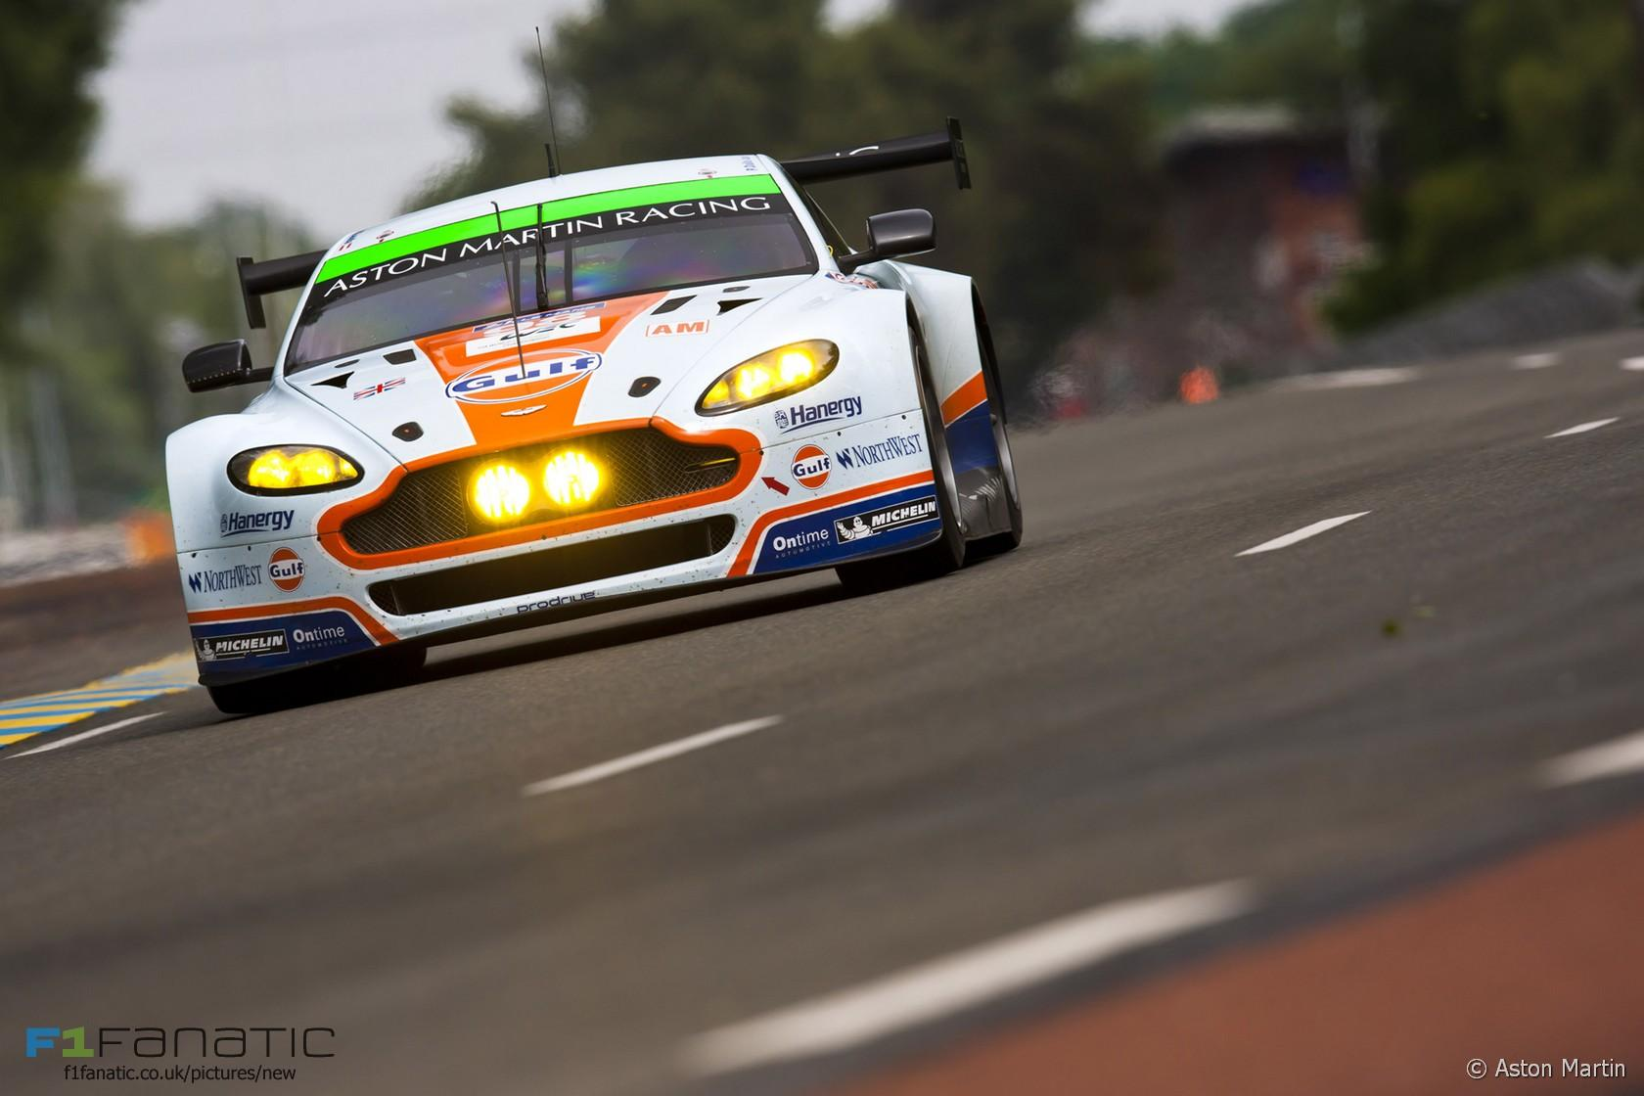
Question 2
What year did aston martin nearly collect a Le man class win?!
Notes:
2015 GTE Am

Slide 5
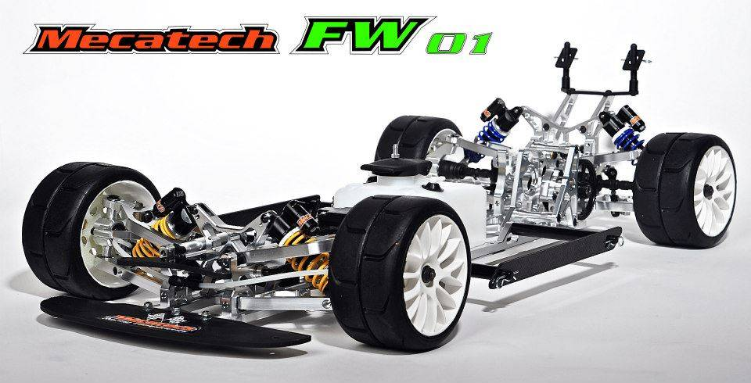
Question 3
What chassis make won the 2019 IFMAR World Championship IC Touring car class?
Notes:
Mecatech FW01

Slide 6
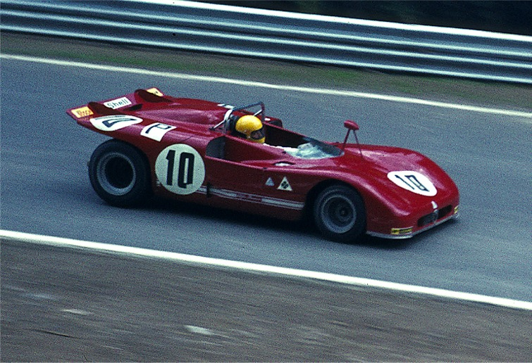
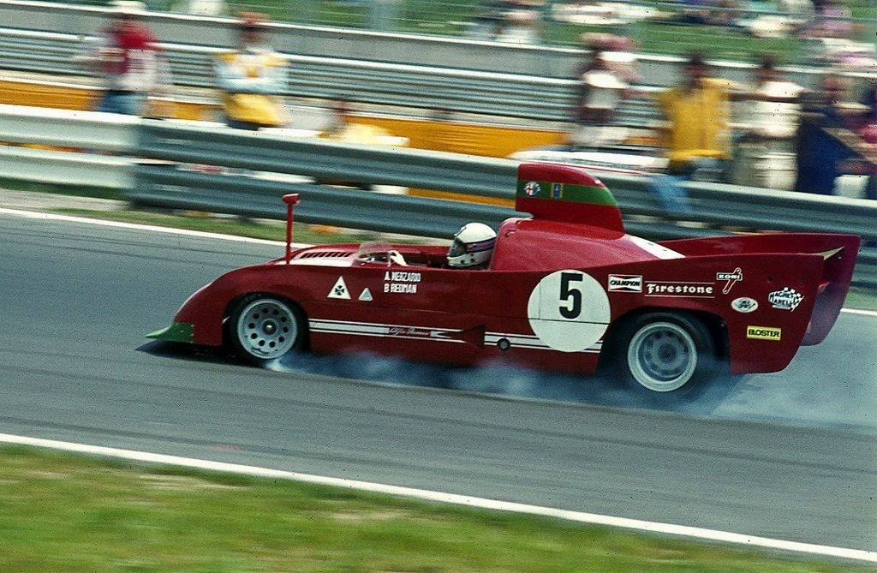
Question 4
What Alfa romeo variant won the Targa Florio twice?
Notes:
SGILE RC Truck according to amazon uk

Slide 7
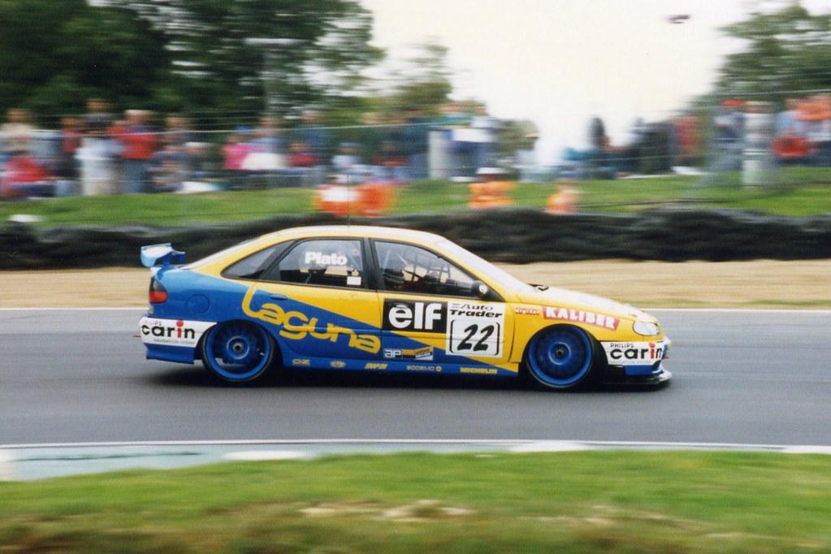
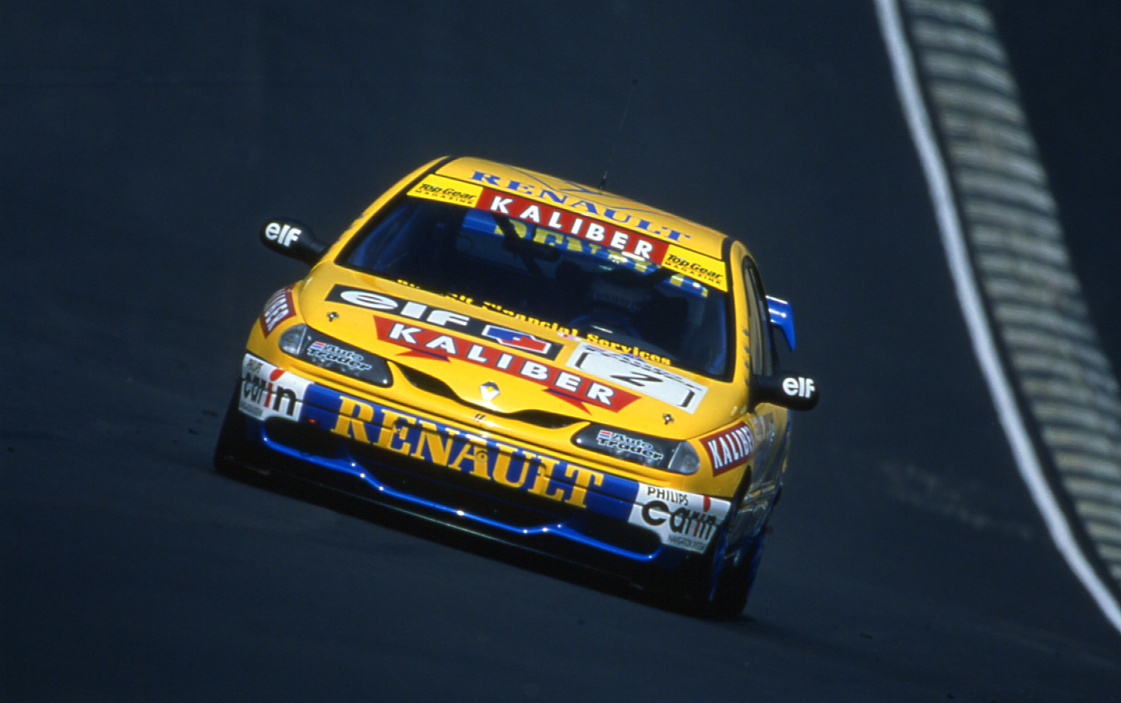
Question 5
Who begged Frank williams for a drive in the 1997 BTCC?

Slide 8
Question 6
What happen next?

Slide 9
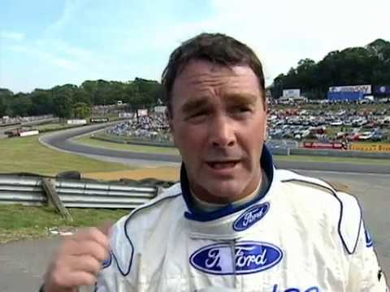
Question 6
What happen next?
Notes:
Fight

Slide 10
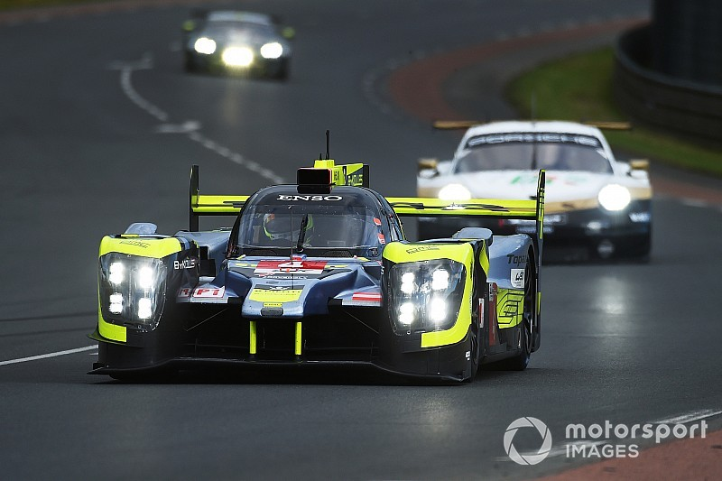
Question 7 Sean’s Section
How many classified WEC Finishes does the team Bykolles have?

Slide 11
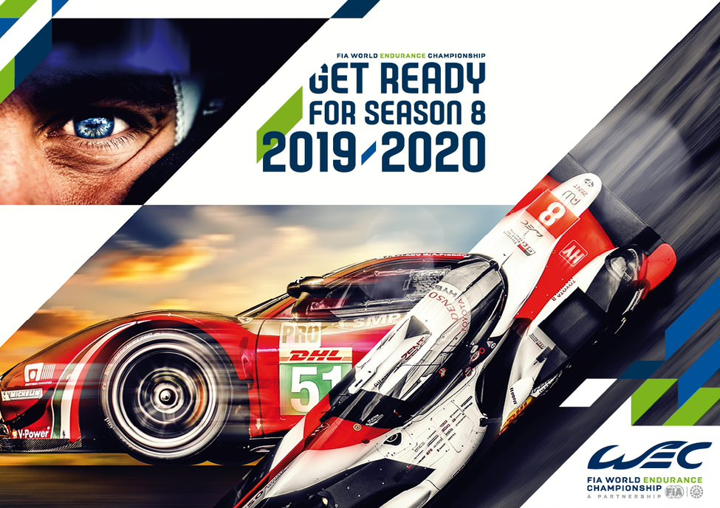
Question 8
Taking the names of each race in the 2018/19 super season how many hours are raced?
Notes:
86

Slide 12
Question 9
What happened next?

Slide 13
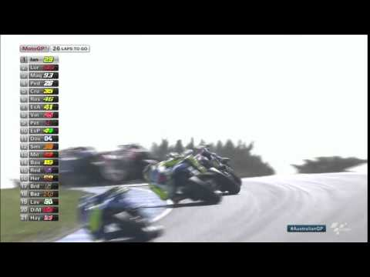

Slide 14
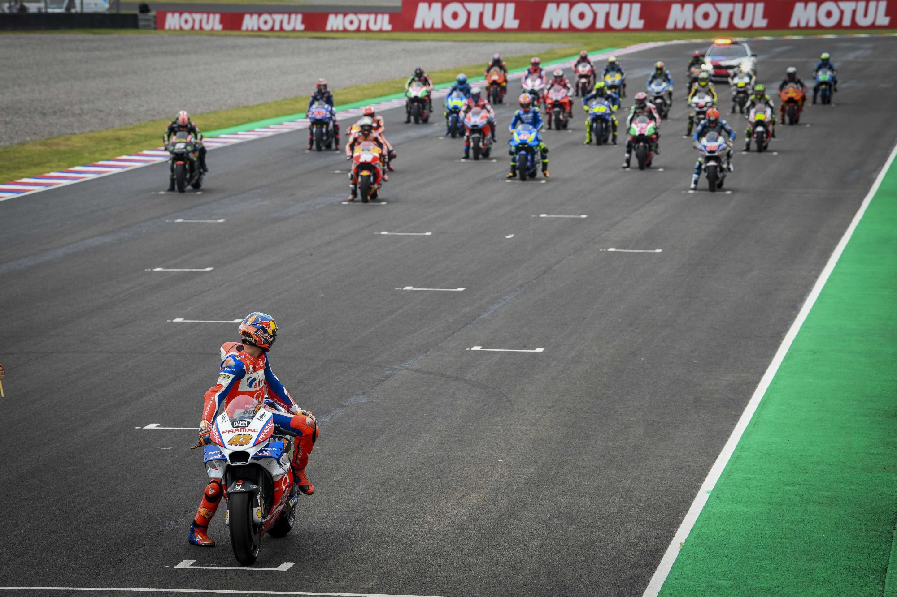
Question 10
Which race did the MotoGp Grid Social isolation and only Jack Miller was in his normal starting position?

Slide 15
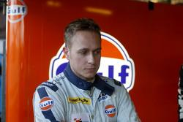
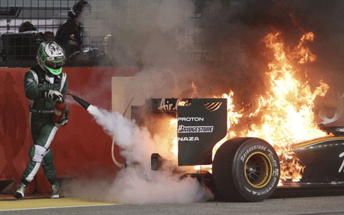
Question 11
Who won on the First ever GP2 race weekend?
Notes:
Adam carroll, Heikki Kovalainen

Slide 16
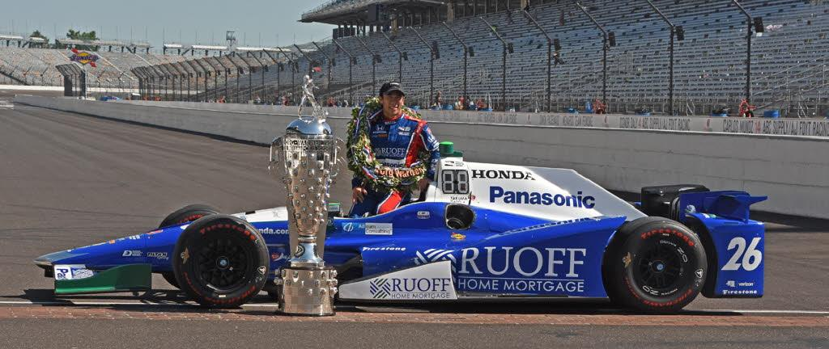
Question 12
Can you name the most successful engine brand in the Indy 500 and how many wins has it got?

Slide 17
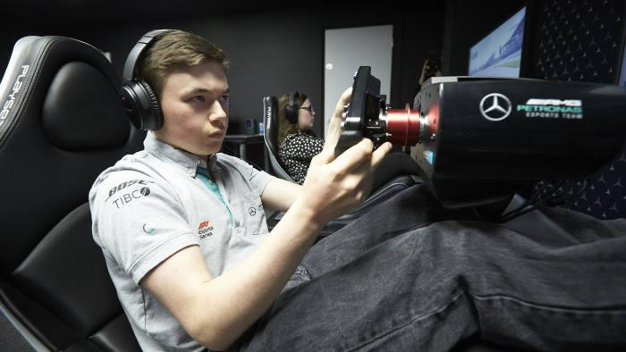
Question 13 Sam’s Section
What was the name of the first F1 esports series champion?
Notes:
Brendan leigh, 2017 and 2018 with merc

Slide 18
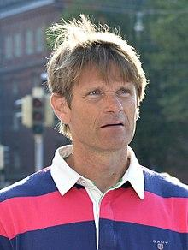
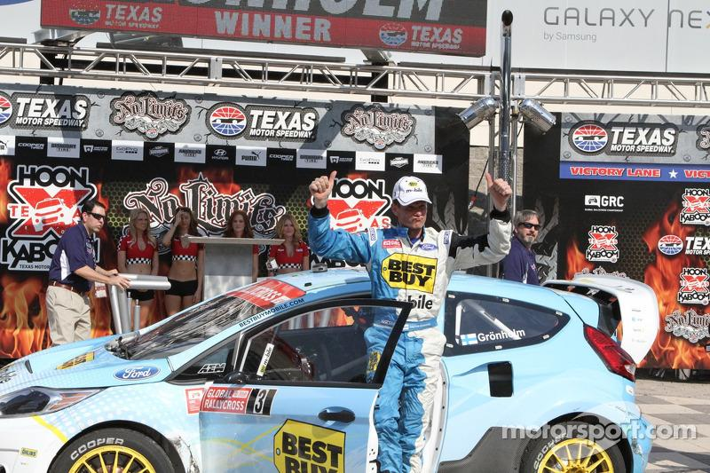
Question 14
Can you name the two time World Rally Champion who competed in the Global Rallycross Championship in the early 2010s, who was later followed by his son into the same sport?

Slide 19
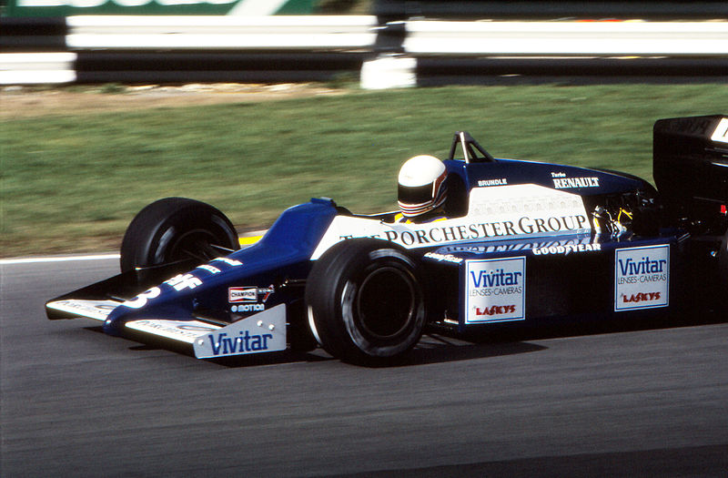
Question 15
What team did Martin Brundle start his F1 career at?
Notes:
Tyrell, Dallas, 5th, 1984

Slide 20
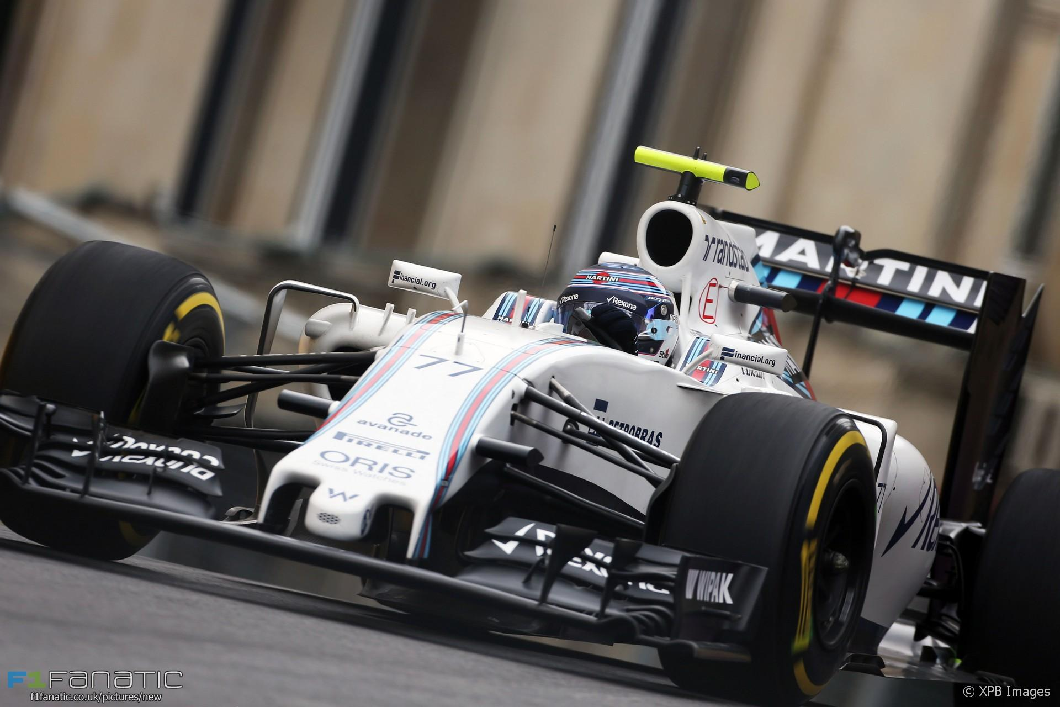
Question 16
What was the fastest ever recorded top speed of an F1 car and at which circuit?
Notes:
234.878mph , valtteri bottas, Azerbaijan

Slide 21
Question 17
What happened next?

Slide 22
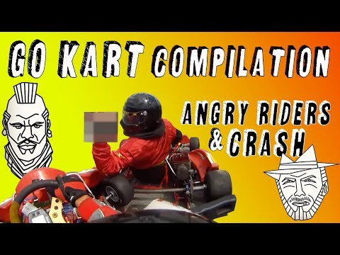

Slide 23
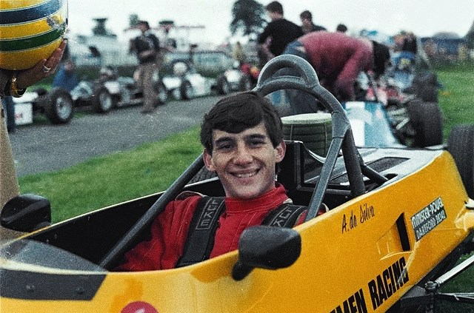
Question 18
What year did Senna move to England to start his single seater career?

Slide 24
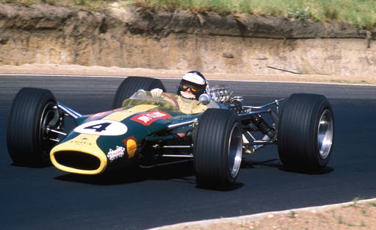
Question 19 My Section!
Who is the greatest F1 Driver ever?

Slide 25
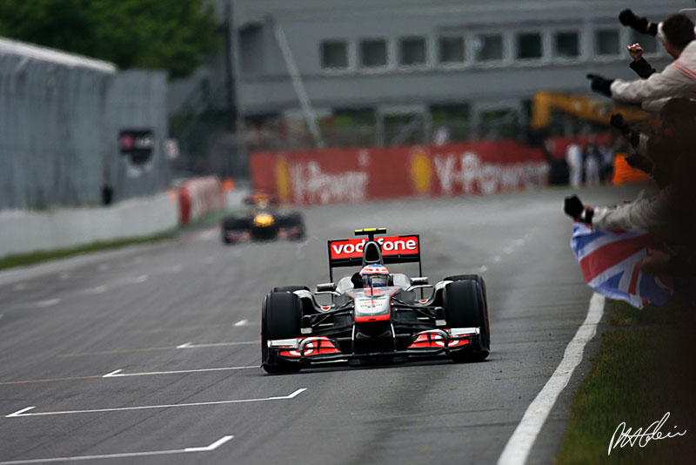
Question 20
How long was the 2011 Canadian GP?

Slide 26
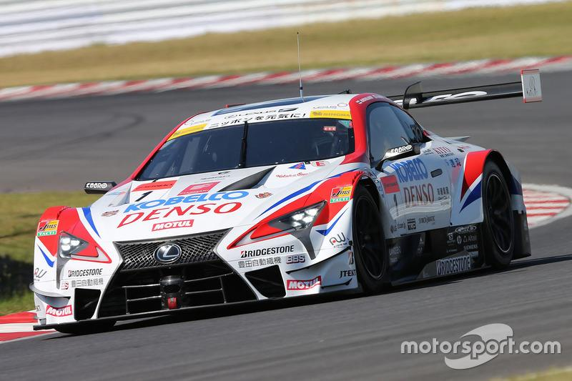
Question 21
What manufacturer did Heikki Kovalainen drive in the 2019 Super Gt championship?

Slide 27
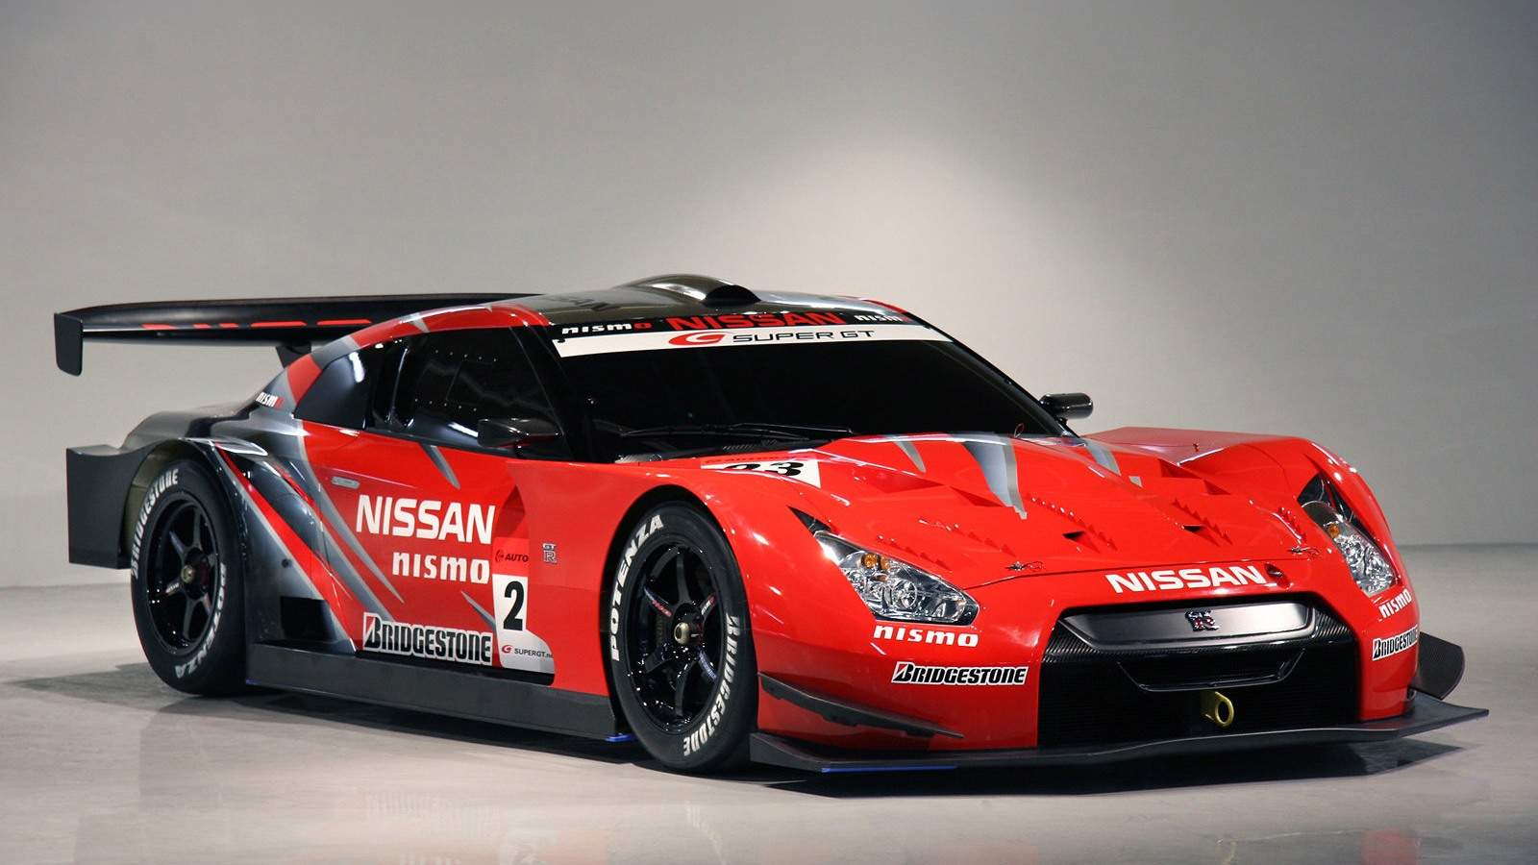
Question 22
How many times has Nissan won the Super GT GT500 Championship since its inception in 2005?
Notes:
5

Slide 28
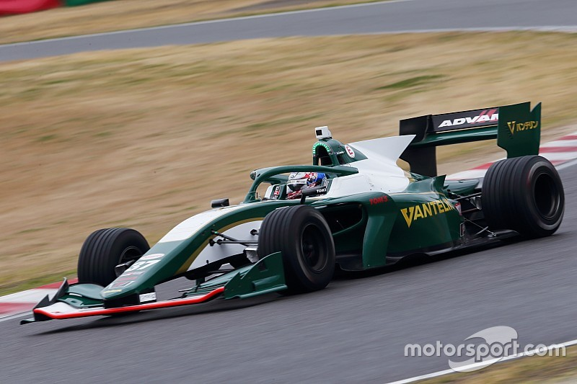
Question 23
How just won the Super GT Championship in 2019?
Notes:
Nick cassidy

Slide 29
Question 24
What happened next?

Slide 30


Slide 31
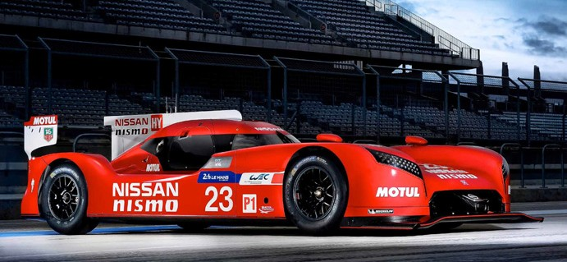
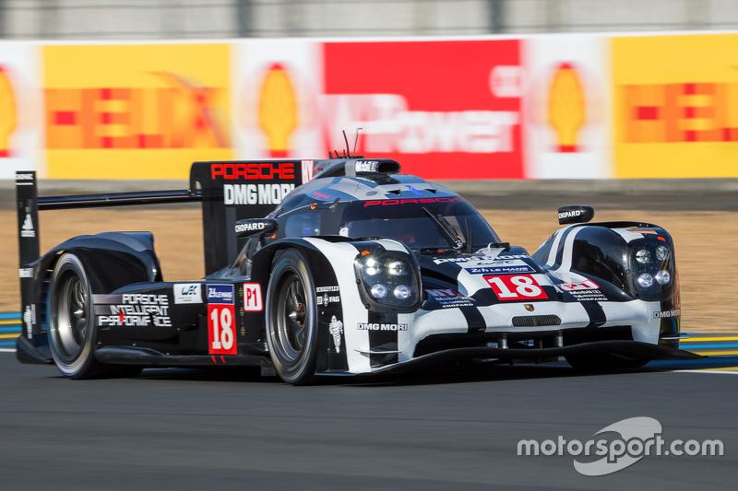
Question 25 Tie Breaker
How far behind the #18 919 pole position porsche was the lead #22 works Nissan GTR-LM in the 2015 24hrs Le mans Qualifying? Closest answer gets the point!

Slide 32
Results

